Slide 1
Psychology
Twelfth Edition
Chapter 15
Psychological Disorders

Slide 2
Diagnosing Mental Disorders
LO 15.1.A Consider why it is difficult to obtain a universally agreed-upon definition of “mental disorder.”
LO 15.1.B Describe four dangers associated with using the DSM for diagnosis of mental disorders, and give an example of each.
LO 15.1.C Explain the theoretical basis of projective tests, and identify the problems associated with these techniques.

Slide 3
Dilemmas of Definition
Diagnosing mental problems is not as straightforward as diagnosing medical problems.
When defining mental disorder, mental health professionals emphasize:
the emotional suffering caused by the behavior
whether the behavior is harmful to others or society
its degree of “harmful dysfunction”

Slide 4
Dilemmas of Diagnosis (1 of 4)
Even with a general definition of mental disorder, classifying mental disorders into distinct categories is not an easy job.
The standard reference manual used to diagnose mental disorders is the Diagnostic and Statistical Manual of Mental Disorders (DSM).
The DSM is designed to provide objective criteria and categories for diagnosing mental disorders.

Slide 5
Dilemmas of Diagnosis (2 of 4)
The DSM lists the symptoms of each disorder and, wherever possible, gives information about:
the typical age of onset
predisposing factors
course of the disorder
prevalence of the disorder
sex ratio of those affected
cultural issues that might affect diagnosis

Slide 6
Dilemmas of Diagnosis (3 of 4)
Critics argue that the diagnosis of mental disorders, unlike those of medical diseases, is inherently a subjective process.
They believe the DSM:
fosters overdiagnosis
overlooks the negative consequences of being given a diagnostic label
confuses serious mental disorders with everyday problems in living
creates an illusion of objectivity

Slide 7
Dilemmas of Diagnosis (4 of 4)
Supporters of the DSM believe that reliability in diagnosis improves:
when the DSM criteria are used correctly, and
when empirically validated objective tests are used
DSM-5 editors have classified many disorders:
along a spectrum of symptoms, and
in degrees from mild to severe, rather than as discrete categories

Slide 8
Dilemmas of Determination (1 of 3)
Clinical psychologists and psychiatrists usually arrive at a diagnosis by:
interviewing the patient and
observing their behavior
But many also use psychological tests to help them determine a diagnosis.
Among these are projective tests such as:
the Rorschach inkblot test or,
with children, anatomically detailed dolls

Slide 9
Dilemmas of Determination (2 of 3)
Projective tests consist of:
ambiguous pictures
sentences, or
stories
These methods have low reliability and validity.
They can create problems when they are used in the legal arena, as in:
custody disputes, or
diagnosing disorders

Slide 10
Dilemmas of Determination (3 of 3)
In general, objective tests (inventories), such as the MMPI, are more reliable and valid than projective ones.
Objective tests involve standardized objective questionnaires requiring written responses.
They typically include scales on which people are asked to rate themselves.
Inventories are only as good as their questions and how knowledgeably they are interpreted.

Slide 11
Anxiety Disorders
LO 15.2.A Differentiate the major symptoms of generalized anxiety disorder and panic disorder.
LO 15.2.B Describe the characteristics of a phobia, and explain why agoraphobia can be so disabling.

Slide 12
Anxiety and Panic (1 of 2)
Generalized anxiety disorder involves continuous, chronic anxiety and worry that interferes with daily functioning.
It involves a sense of foreboding and dread that occurs on a majority of days during a 6-month period.
Life experiences and genetics may contribute to the disorder.

Slide 13
Anxiety and Panic (2 of 2)
Panic disorder involves sudden, intense attacks of profound fear.
Panic attacks are common in the aftermath of:
stress
prolonged emotion
specific worries
frightening experiences
Those who go on to develop a disorder tend to interpret the attacks as a sign of impending disaster.

Slide 14
Fears and Phobias (1 of 2)
Phobias are unrealistic fears of specific situations, activities, or things.
snakes
insects
heights
being trapped in enclosed spaces
Common social phobias include fears of:
speaking in public
eating in a restaurant, or
having to perform for an audience

Slide 15
Fears and Phobias (2 of 2)
Agoraphobia is the most disabling phobia—a “fear of fear.”
It involves the fear of being away from a safe place or person.
It often begins with a panic attack that seems to have no cause.
The person tries to avoid it in the future by staying close to “safe” places or people.

Slide 16
Trauma and Obsessive–Compulsive Disorders
LO 15.3.A Define posttraumatic stress disorder, and discuss its symptoms and origins.
LO 15.3.B Distinguish between obsessions and compulsions, and discuss the defining elements of obsessive–compulsive disorder.

Slide 17
Posttraumatic Stress Disorder (1 of 2)
Most people who live through a traumatic experience eventually recover.
But a minority develop posttraumatic stress disorder (PTSD), which involves such symptoms as:
nightmares
flashbacks
insomnia, and
increased physiological arousal

Slide 18
Posttraumatic Stress Disorder (2 of 2)
The reasons for their increased vulnerability to traumatic events include:
genetic vulnerability
a history of psychological problems
a lack of social and cognitive resources, and
having a smaller hippocampus than normal

Slide 19
Obsessions and Compulsions (1 of 2)
Obsessive–compulsive disorder (OCD) involves:
recurrent, unwished-for thoughts or images (obsessions) and
repetitive, ritualized behaviors (compulsions) that a person feels unable to control
Some people with OCD have abnormalities in an area of the prefrontal cortex.
These may contribute to their cognitive and behavioral rigidity.

Slide 20
Obsessions and Compulsions (2 of 2)
Parts of the brain involved in fear and responses to threat are also more active than normal in people with OCD.
However, with hoarding disorder, hoarders had less activity in parts of the brain involved in:
decision making
problem solving
spatial orientation, and
memory

Slide 21
Depressive and Bipolar Disorders
LO 15.4.A Describe how major depression differs from normal feelings of sadness or loneliness.
LO 15.4.B Explain the main features of bipolar disorder.
LO 15.4.C Discuss the four major factors that contribute to the onset of depression.

Slide 22
Depression (1 of 2)
Major depression involves emotional, behavioral, cognitive, and physical changes.
These changes are severe enough to disrupt a person’s ordinary functioning.
Symptoms include:
distorted thinking patterns
feelings of worthlessness and despair
physical ailments such as fatigue and loss of appetite
loss of interest in formerly pleasurable activities

Slide 23
Depression (2 of 2)
Women are twice as likely as men to suffer from major depression.
But depression in men may be underdiagnosed.
Men who are depressed often try to mask their feelings by:
withdrawing
abusing alcohol or other drugs
driving recklessly
behaving violently

Slide 24
Bipolar Disorder
At the opposite pole from depression is mania, an abnormally high state of exhilaration.
In bipolar disorder, a person experiences episodes of both depression and mania, typically alternating between the two.
Writers, artists, musicians, and scientists have also suffered from this disorder.
Example: Mark Twain

Slide 25
Origins of Depression (1 of 4)
Vulnerability–stress models of depression (or any other disorder) highlight interactions between:
individual vulnerabilities and
stressful experiences
Because depression is moderately heritable, the search for specific genes continues.
Studies of serotonin have not been conclusive and their findings have not been successfully replicated.

Slide 26
Origins of Depression (2 of 4)
Experiences with violence and parental neglect, especially in childhood, increase the risk of developing major depression in adulthood.
The loss of important relationships can also set off depression in vulnerable individuals.
Many depressed people have a history of:
separations
losses
rejections, and
impaired, insecure attachments

Slide 27
Origins of Depression (3 of 4)
Cognitive habits also play a role:
believing that the origin of one’s unhappiness is permanent and uncontrollable
feeling hopeless and pessimistic, and
brooding or ruminating about one’s problems
The combination of factors for depression can vary in individuals.
The same sad event can affect two people entirely differently.

Slide 28
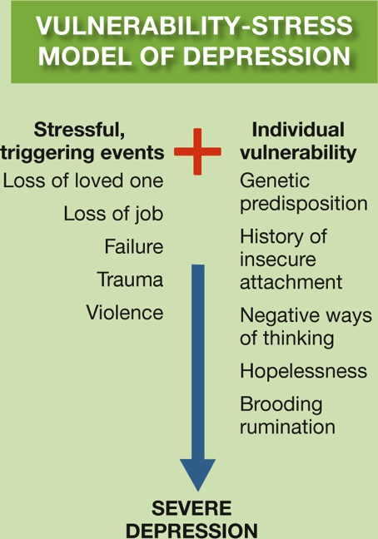
Origins of Depression (4 of 4) Figure 15.1 The Vulnerability–Stress Model of Depression
Notes:
The vulnerability–stress model highlights the interplay between individual differences (in genetics, personality, or cognitive styles) and eliciting situations (stressful life events). The vulnerabilities by themselves may not lead to a diagnosable disorder, just as the stressful events may not be perceived as such by some individuals. But for some people with some vulnerabilities in some stressful situations, the outcome may be a disordered reaction, such as depression.

Slide 29
Personality Disorders
LO 15.5.A Explain the main features of borderline personality disorder.
LO 15.5.B Distinguish between the terms psychopathy and antisocial personality disorder, and note the common elements of each.
LO 15.5.C List and explain the major factors that contribute to the central features of psychopathy.

Slide 30
Borderline Personality Disorder (1 of 2)
Personality disorders involve impairments in personality that:
cause great distress to an individual or
impair his or her ability to get along with others
They also involve the presence of pathological traits such as:
excessive hostility or
callousness

Slide 31
Borderline Personality Disorder (2 of 2)
One is borderline personality disorder, characterized by:
extreme negative emotionality and
an inability to regulate emotions
It often results in:
intense but unstable relationships
self-mutilating behavior
feelings of emptiness, and
a fear of abandonment by others

Slide 32
Antisocial Personality Disorder (1 of 2)
Antisocial personality disorder describes people with a pattern of behavior that is:
aggressive
reckless
impulsive, and often
criminal
Some people with APD have abnormalities in the prefrontal cortex.

Slide 33
Antisocial Personality Disorder (2 of 2)
These abnormalities can be a result of:
genetics
disease, or
physical abuse
Genes may affect the brain, predisposing a child to rule-breaking and violent behavior.
However, many environmental influences can:
disrupt that pathway and
alter the ways that genes express themselves

Slide 34
Psychopathy: Myths and Evidence (1 of 5)
The term psychopath describes people who are:
heartless
utterly lack conscience
unable to feel normal emotions
They are incapable of:
remorse
fear of punishment
shame
guilt
empathy for those they hurt

Slide 35
Psychopathy: Myths and Evidence (2 of 5)
Psychopathy is not the same as being violent and sadistic.
It is not the same as being “psychotic.”
The belief that psychopaths are “born, not made,” appears to be wrong.
The belief that “psychopaths cannot change their spots” is, surprisingly, also wrong.

Slide 36
Psychopathy: Myths and Evidence (3 of 5)
Psychopathy involves a cluster of characteristics.
Psychopaths are fearless, unconcerned about being caught and punished for their misdeeds.
high tolerance for danger, risk, thrill-seeking
They lack empathy for others and remorse for their harmful acts. They also:
behave irresponsibly
treat animals and other people with great cruelty
exploit and deceive others without flinching
are callous and coldhearted

Slide 37
Psychopathy: Myths and Evidence (4 of 5)
Something seems to be amiss in the emotional wiring of psychopaths.
Reduced ability to feel emotional arousal suggests some aberration in the central nervous system.
Psychopaths also have difficulty identifying expressions of fear.
No one yet knows for sure the origins of psychopathy.

Slide 38
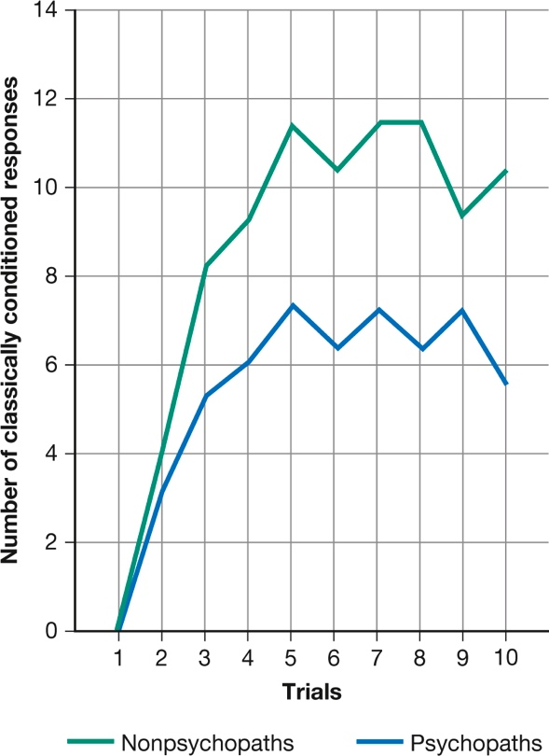
Psychopathy: Myths and Evidence (5 of 5) Figure 15.2 Emotions and Psychopathy
(Hare, 1965, 1993)
Notes:
In several experiments, people diagnosed as psychopaths were slow to develop classically conditioned responses to anticipated danger, pain, or shock—responses that indicate normal anxiety. This deficit may be related to the ability of psychopaths to behave in destructive ways without remorse or regard for the consequences (Hare, 1965, 1993).

Slide 39
Drug Abuse and Addiction
LO 15.6.A Discuss how the biological model of addiction would explain drug abuse and alcoholism.
LO 15.6.B Discuss how the learning model of addiction would explain drug abuse and alcoholism.
LO 15.6.C Explain the different predictions that the biological model and learning model would make regarding the benefits of total abstinence from versus moderate intake of alcohol.

Slide 40
Biology and Addiction (1 of 3)
The biological model holds that addiction is due primarily to a person’s:
neurology and
genetic predisposition
Some people have a genetic vulnerability to the kind of alcoholism that begins in early adolescence and is linked to:
impulsivity
antisocial behavior, and
criminality

Slide 41
Biology and Addiction (2 of 3)
Genes also affect sensitivity to alcohol, which varies across ethnic groups as well as among individuals.
However, addiction also works the other way.
Many people become addicted not because their brains have led them to abuse drugs, but because the abuse of drugs has changed their brains.

Slide 42
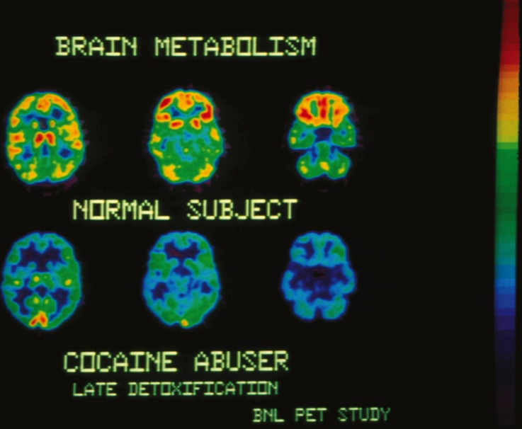
Biology and Addiction (3 of 3) Figure 15.3 The Addicted Brain
Pascal Goetgheluck/Science Source
Notes:
PET studies show that the brains of cocaine addicts have fewer receptors for dopamine, a neurotransmitter involved in pleasurable sensations. (The more yellow and red in the brain image, the more receptors.) The brains of people addicted to methamphetamine, alcohol, and even food show a similar dopamine deficiency.

Slide 43
Learning, Culture, and Addiction (1 of 2)
The learning model examines factors that encourage or discourage addiction, such as:
the role of the environment
learning, and
culture
Addiction patterns vary according to cultural practices and values.

Slide 44
Learning, Culture, and Addiction (2 of 2)
Policies of total abstinence tend to increase addiction rates and abuse.
People who want to drink fail to learn how to drink in moderation.
Many people can stop taking drugs without experiencing withdrawal symptoms.
Drug abuse depends on the reasons for taking a drug.

Slide 45
Debating the Causes of Addiction (1 of 2)
The biological and learning models are polarized on many issues, notably that of abstinence versus moderation.
Neither model offers the only solution.
Alcoholism, problem drinking, and other kinds of substance abuse occur for many reasons.

Slide 46
Debating the Causes of Addiction (2 of 2)
People who are most likely to abuse alcohol and other drugs:
have a genetic vulnerability or prolonged drug use has damaged their brains
believe that they have no control over the drug
are part of a culture or peer group that promotes drug abuse
rely on the drug to cope with problems

Slide 47
Dissociative Identity Disorder
LO 15.7.A Discuss the factors that make dissociative identity disorder a controversial diagnosis.
LO 15.7.B Evaluate the likely explanations for dissociative personality disorder.

Slide 48
Can You See the Real Me? (1 of 2)
One of the most controversial diagnoses ever to arise in psychology and psychiatry is dissociative identity disorder (DID).
formerly called multiple personality disorder (MPD)
In DID, two or more distinct personalities and identities appear to split off (dissociate) within one person.

Slide 49
Can You See the Real Me? (2 of 2)
Some psychiatrists and clinical psychologists take dissociative identity disorder very seriously.
They believe that it originates in childhood as a means of coping with:
sexual abuse or
other traumatic experiences
Psychological scientists have shown that “dissociative amnesia” lacks historical and empirical support.

Slide 50
Putting the Pieces Together (1 of 2)
Media coverage of sensational alleged cases of multiple personality, including the fraudulent case of “Sybil,” greatly contributed to the rise in cases after 1980.
Psychological scientists hold a sociocognitive explanation for DID.
They believe DID is simply an extreme form of the ability to present different aspects of our personalities to others.

Slide 51
Putting the Pieces Together (2 of 2)
In this view, the disorder emerges from an interaction between:
pressure and suggestion by clinicians who believe in its prevalence, and
vulnerable patients who find the diagnosis a plausible explanation for their problems
Thereby a culture-bound syndrome is created.

Slide 52
Schizophrenia
LO 15.8.A Describe the five major symptoms of schizophrenia, and give an example of each.
LO 15.8.B Describe the three main contributing factors to the origin of schizophrenia.

Slide 53
Symptoms of Schizophrenia (1 of 2)
Schizophrenia is the cancer of mental illness: elusive, complex, and varying in form.
The DSM-5 criteria for the disorder include:
bizarre delusions
hallucinations
disorganized, incoherent speech
grossly disorganized or catatonic behavior
negative symptoms
loss of motivation to take care of oneself
emotional flatness

Slide 54
Symptoms of Schizophrenia (2 of 2)
Contrary to stereotype, however, many people with schizophrenia recover.
Over 40 percent of people with schizophrenia:
have one or more periods of recovery
go on to hold good jobs
have successful relationships
especially if they have strong family support and community programs

Slide 55
Origins of Schizophrenia (1 of 5)
Schizophrenia is a brain disease that involves certain structural brain abnormalities.
These include enlarged ventricles and neurotransmitter abnormalities.
They are more likely to have:
abnormalities in the thalamus
deficiencies in the auditory cortex and Broca’s and Wernicke’s areas
might explain voice hallucinations

Slide 56
Origins of Schizophrenia (2 of 5)
In the “relay” that produces the disorder, researchers have identified three contributing factors:
genetic predispositions
prenatal problems or birth complications
biological events during adolescence
All of these interact with environmental stressors.
This explains why one identical twin may develop schizophrenia but not the other.

Slide 57
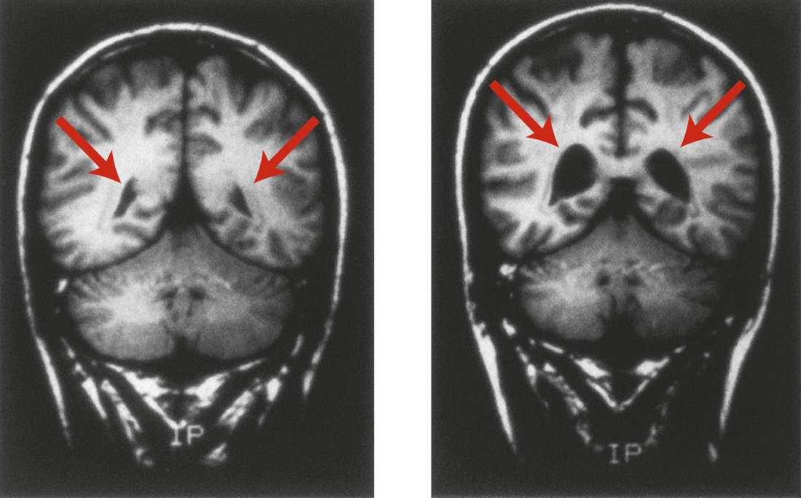
Origins of Schizophrenia (3 of 5) Figure 15.4 Schizophrenia and the Brain
National Institute of Mental Health
Notes:
People with schizophrenia are more likely to have enlarged ventricles (spaces) in the brain. These MRI scans of 28-year-old male identical twins show the difference in the size of ventricles between the twin without schizophrenia (left) and the one with schizophrenia (right).

Slide 58
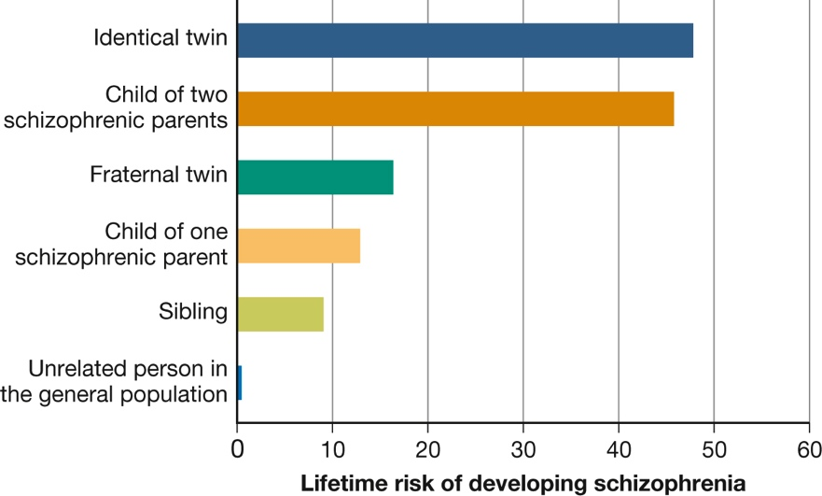
Origins of Schizophrenia (4 of 5) Figure 15.5 Genetic Vulnerability to Schizophrenia
(Based on Gottesman, 1991; see also Gottesman et al., 2010.)
Notes:
This graph, based on combined data from 40 European twin and adoption studies conducted over seven decades, shows that the closer the genetic relationship to a person with schizophrenia, the higher the risk of developing the disorder. (Based on Gottesman, 1991; see also Gottesman et al., 2010.)

Slide 59
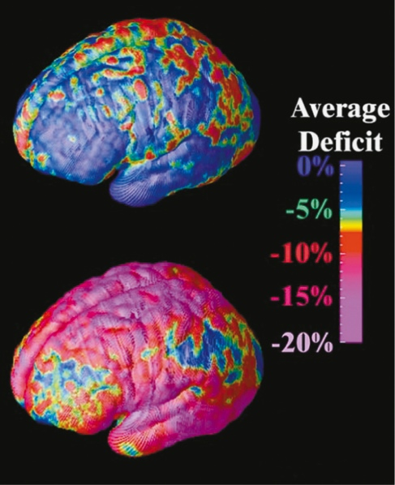
Origins of Schizophrenia (5 of 5) Figure 15.6 The Adolescent Brain and Schizophrenia
Courtesy of Paul Thompson, Ph.D., USC Laboratory of Neuro Imaging, USC Mark and Mary Stevens Neuroimaging and Informatics Institute, www.ioni.usc.edu
Notes:
These dramatic images highlight areas of brain-tissue loss in adolescents with schizophrenia over a 5-year span. The areas of greatest tissue loss (regions that control memory, hearing, motor functions, and attention) are shown in red and magenta. The brain of a person without schizophrenia (top) looks almost entirely blue (P. Thompson et al., 2001b).

