Slide 1

16 APPROACHES TO TREATMENT AND THERAPY
16.1
Biological Treatments for Mental Disorders
16.2
Major Schools of Psychotherapy
16.3
Evaluating Psychotherapy
PSYCHOLOGY, Twelfth Edition | Carole Wade • Carol Tavris
Copyright © 2017, 2014, 2011 Pearson Education Inc. All rights reserved.

Slide 2

16.1
Biological Treatments
for Mental Disorders

Slide 3
16.1
Module Learning Objectives
16.1.A
Describe the four main categories of drugs commonly prescribed for the treatment of mental disorders, and discuss five major cautions associated with drug treatment.
16.1.B
Identify four forms of direct brain intervention used in treating mental disorders, and discuss the limitations of each.

Slide 4
The Question of Drugs
Anti-anxiety drugs
Antipsychotic drugs
Antidepressant drugs
Lithium carbonate
Notes:
4

Slide 5

The Question of Drugs
Antipsychotic Drugs
Used primarily in the treatment of schizophrenia and other psychotic disorders
Designed to block or reduce the sensitivity of brain receptors that respond to dopamine
Some also block serotonin
Can cause troubling side effects such as muscle rigidity, hand tremors, involuntary muscle movements
Notes:
Antipsychotic drugs can reduce agitation, delusions, and hallucinations, and they can shorten schizophrenic episodes.
But they offer little relief from other symptoms of schizophrenia, such as jumbled thoughts, difficulty concentrating, apathy, emotional flatness, or inability to interact with others.
This is why medication by itself is rarely sufficient to help people with schizophrenia manage their symptoms.

Slide 6
The Question of Drugs
Antidepressant Drugs
Used primarily in the treatment of depression, anxiety, phobias, OCD
Monoamine oxidase inhibitors (MAOIs):
Elevate norepinephrine and serotonin
in brain by blocking an enzyme that deactivates these neurotransmitters
Tricyclic antidepressants:
Boost norepinephrine and serotonin by preventing reuptake
Selective serotonin reuptake inhibitors (SSRIs): Work on the same principle as tricyclics but specifically target serotonin
Notes:
Examples:
MAOI: Nardil
Tricyclic antidepressants: Elavil and Tofranil
SSRIs: Prozac, Zoloft, Lexapro, Paxil, Celexa
Others:
Cymbalta and Remeron target both serotonin and norepinephrine.
Wellbutrin is chemically unrelated to the other antidepressants but often prescribed for depression and sometimes as an aid to quitting smoking.

Slide 7
The Question of Drugs
Anti-anxiety drugs (tranquilizers)
Drugs commonly prescribed for patients who complain of unhappiness, anxiety, or worry
Increase the activity of GABA
May temporarily help but are not considered a treatment of choice over time
Notes:
Examples: Valium, Xanax, Ativan, and Klonopin

Slide 8
The Question of Drugs
Lithium carbonate
Used to treat bipolar disorder
Must be given in exactly the right dose
Bloodstream levels must be carefully monitored
  Too little will not help
  Too much is toxic
Notes:
Other drugs commonly prescribed for people with bipolar disorder include Tegetrol and Depakote.

Slide 9
Some Cautions about Drug Treatments
The placebo effect
1
Untested off-label uses
5
2
High relapse and dropout rates
Cautions
Unknown risks over time and drug interactions
Disregard for effective, possibly better nonmedical treatments
4
3

Slide 10
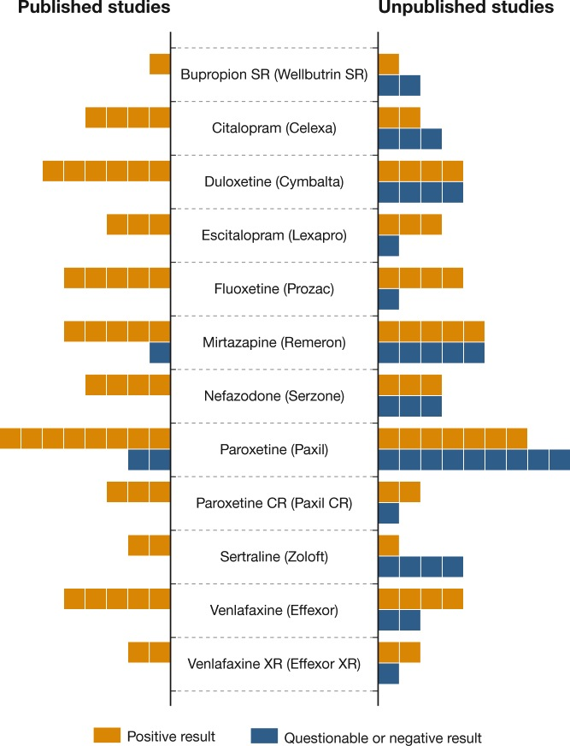
Figure 16.1: Drugs and Publication Bias
Notes:
Figure 16.1 Drugs and Publication Bias
To get FDA approval for a new medication, a pharmaceutical company must present evidence of the drug’s effectiveness. On the bars in this figure, each box represents one study. On the left side, you can see that most of the published studies supported the effectiveness of 12 antidepressants. But when independent researchers got hold of all of the data submitted to the FDA, they found that many unpublished studies had questionable or negative results (right). (Based on Turner et al., 2008.)

Slide 11
The Placebo Effect
1
The apparent success of a medication or treatment due to the patient’s expectations or hopes rather than to the drug or treatment itself.
After a while, when placebo effects decline, many drugs turn out to be neither as effective as promised nor as widely applicable.

Slide 12
High Relapse and Dropout Rates
2
There may be short-term success, but 50–66% of patients stop taking medication due to side effects.
When they do, they are likely to relapse, especially if they have not learned how to cope with their disorders.

Slide 13
Disregard for Nonmedical Treatments
3
The popularity of drugs has
been fueled by pressure from managed-care organizations and by drug companies’ marketing and advertising efforts.
Research shows that nonmedical treatments may work as well or even better.

Slide 14
Unknown Risks and Drug Interactions
4
The effects of taking antidepressants indefinitely are still unknown. The FDA now warns against prescribing SSRIs to anyone under 18.
Medication “cocktails” are sometimes prescribed, but the risks and benefits of this approach have not been investigated.

Slide 15
Untested Off-Label Uses
5
Antipsychotics are being used for nonpsychotic disorders.
Antidepressants are being used to treat “social phobias.”

Slide 16

Direct Brain Intervention
Prefrontal lobotomy: Instrument is used to crush nerve fibers running from prefrontal lobes to other areas
Electroconvulsive therapy (ECT):
Brief brain seizure is induced
Transcranial magnetic stimulation: Involves use of pulsing magnetic coil held to a person’s skull over the left prefrontal cortex
Deep brain simulation: Requires surgery to implant electrodes into the brain and to embed a small box, like a pacemaker, under the collarbone
Notes:
Prefrontal lobotomy never had any scientific validation, yet was performed on many thousands of people.
Electroconvulsive therapy (ECT) has been used successfully to treat suicidal depression, although its benefits rarely last.
Transcranial magnetic stimulation (TMS) is being studied as a way of treating severe depression.
Deep brain stimulation is experimental and risky, and claims of its success are based only on patients’ self-reports, so the powerful placebo effect of surgery cannot be ruled out (Lozano et al., 2008).

Slide 17
16.2
Major Schools of Psychotherapy

Slide 18
16.2
Module Learning Objectives
16.2.A
Summarize the main elements of psychodynamic therapy.
16.2.B
Describe four methods of behavior therapy, and discuss the main techniques used in cognitive therapy.
16.2.C
Summarize the similarities and differences between client-centered therapy and existential therapy.
16.2.D
List the hallmarks of the family-systems perspective, and describe how they apply to family and couples therapy.

Slide 19
Major Schools of Psychotherapy
Humanist
and existential therapy
Family
and couples therapy
Psychodynamic therapy
Behavior
and cognitive therapy
Notes:
19

Slide 20




Psychodynamic Therapy
Psychoanalysis
A theory of personality and a method of psychotherapy, developed by Sigmund Freud, that emphasizes the exploration of unconscious motives and conflicts; modern psychodynamic therapies share this emphasis but differ from Freudian analysis in various ways.
Transference
In psychodynamic therapies, a critical process in which the client transfers unconscious emotions or reactions, such as emotional feelings about his or her parents, onto the therapist

Slide 21


Behavior and Cognitive Therapy
  Person suffering from a phobia or panic attacks is gradually taken into the feared situation or exposed to a traumatic memory until the anxiety subsides
Graduated exposure
  An effort to teach a client skills or new, constructive behaviors to replace self-defeating ones
  Client is taken directly into a feared situation until his or her panic subsides
Skills training
Flooding
Behavior therapy:
Applies classical and operant conditioning to help people change own defeating
or problematic behaviors
  Keeping careful data on the frequency and consequences of the behavior to be changed
A step-by-step process of desensitizing a client to a feared object or experience; based on counterconditioning
Behavioral
self-monitoring
Systematic desensitization
Notes:
Counterconditioning: A stimulus (such as a dog) for an unwanted response (such as fear) is paired with some other stimulus or situation that elicits a response incompatible with the undesirable one.

Slide 22

Cognitive Techniques
Cognitive therapy
A form of therapy designed to identify and change irrational, unproductive ways of thinking and, hence, to reduce negative emotions
Rational emotive
behavior therapy
A form of cognitive therapy devised by Albert Ellis, designed to challenge the client’s unrealistic thoughts
Notes:
Aaron Beck pioneered in the application of cognitive therapy for depression.

Slide 23
Cognitive-Behavioral Therapy (CBT)
Cognitive-behavioral therapy (CBT)
Thoughts and behavior
influence each other.
More common than either cognitive or behavior
therapy alone.
Cognitive
Behavioral
Notes:
A new wave of CBT practitioners, inspired by Eastern philosophies such as Buddhism, has begun to question the goal of changing a client’s self-defeating thoughts.
They argue that it is difficult to completely eliminate unwanted thoughts and feelings, especially when people have been rehearsing them for years.
They therefore propose a form of CBT based on “mindfulness” and “acceptance”: Clients learn to explicitly identify and accept whatever negative thoughts and feelings arise, without trying to eradicate them or letting them derail healthy behavior (Khoury et al., 2013; Norton et al., 2015).

Slide 24

Humanist and Existential Therapy
Humanist therapy
Emphasizes personal growth, resilience, the achievement of human potential, and the client’s ability to change rather than being destined to repeat past conflicts
Client-centered
(nondirective) therapy
Humanist approach developed by Carl Rogers
  Emphasizes the therapist’s empathy with client, and the use of unconditional positive regard

Slide 25

Humanist and Existential Therapy
Existential therapy
A form of therapy designed to help clients explore the meaning of existence and face the great questions of life, such as death, freedom, alienation, and loneliness.

Slide 26

Family and Couples Therapy
Family therapy
Individual problems develop in the context of the family, are sustained by the dynamics of the family, and any change will affect all members of the family
Family-systems perspective:
An approach to doing therapy with individuals or families by identifying how each family member forms part of a larger interacting system.

Slide 27

Family and Couples Therapy
In couples therapy, the therapist usually sees both partners in a relationship to help them:
Cut through blaming and attacking
Resolve their differences
Get over hurt and blame
Make behavioral changes

Slide 28
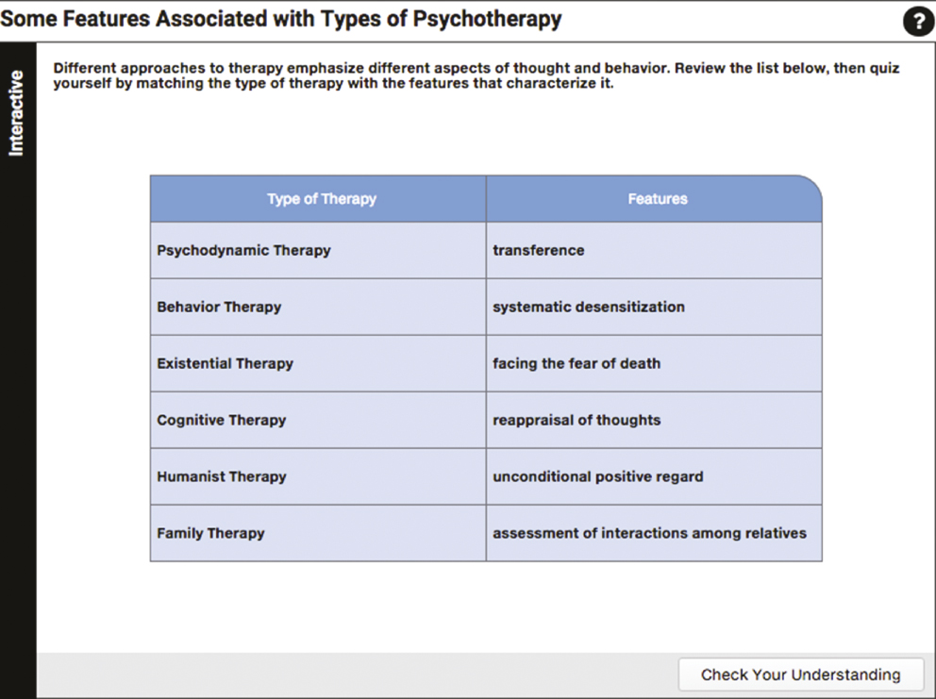
Some Features Associated with Types of Psychotherapy

Slide 29
Integrative Approach
Behavioral and Cognitive
Therapy
In practice, most therapists are integrative, drawing on many methods and ideas and avoiding any strong allegiances to any one theory.
Humanist
and
Existential
Therapy
Family and
Couples
therapy
Psychotherapy
Notes:
29

Slide 30
16.3
Evaluating Psychotherapy

Slide 31
16.3
Module Learning Objectives
16.3.A
Define the scientist–practitioner gap, and identify some of the problems associated with assessing the effectiveness of therapy.
16.3.B
Provide examples of areas in which cognitive and behavior therapies have shown themselves to be particularly effective.
16.3.C
Discuss four ways in which therapy has the potential to harm clients, and give an example of each.

Slide 32

Evaluating Psychotherapy
Therapeutic alliance
The bond of confidence and mutual understanding established between therapist and client, which allows them to work together to solve the client’s problems

Slide 33

The Scientist-Practitioner Gap
Different assumptions are held by researchers and many clinicians regarding the value of empirical research for doing psychotherapy and for assessing its effectiveness.
The gap has widened because of the proliferation of unvalidated therapies in a crowded market.

Slide 34
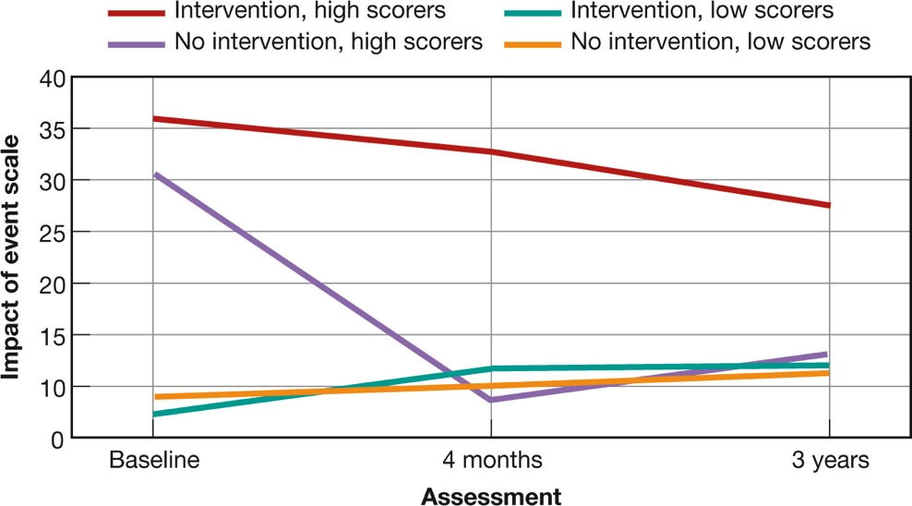
Problems in Assessing Therapy
  Testimonials are not evidence
  Randomized controlled trials offer a means of assessment
  Results are not always encouraging
Notes:
Researchers cannot be satisfied with testimonials, no matter how glowing.
They know that thanks to the justification of effort effect, people who have put time, money, and effort into something will tell you it was worth it.
Randomized controlled trials: Research designed to determine the effectiveness of a new medication or form of therapy, in which people with a given problem or disorder are randomly assigned to one or more treatment groups or to a control group.
Figure 16.2 Do Posttraumatic Interventions Help—or Harm?
Victims of serious car accidents were assessed at the time of the event, 4 months later, and 3 years later. Half received a form of posttraumatic intervention called critical incident stress debriefing (CISD); half received no treatment. As you can see, almost everyone had recovered within 4 months, but one group had higher stress symptoms than everyone else, even after 3 years: the people who were the most emotionally distressed right after the accident and who received CISD. The therapy actually impeded their recovery (Mayou et al., 2000).

Slide 35

CULTURE AND psychotherapy
Does a Therapist-Client “Match” Matter?
When there is a cultural match, clients and psychotherapists are more likely to:
Share perceptions of what
the client’s problem is
Agree on the best way of coping
Have the same expectations
about what therapy can
accomplish
Notes:
In establishing a bond with clients, therapists must distinguish normal cultural patterns from individual psychological problems.
More and more psychotherapists are becoming “sensitized to the issues” caused by cultural differences (Arredondo et al., 2005; Sue et al., 2007).
Being aware of cultural differences, however, does not mean that therapists should stereotype clients.

Slide 36

When Therapy Helps
For many problems and most emotional disorders, cognitive and behavior therapies have emerged as the method of choice:
Depression
Suicide attempts
Anxiety disorders
Anger and impulsive violence
Health problems
Childhood and adolescent behavior problems
Relapses
Special problems and populations:
Rehabilitation and community psychologists
Multisystemic therapy (MST)
Notes:
Rehabilitation psychologists: Are concerned with the assessment and treatment of people who are physically disabled, temporarily or permanently, because of chronic pain, physical injuries, epilepsy, addictions, or other conditions.
Community psychologists: Set up programs at a community level, often coordinating outpatient services at local clinics with support from family and friends.
Multisystemic therapy (MST): community intervention that combines family-systems techniques with behavioral methods, but applies them in the context of forming “neighborhood partnerships” with local leaders, residents, parents, and teachers
Has been highly successful in reducing teenage violence, criminal activity, drug abuse, and school problems in troubled inner-city communities.
36

Slide 37
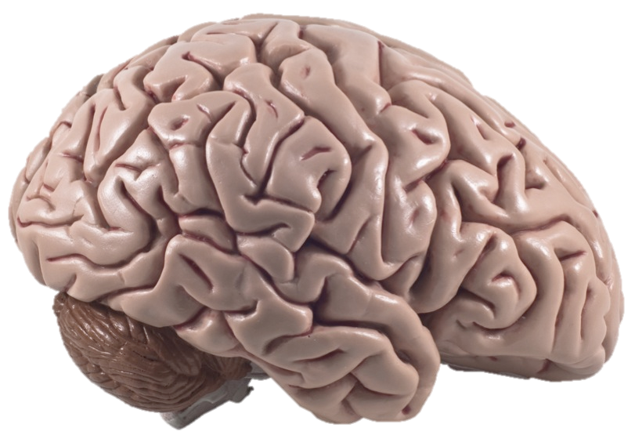
BIOLOGY AND psychotherapy
How Treating the Mind Changes the Brain
  The fact that a disorder appears to have biological origins or involve biochemical
  abnormalities does not mean
  that biological treatments are the only or most appropriate ones.
  Psychotherapy, or simply having other new experiences, can change brain patterns just as medication can.
Notes:
37

Slide 38

When Therapy Harms
In some cases, therapy is harmful.
The risks to clients increase when any of the following occurs:
Use of empirically unsupported, potentially dangerous therapeutic techniques
Inappropriate or coercive influence, which can create new problems for the client
Prejudice or cultural ignorance on the part of the therapist
Sexual intimacies or other unethical behavior on the part of the therapist

Slide 39
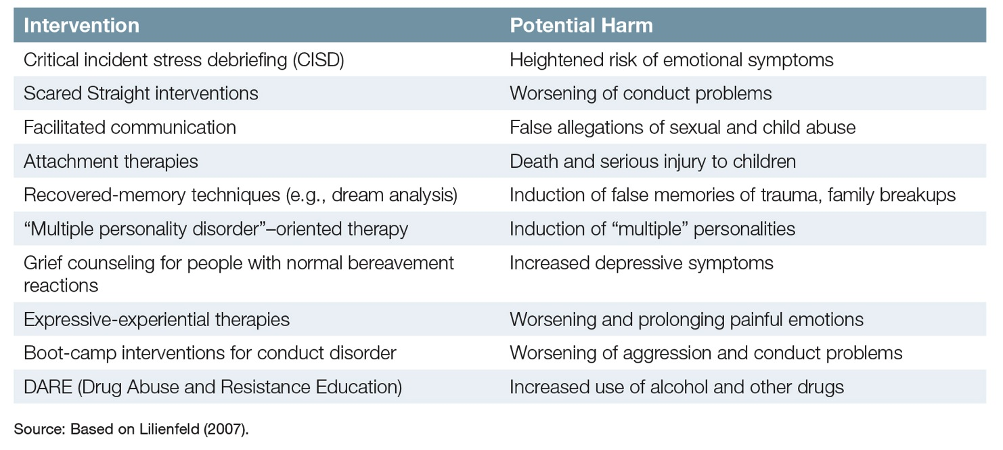
Table 16.1: Potentially Harmful Therapies

Slide 40
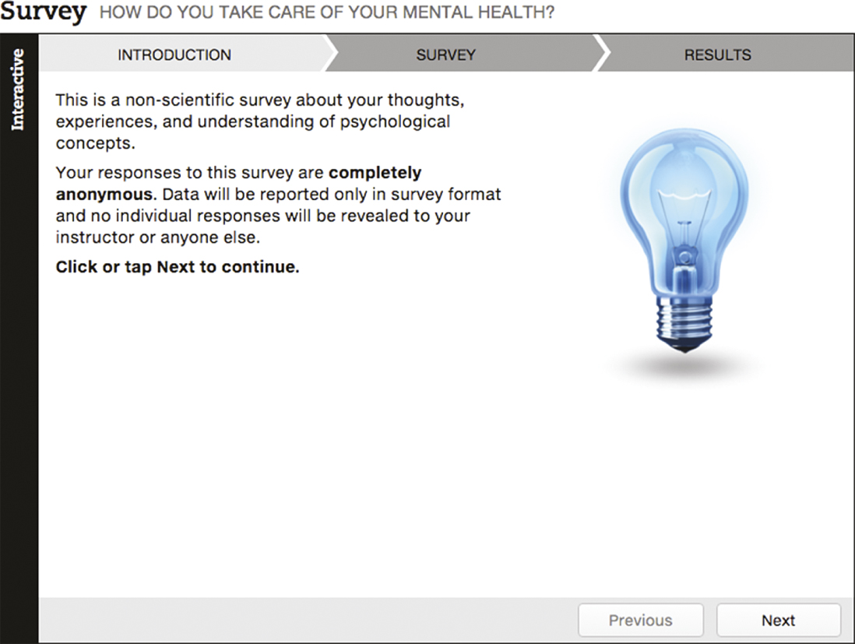
How Do You Take Care of Your Mental Health?

Slide 41

Taking Psychology with You
Becoming a Smart Consumer of Psychological Treatments
Take all ads and internet promotions for prescription drugs with a large grain of salt. Be skeptical!
Make an informed decision when you choose a therapist.
Choose a therapy or treatment most likely to help you.
Consider, but be wary of, online therapy delivered by video, smartphone, or email.
Consider a self-help group.
Choose self-help books that are scientifically based and promote realistic goals.

Slide 42
End of Chapter

Slide 43
Acknowledgments

Slide 44
Slide | Credit
Slides 5, 6, 7, 8 | gemphoto. Shutterstock
Slide 16 | Berents. Shutterstock
Slide 20 | musicman. Shutterstock
Slide 21 | 123rf.com
Slide 22 | Lichtmeister. Shutterstock
Slide 24 | Adam Gregor. Shutterstock
Slide 25 | Sergey Nivens. Shutterstock
Slide 26 | Anton Gvozdikov. Shutterstock
Slide 27 | Lisa F. Young. Shutterstock
Slide 32 | Peshkova. Shutterstock
Slide 33 | Pressmaster. Shutterstock
Slide 35 | Thorsten Schmitt. Shutterstock
Slide 36 | Pakhnyushcha. Shutterstock
Slide 37 | cesc_assawin. Shutterstock
Slide 38 | Fedorov Oleksiy. Shutterstock
Slide 41 | quetton. Shutterstock

