Slide 1
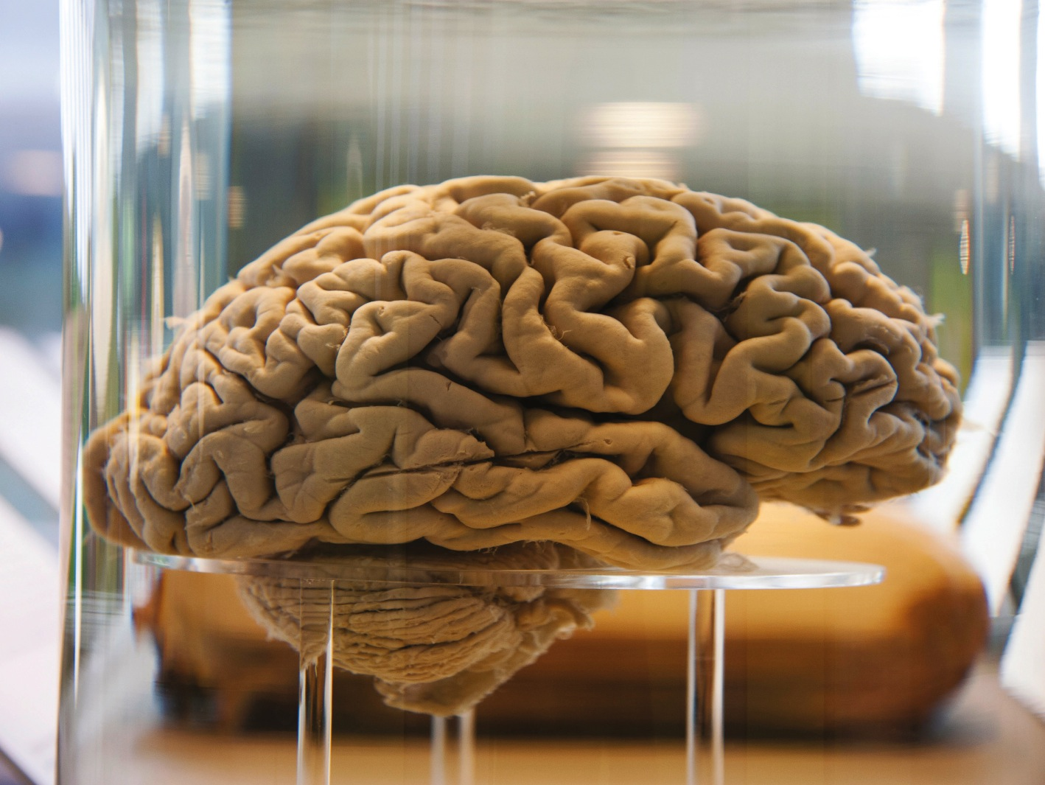
4 THE BRAIN AND NERVOUS SYSTEM
4.1
The Nervous System: A Basic Blueprint
4.4
A Tour Through the Brain
4.2
Communication in the Nervous System
4.5
The Two Hemispheres of the Brain
4.3
Mapping the Brain
4.6
The Flexible Brain
PSYCHOLOGY, Twelfth Edition | Carole Wade • Carol Tavris
Copyright © 2017, 2014, 2011 Pearson Education Inc. All rights reserved.

Slide 2
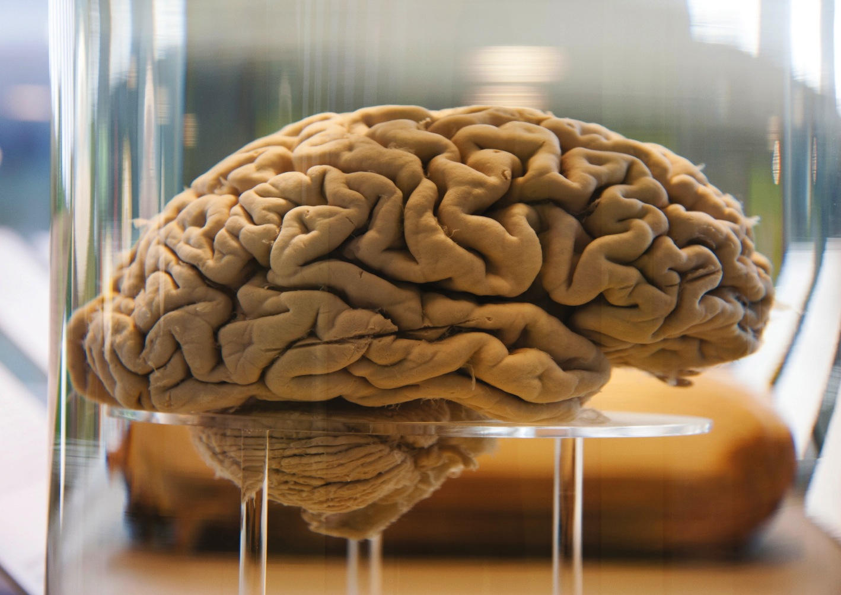
4.1
The Nervous System: A Basic Blueprint

Slide 3
4.1
Module Learning Objectives
4.1.A
List the major structures of the central nervous system, and describe their primary functions.
4.1.B
List the major structures and major divisions of the peripheral nervous system, and describe their primary functions.

Slide 4


ervous
system
Gathers and processes information, produces responses to stimuli, and coordinates the workings of different cells
Notes:
Neuroscientists in psychology and other disciplines study the brain and the rest of the nervous system in hopes of gaining a better understanding of normal behavior and of the outer reaches of what is possible for this organ.
Cognitive neuroscientists explore the biological foundations of consciousness, perception, memory, and language; social neuroscientists focus on processes such as attachment and attitudes; affective neuroscientists study the nervous system’s involvement in emotion, motivation, and stress; and behavioral neuroscientists study the biology of such basic processes as learning, conditioning, eating, and sex.

Slide 5
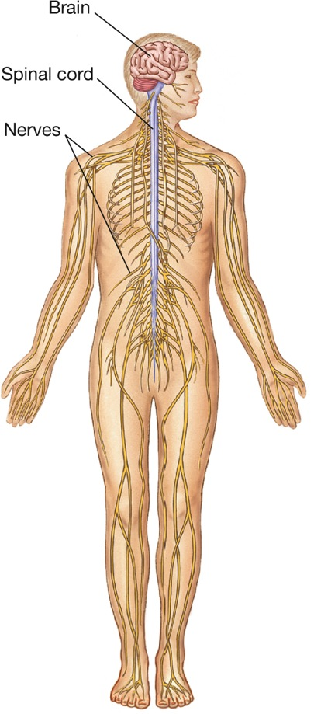
Figure 4.1: The Central and Peripheral Nervous Systems
Notes:
Figure 4.1 The Central and Peripheral Nervous Systems
The central nervous system includes the brain and the spinal cord. The peripheral nervous system consists of 43 pairs of nerves that transmit information to and from the central nervous system. Twelve pairs of cranial nerves in the head enter the brain directly; 31 pairs of spinal nerves enter the spinal cord at the spaces between the vertebrae.
Central nervous system: The portion of the nervous system consisting of the brain and spinal cord.
Peripheral nervous system: All portions of the nervous system outside brain and spinal cord; includes sensory and motor nerves.

Slide 6
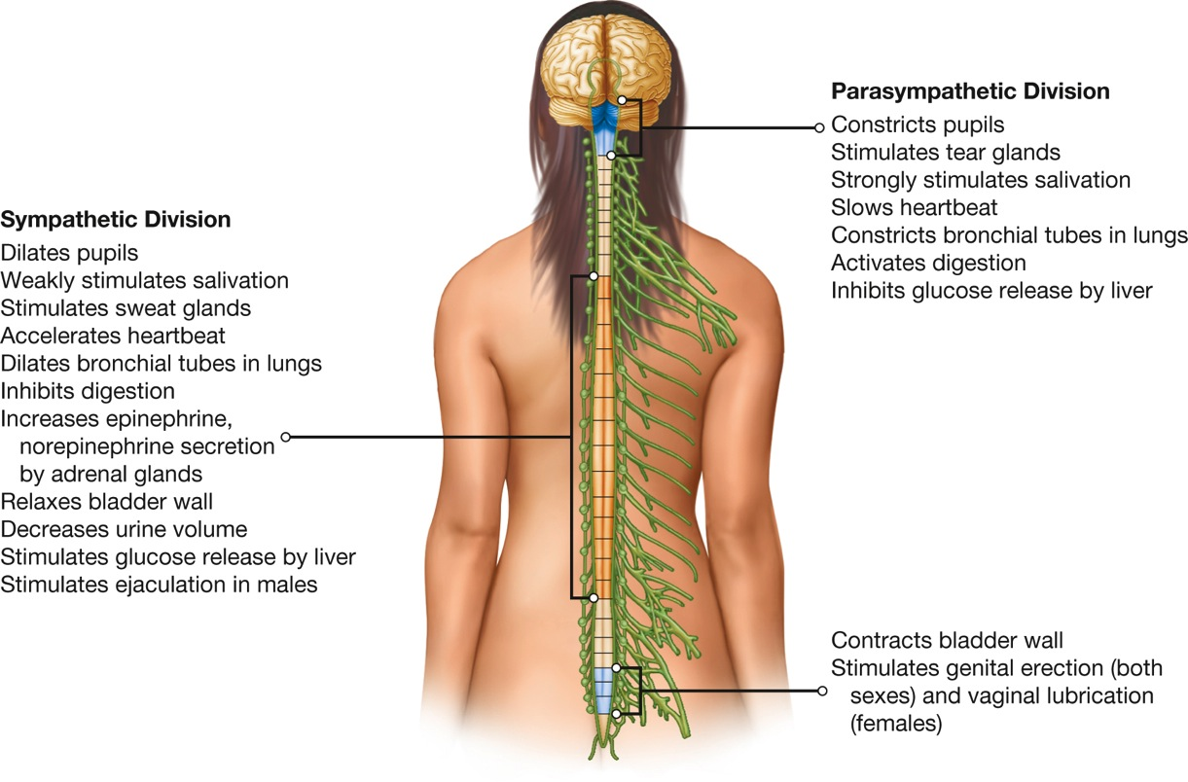
Figure 4.2: The Autonomic Nervous System
Notes:
Figure 4.2 The Autonomic Nervous System
In general, the sympathetic division of the autonomic nervous system prepares the body to expend energy, and the parasympathetic division restores and conserves energy. Sympathetic nerve fibers exit from areas of the spinal cord shown in orange in this illustration; parasympathetic fibers exit from the base of the brain and from spinal-cord areas shown in blue.
Sympathetic nervous system: The subdivision of the autonomic nervous system that mobilizes bodily resources and increases the output of energy during emotion and stress.
Parasympathetic nervous system: The subdivision of the autonomic nervous system that operates during relaxed states and that conserves energy.

Slide 7
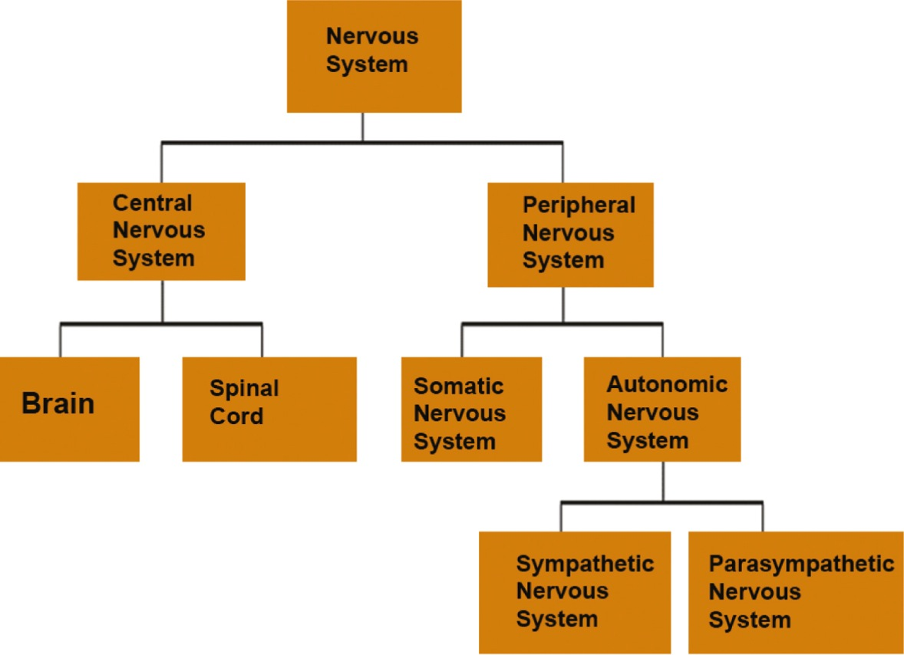
The Nervous System

Slide 8
4.2
Communication in the Nervous System

Slide 9
4.2
Module Learning Objectives
4.2.A
Compare the functions of neurons and glial cells in the nervous system.
4.2.B
Describe each of the three main parts of a neuron, and explain their functions.
4.2.C
Explain how stem cells contribute to the process of neurogenesis.
4.2.D
Outline the process by which neurons communicate with each other, and explain the basic functions of the synapse, action potential, synaptic vesicles, and neurotransmitters.

Slide 10
4.2
Module Learning Objectives
4.2.E
Summarize the effects of some of the main neurotransmitters in the brain, and list four hormones that influence behavior.

Slide 11

Types of Cells
Neurons:
A cell that conducts electrochemical signals
The basic unit of the nervous system
Also called a nerve cell
Glia:
Support, nurture, and insulate neurons
Remove debris when neurons die
Enhance the formation and maintenance of neural connections
Modify neuronal functioning
Glia
Neurons
Notes:
11

Slide 12
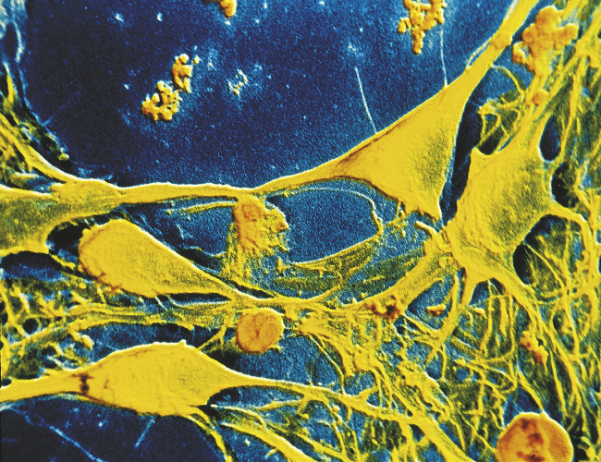
Types of Cells
Notes:
Neurons in the outer layers of the brain.

Slide 13
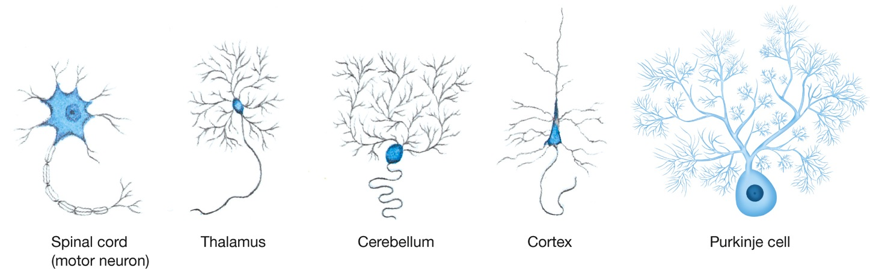
Figure 4.3: Different Kinds of Neurons
Notes:
Figure 4.3 Different Kinds of Neurons
Neurons vary in size and shape, depending on their location and function. More than 200 types of neurons have been identified in mammals.

Slide 14
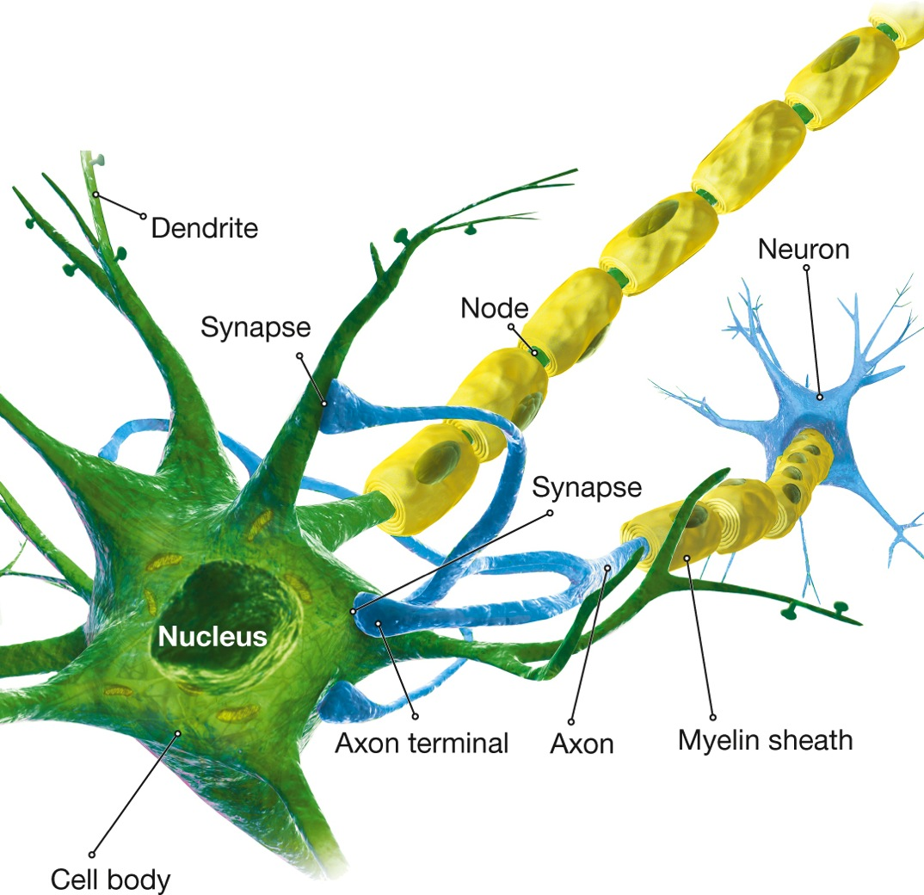
The Structure of the Neuron
Notes:
Figure 4.4 The Structure of a Neuron
Incoming neural impulses are received by the dendrites of a neuron and are transmitted to the cell body. Outgoing signals pass along the axon to terminal branches.
Dendrites: A neuron’s branches that receive information from other neurons and transmit it toward the cell body.
Cell body: The part of the neuron that keeps it alive and determines whether or not it will fire.
Axon: A neuron’s extending fiber that conducts impulses away from the cell body and transmits them to other neurons.
Myelin sheath: A fatty insulation that may surround the axon of a neuron.
Nerve: A bundle of nerve fibers (axons and sometimes dendrites) in the peripheral nervous system.

Slide 15
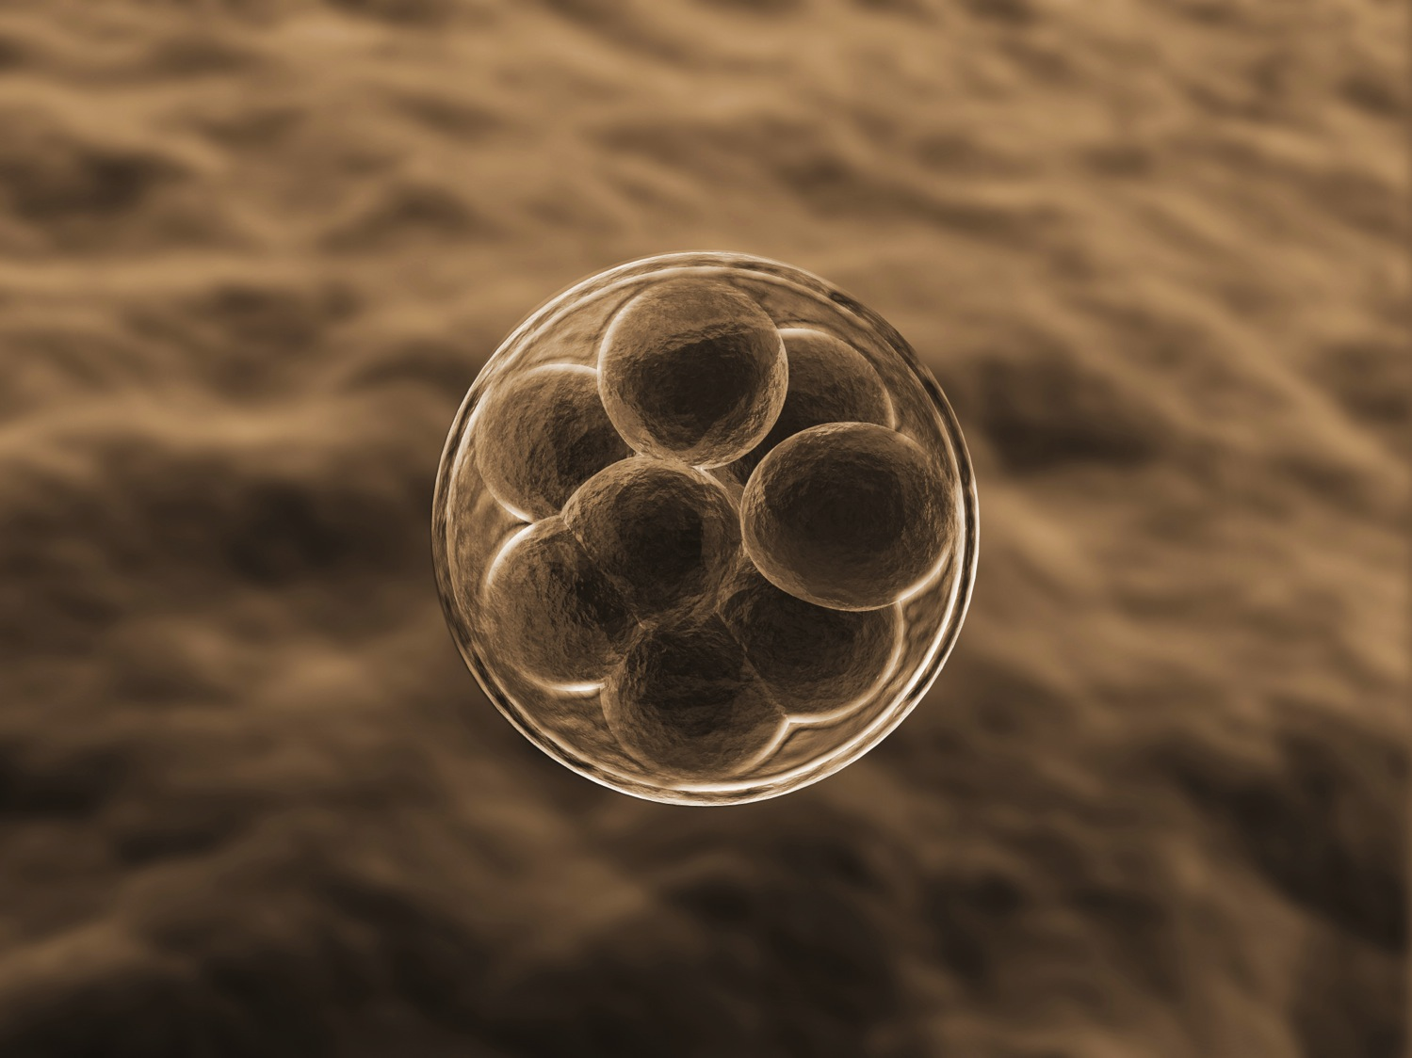
Neurogenesis: The Birth of Neurons
Neurogenesis:
The production of new neurons from immature stem cells
Stem cells:
Immature cells that renew themselves and have the potential to develop into mature cells
Stem cells from early embryos can develop into any cell type
Notes:
15
Discovery of neurogenesis has reshaped the thinking of many brain scientists.
Stem cell research offers an abundance of promising avenues.
Embryonic stem cells hold the promise of medical advances, yet federal funding faces resistance from some advocates.
An alternative to the use of ES cells is to reprogram adult cells from certain organs to become stem cells.
Patient-advocacy groups hope that transplanted stem cells will eventually help people recover from diseases of the brain (such as Parkinson’s) and from damage to the spinal cord and other parts of the body.

Slide 16
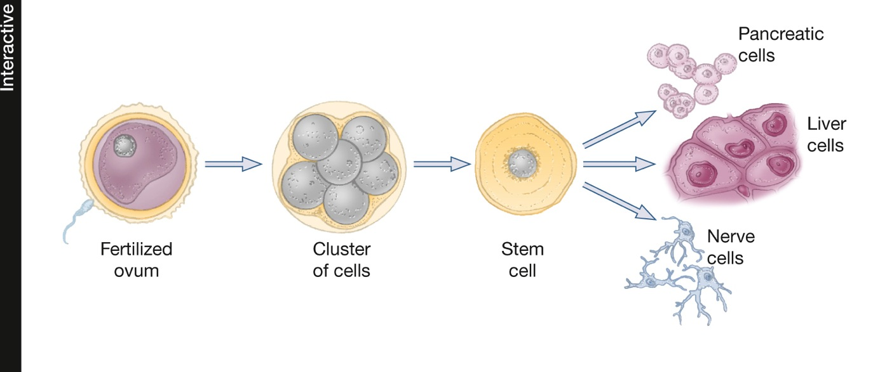
Figure 4.5: Stem Cell Production
Notes:
Figure 4.5 Stem Cell Production
Embryonic stem cells (ES) exhibit pluripotency, the capacity to develop into many types of mature cells. ES cells appear when an embryo is just a few days old, consisting of a cluster of approximately 100 cells.

Slide 17
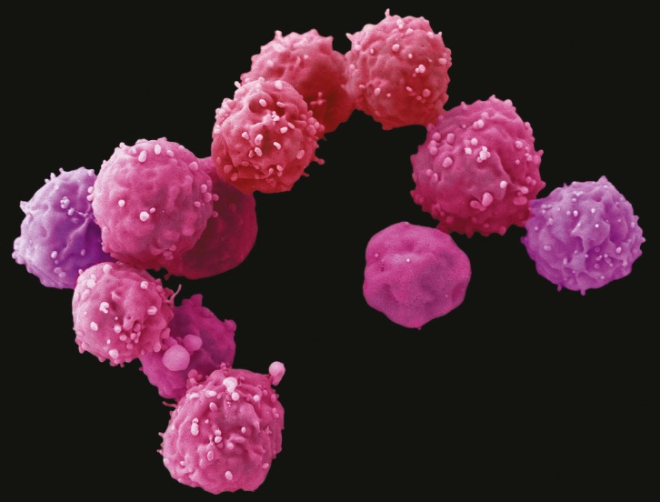
Neurogenesis: The Birth of Neurons
Embryonic cells are pluripotent
Can generate many different kinds of cells in the body
Notes:
These tiny embryonic stem cells, here greatly magnified, are pluripotent, meaning that they can generate many different kinds of cells in the body.

Slide 18
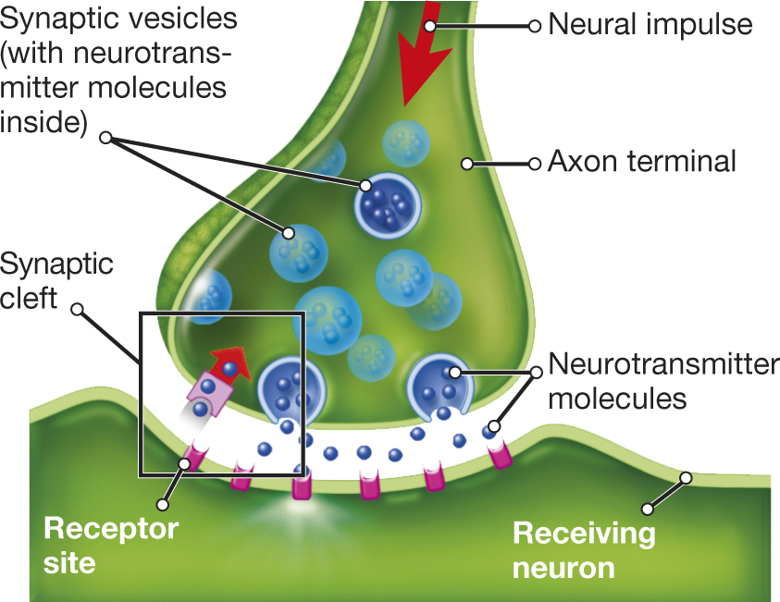
How Neurons Communicate
Notes:
Figure 4.6 Neurotransmitter Crossing a Synapse
Neurotransmitter molecules are released into the synaptic cleft between two neurons from vesicles (chambers) in the transmitting neuron’s axon terminal. The molecules then bind to receptor sites on the receiving neuron. As a result, the electrical state of the receiving neuron changes and the neuron becomes either more likely to fire an impulse or less so, depending on the type of neurotransmitter.
Synapse: The site where transmission of a nerve impulse from one nerve cell to another occurs; it includes the axon terminal, the synaptic cleft, and receptor sites in the membrane of the receiving cell.
Action potential: A brief change in electrical voltage that occurs between the inside and the outside of an axon when a neuron is stimulated; it serves to produce an electrical impulse.
Neurotransmitter: A chemical substance that is released by a transmitting neuron at the synapse and that alters the activity of a receiving neuron.

Slide 19

Chemical Messengers in the Nervous System
_{Hormones}
_{Neurotransmitters}
_{Neuromodulators}
Notes:
Neurotransmitter: A chemical substance that is released by a transmitting neuron at the synapse and that alters the activity of a receiving neuron.
Hormones: Chemical substances, secreted by organs called glands, that affect the functioning of other organs.
Neuromodulators: Neurochemicals that modulate the functioning of neurons and neurotransmitters.
19

Slide 20
Neurotransmitters:
Versatile Couriers
sleep, appetite, sensory perception, temperature regulation, pain suppression, mood
Serotonin
major exhibitory neurotransmitter in the brain
movement, attention, learning, memory, emotion, pleasure, reward, novelty
Glutamate
Dopamine
Neurotransmitters
major inhibitory neurotransmitter in the brain
muscle action, arousal, vigilance, memory,
emotion
GABA
Acetylcholine
Norepinephrine
heart rate, stress, learning, memory

Slide 21
Neurotransmitters: Versatile Couriers
Abnormal levels have been implicated in sleep and eating disorders and in convulsive disorders such as epilepsy.
GABA
Deficits help account for devastating memory problems in people with Alzheimer’s.
Acetylcholine
A loss of cells that produce dopamine is responsible for the tremors and rigidity of Parkinson’s.
Dopamine
In multiple sclerosis, immune cells overproduce glutamate, which damages or kills glial cells that normally make myelin.
Glutamate
Notes:
21
Harmful effects can occur when neurotransmitters levels are too high or too low.

Slide 22

Hormones: Long-Distance Messengers
Secreted by the pineal gland, helps to regulate daily biological rhythms and promotes sleep
Melatonin
Z
Z
Oxytocin
Adrenal hormones
Sex hormones
Notes:
Hormones: Chemical substances, secreted by organs called glands, that affect the functioning of other organs.
Endocrine glands: Internal organs that produce hormones and release them into the bloodstream.

Slide 23

Hormones: Long-Distance Messengers
Secreted by the pituitary gland, enhances uterine contractions during childbirth and facilitates the ejection of milk during nursing
Melatonin
Oxytocin
Adrenal hormones
Sex hormones
Notes:
Along with another hormone, vasopressin, it contributes to relationships in both sexes by promoting attachment and trust.
Oxytocin: A hormone, secreted by the pituitary gland, that stimulates uterine contractions during childbirth, facilitates the ejection of milk during nursing, and seems to promote, in both sexes, attachment and trust in relationships.

Slide 24

Hormones: Long-Distance Messengers
Produced by the adrenal glands and involved in emotion and stress
Melatonin
Oxytocin
Adrenal hormones
Sex hormones
Notes:
The outer part of each adrenal gland produces cortisol, which increases blood-sugar levels and boosts energy.
The inner part produces epinephrine (commonly known as adrenaline) and norepinephrine.
When adrenal hormones are released in your body, activated by the sympathetic nervous system, they increase your arousal level and prepare you for action.
Adrenal hormones also enhance memory.

Slide 25

Hormones: Long-Distance Messengers
Hormones that regulate the development and functioning of reproductive organs and stimulate the development of male and female sex characteristics
Melatonin
Oxytocin
Adrenal hormones
Sex hormones
Notes:
Androgens (e.g., testosterone):
Masculinizing hormones
Set in motion the physical changes males experience at puberty—for example, a deepened voice and facial and chest hair—and cause pubic and underarm hair to develop in both sexes
Testosterone influences sexual arousal in both sexes.
Estrogens:
Feminizing hormones
Bring on physical changes in females at puberty, such as breast development and the onset of menstruation
Influence the course of the menstrual cycle
Progesterone: Contributes to the growth and maintenance of the uterine lining in preparation for a fertilized egg, among other functions.

Slide 26
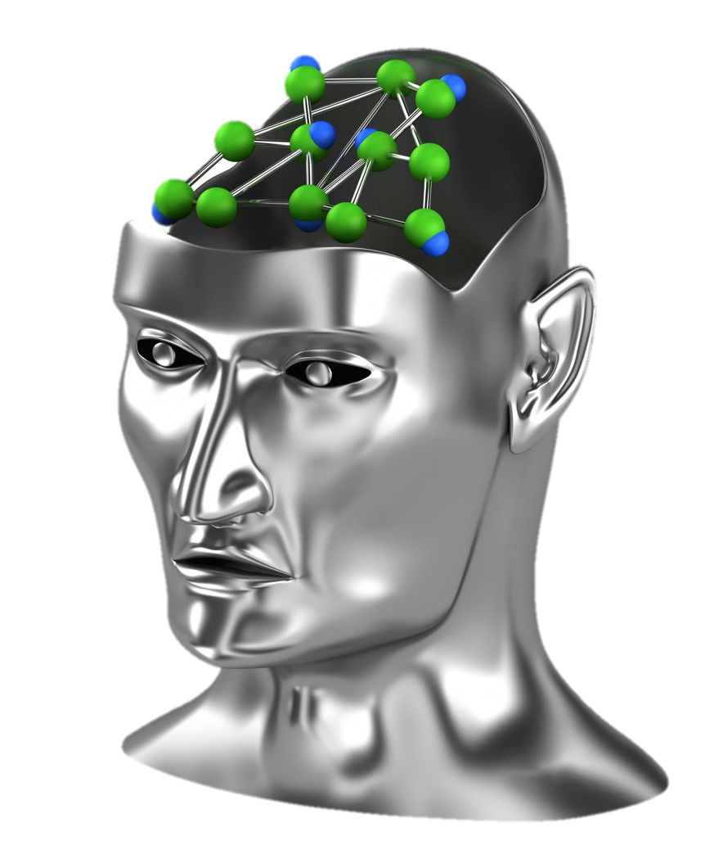
Neuromodulators: The Brain’s Volume Control
Neuromodulators
Chemicals that modulate neural functions
Serotonin transporter
Endorphins
Notes:
Neuromodulators: Neurochemicals that modulate the functioning of neurons and neurotransmitters.
26

Slide 27
Neuromodulators: The Brain’s Volume Control
PAIN
Endorphins PROMOTE pleasure
Endorphins REDUCE pain.
PLEASURE
Notes:
Endorphins: Chemical substances in the nervous system that are similar in structure and action to opiates; they are involved in pain reduction, pleasure, and memory and are known technically as endogenous opioid peptides.
Most act by altering the effects of neurotransmitters
Levels increase when an animal or person is afraid or under stress
27

Slide 28
4.3
Mapping the Brain

Slide 29
4.3
Module Learning Objectives
4.3.A
Describe three techniques researchers use for intervening in the brain and observing the behavior that results.
4.3.B
Describe five techniques researchers use for intervening in behavior and observing the effects on the brain.

Slide 30
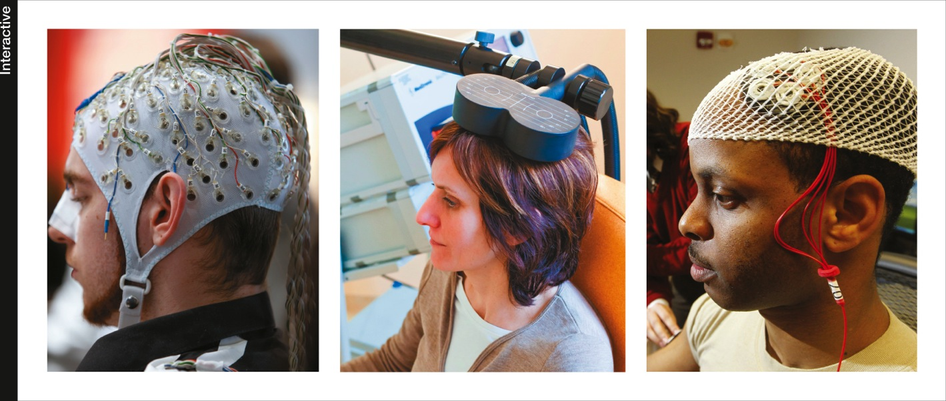
Intervening in the Brain and Observing Behavior
Notes:
Electrodes on the scalp (left) are used to produce an overall picture of electrical activity in different areas of the brain. Transcranial magnetic stimulation, or TMS (center), delivers a large current through a coil on a person’s head, causing neurons under the coil to fire. It can be used to temporarily inactivate certain brain regions. Transcranial direct current stimulation, or tDCS (right), applies direct current to a specific area of the cortex, which either stimulates or suppresses activity in that area depending on the direction of the current.

Slide 31
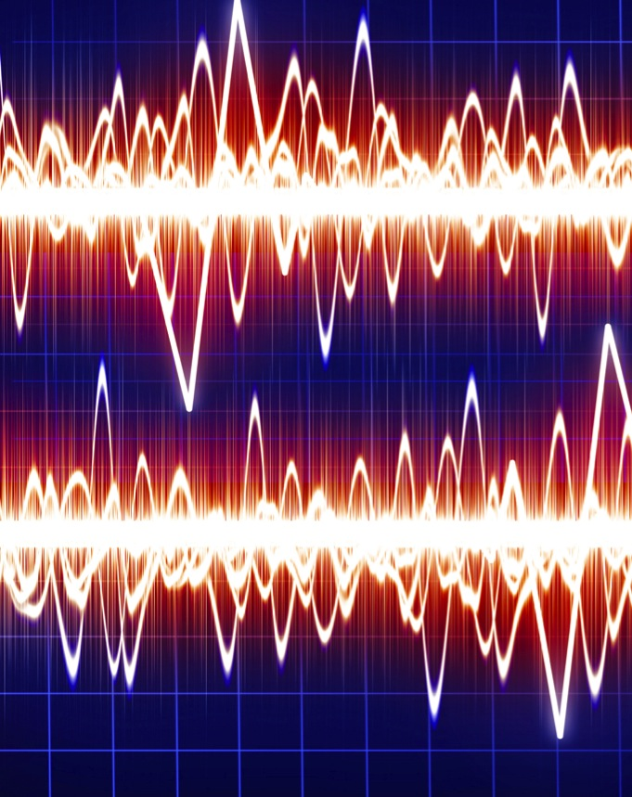
Intervening in Behavior and Observing the Brain
Electroencephalogram (EEG)
Event-related potentials (ERP)
Positron emission tomography (PET)
Magnetic resonance imaging (MRI)
Functional MRI (fMRI)
Notes:
Electroencephalogram (EEG)
A recording of neural activity detected by electrodes.
Event-related potentials (ERP)
A technique that isolates the neural activity associated with a specific stimulus (“event”).
PET scan (positron-emission tomography)
A method for analyzing biochemical activity in the brain, for example by using injections of a glucose-like substance containing a radioactive element.
MRI (magnetic resonance imaging)
A method for studying body and brain tissue, using magnetic fields and special radio receivers.
fMRI (functional magnetic resonance imaging)
A type of magnetic resonance imaging used to study brain activity associated with specific thoughts and behaviors.

Slide 32
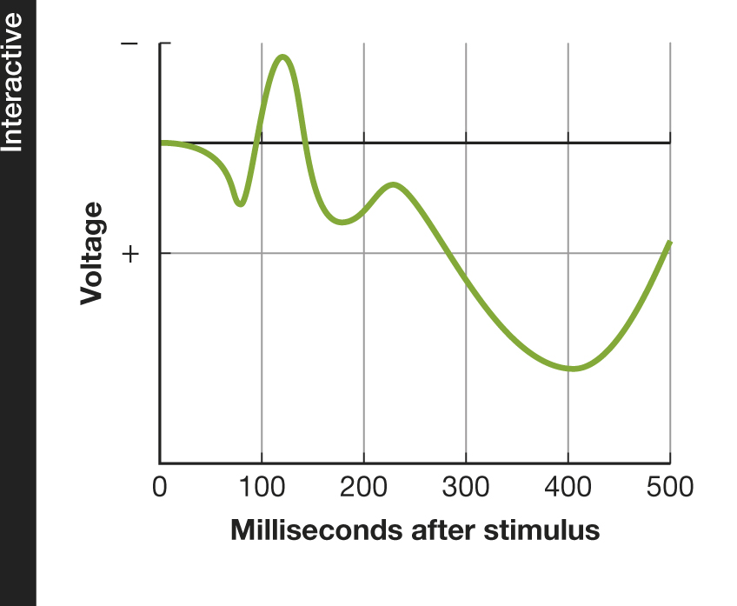
Figure 4.7: An Event-Related Potential
Notes:
Figure 4.7 An Event-Related Potential
An ERP is the brain’s response to a specific event—a wave of electrical activity detected on the scalp after a person encounters a stimulus, such as a picture or a word. The first parts of the wave show brain activity associated with encountering the stimulus; later parts show activity associated with understanding it.

Slide 33

Controversies and Cautions
Images can convey oversimplified & sometimes misleading impressions.
Questionable statistical procedures
Bad theories, poorly defined dependent measures, inappropriate interpretations of results
Interpret with Caution
Notes:
33

Slide 34
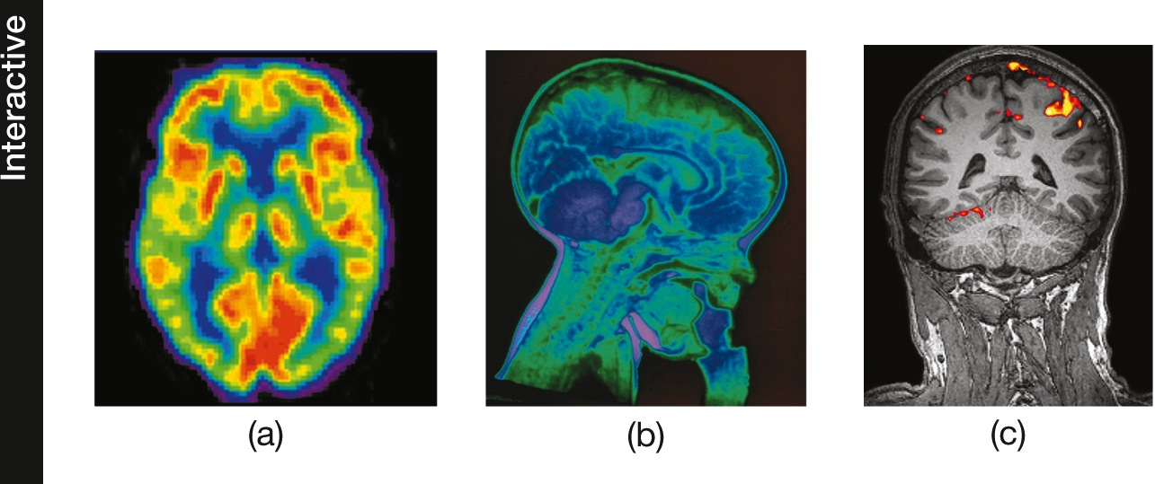
Figure 4.8: Scanning the Brain
Notes:
Figure 4.8 Scanning the Brain
(a) The PET scan shows the brain of a healthy 20-year-old. The colors indicate different levels of activity, where red reveals the highest level. (b) An MRI scan shows a child’s brain and the bottle he was drinking from while the image was obtained. (c) This fMRI image shows how a person’s visual cortex is activated while he or she views a red hibiscus flower.

Slide 35
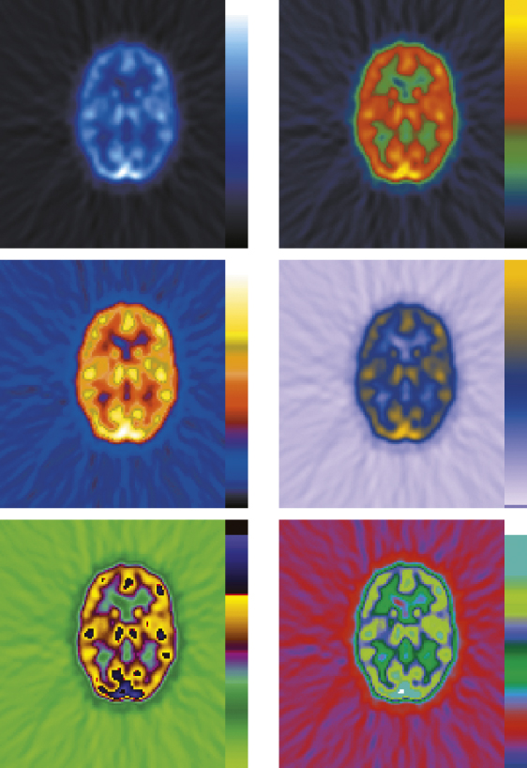
Figure 4.9: Coloring the Brain
Notes:
Figure 4.9 Coloring the Brain
By altering the colors used in brain images, such as in this PET scan, researchers can create the appearance of dramatic brain differences. These scans are actually images of the same brain.

Slide 36
4.4
A Tour Through the Brain

Slide 37
4.4
Module Learning Objectives
4.4.A
List and describe three main structures in the brain stem, explain the primary functions each structure performs, and discuss the processes controlled by the cerebellum.
4.4.B
Describe the structure, function, and location of the thalamus.
4.4.C
Describe the structure, function, and location of the hypothalamus and pituitary gland.
4.4.D
Describe the structure, function, and location of the amygdala.

Slide 38
4.4
Module Learning Objectives
4.4.E
Describe the structure, function, and location of the hippocampus.
4.4.F
Describe the structure of the cerebrum, and explain the function of the corpus callosum.
4.4.G
Sketch the location of each of the lobes of the cerebral cortex, and explain the major functions each lobe performs, with particular reference to the prefrontal cortex.

Slide 39
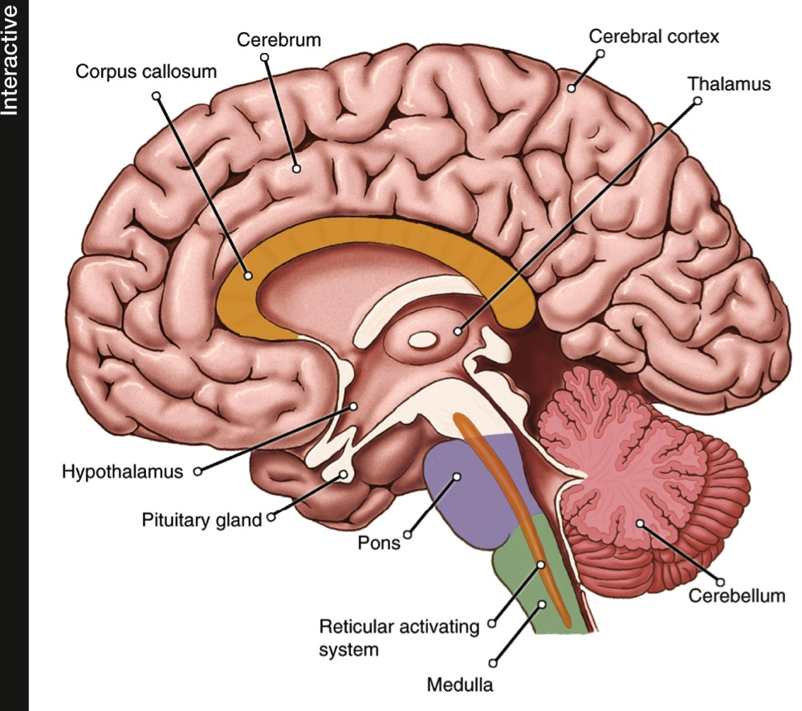
Figure 4.10: Major Structures of the Human Brain
Notes:
Figure 4.10 Major Structures of the Human Brain
This cross section depicts the brain as if it were split down the middle and shows the structures described in the text.

Slide 40
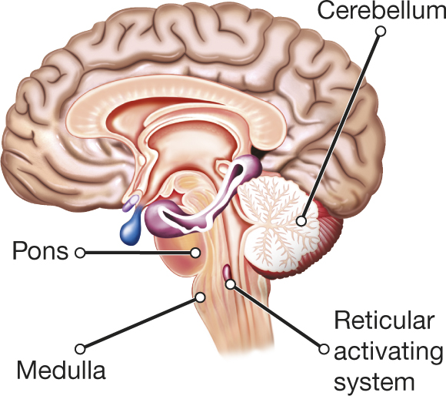
The Brain Stem and Cerebellum
Notes:
Brain stem
The part of the brain at the top of the spinal cord, consisting of the medulla and the pons.
Pons
A structure in the brain stem involved in, among other things, sleeping, waking, and dreaming.
Medulla [muh-DUL-uh]
A structure in the brain stem responsible for certain automatic functions, such as breathing and heart rate.
Reticular activating system (RAS)
A dense network of neurons found in the core of the brain stem; it arouses the cortex and screens incoming information.
Cerebellum
A brain structure that regulates movement and balance, is involved in remembering simple skills and acquired reflexes, and plays a role in cognitive and emotional learning.

Slide 41
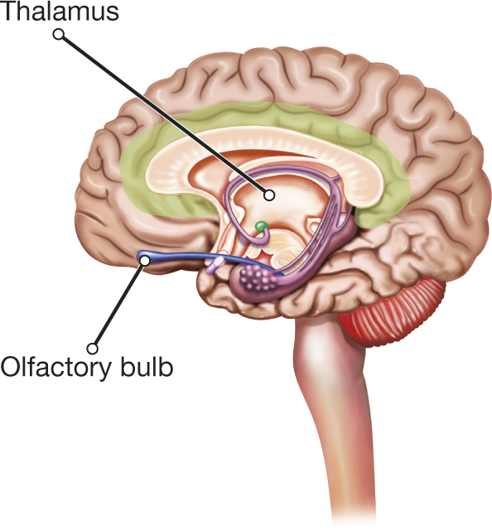
The Thalamus
Notes:
Thalamus: brain structure that relays sensory messages to the cerebral cortex.

Slide 42
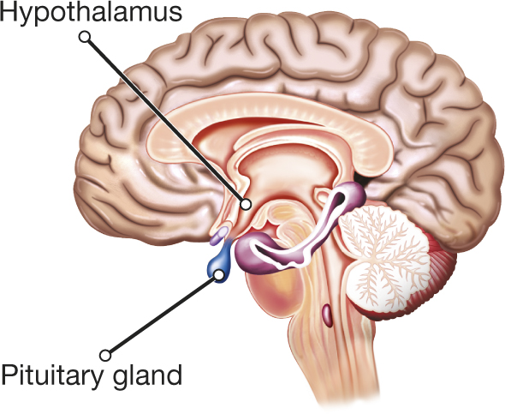
The Hypothalamus and the Pituitary Gland
Notes:
Hypothalamus: A brain structure involved in emotions and drives vital to survival; it regulates the autonomic nervous system.
Pituitary gland: A small endocrine gland at the base of the brain that releases many hormones and regulates other endocrine glands.

Slide 43
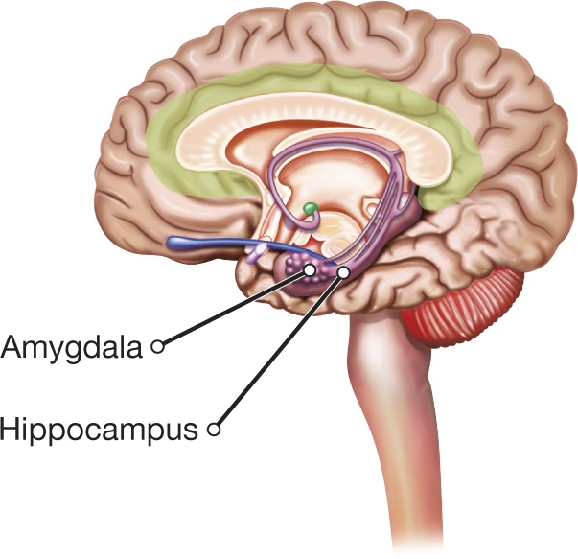
The Amygdala
Notes:
Amygdala [uh-MIG-dul-uh]: A brain structure involved in the arousal and regulation of emotion and the initial emotional response to sensory information.

Slide 44

The Hippocampus
Hippocampus
Brain structure involved in the storage of new information in memory
Henry Molaison (H. M.)
Notes:
The hippocampus is the brain’s primary memory structure, and indeed has often been called the “gateway to memory.” It enables us to take in and combine different components of experiences—sights, sounds, and feelings—and bind them together into one “memory.”

Slide 45
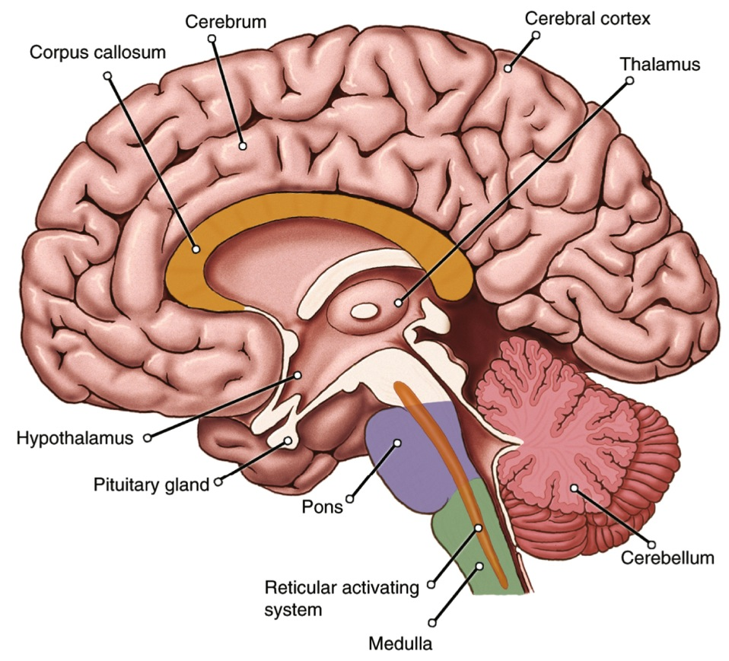
The Cerebrum
Notes:
Cerebrum [suh-REE-brum]: The largest brain structure, consisting of the upper part of the brain; divided into two hemispheres, it is in charge of most sensory, motor, and cognitive processes. From the Latin for “brain.”
Cerebral hemispheres: The two halves of the cerebrum.
Corpus callosum: The bundle of nerve fibers connecting the two cerebral hemispheres.

Slide 46
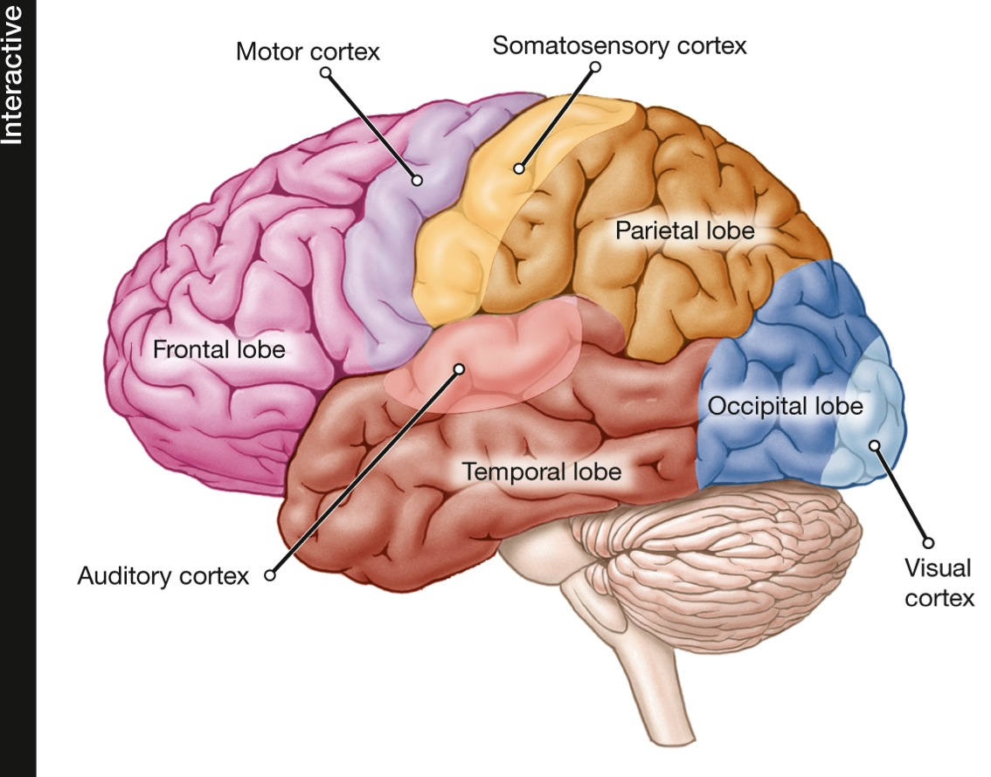
The Cerebral Cortex
Notes:
Occipital [ahk-SIP-uh-tuhl] lobes: Lobes at the lower back part of the brain’s cerebral cortex; they contain areas that receive visual information.
Parietal [puh-RYE-uh-tuhl] lobes: Lobes at the top of the brain’s cerebral cortex; they contain areas that receive information on pressure, pain, touch, and temperature as well as handle attention and awareness of spatial relationships.
Temporal lobes: Lobes at the sides of the brain’s cerebral cortex; they contain areas involved in hearing, memory, perception, emotion, and (in the left lobe, typically) language comprehension.
Frontal lobes: Lobes at the front of the brain’s cerebral cortex; they contain areas involved in short-term memory, higher-order thinking, initiative, social judgment, and (in the left lobe, typically) speech production.

Slide 47

The Prefrontal Cortex
Forward part of the frontal lobes
Associated with complex abilities:
Reasoning
Decision making
Planning
Phineas Gage
Accident destroyed his prefrontal cortex
Retained his ability to speak, think, and remember but his personality was altered

Slide 48
4.5
The Two Hemispheres of the Brain

Slide 49
4.5
Module Learning Objectives
4.5.A
Discuss the basic format of a split-brain experiment, and describe what the results of such experiments reveal about the functioning of the cerebral hemispheres.
4.5.B
Describe why the two hemispheres of the brain are allies rather than opposites.

Slide 50
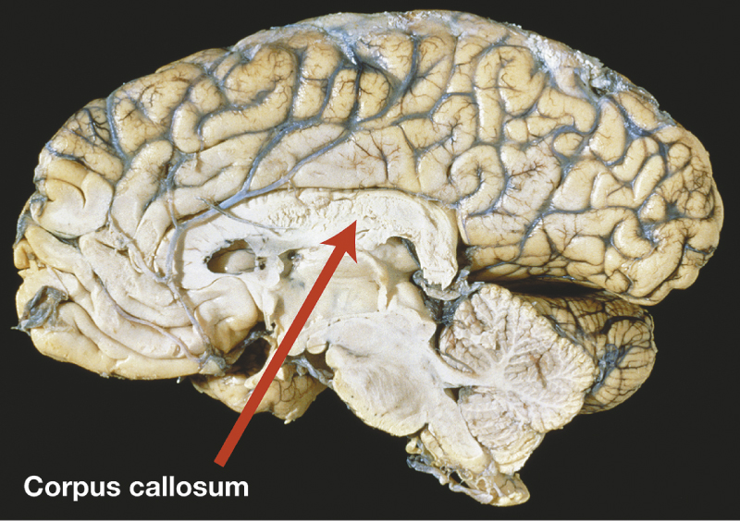
Split Brains: A House Divided
  Split brain research
Study of patients with severed corpus callosum
Involves sending messages to only one side of the brain
Demonstrates right and left brain specialization
Notes:
Some of the most interesting findings about hemispheric specialization come from people known as “split-brain patients.”
In a normal brain, the two hemispheres of the cortex communicate with one another across the corpus callosum, the bundle of fibers that connects them.
Whatever happens in one side of the brain is instantly transferred to the other side. What would happen, though, if the two sides were cut off from one another?

Slide 51
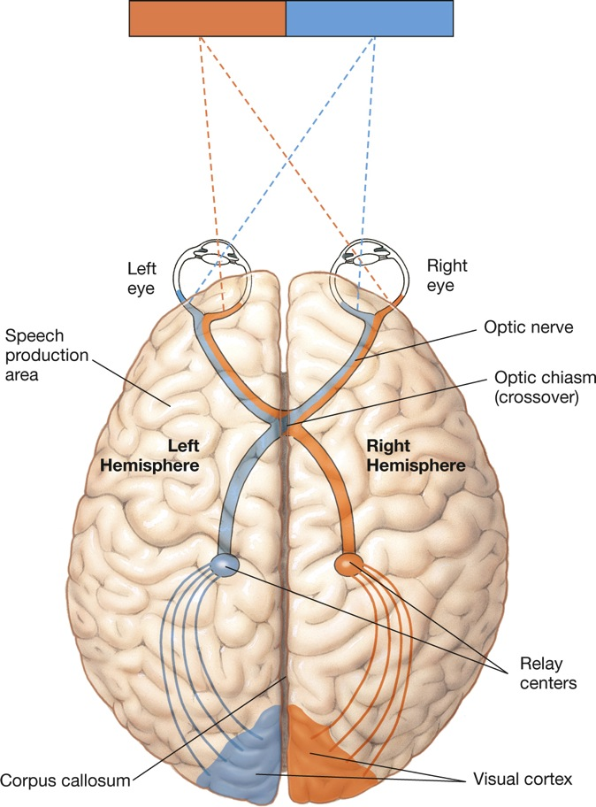
Figure 4.12: Visual Pathways
Notes:
Figure 4.12 Visual Pathways
Each cerebral hemisphere receives information from the eyes about the opposite side of the visual field. Thus, if you stare directly at the corner of a room, everything to the left of the juncture is represented in your right hemisphere, and vice versa. This is so because half the axons in each optic nerve cross over (at the optic chiasm) to the opposite side of the brain. Normally, each hemisphere immediately shares its information with the other one, but in split-brain patients, severing the corpus callosum prevents such communication.

Slide 52
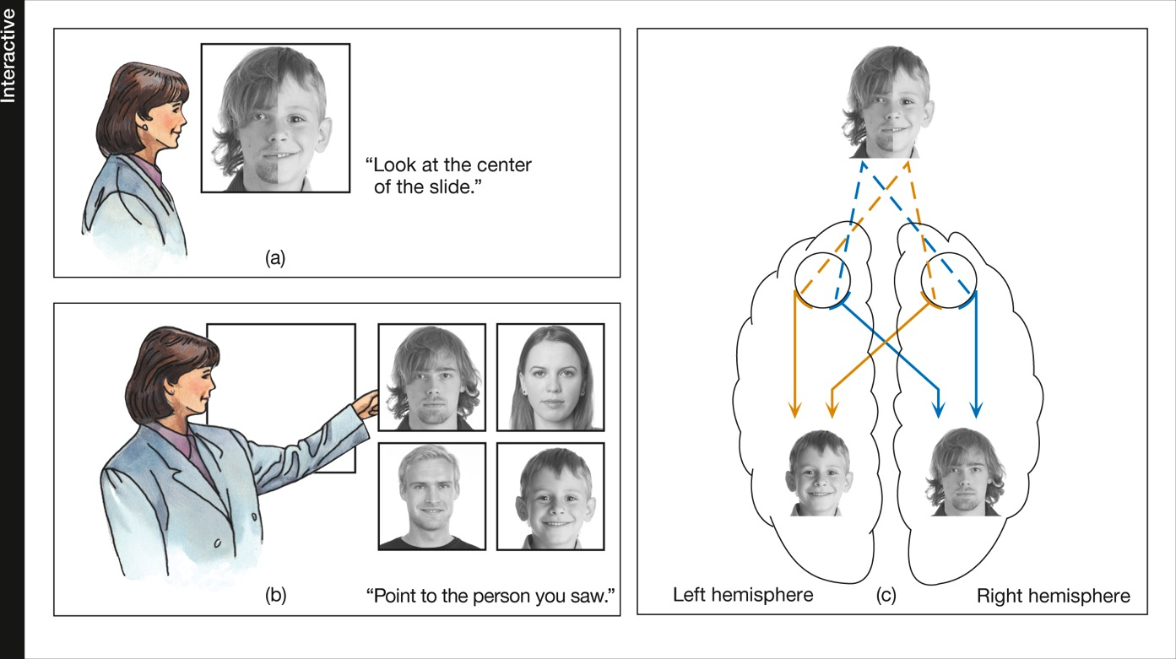
Figure 4.13: A Divided View
Notes:
Figure 4.13 A Divided View
Split-brain patients were shown composite photographs (a) and were then asked to pick out the face they had seen from a series of intact photographs (b). They said they had seen the face on the right side of the composite, yet they pointed with their left hands to the face that had been on the left. Because the two cerebral hemispheres could not communicate, the verbal left hemisphere was aware of only the right half of the picture, and the relatively mute right hemisphere was aware of only the left half (c).

Slide 53
The Two Hemispheres: Allies or Opposites?
Left
hemisphere:
Early researchers viewed as dominant because of its linguistic and analytic talents
Right
hemisphere:
Superior at recognizing facial expressions; has spatial-visual ability; has some language ability
In most
real-life activities, the two sides cooperate naturally.

Slide 54

The Two Hemispheres: Allies or Opposites?
Notes:
Have a righthanded friend tap on a sheet of paper with a pencil held in the right hand for 1 minute. Then have the person do the same with the left hand, using a fresh sheet of paper. Finally, repeat the procedure, having the person talk at the same time as tapping. For most people, talking will decrease the rate of tapping—but more for the right hand than for the left, probably because both activities involve the same hemisphere (the left one), and there is competition between them. (Lefthanded people vary more in terms of which hemisphere is dominant for language, so the results for them will be more variable.)

Slide 55
4.6
The Flexible Brain

Slide 56
4.6
Module Learning Objectives
4.6.A
Define neural plasticity, and summarize some of the main evidence that the brain has the ability to change in response to new experiences.
4.6.B
Summarize five cautions surrounding whether sex differences in anatomical brain size are linked to sex differences in behavior.

Slide 57
Experience and the Brain
Plasticity: The brain’s ability to change and adapt in response to experience—through neurogenesis, or by reorganizing or growing new neural connections
At birth
3 months
6 months
15 months
Notes:
Figure 4.14 Getting Connected
Neurons in a newborn’s brain are widely spaced, but they immediately begin to form new connections. These drawings show the marked increase in the number of connections from birth to age 15 months.
57

Slide 58
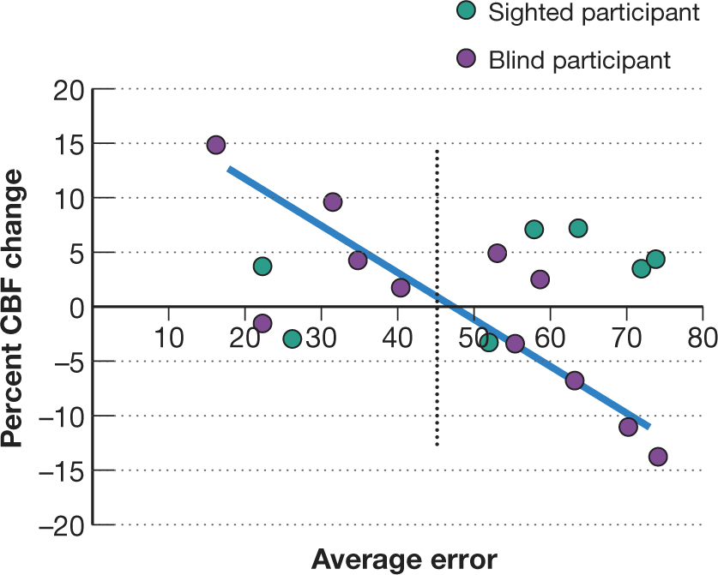
Figure 4.15: Adapting to Blindness
Notes:
Figure 4.15 Adapting to Blindness
In some blind people, brain areas usually associated with vision may become active in tasks requiring hearing. The purple circles to the left of the dotted line represent blind individuals with low error rates in a sound-localization task; those to the right represent blind individuals with high error rates. The graph shows that error rates for blind people—but not sighted ones—were correlated with changes in cerebral blood flow (CBF), and thus neural activity, in a visual area of the brain. The more accurate blind people were, the greater the activity in this region. (Adapted from Gougoux et al., 2005.)

Slide 59

CULTURE AND THE BRAIN
Can Culture Shape the Brain?
  Cultural influences show up in fMRI studies of perception, problem-solving, language, and thinking
Notes:
59

Slide 60

Are There “His” and “Hers” Brains?
Average sex differences in the brain do exist.
However:
Many supposed differences are stereotypes.
May not produce a difference in behavior or performance.
Do not account for differences in behavior across situations.
Some differences can be the result rather than the cause of behavioral differences.
Results of studies may not be generalizable to everyone.
Notes:
60

Slide 61

Taking Psychology with You
Cosmetic Neurology: Tinkering with the Brain
People use caffeine, diet, and exercise to stimulate their brains and improve learning & memory.
But drugs like Provigil (for sleep disorders), and Ritalin or Adderall (for ADHD) have side effects.
And when attention/concentration is improved, sometimes creativity suffers.

Slide 62
End of Chapter

Slide 63
Interactive Figures

Slide 64
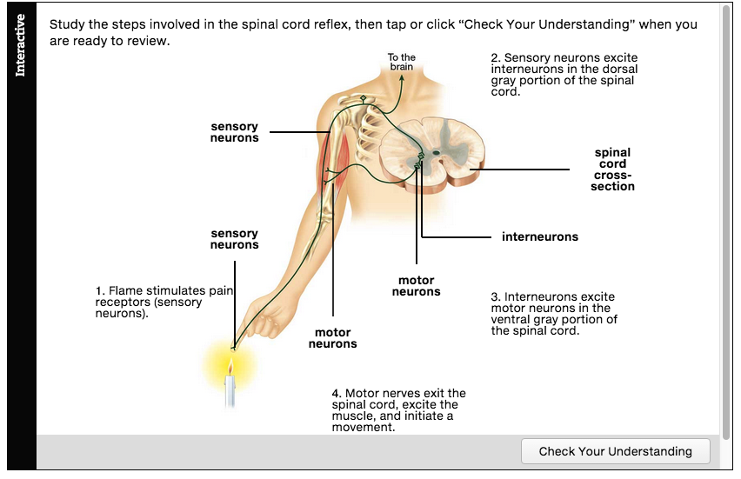
Interactive figure
The Spinal Cord Reflex
Click here to watch the interactive feature.

Slide 65
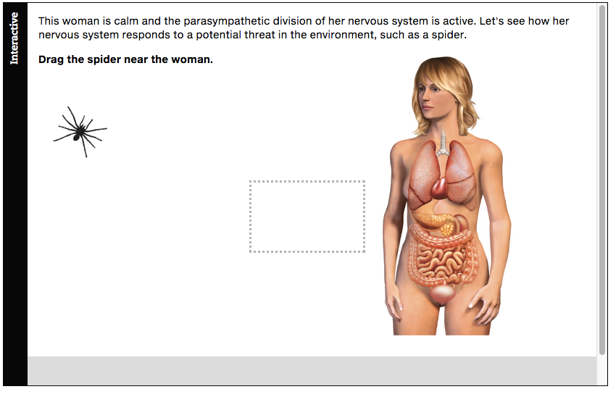
Interactive figure
Functions of the Parasympathetic and Sympathetic Divisions of the Nervous System
Click here to watch the interactive feature.

Slide 66
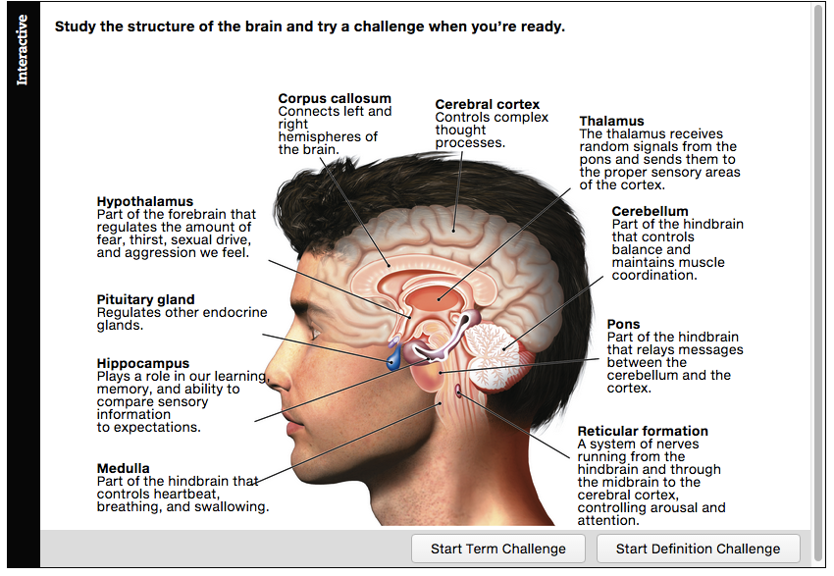
Interactive figure
Major Structures of the Human Brain
Click here to watch the interactive feature.

Slide 67
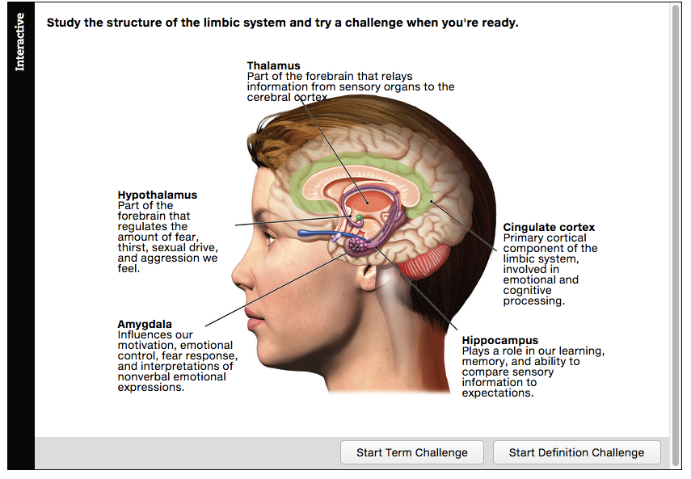
Interactive figure
The Limbic System
Click here to watch the interactive feature.

Slide 68
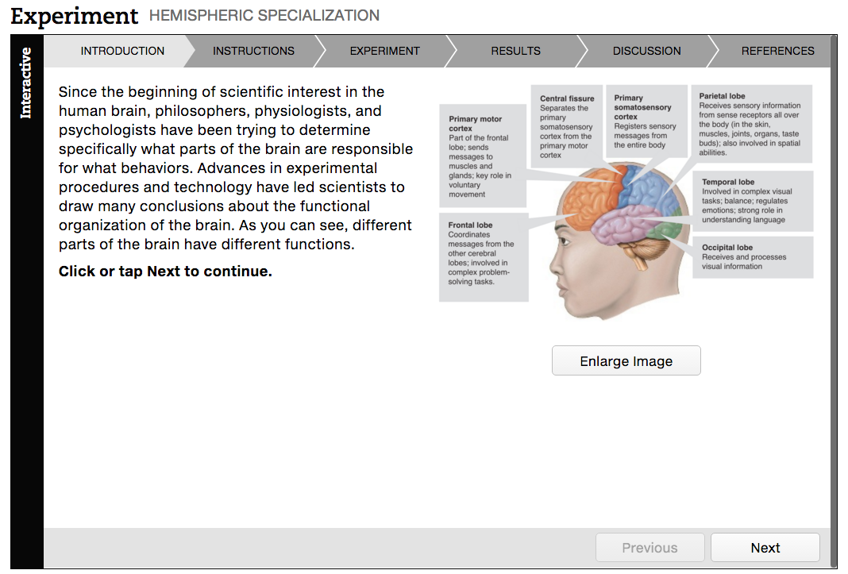
Interactive figure
Hemispheric Specialization
Click here to watch the interactive feature.

Slide 69
Acknowledgments

Slide 70
Slide | Credit
Slide 4 | yienkeat. Shutterstock
Slide 15 | BioMedical. Shutterstock
Slide 19 | Serg64. Shutterstock
Slide 22 | MJTH. Shutterstock
Slide 23 | SvetlanaFedoseyeva. Shutterstock
Slide 24 | Sebastian Gauert. Shutterstock
Slide 25 | Iraidka. Shutterstock
Slide 26 | Alex Mit. Shutterstock
Slide 31 | argus. Shutterstock
Slide 33 | Gunnar Pippel. Shutterstock
Slide 44 | lightwise. 123rf.com
Slide 47 | Peshkova. Shutterstock
Slide 59 | Thorsten Schmitt. Shutterstock
Slide 60 | Imagewell. Shutterstock
Slide 61 | quetton. Shutterstock

