Slide 1
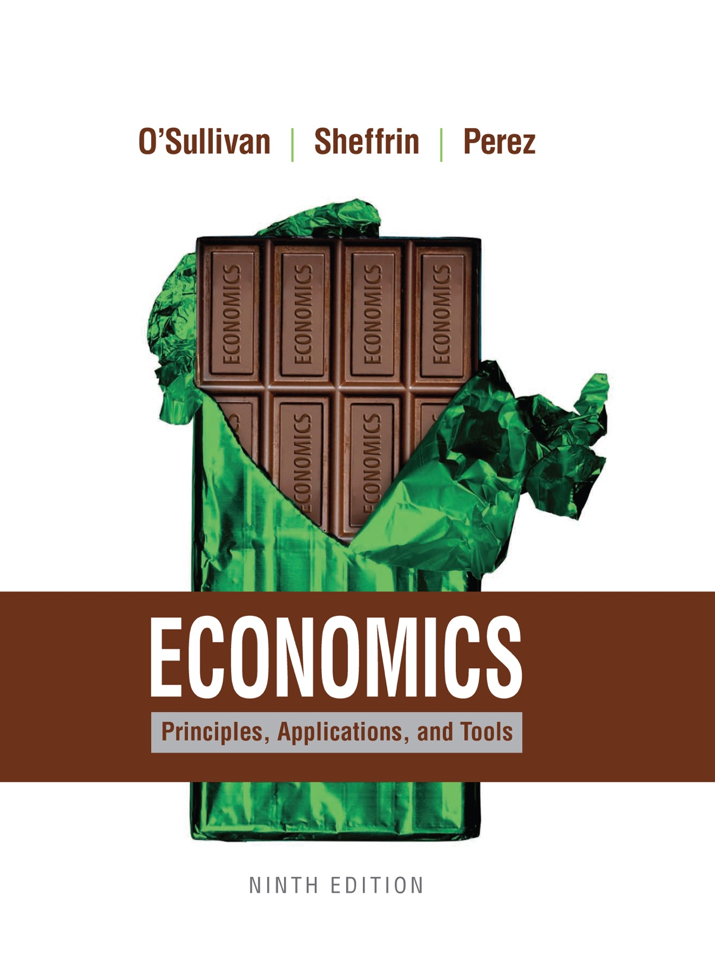
Economics
NINTH EDITION
Chapter 18
Insert Cover Picture
International Trade and Public Policy

Slide 2
Learning Objectives
18.1 Explain carefully the terms comparative advantage and terms of trade.
18.2 List the common protectionist policies.
18.3 Describe the rationales that have been offered for protectionist policies.
18.4 Summarize the history of international trade agreements.
18.5 Analyze one recent controversy in trade policy.

Slide 3
18.1 BENEFITS FROM SPECIALIZATION AND TRADE (1 of 6)
PRINCIPLE OF OPPORTUNITY COST
The opportunity cost of something is what you sacrifice to get it.
TABLE 18.1 Output and Opportunity Cost
 | Quantity Produced Per Day | Opportunity Cost of Shirts | Opportunity Cost of Chips
Shirtland | 108 shirts 36 chips | 1/3 chip | 3 shirts
Chipland | 120 shirts 120 chip | 1 chip | 1 shirt

Slide 4
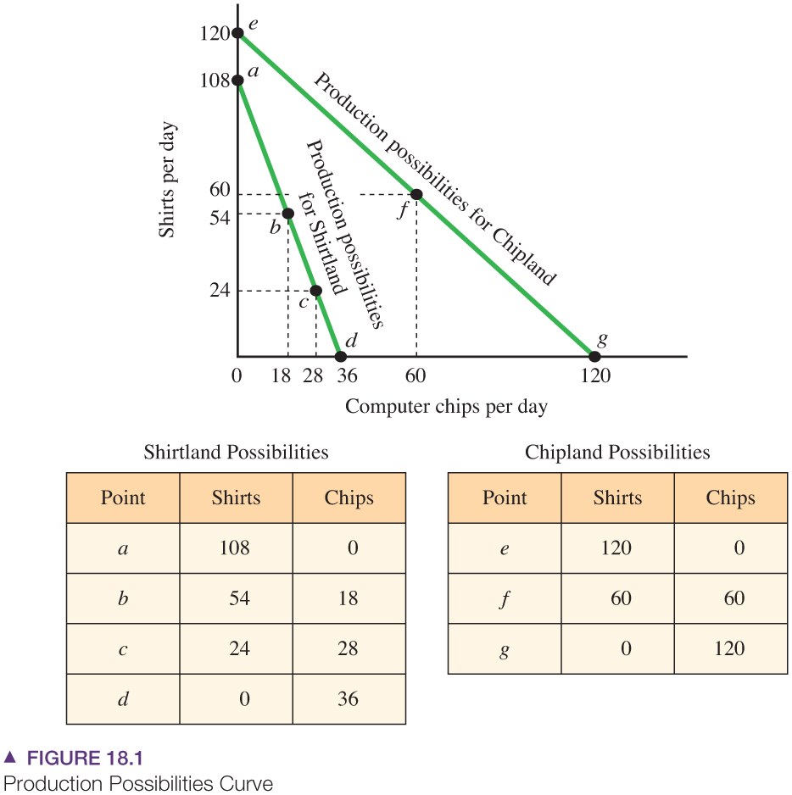
18.1 BENEFITS FROM SPECIALIZATION AND TRADE (2 of 6)
Production Possibilities Curve
The production possibilities curve shows the combination of two goods that can be produced with a nation’s resources.
For Chipland, the trade-off between the two goods is one to one.
For Shirtland, the trade-off is three shirts for every computer chip.
In the absence of trade, Shirtland can pick point c—28 chips and 24 shirts—and Chipland can pick point f—60 chips and 60 shirts.
All shirts and no chips: point a.
All chips and no shirts: point d.
Equal division of resources: point b.

Slide 5
18.1 BENEFITS FROM SPECIALIZATION AND TRADE (3 of 6)
Comparative Advantage and the Terms of Trade
Terms of trade
The rate at which units of one product can be exchanged for units of another product.

Slide 6
18.1 BENEFITS FROM SPECIALIZATION AND TRADE (4 of 6)
The Consumption Possibilities Curve
Consumption possibilities curve
A curve showing the combinations of two goods that can be consumed when a nation specializes in a particular good and trades with another nation.

Slide 7
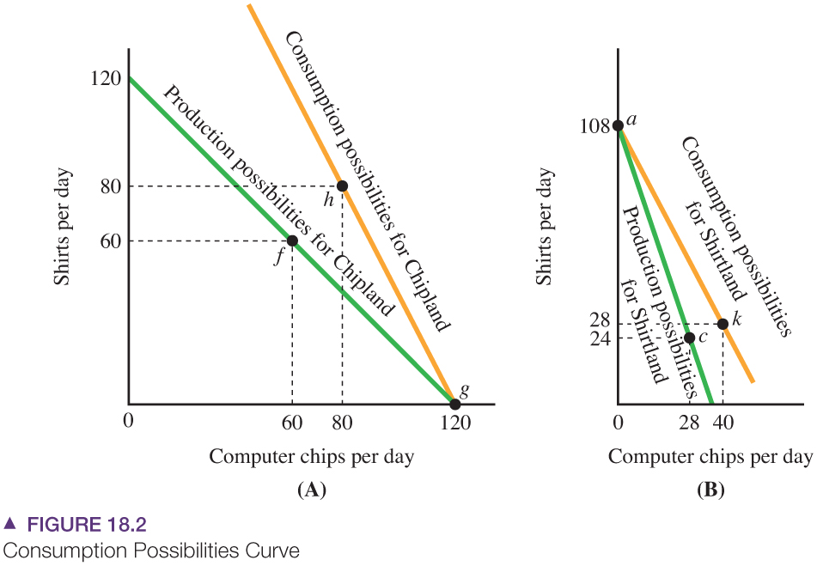
18.1 BENEFITS FROM SPECIALIZATION AND TRADE (5 of 6)
The Consumption Possibilities Curve
The consumption possibilities curve shows the combinations of computer chips and shirts that can be consumed if each country specializes and trades.
Given the terms of trade, Chipland can exchange 40 of its120 chips for 80 shirts, leading to point h. At point h, Chipland can consume 80 chips and 80 shirts.
Shirtland can exchange 80 of its 108 shirts for 40 chips, leading to point k on its consumption possibilities curve. Shirtland can consume 28 shirts and 40 chips.

Slide 8
18.1 BENEFITS FROM SPECIALIZATION AND TRADE (6 of 6)
How Free Trade Affects Employment
Under free trade, each nation will begin to specialize in a single good, causing considerable changes in the country’s employment in different industries.
Switching from self-sufficiency to specialization and trade increases consumption in both nations, so on average, people in each nation benefit from free trade.
But some people in both national will be harmed by free trade.

Slide 9
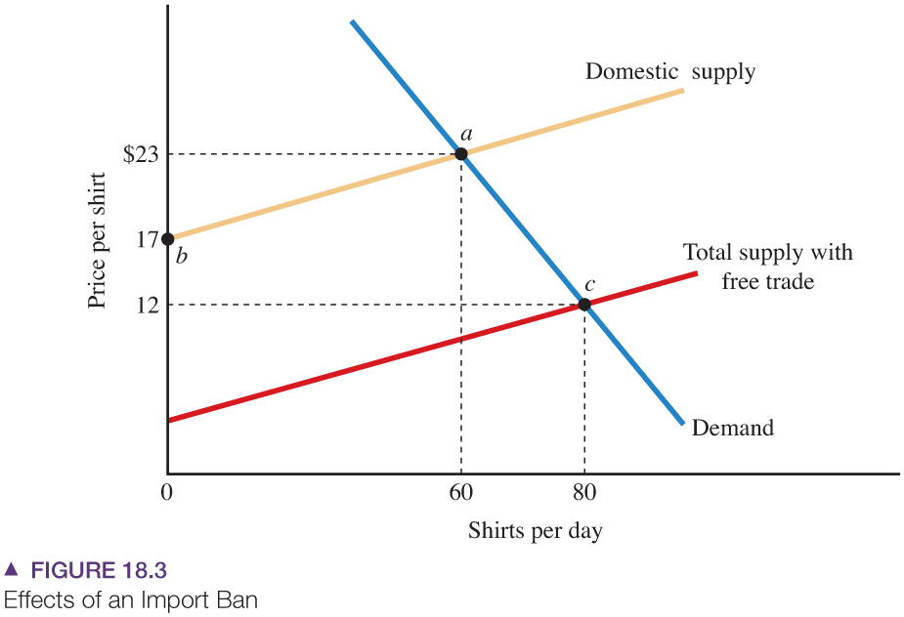
18.2 PROTECTIONIST POLICIES (1of 4)
Import Bans
In the free-trade equilibrium, demand intersects the total supply curve at point c, with a price of $12 and a quantity of 80 shirts.
If shirt imports are banned, the equilibrium is shown by the intersection of the demand curve and the domestic supply curve (point a).
The price increases to $23.

Slide 10
18.2 PROTECTIONIST POLICIES (2 of 4)
Quotas and Voluntary Export Restraints
Import quota
A government-imposed limit on the quantity of a good that can be imported.
Voluntary export restraint (VER)
A scheme under which an exporting country voluntarily decreases its exports.

Slide 11
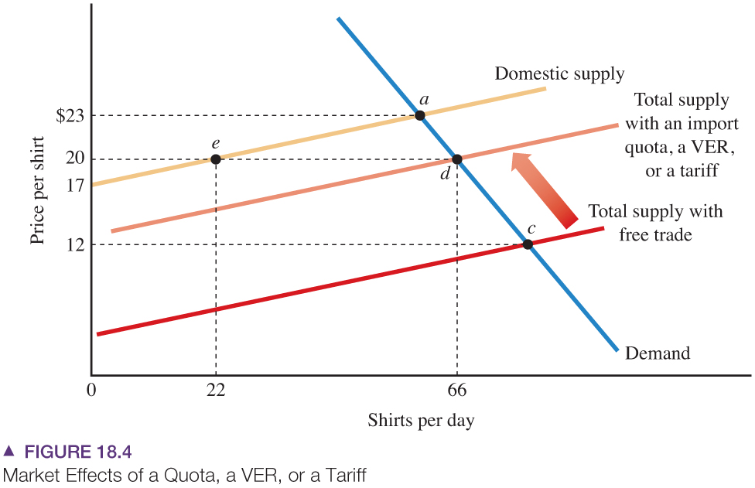
18.2 PROTECTIONIST POLICIES (3 of 4)
Quotas, Voluntary Export Restraints, or a Tariff
An import quota shifts the supply curve to the left.
The market moves upward along the demand curve to point d, which is between point c (free trade) and a (an import ban).
We can reach the same point with a tariff that shifts the total supply curve to the same position.

Slide 12
18.2 PROTECTIONIST POLICIES (4 of 4)
Quotas and Voluntary Export Restraints
Import licenses
Rights, issued by a government, to import goods.
Tariff
A tax on imported goods.
Responses to Protectionist Policies
A restriction on imports is likely to lead to further restrictions on trade.
Many import restrictions have led to retaliatory policies and substantially lessened trade.
The most famous was the Smoot-Hawley Tariff Act of 1930. When the United States increased its average tariff on imports to 59 percent, its trading partners retaliated with higher tariffs on U.S. products.
The resulting trade war reduced international trade and deepened the worldwide depression of the 1930s.

Slide 13
APPLICATION 1
THE IMPACT OF TARIFFS ON THE POOR
APPLYING THE CONCEPTS #1: Do tariffs (taxes) on imported goods hurt the poor disproportionately?
Economists have found that tariffs in the United States fall most heavily on lower-income consumers.
Footwear accounts for:
1.3 percent of the expenditure of lower-income households.
0.5 percent of the expenditure of higher-income households.
The highest tariffs fall on the cheapest products—precisely those that will be purchased by lower-income consumers.
Low-price sneakers face a 32 percent tariff.
Expensive track shoes face only a 20 percent tariff.
To protect U.S. industries, tariffs are highest on labor-intensive goods. But these goods tend to be lower priced. That is why tariffs do fall disproportionately on the poor.

Slide 14
18.3 WHAT ARE THE RATIONALES FOR PROTECTIONIST POLICIES?
To Shield Workers from Foreign Competition
One of the most basic arguments for protectionism is that it shields workers in industries that would be hurt by trade.
To Nurture Infant Industries until They Mature
Learning by doing
Knowledge and skills workers gain during production that increase productivity and lower cost.
Infant industries
Industries that are at an early stage of development.
To Help Domestic Firms Establish Monopolies in World Markets
If the production of a particular good requires extremely large economies of scale, the world market will support only a few, or perhaps just one, firm.

Slide 15
APPLICATION 2
CHINESE IMPORTS AND LOCAL ECONOMIES
APPLYING THE CONCEPTS #2: What have been the local effects of Chinese imports?
Do imports from China really make a difference in U.S. labor markets? Economists David Autor David Dorn, and Gordon Hanson examined detailed data on Chinese imports into local communities. Some local communities are more heavily impacted by Chinese imports than others depending on the mix of products produced locally.
The authors found that the pace of Chinese import growth was so rapid from 1990 to 2007 that it often had a strong and negative effect on local economies. Those communities that were more exposed to imports had larger increases in workers receiving unemployment insurance, food stamps, and disability payments.
These findings do not mean that trade with China was ultimately beneficial. Displaced workers can find new jobs and import competition lowers prices for all consumers. But it does mean that the burden of adjustment to imports varies by region. Some regions will have a more difficult time adjusting than others to a sudden influx of imports The study also does not measure the indirect benefits from trade with China. As the Chinese economy expanded during this period, it created more export opportunities for producers in the United States. Those benefits were not measured in this study.

Slide 16
18.4 A BRIEF HISTORY OF INTERNATIONAL TARIFF AND TRADE AGREEMENTS
General Agreement on Tariffs and Trade (GATT)
An international agreement established in 1947 that has lowered trade barriers between the United States and other nations.
World Trade Organization (WTO)
An organization established in 1995 that oversees GATT and other international trade agreements, resolves trade disputes, and holds forums for further rounds of trade negotiations.
In addition to the large group of nations in the WTO, other nations have formed trade associations to lower trade barriers and promote international trade:
The North American Free Trade Agreement (NAFTA)
The European Union (EU)
Asian Pacific Economic Cooperation (APEC)
Dominican Republic - Central America Free Trade Agreement (DR-CAFTA)

Slide 17
18.5 RECENT POLICY DEBATES AND TRADE AGREEMENTS (1 of 2)
Are Foreign Producers Dumping Their Products?
Dumping
A situation in which the price a firm charges in a foreign market is lower than either the price it charges in its home markets or the production cost.
Price discrimination
The process under which a firm divides consumers into two or more groups and charges a different price for each group buying the same product.
Predatory pricing
A pricing scheme under which a firm decreases the price to drive rival firms out of business and increases the price when rival firms leave the market.

Slide 18
APPLICATION 3
DOES LOSING IN THE WTO REALLY MATTER?
APPLYING THE CONCEPTS #3: How do decisions by the WTO affect trade disputes between countries?
In July 2014 the World Trade Organization ruled that the U.S. had violated trade laws by imposing excessive tariffs on Chinese imports.
The U.S. agreed to the ruling but planned to impose a tariff on imported solar panels, requested by Solar World, an American subsidiary of a German company.
The company planned to move their production to other countries that would not be subject to tariffs.
WTO rulings do affect member countries, but continued trade negotiations between trading partners are still necessary.

Slide 19
18.5 RECENT POLICY DEBATES AND TRADE AGREEMENTS (2 of 2)
Do Trade Laws Inhibit Environmental Protection?
Trade disputes about environmental issues are part of a larger phenomenon that occurs when trade issues and national regulations collide.
Do Outsourcing and Trade Cause Income Inequality?
Outsourcing
Firms producing components of their goods and services in other countries.
Why Do People Protest Free Trade?
As we have seen in this chapter, trade and specialization provide important opportunities to raise living standards throughout the globe. But they also mean individuals and nations surrender some of their independence and sovereignty.

Slide 20
APPLICATION 4
HOW AMERICAN ARE AMERICAN CARS
APPLYING THE CONCEPTS #4: How has worldwide trade in automobile parts affected the U.S. auto industry?
Over the last 5 years, there has been explosive growth in imports of automobile parts from outside the U.S. and Canada. Our U.S. cars have increasing amounts of foreign content.
As a result, cars are mow more competitively priced for U.S. consumers and the U.S. is better able to export its cars and compete on world markets.
Yet, these changes have adversely affected domestic manufacturers of auto parts.

Slide 21
KEY TERMS
Consumption possibilities curve Outsourcing
Dumping Predatory pricing
General agreement on tariffs Price discrimination
and trade (gatt)
Import licenses Tariff
Import quota Terms of trade
Infant industries Voluntary export restraint (VER)
Learning by doing World Trade Organization (WTO)

