Slide 1
Word Web Feature
Creating Web Pages
Using Word

Slide 2
Objectives
Saving a Word document as a Web page
Inserting a hyperlink
Adding a background color with a pattern
Using Windows Explorer to view a Web page

Slide 3
Plan Ahead
Craft a successful resume
Create a resume Web page from your resume Word document
Publish your resume Web page

Slide 4
Saving a Word Document as a Web Page
Start Word and then open the file named Canaan Resume created in Chapter 3
With the resume file open in the document window, click the Office Button and then point to Save As on the Office Button menu to display the Save As submenu
Click Other Formats on the Save As submenu to display the Save As dialog box
Type Canaan Resume Web Page in the File name text box to change the file name. If necessary, change the Save in location to UDISK 2.0 (E:). (Your USB flash drive may have a different name and letter.)
Click the Save as type box arrow, scroll to and then click Single File Web Page

Slide 5
Saving a Word Document as a Web Page
Click the Change Title button to display the Set Page Title dialog box
Type Canaan Resume in the Page title text box
Click the OK button in the Set Page Title dialog box
Click the Save button in the Save As dialog box to save the resume as a Web page and display it in the document window

Slide 6
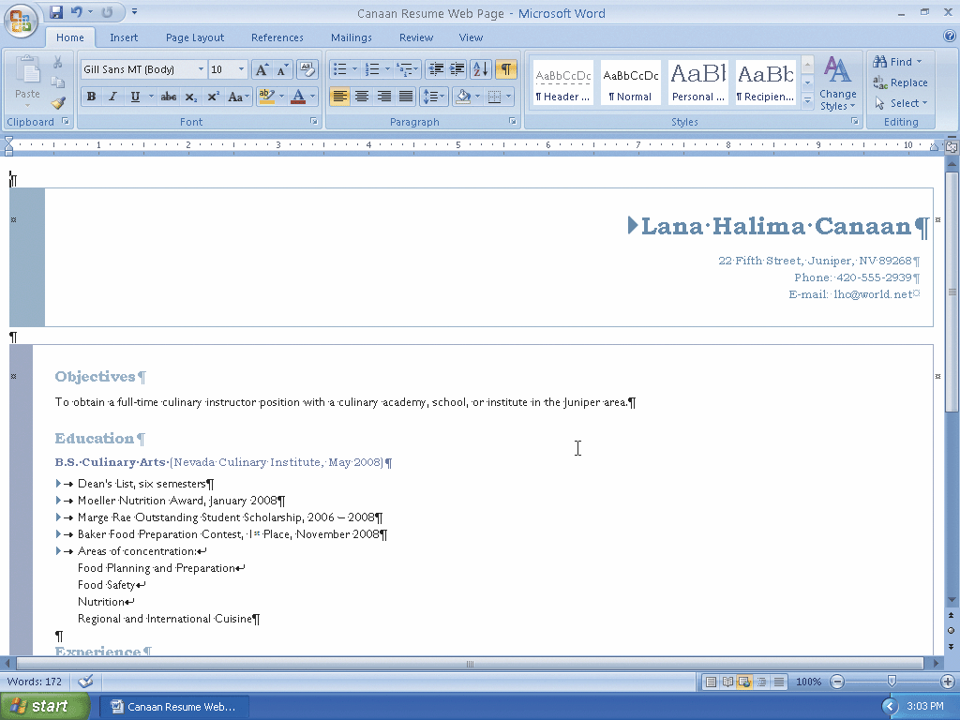
Saving a Word Document as a Web Page

Slide 7
Formatting Text as a Hyperlink
Select the e-mail address (lhc@world.net, in this case)
Display the Insert tab
Click the Insert Hyperlink button on the Insert tab to display the Insert Hyperlink dialog box
Click E-mail Address in the Link to bar so that the dialog box displays e-mail address settings instead of Web page settings
In the ‘Text to display’ text box, if necessary, type lhc@world.net, which specifies the text that shows on the screen for the hyperlink

Slide 8
Formatting Text as a Hyperlink
Click the E-mail address text box and then type lhc@world.net to specify the e-mail address that the Web browser uses when a user clicks the hyperlink
Click the ScreenTip button to display the Set Hyperlink ScreenTip dialog box
In the text box, type Send e-mail message to Lana Halima Canaan, which is the text that will be displayed when a user points to the hyperlink
Click the OK button in each dialog box to format the e-mail address as a hyperlink

Slide 9
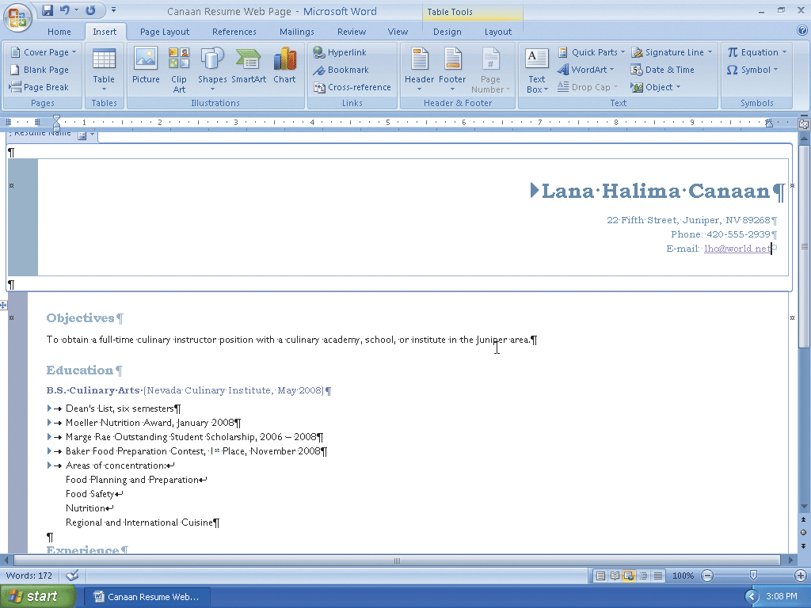
Formatting Text as a Hyperlink

Slide 10
Adding a Background Color
Display the Page Layout tab
Click the Page Color button on the Page Layout tab to display the Page Color gallery
Point to the sixth color in the second row (Ice Blue, Accent 2, Lighter 80%) to display a live preview of the background color
Click the sixth color in the second row to change the background color to a light shade of blue

Slide 11
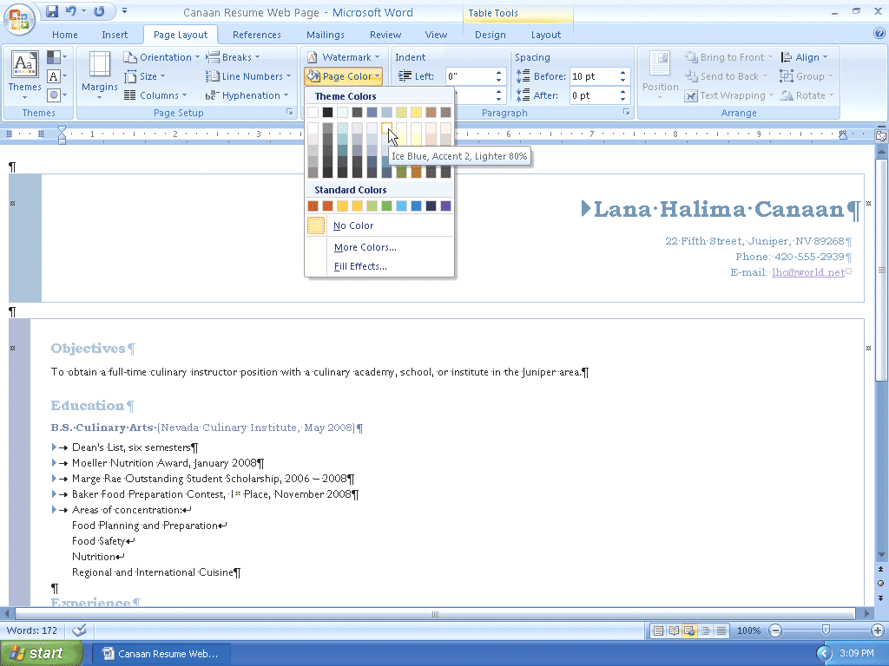
Adding a Background Color

Slide 12
Adding a Pattern Fill Effect to a Background
Click the Page Color button on the Page Layout tab to display the Page Color gallery again.
Click Fill Effects in the Page Color gallery to display the Fill Effects dialog box
Click the Pattern tab to display the Pattern sheet in the dialog box
Click the Outlined diamond pattern (rightmost pattern in the fifth row) to select it
Click the OK button to add the outlined diamond pattern to the blue background color

Slide 13
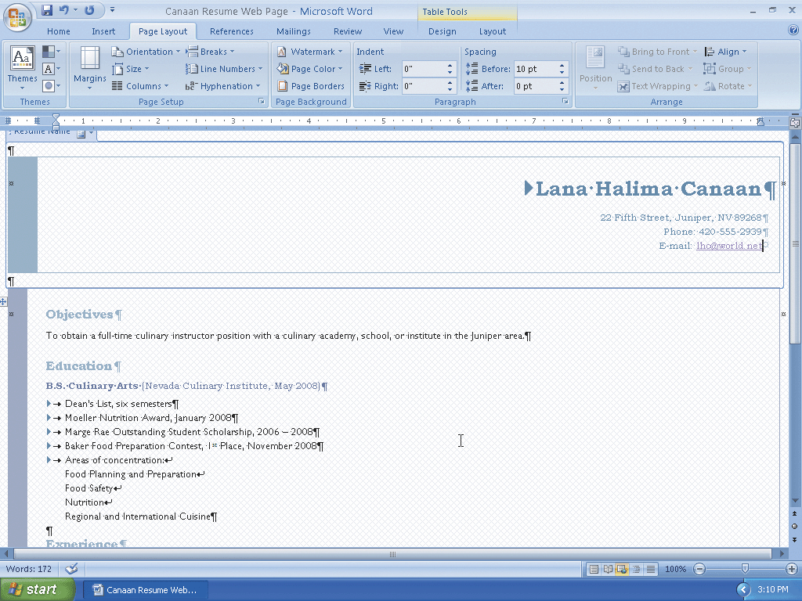
Adding a Pattern Fill Effect to a Background

Slide 14
Saving an Existing Document and Quitting Word
Click the Save button on the Quick Access Toolbar to overwrite the previous Canaan Resume Web Page file on the USB flash drive
Click the Close button on the right side of the title bar to quit Word

Slide 15
Testing the Web Page in a Web Browser
Click the Start button on the Windows taskbar to display the Start menu
Click My Computer on the Start menu to display the My Computer window
If necessary, maximize the My Computer window
Double-click the USB flash drive icon in the My Computer window to display the contents of the USB flash drive in an Explorer window

Slide 16
Testing the Web Page in a Web Browser
Double-click the file name, Canaan Resume Web Page, to start the Internet Explorer Web browser and display the file in the browser window (shown in Figure 1a on page WD 217)
With the Web page document displaying in the Web browser, click the e-mail address link to ensure it displays the e-mail window, as shown in Figure 1b on page WD 217
Close all open windows

Slide 17
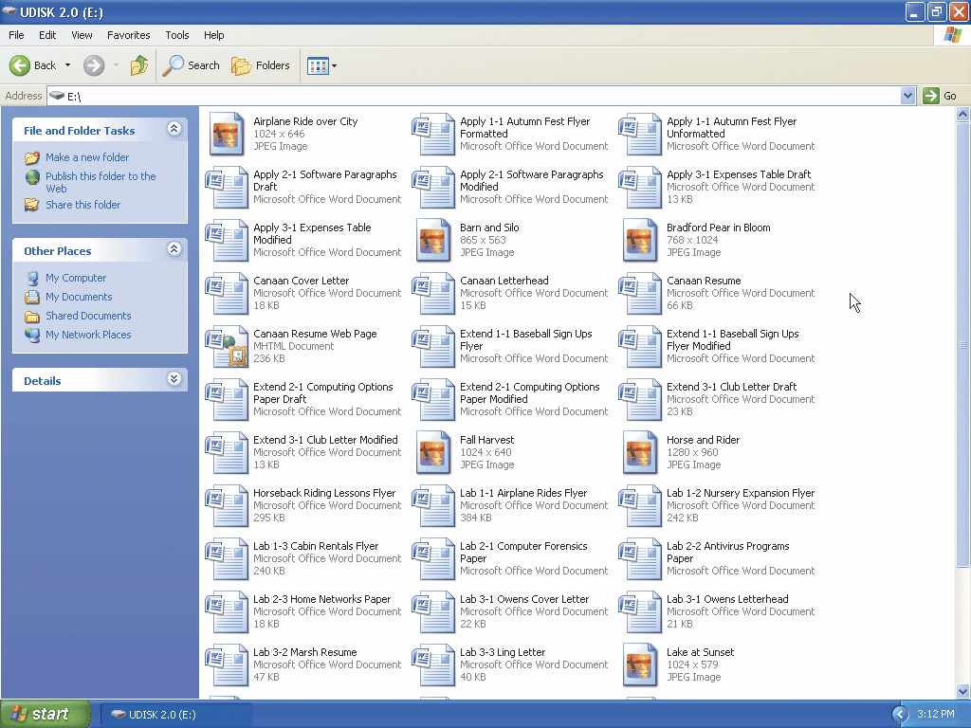
Testing the Web Page in a Web Browser

Slide 18
Summary
Saving a Word document as a Web page
Inserting a hyperlink
Adding a background color with a pattern
Using Windows Explorer to view a Web page

Slide 19
Word Web Feature Complete

