Slide 1
Word Chapter 3
Creating a Cover Letter
and a Resume

Slide 2
Objectives
Format characters and paragraphs
Insert and format clip art
Set and use tab stops
Identify the components of a business letter
Insert the current date
Create and insert a building block

Slide 3
Objectives
Insert a Word table, enter data in the table, and format the table
Use a template to create a document
Fill in a document template
Copy and paste using the Office Clipboard
Indent paragraphs

Slide 4
Objectives
Insert a Quick Part
Sort a List
Use print preview to view and print a document
Address and print an envelope

Slide 5
Plan Ahead
Design a creative letterhead
Compose an effective cover letter
Craft a successful resume

Slide 6
Starting Word and Displaying Formatting Marks
Start Word. If necessary, maximize the Word window
If the Print Layout button is not selected, click it so that your screen layout matches Figure 3–3 on the next slide
If your zoom level is not 100%, change it to 100%
If the Show/Hide ¶ button on the Home tab is not selected already, click it to display formatting marks on the screen

Slide 7
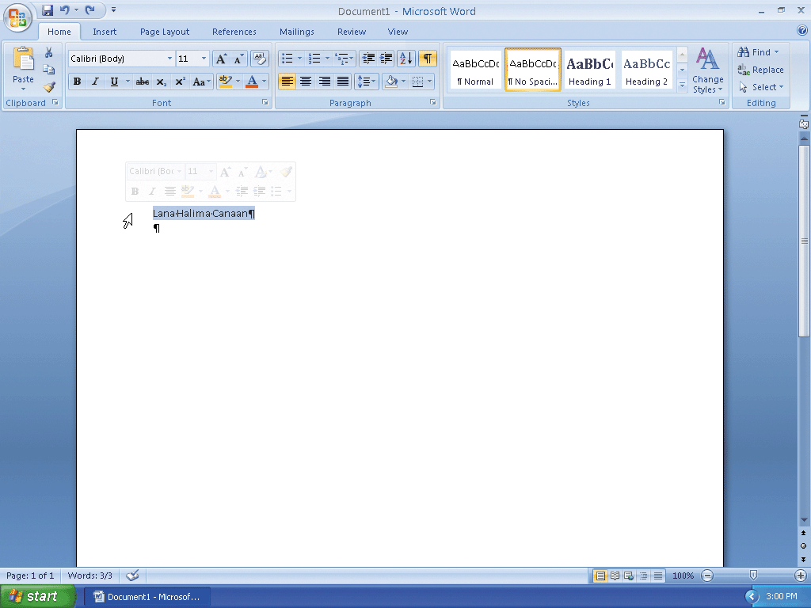
Starting Word and Displaying Formatting Marks

Slide 8
Applying a Quick Style
Click No Spacing in the Styles gallery to apply the No Spacing style to the current paragraph

Slide 9
Changing Theme Colors
Click the Change Styles button on the Home tab to display the Change Styles menu, and then point to Colors on the Change Styles menu to display the Colors gallery
Click Urban in the Colors gallery to change the document theme colors to Urban

Slide 10
Typing Text
Type Lana Halima Canaan and then press the ENTER key

Slide 11
Using the Grow Font Button to Increase Font Size
Move the mouse pointer to the left of the line to be selected (in this case, the line containing your name) until the mouse pointer changes to a right-pointing block arrow, and then click the mouse to select the line
Move the mouse pointer into the transparent Mini toolbar, so that it changes to a bright toolbar.
Repeatedly click the Grow Font button on the Mini toolbar until the Font Size box displays 20, for 20 point

Slide 12
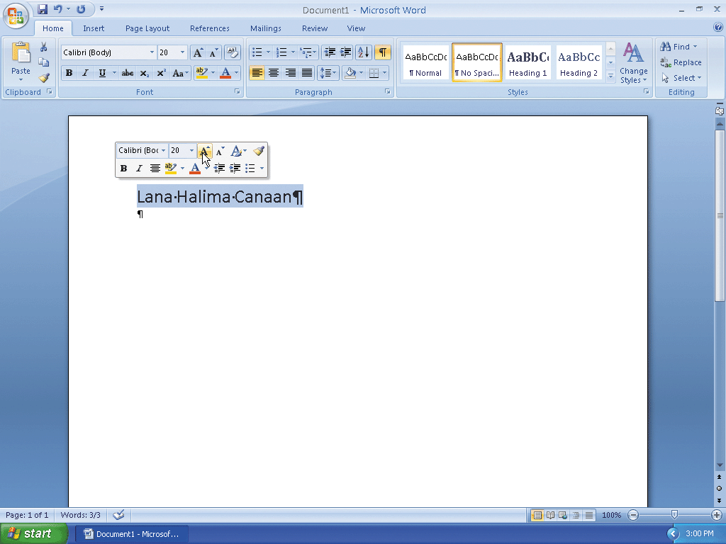
Using the Grow Font Button to Increase Font Size

Slide 13
Coloring Text
With the text still selected and the Mini toolbar still displaying, click the Font Color button arrow on the Mini toolbar to display the Font Color gallery
Click Teal, Accent 2, Darker 25%, which is the sixth color in the fifth row in the Theme Colors area, to change the color of the selected text to a shade of teal
Click the paragraph mark below the name to deselect the text and position the insertion point on line 2 of the document

Slide 14
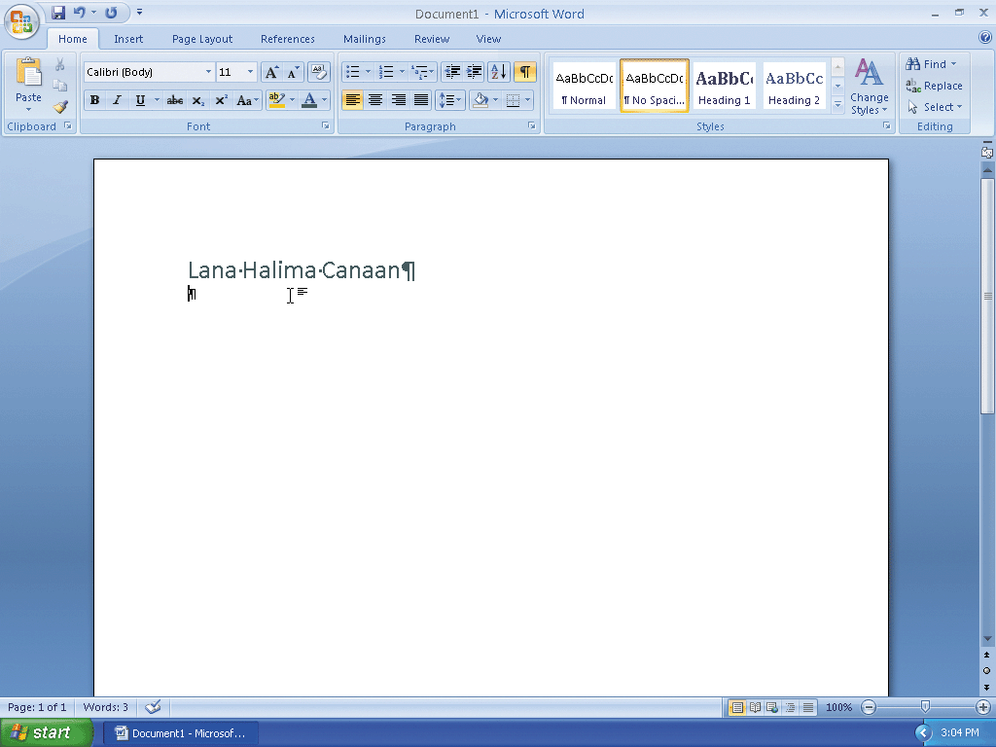
Coloring Text

Slide 15
Inserting Clip Art
With the insertion point on line 2 below the name, click Insert on the Ribbon to display the Insert tab
Click the Clip Art button on the Insert tab to display the Clip Art task pane
If the Search for text box displays text, drag through the text to select it.
Type teacher in the Search for text box
Click the Go button to display a list of clips that match the description, teacher

Slide 16
Inserting Clip Art
Click the clip art of the apple on the stack of books to insert it in the document at the location of the insertion point
Click the Close button on the Clip Art task pane title bar to close the task pane

Slide 17
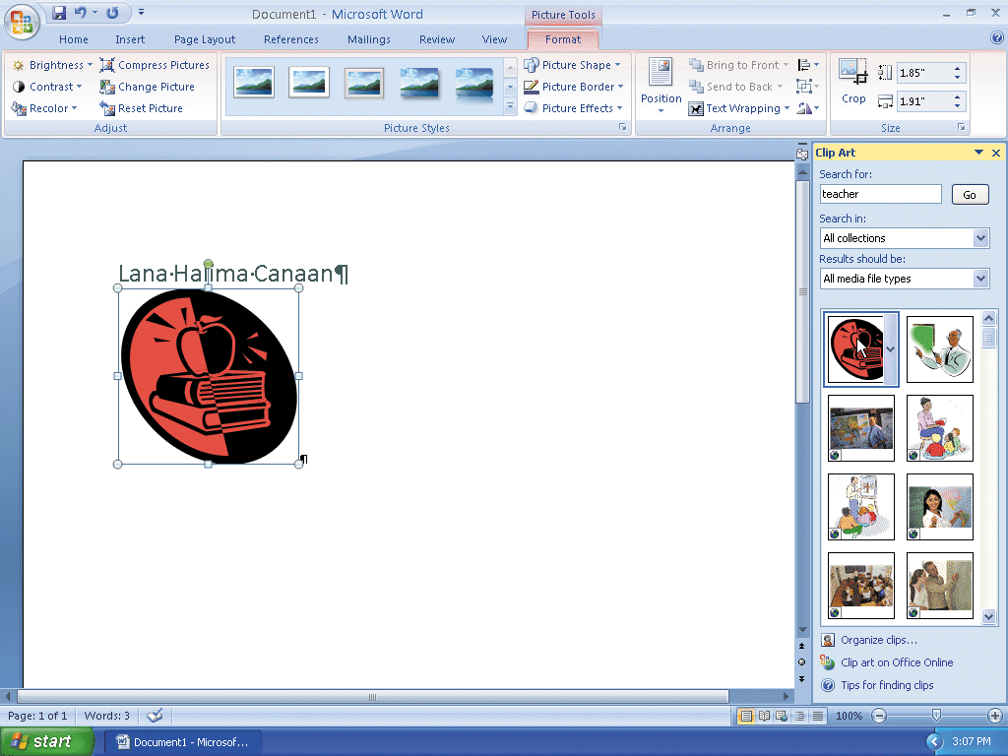
Inserting Clip Art

Slide 18
Resizing a Graphic Using the Size Dialog Box
With the graphic still selected, click the Size Dialog Box Launcher on the Format tab to display the Size dialog box
In the Scale area, triple-click the Height box to select it.
Type 35 and then press the TAB key to display 35% in the Height and Width boxes and resize the selected graphic to 35 percent of its original size
Click the Close button in the Size dialog box to close the dialog box

Slide 19
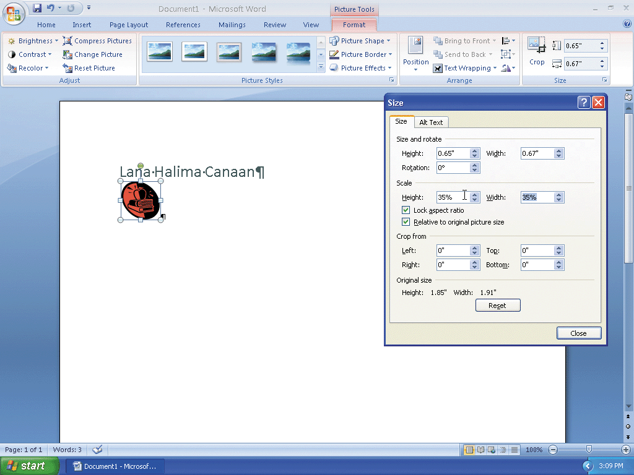
Resizing a Graphic Using the Size Dialog Box

Slide 20
Re-coloring a Graphic
With the graphic still selected, click the Recolor button on the Format tab to display the Recolor gallery
Click Accent color 2 Light in the Recolor gallery (third color in Light Variations area) to change the color of the selected graphic in the document window

Slide 21
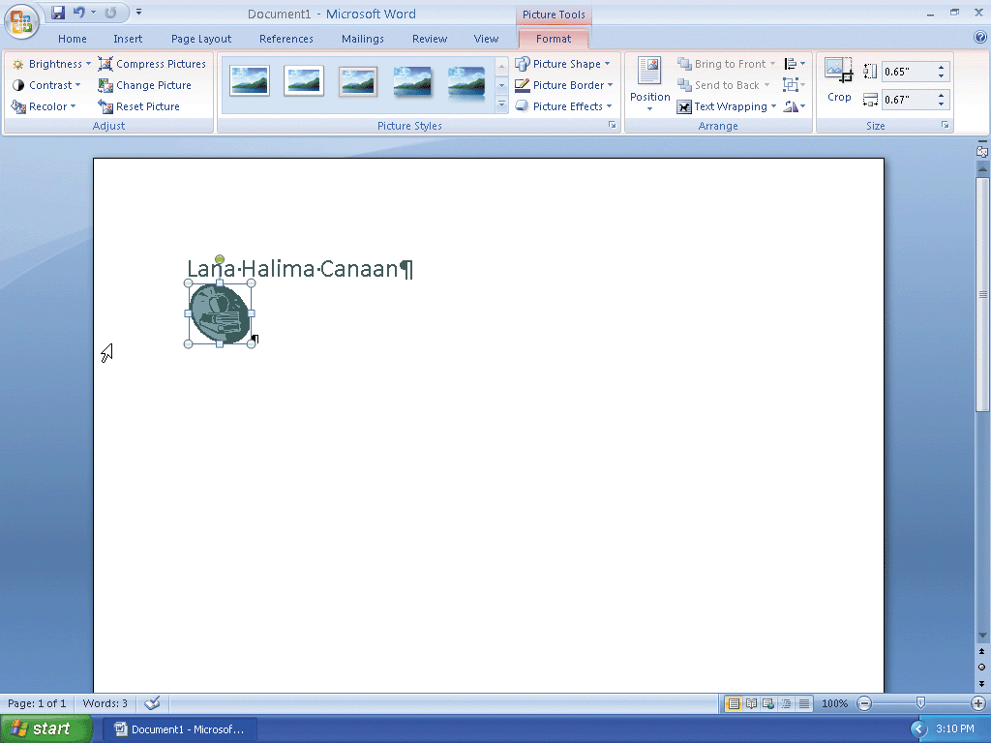
Re-coloring a Graphic

Slide 22
Setting a Transparent Color in a Graphic
With the graphic still selected, click the Recolor button on the Format tab to display the Recolor gallery
Click Set Transparent Color in the Recolor gallery to display a pen mouse pointer in the document window
Position the pen mouse pointer in the graphic where you want to make the color transparent
Click the location in the graphic where you want the color to be transparent
Press the END key to deselect the graphic and move the insertion point to the end of the line, which is between the graphic and the paragraph mark

Slide 23
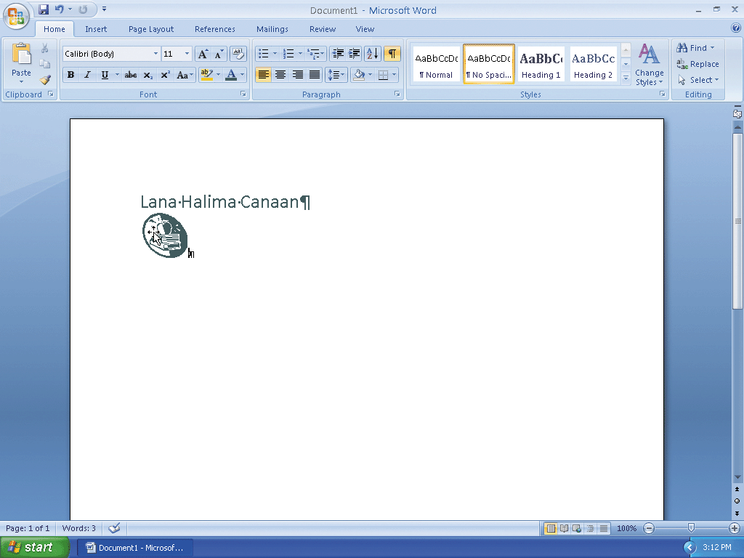
Setting a Transparent Color in a Graphic

Slide 24
Displaying the Ruler
If the rulers are not displayed already, click the View Ruler button on the vertical scroll bar

Slide 25
Setting Custom Tab Stops Using the Tabs Dialog Box
With the insertion point positioned between the paragraph mark and the graphic, click the Paragraph Dialog Box Launcher to display the Paragraph dialog box
Click the Tabs button in the Paragraph dialog box to display the Tabs dialog box
Type 6.5 in the Tab stop position text box
Click Right in the Alignment area to specify alignment for text at the tab stop clicking Clear All button erases all custom tab stops Tabs dialog box Tab stop position text box Right option button selected Set button OK button
Click the Set button in the Tabs dialog box to set a right-aligned custom tab stop
Click the OK button to place a right tab marker at the 6.5" mark on the ruler

Slide 26
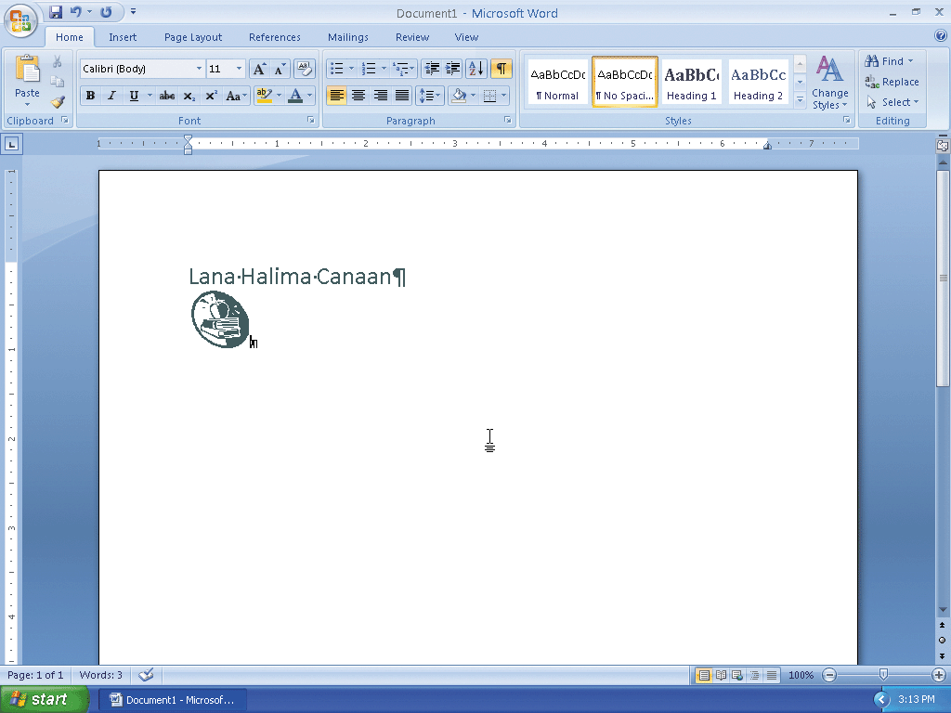
Setting Custom Tab Stops Using the Tabs Dialog Box

Slide 27
Specifying Font Color before Typing
Click the Font Color button on the Home tab so that the text you type will be the color displayed on the face of the button
With the insertion point positioned between the graphic and the paragraph mark, press the TAB key to move the insertion point to the 6.5" mark on the ruler
Type 22 Fifth Street, Juniper, NV 89268 * Phone: 420-555-2939 * E-mail: lhc@world.net in the letterhead

Slide 28
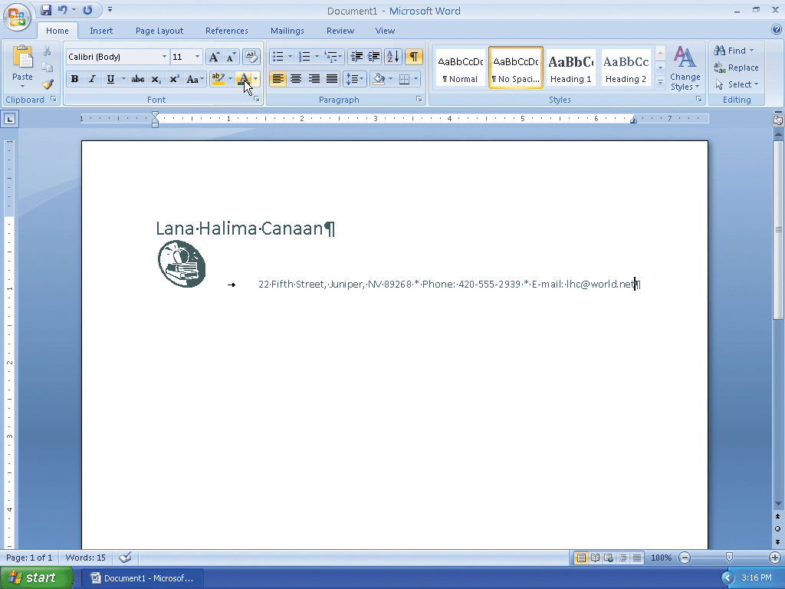
Specifying Font Color before Typing

Slide 29
Bottom Bordering a Paragraph
With the insertion point in the paragraph to border, click the Border button arrow on the Home tab to display the Border gallery
Click Bottom Border in the Border gallery to place a border below the paragraph containing the insertion point

Slide 30

Bottom Bordering a Paragraph

Slide 31
Clear Formatting
With the insertion point between the e-mail address and paragraph mark press the ENTER key
Click the Clear Formatting button on the Home tab to apply the Normal style to the location of the insertion point

Slide 32
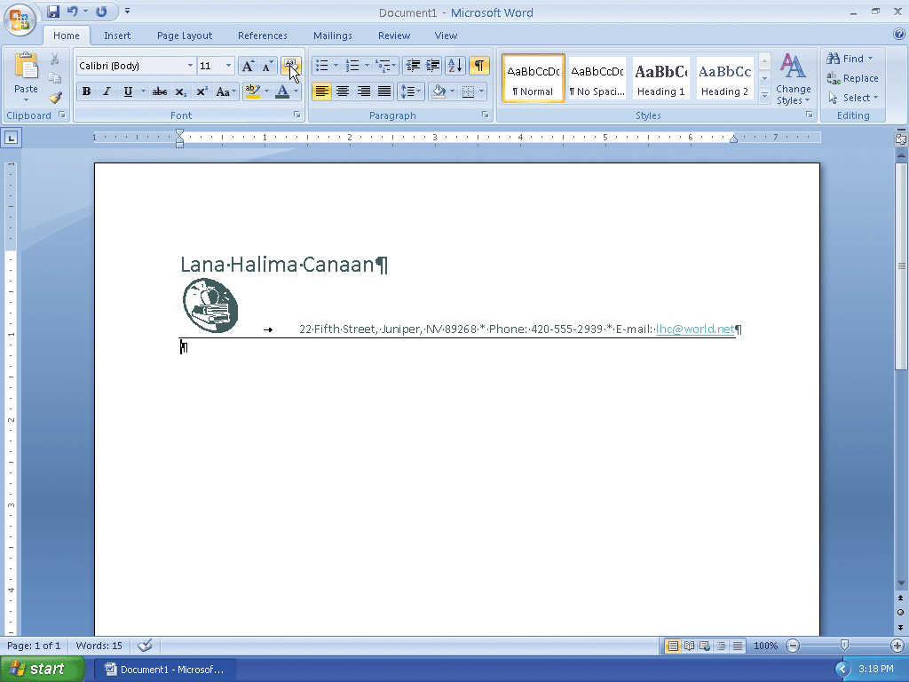
Clear Formatting

Slide 33
Converting a Hyperlink to Regular Text
Right-click the hyperlink (in this case, the e-mail address) to display the Mini toolbar and a shortcut menu
Click Remove Hyperlink on the shortcut menu to remove the hyperlink format from the e-mail address
Position the insertion point on the paragraph mark below the border

Slide 34

Converting a Hyperlink to Regular Text

Slide 35
Saving the Letterhead
With a USB flash drive connected to one of the computer’s USB ports, click the Save button on the Quick Access Toolbar to display the Save As dialog box
Type Canaan Letterhead in the File name text box to change the file name
Click the Save in box arrow and select the USB flash drive as the new save location
Click the Save button in the Save As dialog box to save the document on the USB flash drive with the file name, Canaan Letterhead

Slide 36
Saving the Document with a New File Name
With a USB flash drive connected to one of the computer’s USB ports, click the Office
Button to display the Office Button menu and then click Save As on the Office Button menu to display the Save As dialog box
Type Canaan Cover Letter in the File name text box to change the file name
If necessary, click the Save in box arrow and then select the USB flash drive as the new save location
Click the Save button in the Save As dialog box to save the document on the USB flash drive with the file name, Canaan Cover Letter

Slide 37
Applying a Quick Style
Click No Spacing in the Styles gallery to apply the No Spacing style to the current paragraph

Slide 38
Setting the Custom Tab Stops Using the Ruler
With the insertion point on the paragraph mark below the border, press the ENTER key so that a blank line appears between the letterhead and the date line
If necessary, click the tab selector at the left edge of the horizontal ruler until it displays the Left Tab icon
Position the mouse pointer on the 3.5" mark on the ruler
Click the 3.5" mark on the ruler to place a left tab marker at that location on the ruler

Slide 39
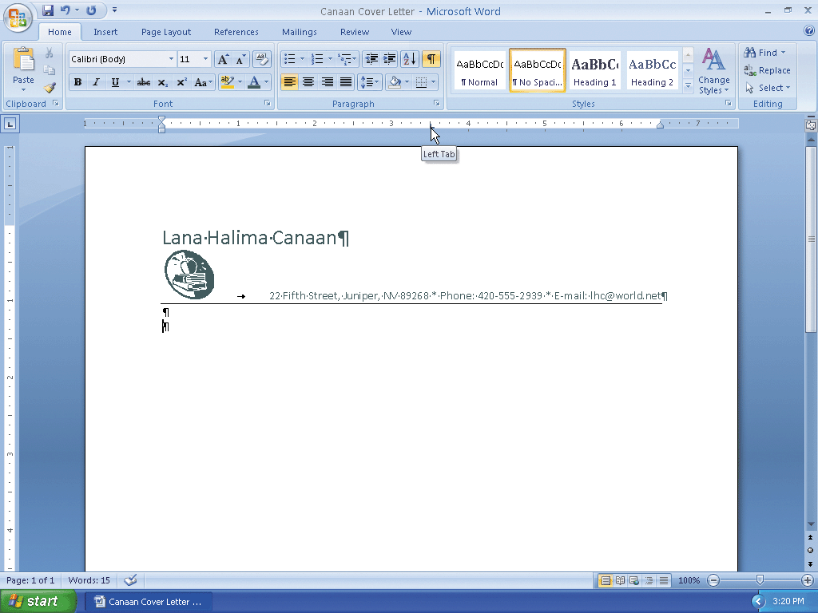
Setting the Custom Tab Stops Using the Ruler

Slide 40
Inserting the Current Date in a Document
Press the TAB key
Click Insert on the Ribbon to display the Insert tab
Click the Insert Date and Time button on the Insert tab to display the Date and Time dialog box
Click the desired format (in this case, May 12, 2008) in the dialog box
If the Update automatically check box is selected, click the check box to remove the check mark
Click the OK button to insert the current date at the location of the insertion point

Slide 41
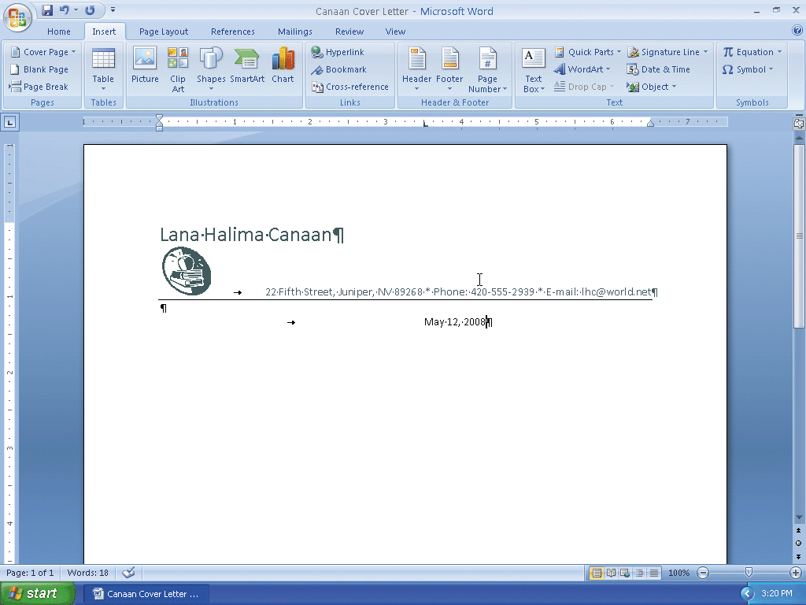
Inserting the Current Date in a Document

Slide 42
Entering the Inside Address and Salutation
With the insertion point at the end of the date, press the ENTER key three times
Type Mr. Raul Ramos and then press the ENTER key
Type Personnel Director and then press the ENTER key
Type Juniper Culinary Academy and then press the ENTER key
Type 202 Park Boulevard and then press the ENTER key
Type Juniper, NV 89268 and then press the ENTER key twice
Type Dear Mr. Ramos and then press the COLON key (:) to complete the entries of the inside address and salutation

Slide 43
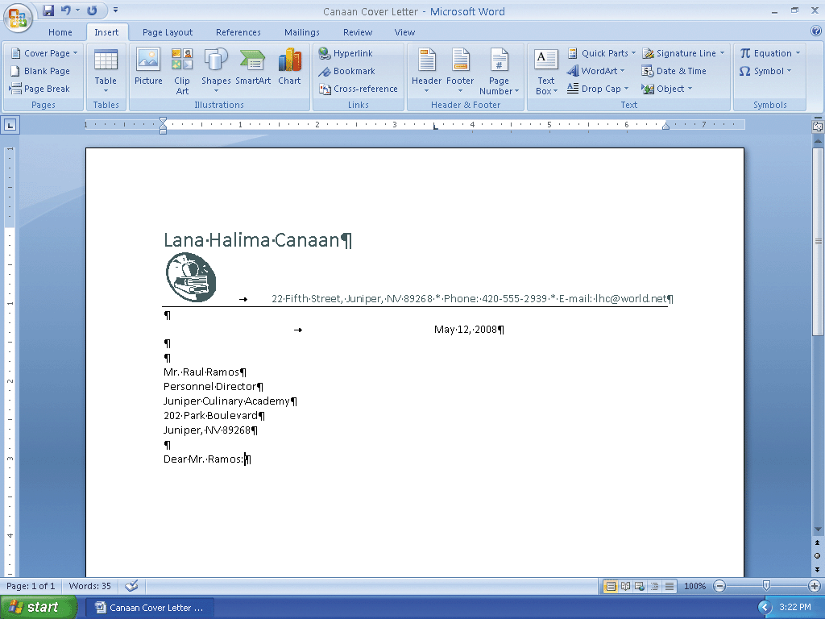
Entering the Inside Address and Salutation

Slide 44
Creating a Building Block
Select the text to be a building block, in this case, Juniper Culinary Academy. Do not select the paragraph mark at the end of the text
Click the Quick Parts button on the Insert tab to display the Quick Parts menu
Click Save Selection to Quick Part Gallery on the Quick Parts menu to display the Create New Building Block dialog box
Type jca in the Name text box to replace the proposed building block name (Juniper Culinary) with a shorter building block name
Click the OK button to store the building block entry and close the dialog box.
If Word displays another dialog box, click the Yes button

Slide 45
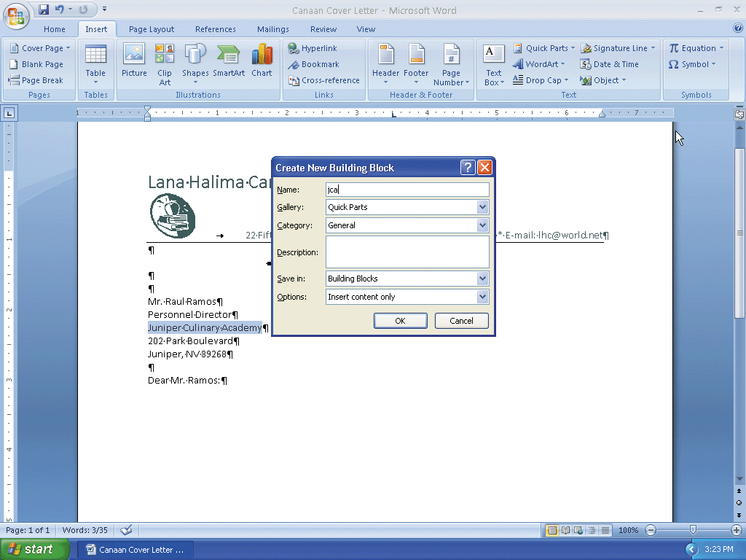
Creating a Building Block

Slide 46
Inserting a Nonbreaking Space
Click to the right of the colon in the salutation and then press the ENTER key twice to position the insertion point one blank line below the salutation
Type I am responding to the junior culinary instructor position that you recently advertised in the and then press the SPACEBAR
Press CTRL+I to turn on italics. Type Juniper as the first word in the newspaper name and then press CTRL+SHIFT+SPACEBAR to insert a nonbreaking space after the word, Juniper

Slide 47
Inserting a Nonbreaking Space
Type Daily and then press CTRL+SHIFT+SPACEBAR to insert another nonbreaking space after the word, Daily
Type Herald and then press CTRL+I to turn off italics. Press the PERIOD key

Slide 48
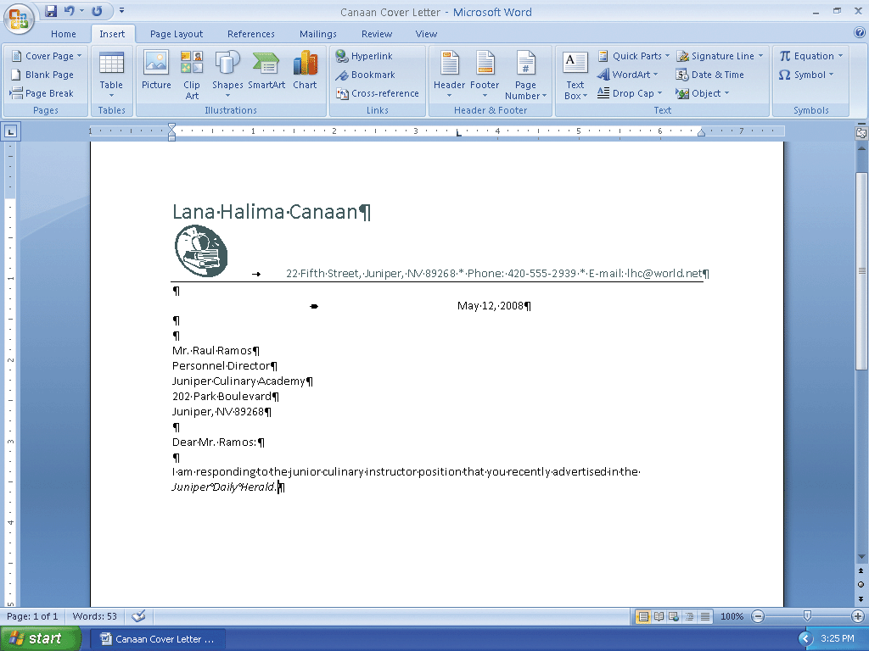
Inserting a Nonbreaking Space

Slide 49
Inserting a Building Block
Press the SPACEBAR. Type As indicated on the enclosed resume, I have the credentials you are seeking and believe I can be a valuable asset to jca
Press the F3 key to instruct word to replace the building block name (jca) with the stored building block entry (Juniper Culinary Academy)
Press the PERIOD key

Slide 50
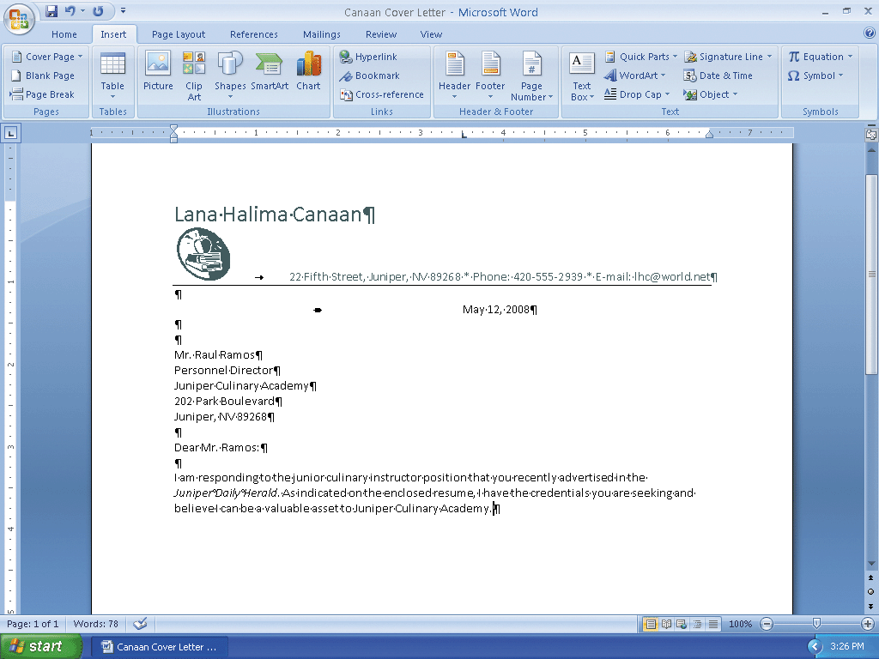
Inserting a Building Block

Slide 51
Entering a Paragraph
Press the ENTER key twice to place a blank line between paragraphs, according to the guidelines of the modified block letter style
Type I recently received my bachelor’s degree in culinary arts from Nevada Culinary Institute. The following table outlines my areas of concentration:
Press the ENTER key twice

Slide 52
Inserting an Empty Table
Click the Table button on the Insert tab to display the Table gallery
Position the mouse pointer on the cell in the first row and second column of the grid to preview the desired table dimension
Click the cell in the first row and second column of the grid to insert an empty table with one row and two columns in the document

Slide 53
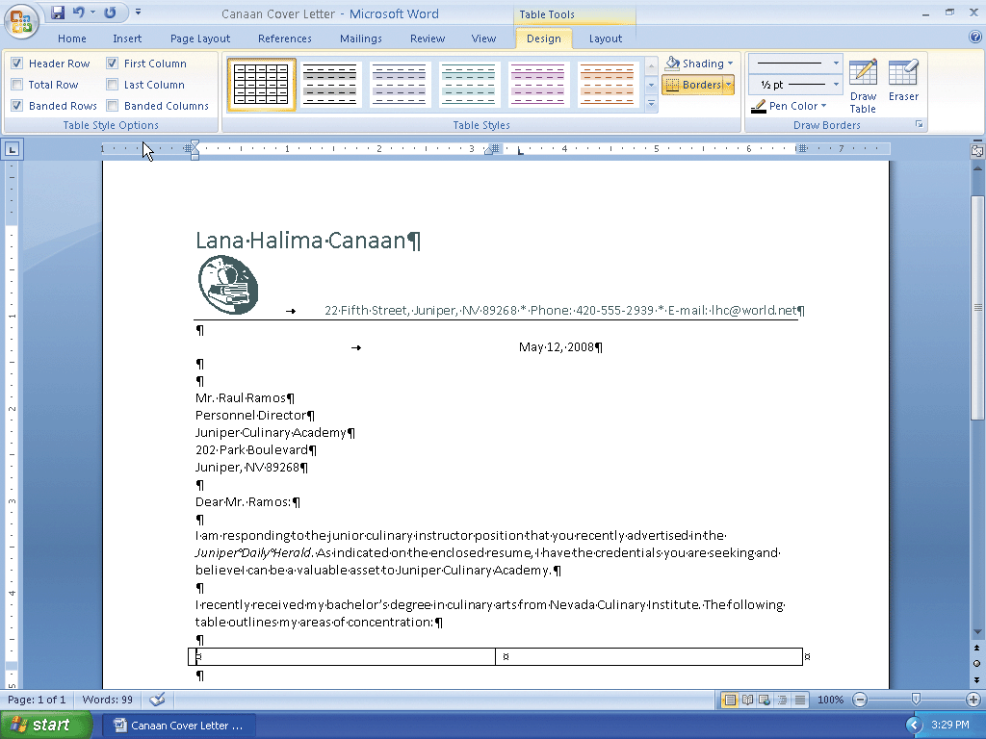
Inserting an Empty Table

Slide 54
Entering Data in a Table
If necessary, scroll the table up in the document window
With the insertion point in the left cell of the table, type Food Planning and Preparation and then press the TAB key to advance the insertion point to the next cell
Type 30 hours and then press the TAB key to add a second row to the table and position the insertion point in the first column of that row

Slide 55
Entering Data in a Table
Type Food Safety and then press the TAB key. Type 15 hours and then press the TAB key
Type Nutrition and then press the TAB key. Type 15 hours and then press the TAB key
Type Regional and International Cuisine and then press the TAB key. Type 21 hours to complete the entries in the table

Slide 56
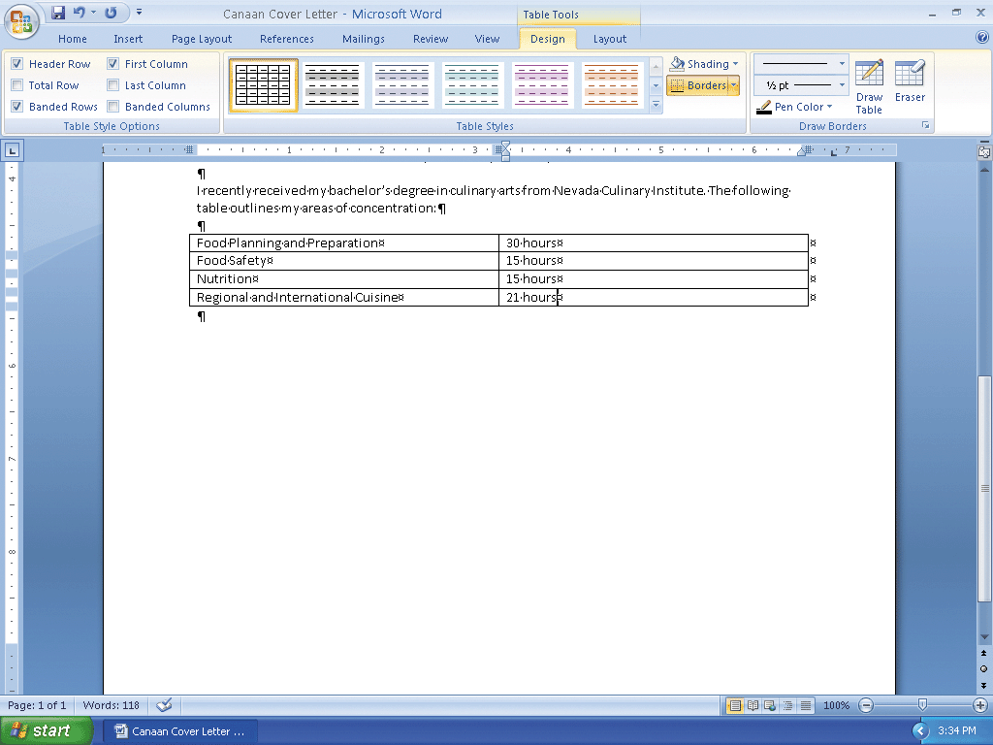
Entering Data in a Table

Slide 57
Applying a Table Style
With the insertion point in the table, remove the check marks from the Header Row and Banded Rows check boxes in the Design tab so that all rows in the table will be formatted the same
Click the More button in the Table Styles gallery to expand the Table Styles gallery
Scroll and then point to Medium Grid 3 - Accent 2 in the Table Styles gallery to display a live preview of that style applied to the table in the document
Click Medium Grid3 - Accent 2 in the Table Styles gallery to apply the selected style to the table

Slide 58
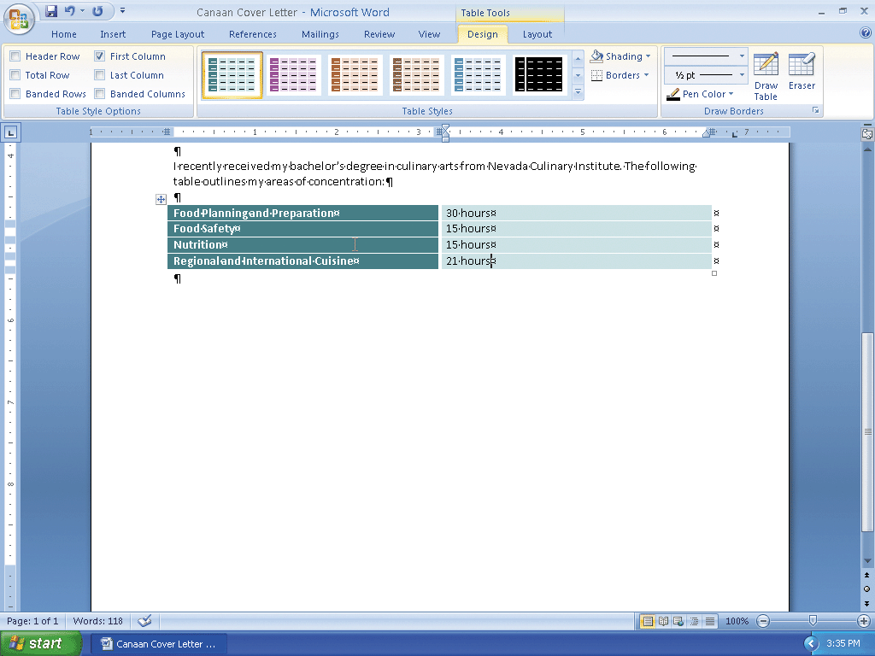
Applying a Table Style

Slide 59
Resizing Table Columns to Fit Table Contents
With the insertion point in the table, click Layout on the Ribbon to display the Layout tab
Click the AutoFit button and then point to AutoFit Contents on the AutoFit menu
Click AutoFit Contents on the AutoFit menu, so that Word automatically adjusts the widths of the columns based on the text in the table

Slide 60
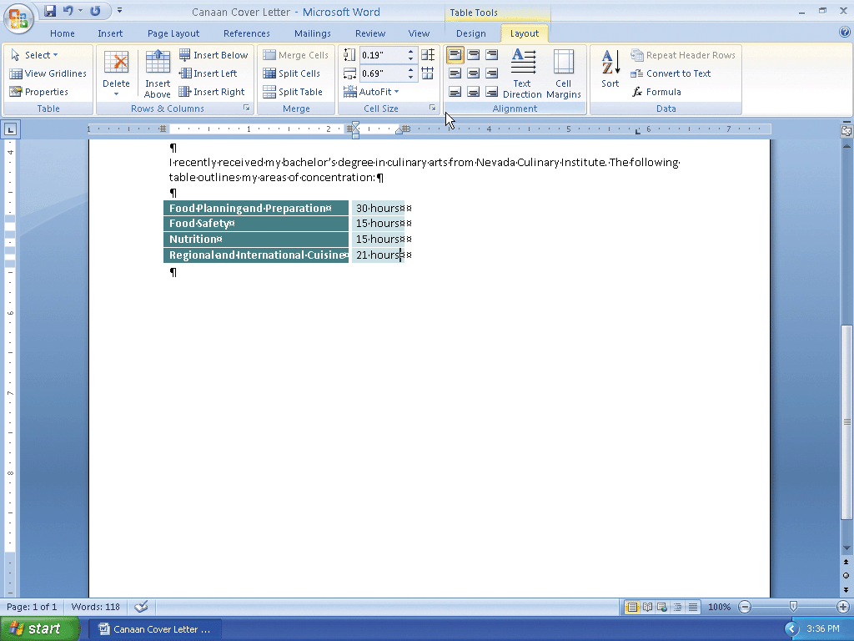
Resizing Table Columns to Fit Table Contents

Slide 61
Selecting a Table
Position the mouse pointer in the table so that the table move handle appears
Click the table move handle to select the entire table

Slide 62
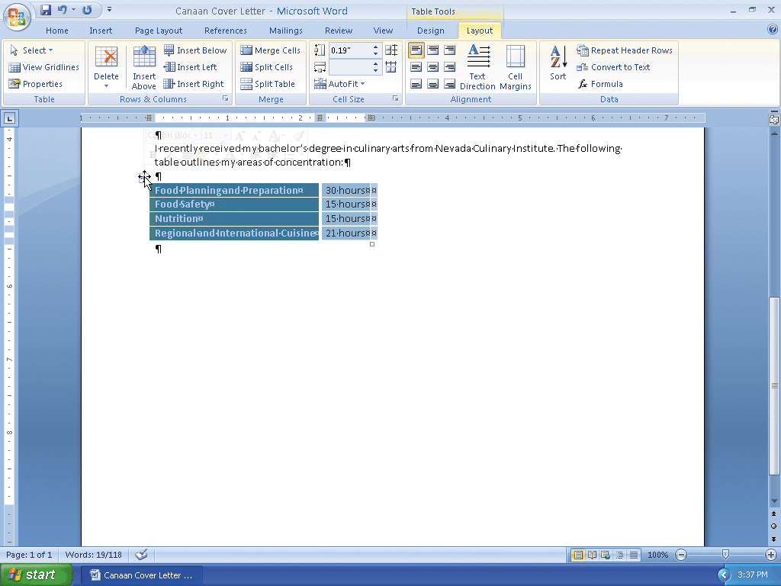
Selecting a Table

Slide 63
Centering a Selected Table
Move the mouse pointer into the Mini toolbar, so that the toolbar changes to a bright toolbar
Click the Center button on the Mini toolbar to center the selected table between the left and right margins

Slide 64
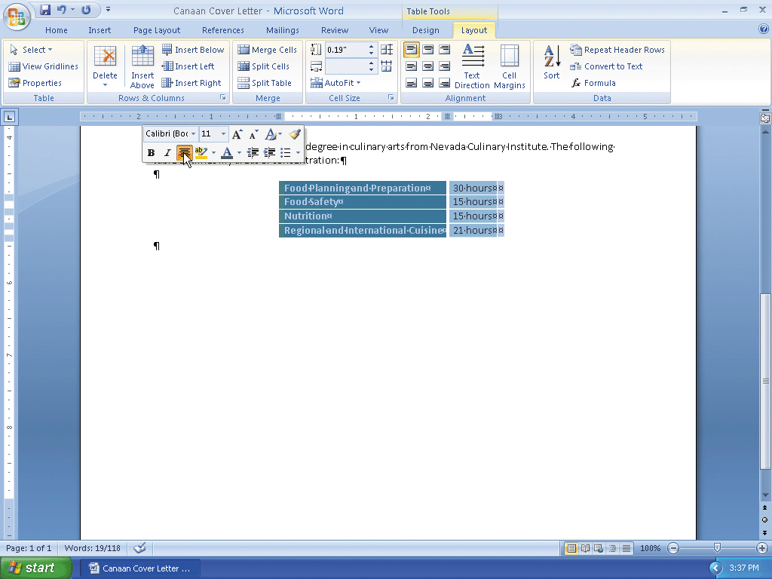
Centering a Selected Table

Slide 65
Adding More Text
Position the insertion point on the paragraph mark below the table and then press the ENTER key
Type In addition to my coursework, I have the following culinary experience: and then press the ENTER key

Slide 66
Bulleting a List as you Type
Press the ASTERISK key (*) as the first character on the line
Press the SPACEBAR to convert the asterisk to a bullet character
Type Assist with food preparation at my family's local pastry, bread, and bakery business as the first bulleted item
Press the ENTER key to place another bullet character at the beginning of the next line

Slide 67
Bulleting a List as you Type
Type Prepare food and serve meals at Hope Mission and then press the ENTER key
Type Assisted the chef with meal preparation and presentation during internship at The Garden Grill and then press the ENTER key
Type Prepared salads, soups, sandwiches, entrees, and desserts while working at the school cafeteria and then press the ENTER key
Press the ENTER key to turn off automatic bullets as you type

Slide 68
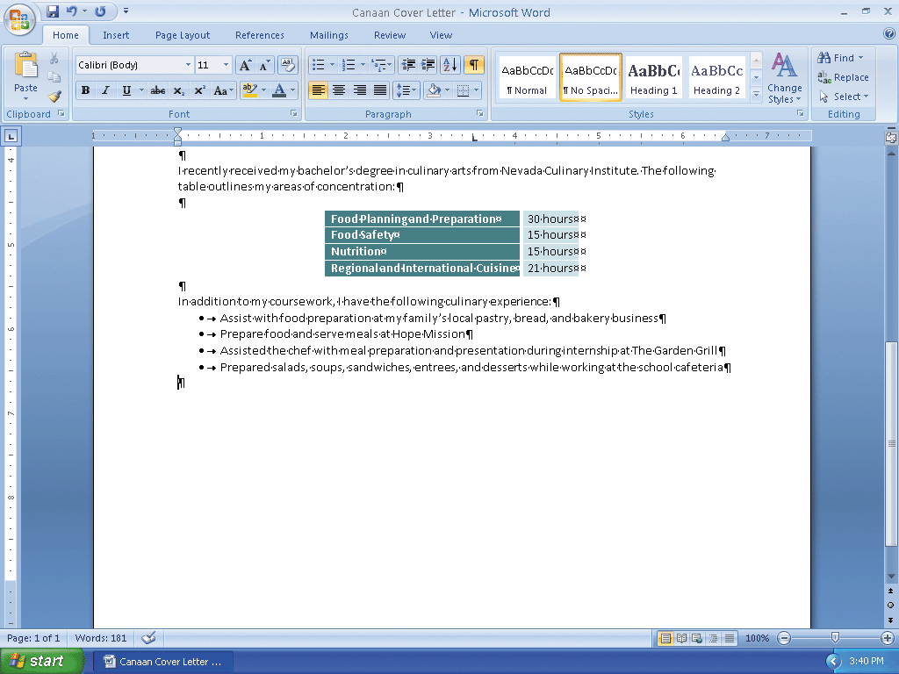
Bulleting a List as you Type

Slide 69
Entering the Remainder of the Cover Letter
Press the ENTER key and then type the paragraph shown in Figure 3–51, making certain you use the building block name, jca, to insert the employer name
Press the ENTER key twice. Press the TAB key. Type Sincerely and then press the COMMA key
Press the ENTER key four times. Press the TAB key. Type Lana Halima Canaan and then press the ENTER key twice. Type Enclosure as the final text in the cover letter

Slide 70
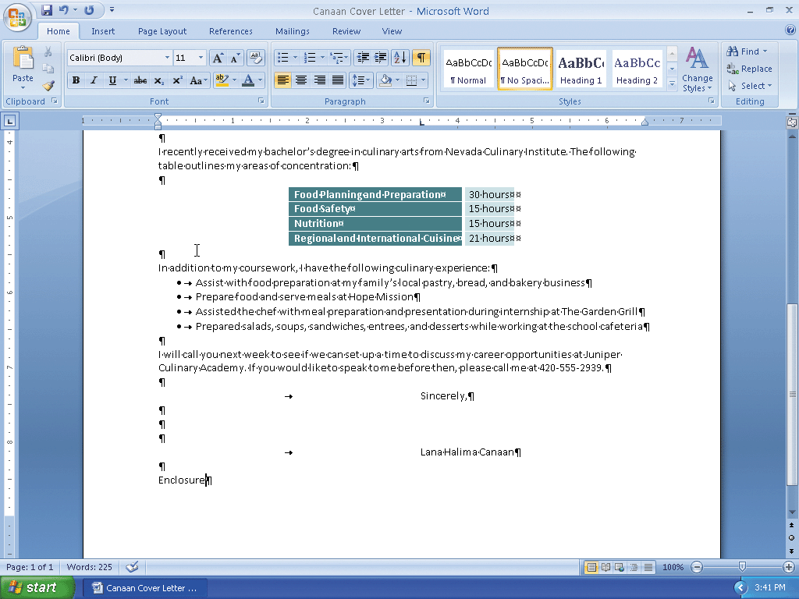
Entering the Remainder of the Cover Letter

Slide 71
Changing Document Properties
Display the Office Button menu, point to Prepare on the Office Button menu, and then click Properties on the Prepare submenu to display the Document Information Panel
Click the Author text box, if necessary, and then type your name as the Author property. If a name already is displayed in the Author text box, delete it before typing your name. Click the Subject text box, if necessary delete any existing text, and then type your course and section as the Subject property. Click the Keywords text box, if necessary delete any existing text, and then type cover letter as the Keywords property
Close the Document Information Panel

Slide 72
Saving an Existing Document and Printing it
Click the Save button on the Quick Access Toolbar to overwrite the previous Canaan Cover Letter file on the USB flash drive
Display the Office Button menu, point to Print, and then click Quick Print to print the cover letter

Slide 73
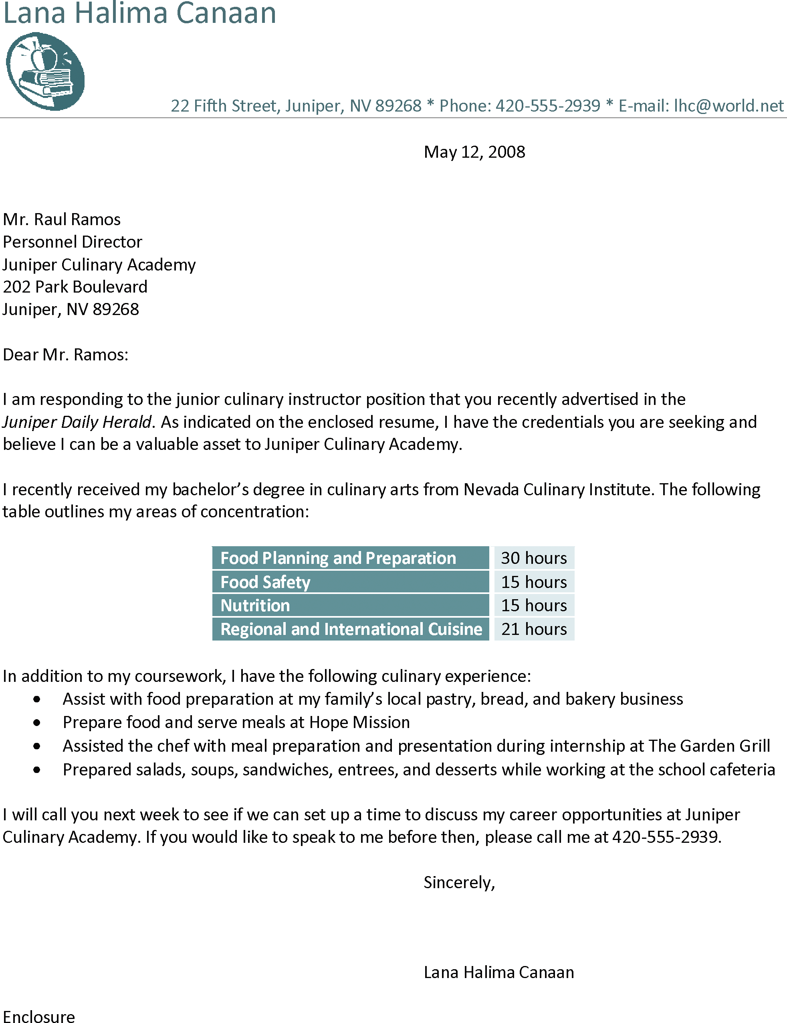
Saving an Existing Document and Printing it

Slide 74
Using a Template
Display the Office Button menu
Click New on the Office Button menu to display the New Document dialog box
Click Installed Templates in the Templates area to display the list of templates on the hard disk
Scroll through the Installed Templates list and then click Origin Resume to select it
Click the Create button to create a new document based on the selected template

Slide 75
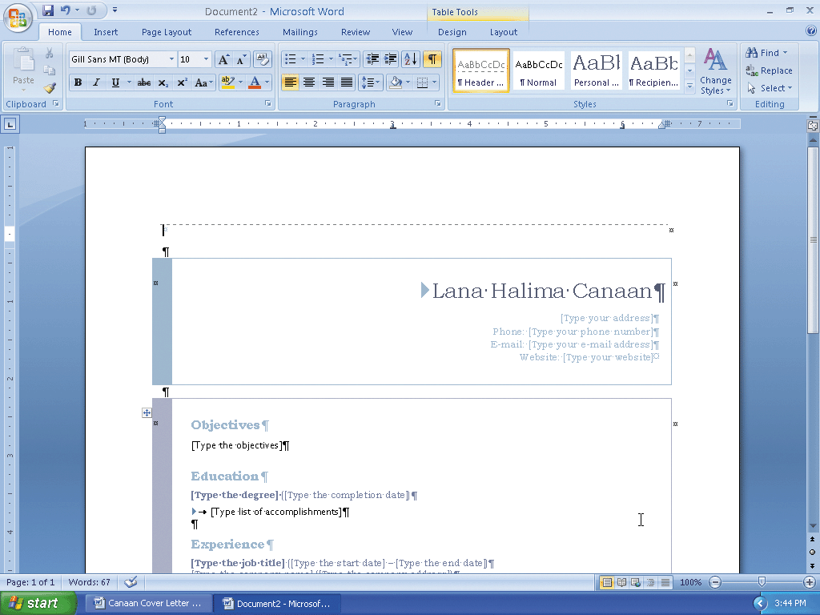
Using a Template

Slide 76
Printing the Resume
Ready the printer. Display the Office Button menu, point to Print, and then click Quick Print to print the resume created from the template

Slide 77
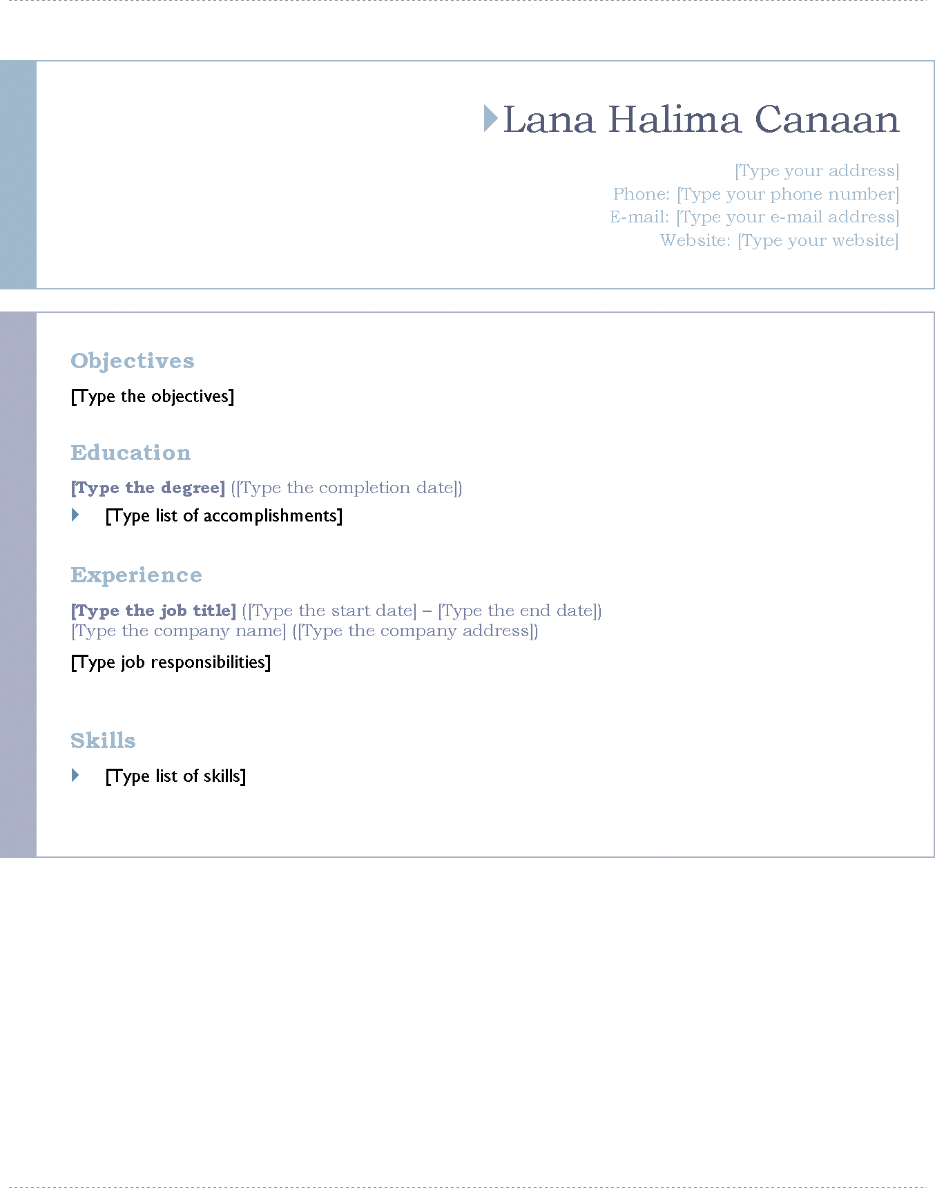
Printing the Resume

Slide 78
Deleting Rows
With the insertion point at the top of the document, click Layout on the Ribbon to display the Layout tab
Click the Delete button on the Layout tab to display the Delete menu
Click Delete Rows on the Delete menu to delete the row containing the insertion point

Slide 79
Deleting Rows
Press CTRL+END and then press the DOWN ARROW key to position the insertion point at the bottom of the document in the last row
Click Layout on the Ribbon to display the Layout tab
Click the Delete button on the Layout tab to display the Delete menu. Delete button Delete menu
Click Delete Rows on the Delete menu to delete the row containing the insertion point

Slide 80
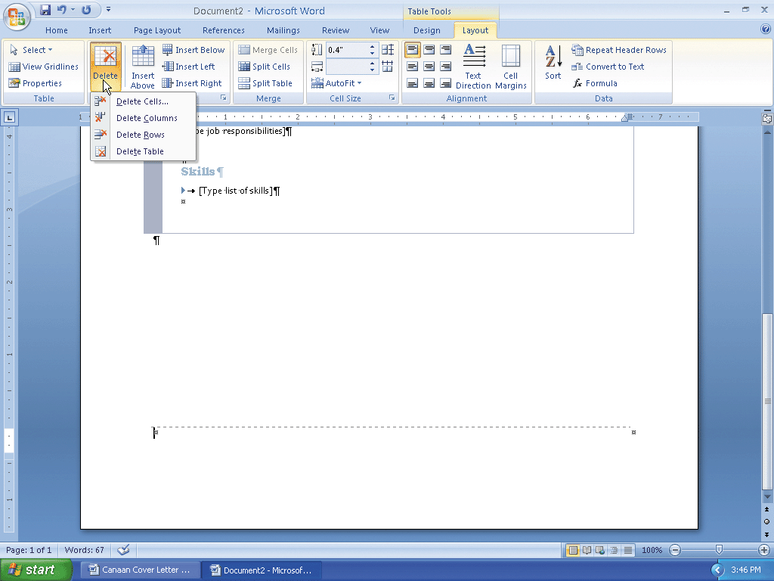
Deleting Rows

Slide 81
Modifying Text in a Content Control
Press CTRL+HOME to position the insertion point at the top of the document
Click the name content control to select it (if it already contains a name, instead of the instruction, Type name here, drag through the name to select it). Then, type Lana Halima Canaan as the name
Triple-click the name content control to select its contents, so that you can format the name

Slide 82
Modifying Text in a Content Control
Move the mouse pointer into the transparent Mini toolbar, so that it changes to a bright toolbar
Click the Bold button on the Mini toolbar to bold the selected name
Click the Font Color button on the Mini toolbar to change the font color of the selected name to the most recently used font color, which was the color of the name in the cover letter

Slide 83
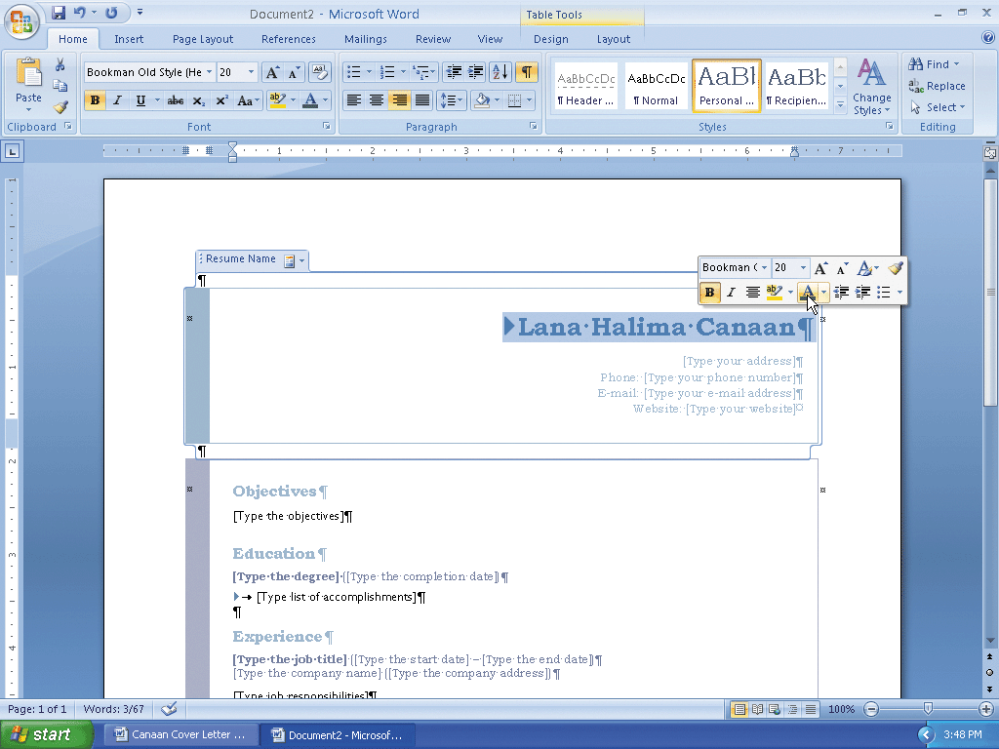
Modifying Text in a Content Control

Slide 84
Saving the Resume
Display the Office Button menu and then click Save As to display the Save As dialog box
Save the file on your USB flash drive using Canaan Resume as the file name

Slide 85
Switching from One Open Document to Another
Click the Canaan Cover Letter - Microsoft Word program button on the Windows taskbar to switch from the resume document to the cover letter document

Slide 86
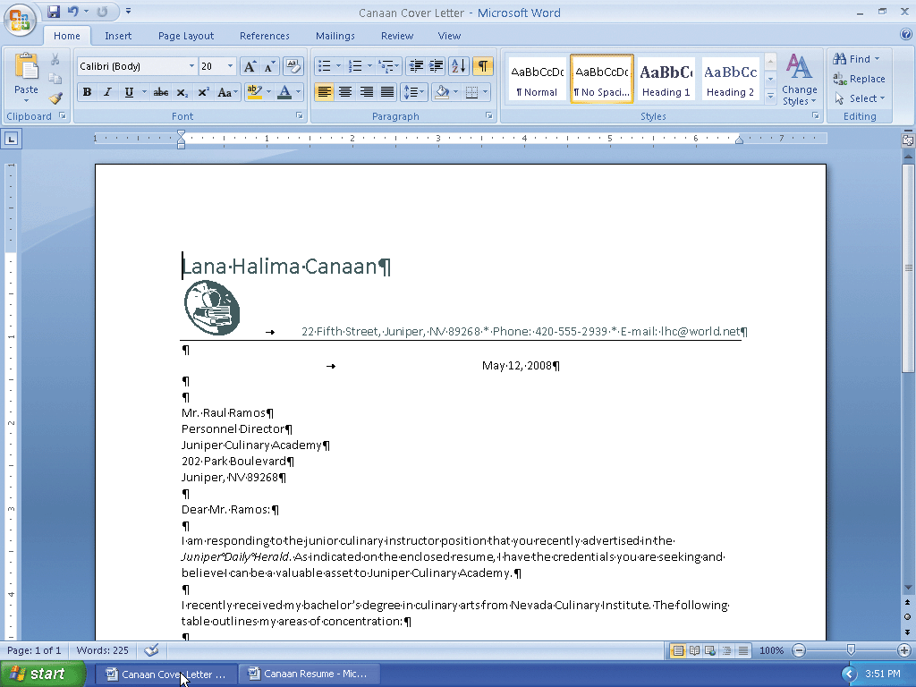
Switching from One Open Document to Another

Slide 87
Copying Items to the Office Clipboard
If necessary, scroll to the top of the cover letter, so that the items to be copied are visible in the document window
Click the Clipboard Dialog Box Launcher on the Home tab to display the Clipboard task pane
If the Office Clipboard in the Clipboard task pane is not empty, click the Clear All button in the Clipboard task pane

Slide 88
Copying Items to the Office Clipboard
In the cover letter, select the address, 22 Fifth Street, Juniper, NV 89268, which I the first item to be copied. Do not include the spaces to the right and left of the address
Click the Copy button on the Home tab to copy the selection to the Office Clipboard
Select the phone number (just the number, not the word Phone: and no spaces before or after the number) and then click the Copy button on the Home tab to copy the selection to the Office Clipboard
Select the e-mail address (just the e-mail address, not the word E-mail: and no spaces before or after the address) and then click the Copy button on the Home tab to copy the selection to the Office Clipboard

Slide 89
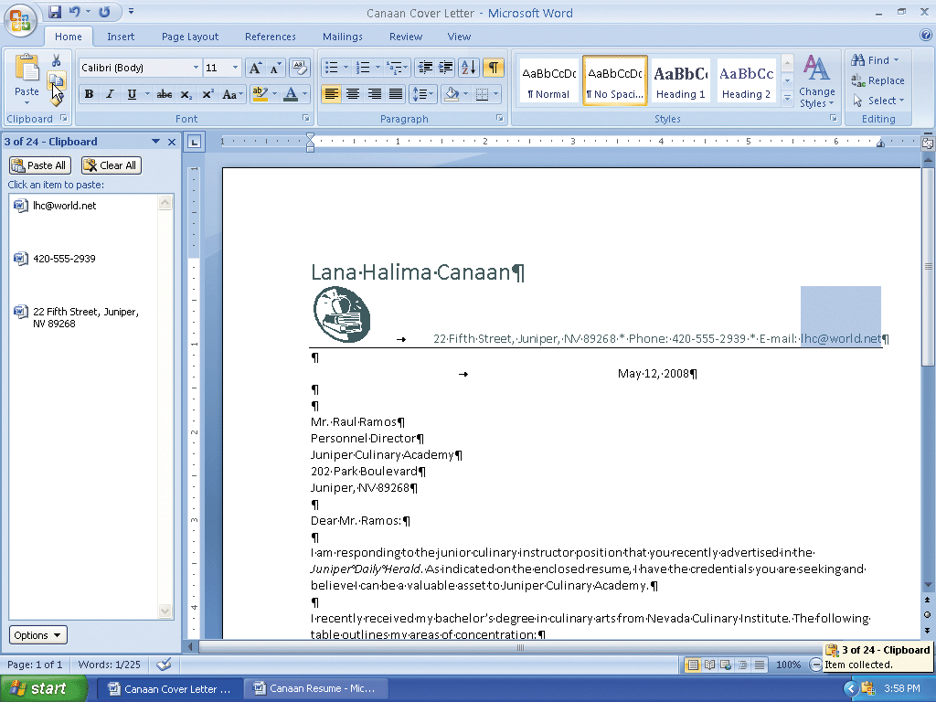
Copying Items to the Office Clipboard

Slide 90
Pasting from the Office Clipboard
Click the Canaan Resume - Microsoft Word program button on the Windows taskbar to display the resume document
If the Clipboard task pane is not displayed on the screen, click the Clipboard Dialog Box Launcher on the Home tab to display the Clipboard task pane
Click the content control in the resume with the instruction, Type your address, to select it

Slide 91
Pasting from the Office Clipboard
Click the address entry in the Office Clipboard to paste it in the document at the location of the selected content control
Click the content control in the resume with the instruction, Type your phone number, to select it
Click the phone entry in the Office Clipboard to paste it in the document at the location of the selected content control
Click the content control in the resume with the instruction, Type your e-mail address, to select it
Click the e-mail entry in the Office Clipboard to paste it in the document at the location of the selected content control
Click the Close button on the Clipboard task pane title bar

Slide 92
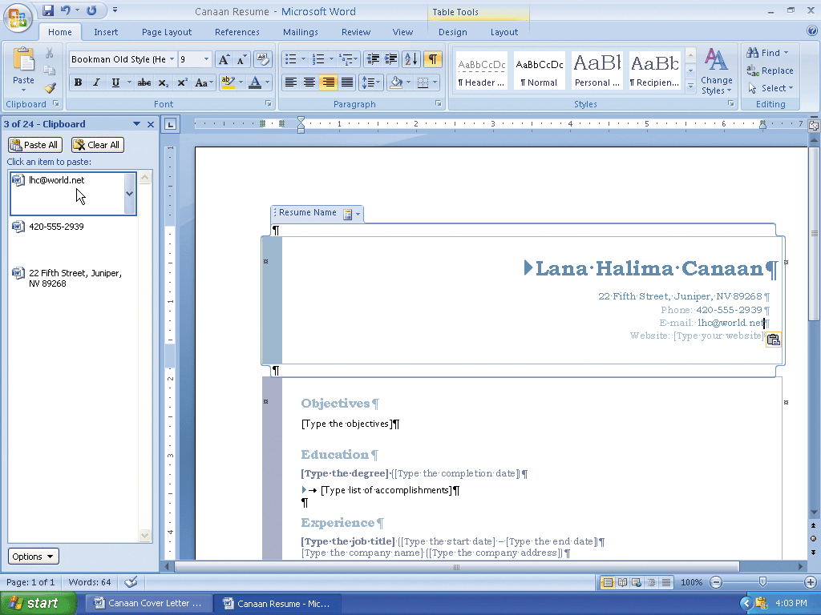
Pasting from the Office Clipboard

Slide 93
Changing Font Color
Drag through the text, Phone:, to select it. Move the mouse pointer into the transparent Mini toolbar, so that it changes to a bright toolbar. Click the Font Color button on the Mini toolbar to change the color of the Phone: label to the color displayed on the button
Drag through the text, E-mail:, to select it. Move the mouse pointer into the transparent Mini toolbar, so that it changes to a bright toolbar. Click the Font Color button on the Mini toolbar to change the color of the E-mail: label

Slide 94
Deleting Text and Lines
Drag through the text to be deleted
Press the DELETE key to delete the label and content control
Press the UP ARROW key to position the insertion point at the end of the e-mail address
Press the DELETE key to delete the extra paragraph mark and line below the e-mail address

Slide 95
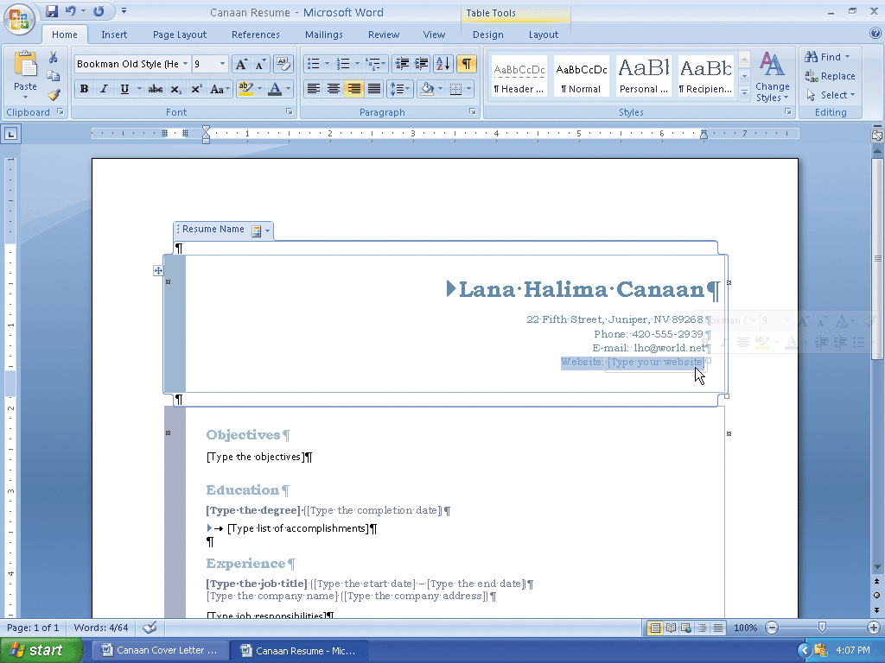
Deleting Text and Lines

Slide 96
Zooming in and out of the Document
Use the Zoom slider to change the zoom to 110%

Slide 97
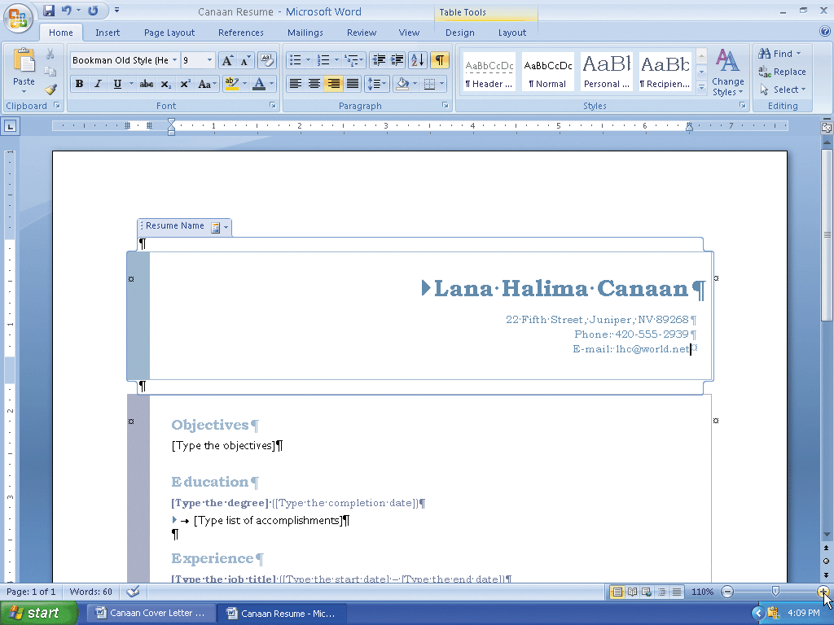
Zooming in and out of the Document

Slide 98
Entering More Text in Content Controls
Scroll to position the Objectives section near the top of the document window. In the Objectives section of the resume, click the content control with the instruction, Type the objectives. Type To obtain a full-time culinary instructor position with a culinary academy, school, or institute in the Juniper area.
In the Education section of the resume, click the content control with the instruction, Type the degree. Type B.S. Culinary Arts and then click the content control with the instruction, Type the completion date
Type Nevada Culinary Institute, May 2008 and then click the content control with the instruction, Type list of accomplishments. Type Dean's List, six semesters and then press the ENTER key. Type Moeller Nutrition Award, January 2008 and then press the ENTER key. Type Marge Rae Outstanding Student Scholarship, 2006 – 2008 and then press the ENTER key. Type Baker Food Preparation, 1st Place, November 2008

Slide 99
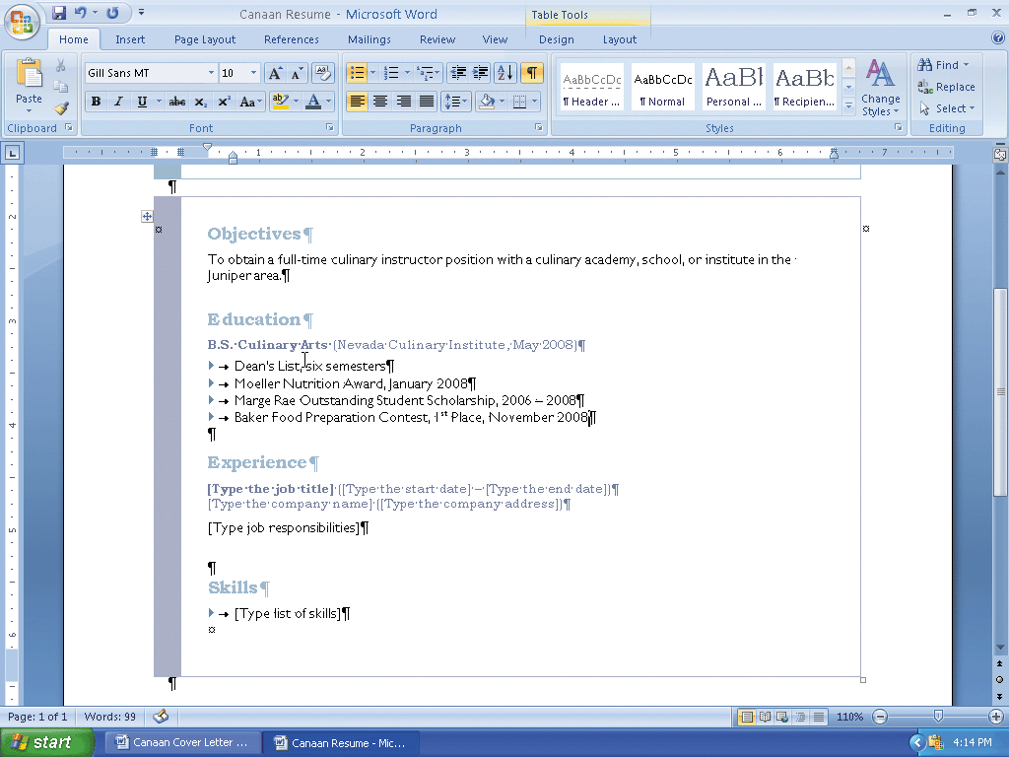
Entering More Text in Content Controls

Slide 100
Entering a Line Break
Press the ENTER key
Type Areas of concentration: and then press SHIFT+ENTER to insert a line break character and move the insertion point to the beginning of the next physical line
Type Food Planning and Preparation and then press SHIFT+ENTER
Type Food Safety and then press SHIFT+ENTER
Type Nutrition and then press SHIFT+ENTER
Type Regional and International Cuisine as the last entry. Do not press SHIFT+ENTER at the end of this line

Slide 101
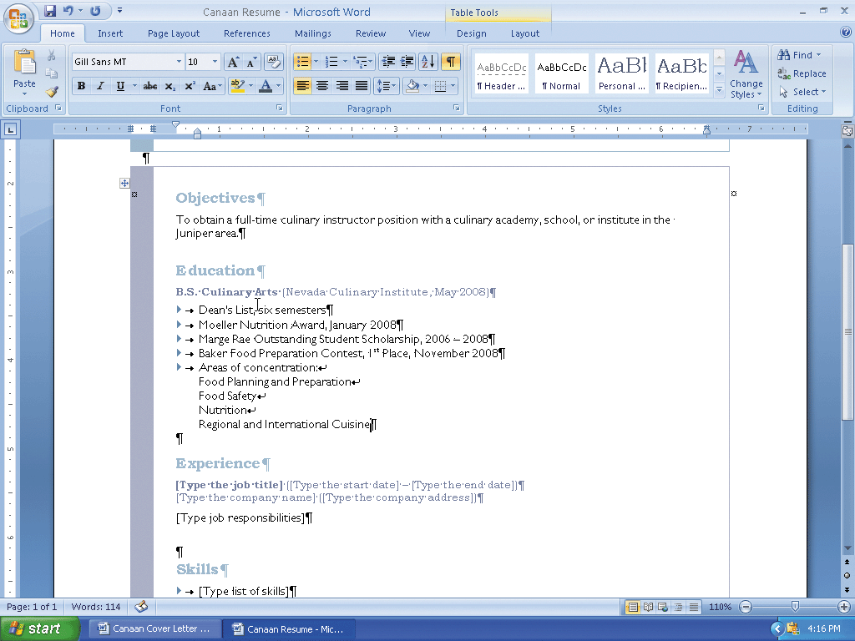
Entering a Line Break

Slide 102
Changing the Spacing Below Paragraphs
Position the insertion point in the paragraph to be adjusted, in this case, the paragraph mark below the Education section on the resume
Display the Page Layout tab
Click the Spacing After box down arrow on the Page Layout tab as many times as necessary until 0 pt is displayed in the Spacing After box

Slide 103
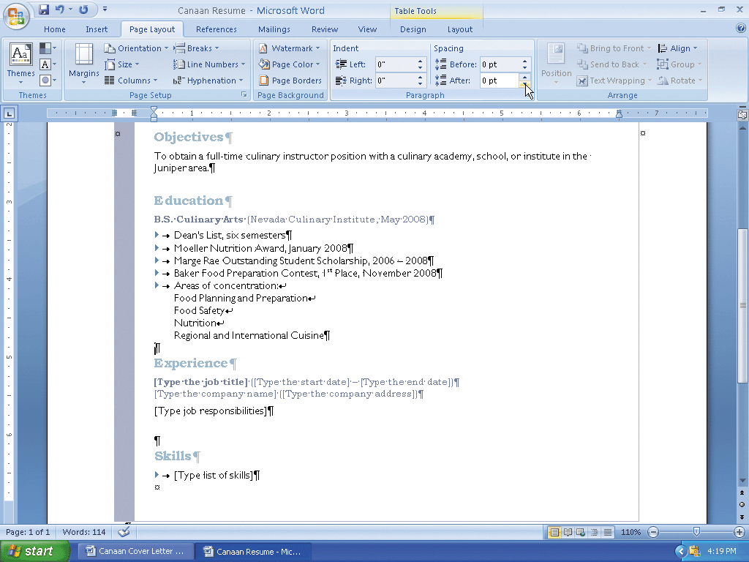
Changing the Spacing Below Paragraphs

Slide 104
Entering More test in Content Controls
In the Experience section of the resume, click the content control with the instruction, Type the job title
Type Chef Intern and then bold the text, Chef Intern
Click the content control with the instruction, Type the start date
Type September 2006 and then click the content control with the instruction, Type the end date
Type May 2008 and then click the content control with the instruction, Type the company name
Type The Garden Grill and then click the content control with the instruction, Type the company address
Type Juniper, NV as the company address

Slide 105
Indenting a Paragraph
Display the Home tab
With the insertion point in the paragraph to indent, click the Increase Indent button on the Home tab to indent the paragraph one-half inch

Slide 106
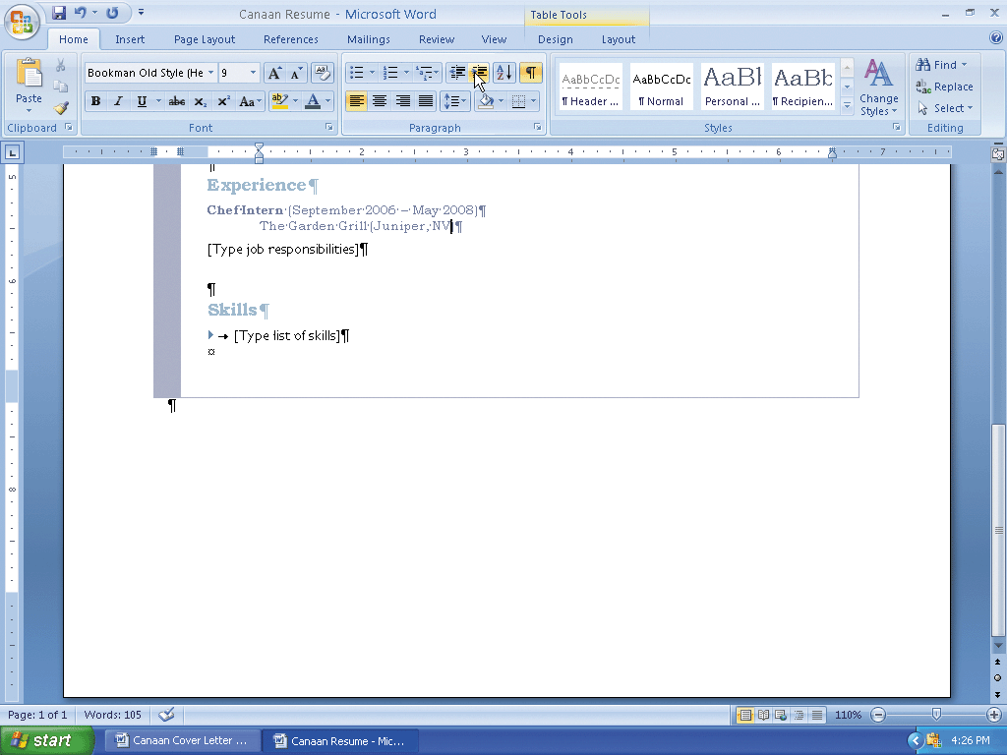
Indenting a Paragraph

Slide 107
Changing Spacing Below Paragraphs
Display the Page Layout tab
With the insertion point in the paragraph to be adjusted, click the Spacing After box down arrow on the Page Layout tab as many times as necessary until 0 pt is displayed in the Spacing After box

Slide 108
Entering and Formatting More Text in Content Controls
In the Experience section of the resume, click the content control with the instruction, Type job responsibilities
Type Assisted chef with meal selection, preparation, and presentation Assumed chef responsibilities during last semester of school
With the insertion point in the paragraph to be adjusted, in this case, the job responsibilities paragraph, click the Spacing After box down arrow on the Page Layout tab as many times as necessary until 6 pt is displayed in the Spacing After box
Display the Home tab
Click the Increase Indent button on the Home tab to indent the paragraph one-half inch

Slide 109
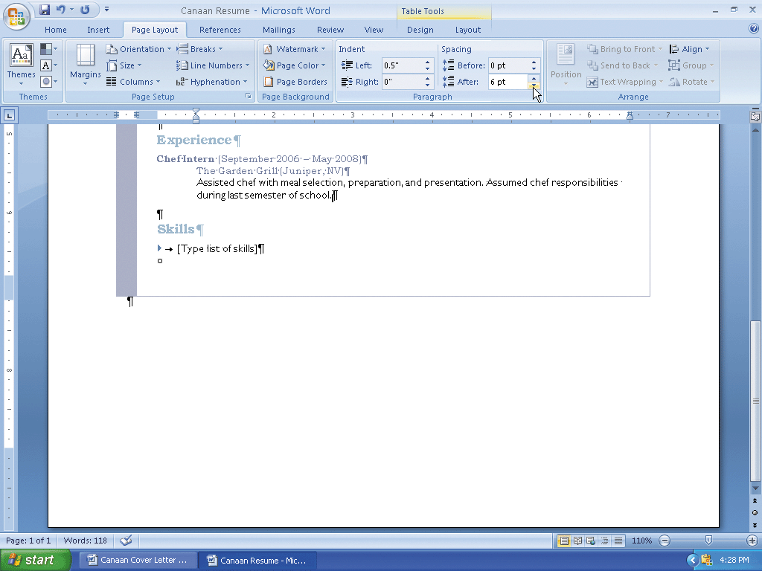
Entering and Formatting More Text in Content Controls

Slide 110
Inserting a Building Block Using the Quick Parts Gallery
Position the insertion point on the paragraph mark below the first job entry
Display the Insert tab
Click the Quick Parts button on the Insert tab and then scroll through the Quick Parts gallery until Experience Subsection is displayed
Click the Experience Subsection to insert the building block in the document at the location of the insertion point
Press the DELETE key to remove the extra paragraph mark inserted with the building block

Slide 111
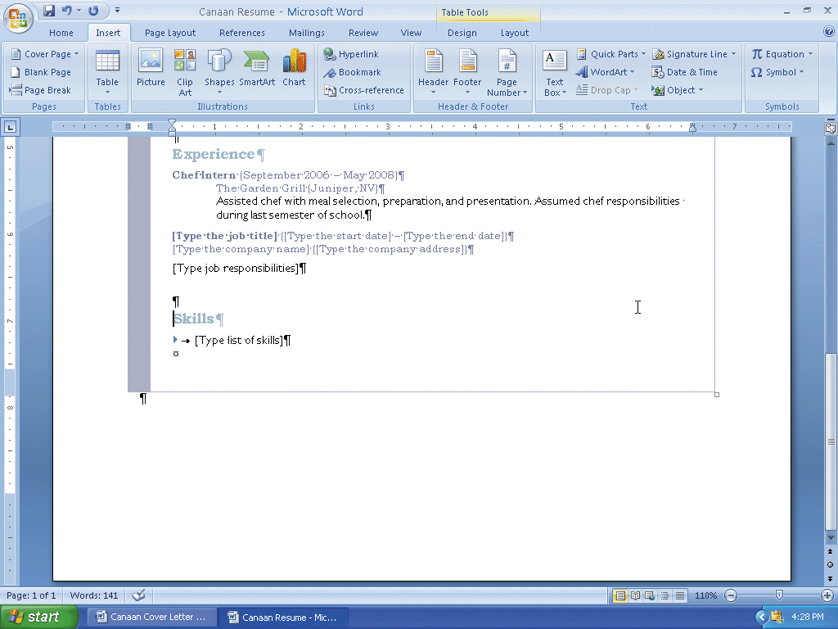
Inserting a Building Block Using the Quick Parts Gallery

Slide 112
Entering and Formatting the Experience Subsection and the Skills Section
Enter Assistant Cook as the job title and then bold the job title. Enter September 2004 as the start date. Enter August 2006 as the end date. Enter Nevada Culinary Institute Cafeteria as the company name. Enter Juniper, NV as the company address
Display the Home tab. With the insertion point in the paragraph to indent (company address line), click the Increase Indent button on the Home tab to indent the paragraph one-half inch
Display the Page Layout tab. With the insertion point in the paragraph to be adjusted (company address line), change the Spacing After to 0 point

Slide 113
Entering and Formatting the Experience Subsection and the Skills Section
Enter this sentence for the job responsibilities: Planned meals for staff and students. Prepared salads, soups, sandwiches, entrees, and desserts
With the insertion point in the paragraph to be adjusted, in this case, the job responsibilities paragraph, change Spacing After to 0 point
Display the Home tab. Click the Increase Indent button on the Home tab to indent the paragraph one-half inch
In the Skills section, click the content control with the instruction, Type list of skills, to select it. Type National Honor Society and then press the ENTER key. Type Culinary Arts Association and then press the ENTER key. Type Nutrition Services of America and then press the ENTER key. Type Student Government Association, President and then press the ENTER key. Enter Nevada Restaurant Federation as the last skill

Slide 114
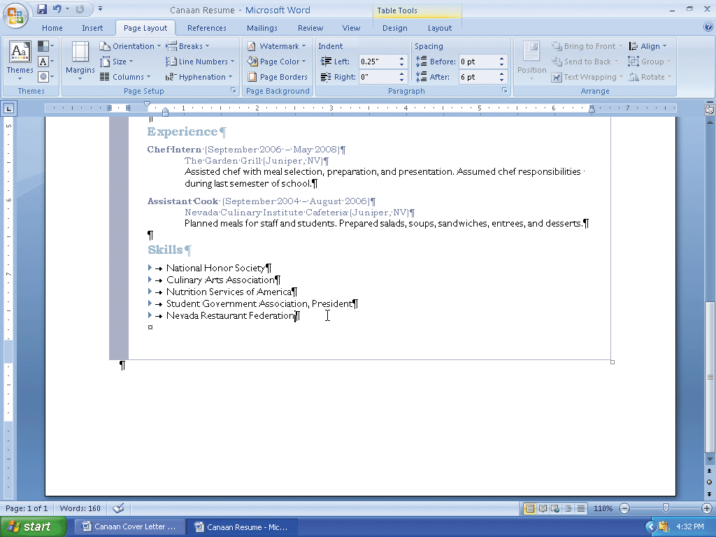
Entering and Formatting the Experience Subsection and the Skills Section

Slide 115
Sorting Paragraphs
Drag through the paragraphs to be sorted, in this case, the list of skills
Display the Home tab
Click the Sort button on the Home tab to display the Sort Text dialog box
Click the OK button to close the dialog box and instruct Word to alphabetize the selected paragraphs

Slide 116
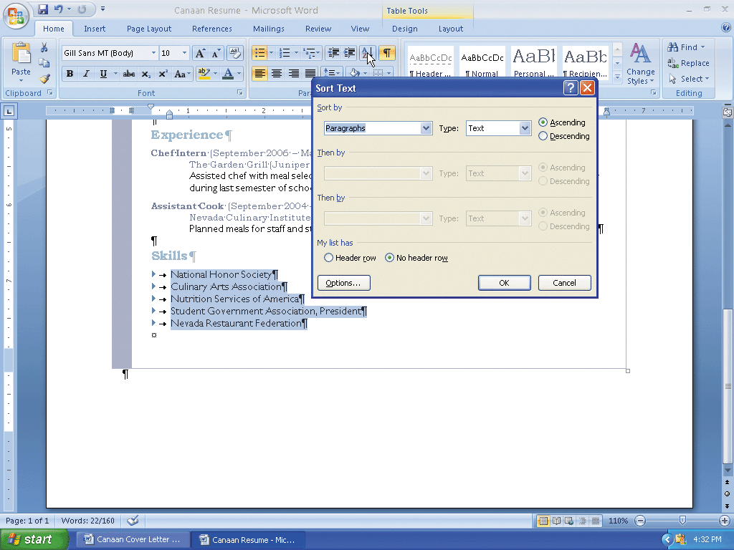
Sorting Paragraphs

Slide 117
Inserting Another Building Block
Position the insertion point on the line below the Skills section on the resume. Display the Insert tab. Click the Quick Parts button on the Insert tab and then scroll through the Quick Parts gallery until Reference Section is displayed. Click Reference Section to insert the building block in the document at the location of the insertion point
Press the BACKSPACE key to remove the extra blank line inserted with the building block

Slide 118
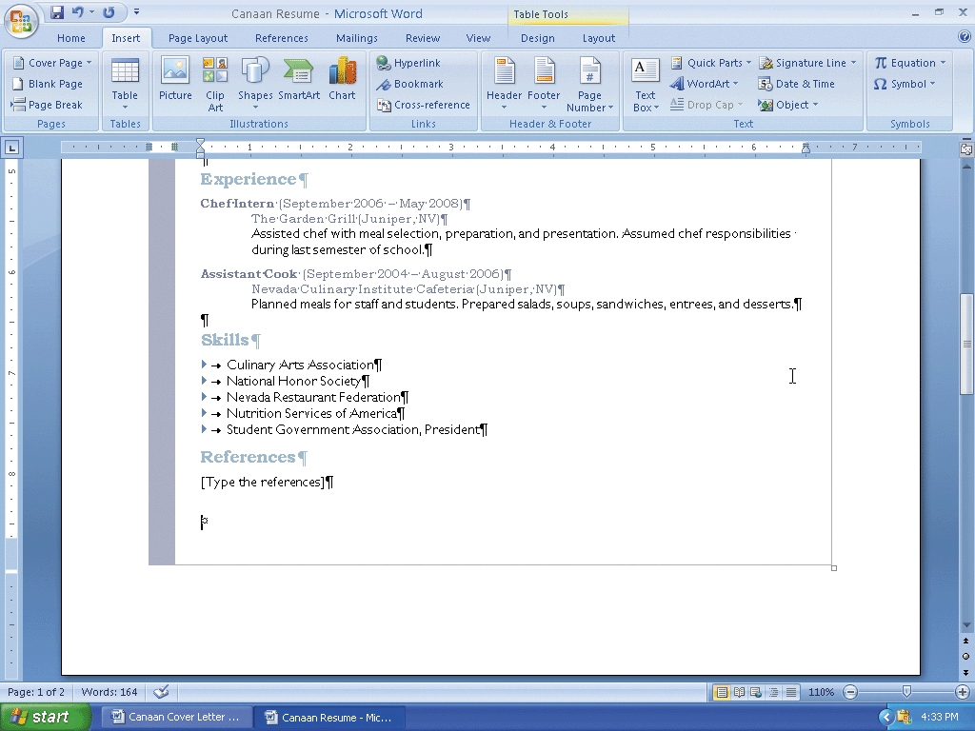
Inserting Another Building Block

Slide 119
Entering and Formatting the Community Service Section
Change the title, References, to Community Service
Display the Page Layout tab. With the insertion point in the paragraph to be adjusted (Community Service heading), change the Spacing Before to 12 point
In the last content control, type Prepare food and serve meals at Hope Mission every week
With the insertion point in the paragraph to be adjusted, in this case, the community services paragraph, change Spacing After to 0 point
If the document flows to a second page, reduce the space after internal paragraphs so that it fits on a single page

Slide 120
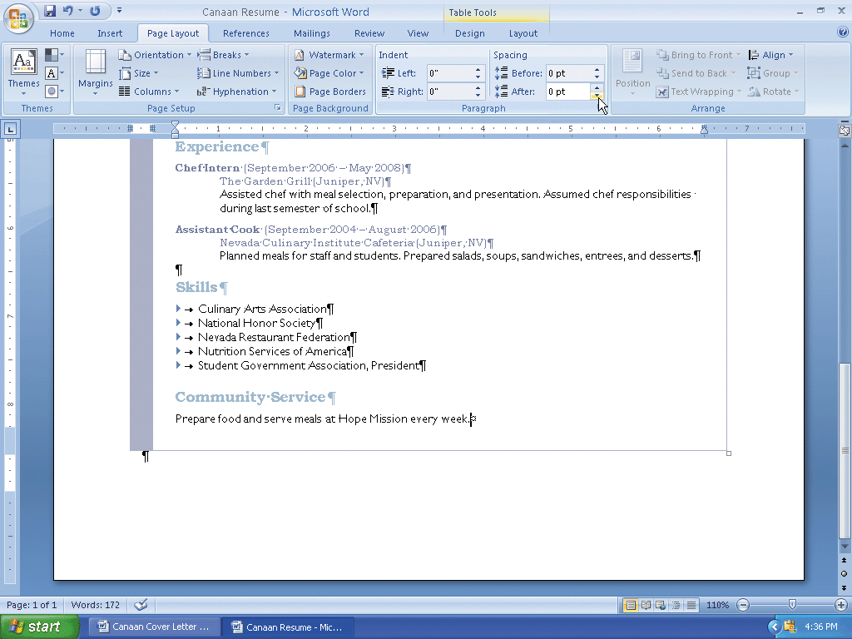
Entering and Formatting the Community Service Section

Slide 121
Changing Theme Colors
Display the Home tab. Click the Change Styles button on the Home tab, point to Colors on the Change Styles menu, and then click Urban in the Colors gallery to change the document theme colors to Urban

Slide 122
Printing a Preview of a Document
Click the Office Button and then point to Print on the Office Button menu
Click Print Preview on the Print submenu to display the document in print preview
Click the Print button on the Print Preview tab to print the resume
Click the Close Print Preview button on the Print Preview tab to redisplay the resume in the document window

Slide 123
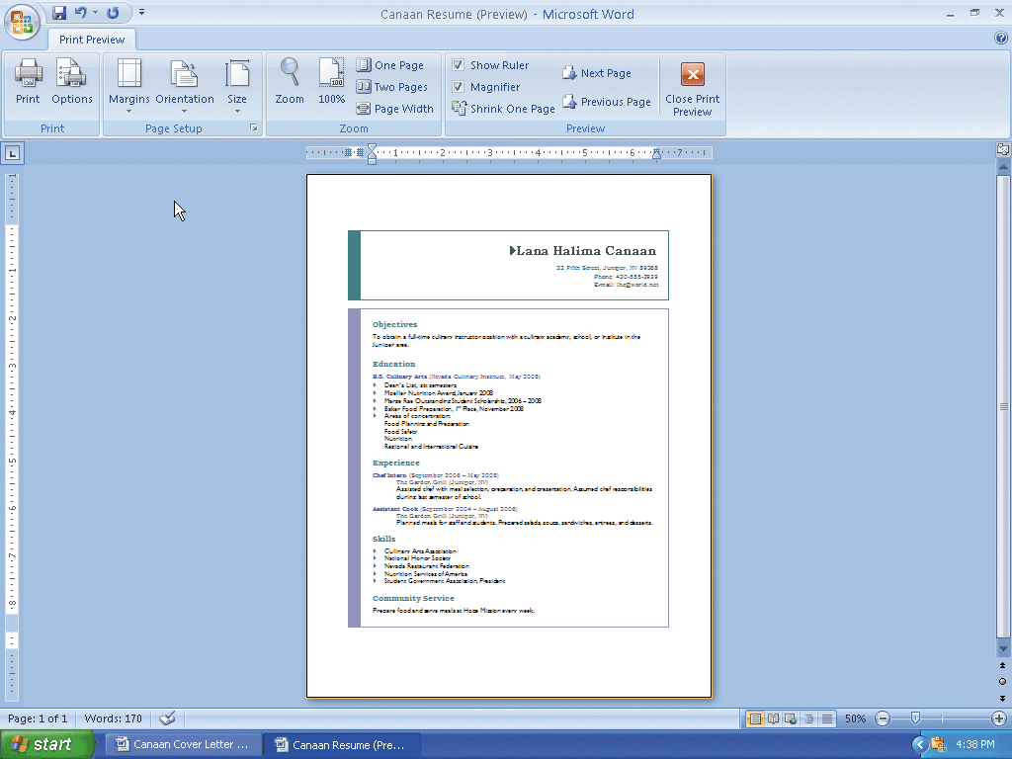
Printing a Preview of a Document

Slide 124
Changing Document Properties and Saving Again
Display the Office Button menu, point to Prepare on the Office Button menu, and then click Properties on the Prepare submenu to display the Document Information Panel
Enter your name in the Author text box. Enter your course and section in the Subject text box. Enter the text, resume, in the Keywords text box
Close the Document Information Panel
Click the Save button on the Quick Access Toolbar to overwrite the previous Canaan Resume file on the USB flash drive

Slide 125
Address and Printing an Envelope
Switch to the cover letter by clicking its program button on the Windows taskbar
Close the Clipboard task pane
Scroll through the cover letter to display the inside address in the document window
Drag through the inside address to select it
Click Mailings on the Ribbon to display the Mailings tab

Slide 126
Address and Printing an Envelope
Click the Envelopes button on the Mailings tab to display the Envelopes and Labels dialog box
If necessary, click the Envelopes tab in the dialog box
Click the Return address text box
Type Lana Halima Canaan and then press the ENTER key
Type 22 Fifth Street and then press the ENTER key

Slide 127
Address and Printing an Envelope
Type Juniper, NV 89268
Insert an envelope into your printer, as shown in the Feed area of the dialog box (your Feed area may be different depending on your printer)
Click the Print button in the Envelopes and Labels dialog box to print the envelope
If a dialog box is displayed, click the No button

Slide 128
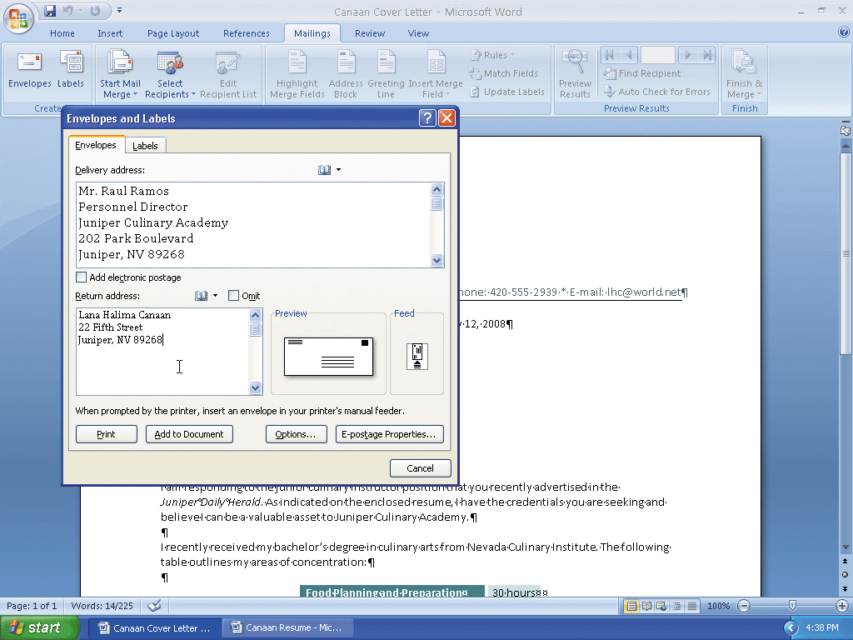
Address and Printing an Envelope

Slide 129
Quitting Word
Click the Close button on the right side of the title bar to quit Word

Slide 130
Summary
Format characters and paragraphs
Insert and format clip art
Set and use tab stops
Identify the components of a business letter
Insert the current date
Create and insert a building block

Slide 131
Summary
Insert a Word table, enter data in the table, and format the table
Use a template to create a document
Fill in a document template
Copy and paste using the Office Clipboard
Indent paragraphs

Slide 132
Summary
Insert a Quick Part
Sort a List
Use print preview to view and print a document
Address and print an envelope

Slide 133
Word Chapter 3 Complete

