Slide 1
Word Chapter 2
Creating a
Research Paper

Slide 2
Objectives
Describe the MLA documentation style for research papers
Change line and paragraph spacing in a document
Use a header to number pages of a document
Apply formatting using shortcut keys
Modify paragraph indentation
Create and modify styles

Slide 3
Objectives
Insert and edit citations and their sources
Add a footnote to a document
Insert a manual page break
Create a bibliographical list of sources
Move text
Find and replace text
Use the Research task pane to look up information

Slide 4
Plan Ahead
Select a topic
Research the topic and take notes
Organize your ideas
Write the first draft, referencing sources
Create the list of sources
Proofread and revise the paper

Slide 5
Starting Word
Click the Start button on the Windows taskbar to display the Start menu, and then point to All Programs on the Start menu to display the All Programs submenu
Point to Microsoft Office on the All Programs submenu to display the Microsoft Office submenu, and then click Microsoft Office Word 2007 to start Word and display a new blank document in the Word window
If the Word window is not maximized, click the Maximize button next to the Close button on its title bar to maximize the window
If the Print Layout button is not selected, click it so your screen layout matches Figure 2–2 on the next slide
If your zoom percent is not 100, click the Zoom Out or Zoom In button as many times as necessary until the Zoom level button displays 100% on its face

Slide 6
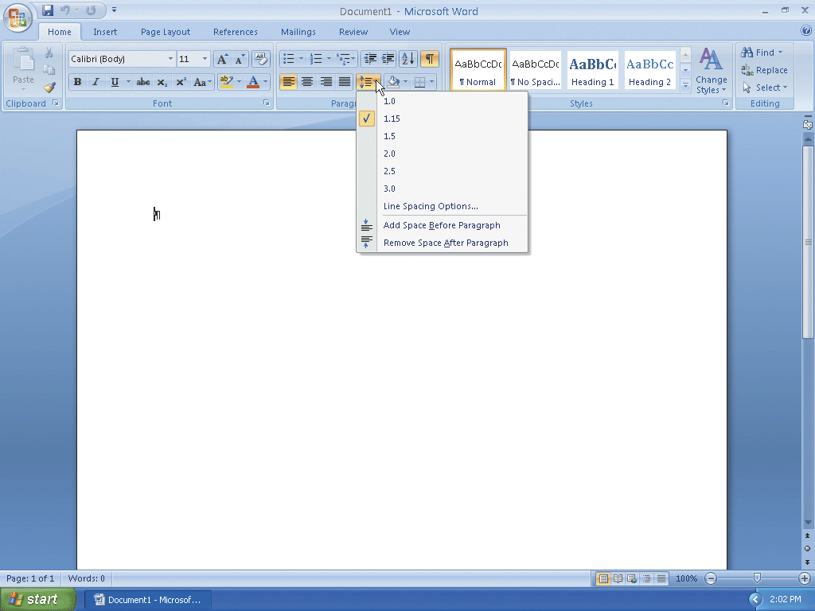
Starting Word

Slide 7
Displaying Formatting Marks
If necessary, click Home on the Ribbon to display the Home tab. If the Show/Hide ¶ button on the Home tab is not selected already, click it to display formatting marks on the screen

Slide 8
Double-Spacing Text
Click the Line spacing button on the Home tab to display the Line spacing gallery
Click 2.0 in the Line spacing gallery to change the line spacing to double at the location of the insertion point

Slide 9
Double-Spacing Text

Slide 10
Removing the Space after a Paragraph
Click the Line spacing button on the Home tab to display the Line spacing gallery
Click Remove Space After Paragraph in the Line spacing gallery so that no blank space appears after a paragraph

Slide 11

Removing the Space after a Paragraph

Slide 12
Switching to the Header
Click Insert on the Ribbon to display the Insert tab
Click the Header button on the Insert tab to display the Header gallery
Click the Edit Header command to switch from the document text to the header, which allows you to edit the contents of the header

Slide 13
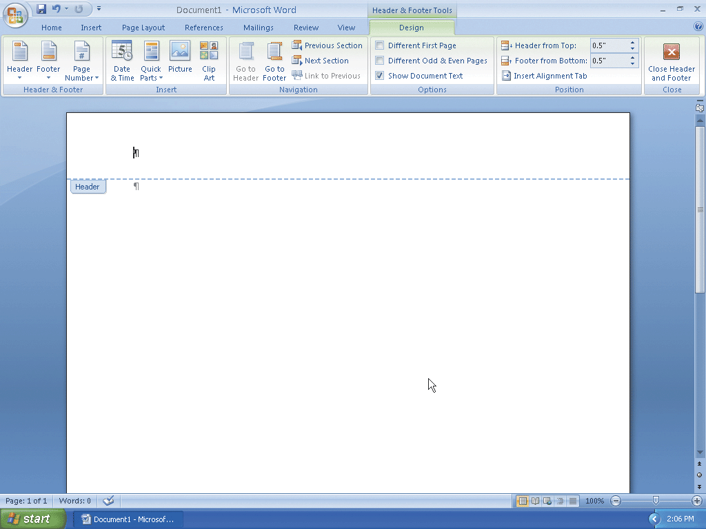
Switching to the Header

Slide 14
Right-Aligning a Paragraph
Click Home on the Ribbon to display the Home tab
Click the Align Text Right button on the Home tab to right-align the paragraph in the header

Slide 15
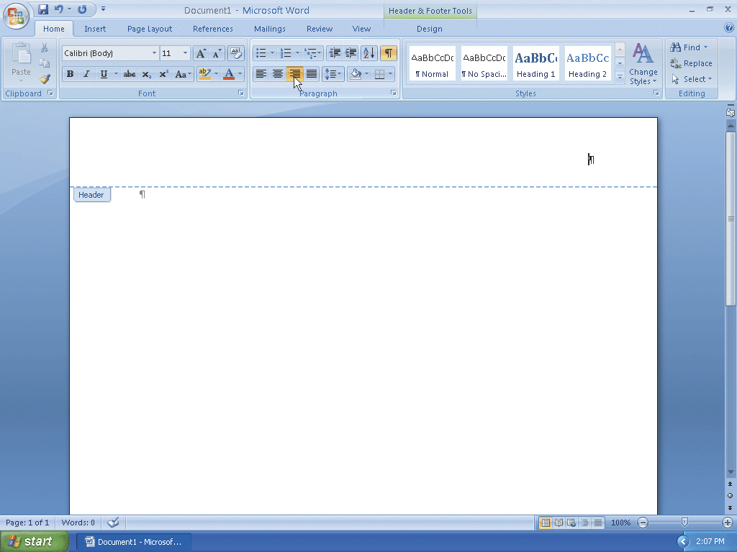
Right-Aligning a Paragraph

Slide 16
Entering Text
Click Design on the Ribbon to display the Design tab
Type Pappas and then press the SPACEBAR to enter your last name in the header

Slide 17
Inserting a Page Number
Click the Insert Page Number button on the Design tab to display the Insert Page Number menu.
Point to Current Position on the Insert Page Number menu to display the Current Position gallery
If necessary, scroll to the top of the Current Position gallery. Click Plain Number in the Current Position gallery to insert an unformatted page number at the location of the insertion point

Slide 18
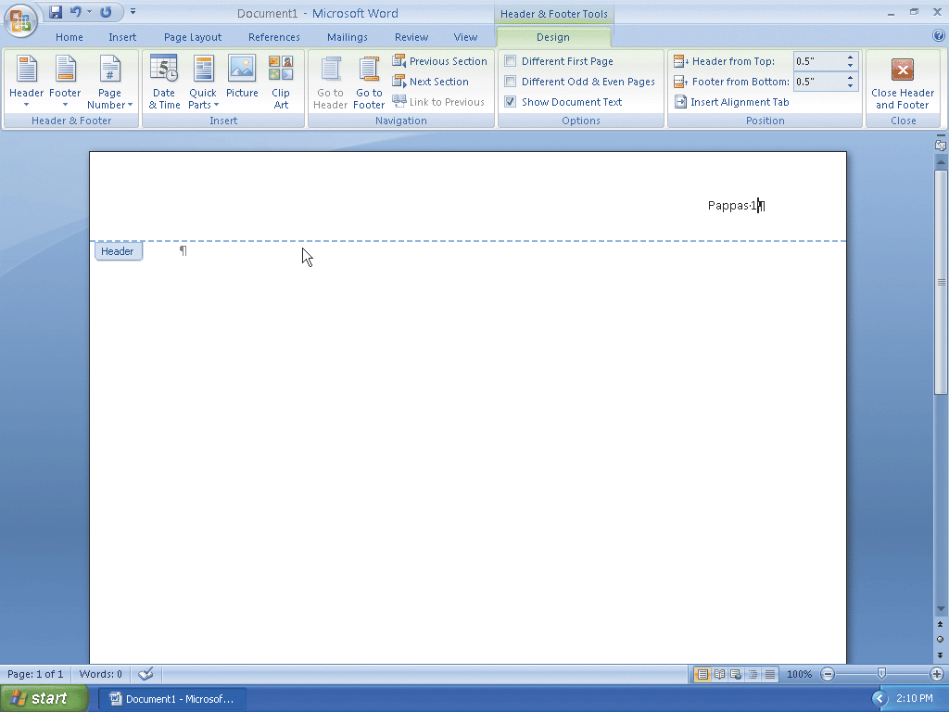
Inserting a Page Number

Slide 19
Closing the Header
Click the Close Header and Footer button on the Design tab to close the header and switch back to the document text

Slide 20
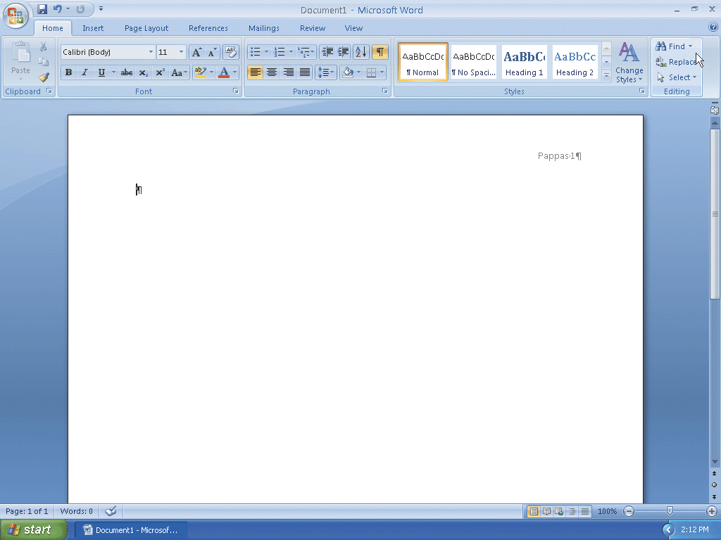
Closing the Header

Slide 21
Entering a Name and Course Information
Type Alex Pappas as the student name and then press the ENTER key
Type Ms. Singh as the instructor name and then press the ENTER key
Type English 104 as the course name and then press the ENTER key
Type 28 March 2008 as the paper due date and then press the ENTER key

Slide 22
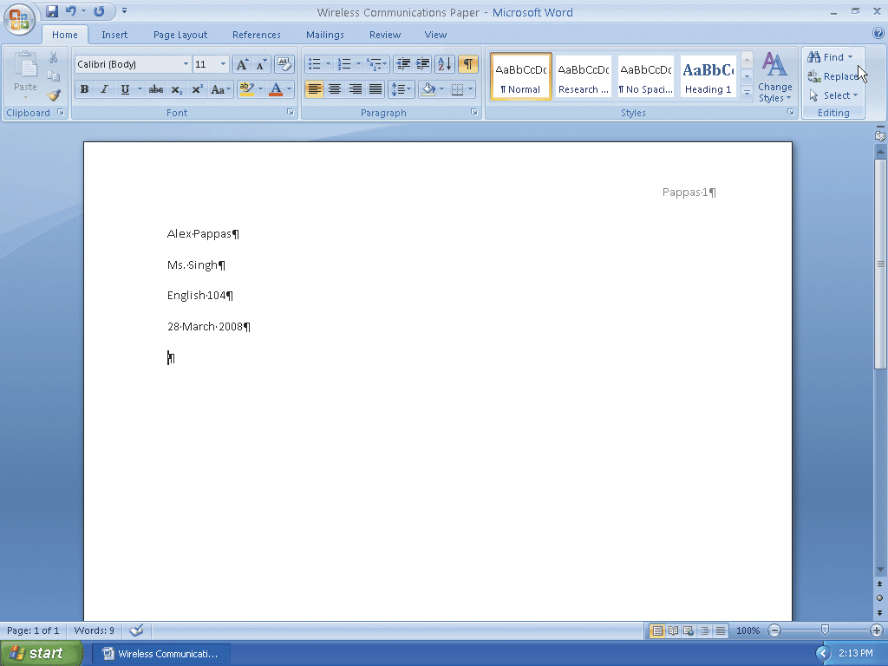
Entering a Name and Course Information

Slide 23
Clicking and Typing
Position the mouse pointer in the center of the document at the approximate location for the research paper title until a center icon appears below the I-beam
Double-click to center the paragraph mark and insertion point between the left and right margins
Type Wireless Communications as the paper title and then press the ENTER key

Slide 24
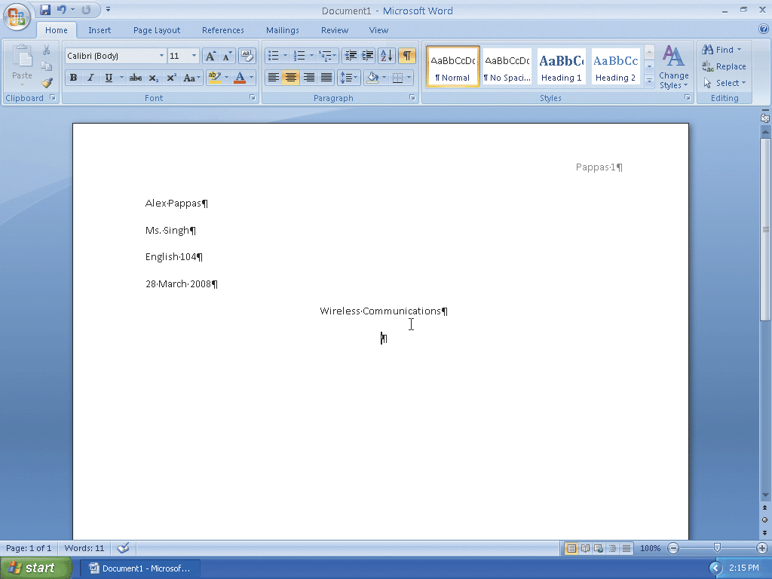
Clicking and Typing

Slide 25
Formatting Text Using Shortcut Keys
Press CTRL+l to left-align the current paragraph, that is, the paragraph containing the insertion point

Slide 26
Saving a Document
With a USB flash drive connected to one of the computer’s USB ports, click the Save button on the Quick Access Toolbar to display the Save As dialog box
Type Wireless Communications Paper in the File name text box to change the file name
Click the Save in box arrow and then click UDISK 2.0 (E:) in the Save in list to select the USB flash drive as the new save location. (Your USB flash drive may have a different name and letter)
Click the Save button in the Save As dialog box to save the document on the USB flash drive with the fi le name, Wireless Communications Paper

Slide 27
Displaying the Rulers
If the rulers are not displayed, click the View Ruler button on the vertical scroll bar because you want to use the ruler to indent paragraphs

Slide 28
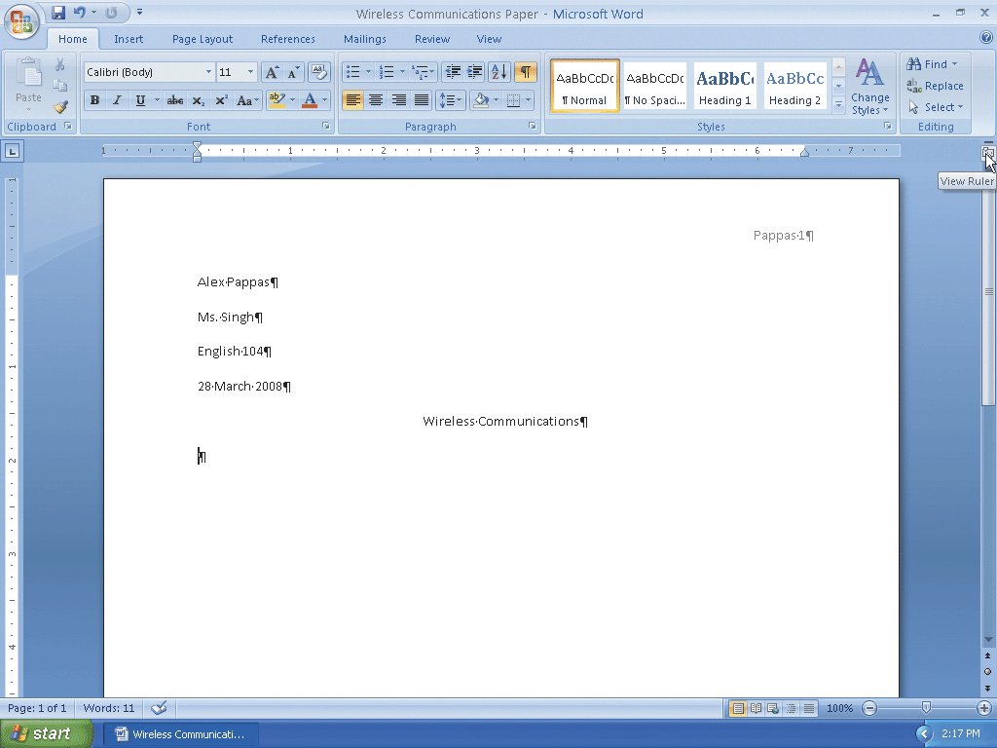
Displaying the Rulers

Slide 29
First-Line Indenting Paragraphs
With the insertion point on the paragraph mark below the research paper title, point to the First Line Indent marker on the ruler
Drag the First Line Indent marker to the .5” mark on the ruler to display a vertical dotted line in the document window, which indicates the proposed location of the first line of the paragraph

Slide 30
First-Line Indenting Paragraphs
Release the mouse button to place the First Line Indent marker at the .5” mark on the ruler, or one-half inch from the left margin
Type Wireless communications are everywhere. People around the world regularly send and receive messages wirelessly, that is, transmitted through the air. and notice that Word automatically indented the first line of the paragraph by one-half inch

Slide 31
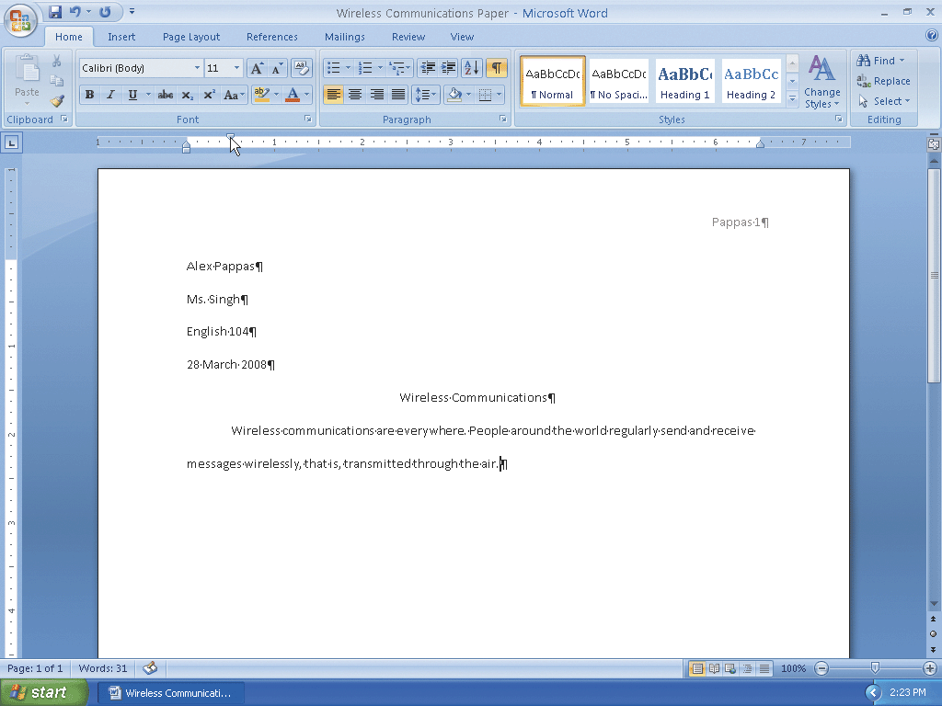
First-Line Indenting Paragraphs

Slide 32
Creating a Quick Style
Position the mouse pointer in the paragraph below the title and then triple-click; that is, press the mouse button three times in rapid succession, to select the paragraph
Right-click the selected paragraph to display a shortcut menu
Point to Styles on the shortcut menu to display the Styles submenu

Slide 33
Creating a Quick Style
Click Save Selection as a New Quick Style on the Styles submenu to display the Create New Style from Formatting dialog box
Type Research Paper Paragraphs in the Name text box
Click the OK button to create the new Quick Style and add it to the Styles gallery

Slide 34
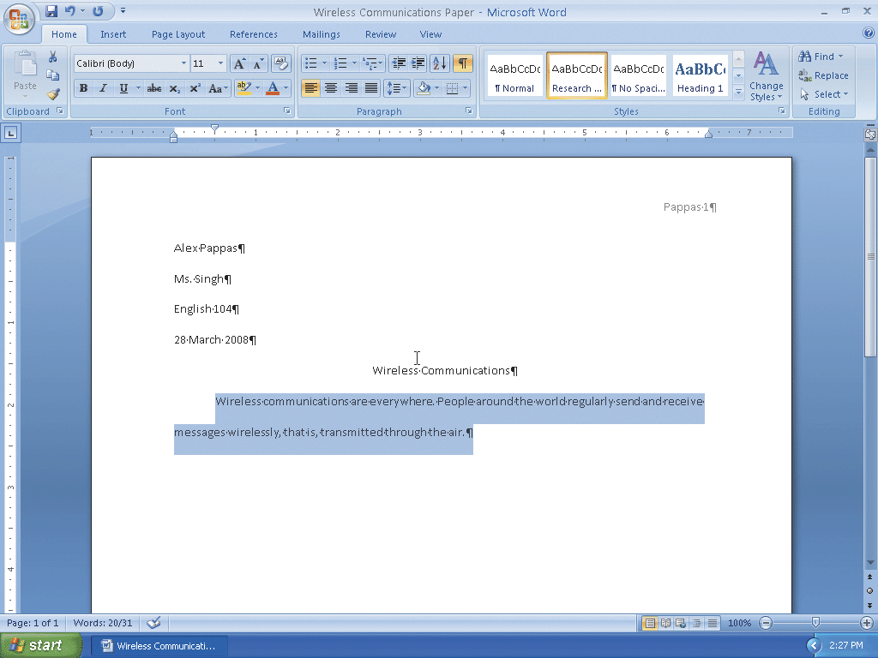
Creating a Quick Style

Slide 35
AutoCorrecting as you Type
Press CTRL+END to move the insertion point to the end of the document.
Press the SPACEBAR
Type the beginning of the next sentence, misspelling the word, wireless, as follows: Three types of wireless communications include wireless messaging services, wreless
Press the SPACEBAR and watch how Word automatically corrects the misspelled word
Type the rest of the sentence : Internet access points, and global positioning systems.

Slide 36
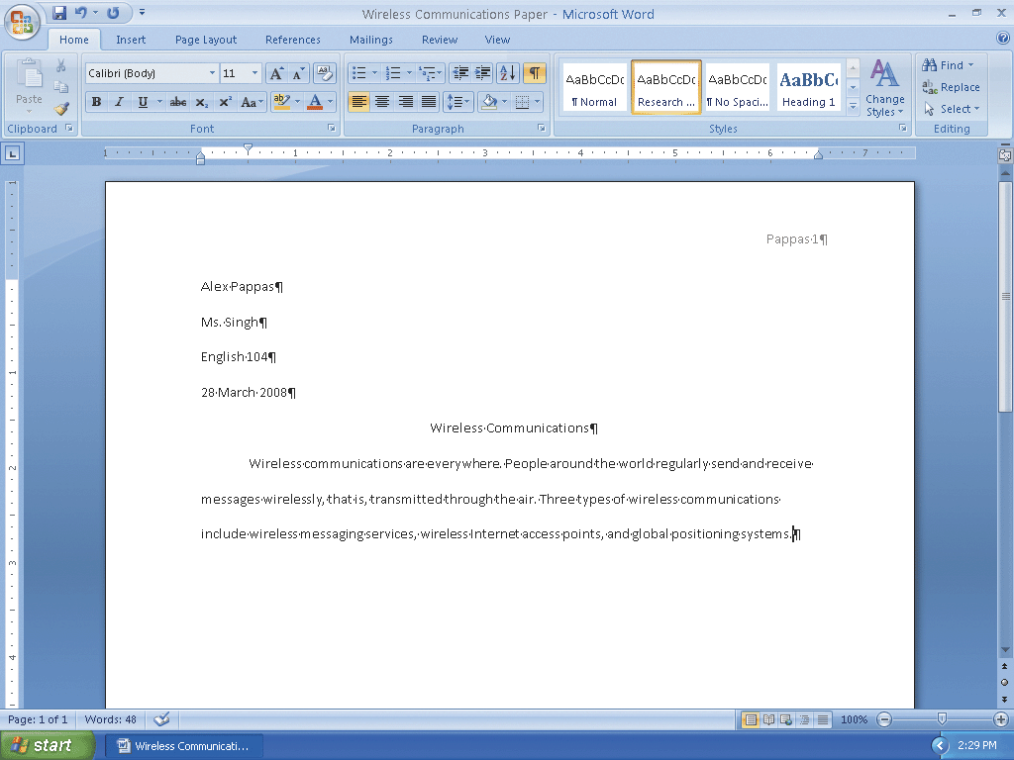
AutoCorrecting as you Type

Slide 37
Using the AutoCorrect Options Button
Position the mouse pointer in the text automatically corrected by Word (in this case, the word wireless) to display a small blue box below the automatically corrected word
Point to the small blue box to display the AutoCorrect Options button
Click the AutoCorrect Options button to display the AutoCorrect Options menu
Press the ESCAPE key to remove the AutoCorrect Options menu from the screen

Slide 38
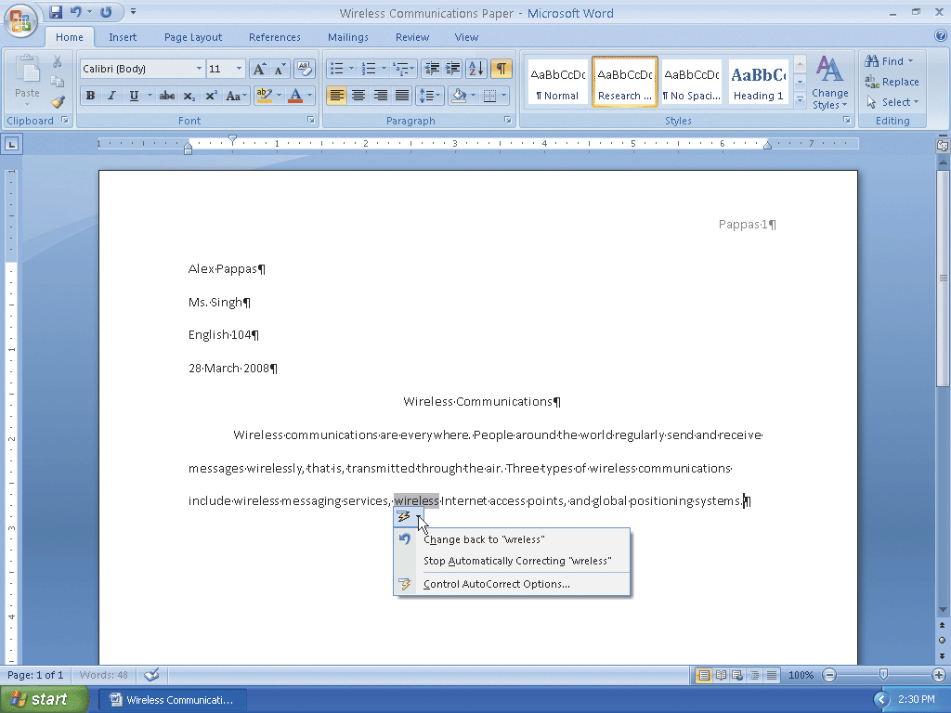
Using the AutoCorrect Options Button

Slide 39
Creating an AutoCorrect Entry
Click the Office Button to display the Office Button menu
Click the Word Options button on the Office Button menu to display the Word Options dialog box
Click Proofing in the left pane to display proofing options in the right pane
Click the AutoCorrect Options button in the right pane to display the AutoCorrect dialog box
When Word displays the AutoCorrect dialog box, type moble in the Replace text box

Slide 40
Creating an AutoCorrect Entry
Press the TAB key and then type mobile in the With text box
Click the Add button in the AutoCorrect dialog box. (If your dialog box displays a Replace button instead, click it and then click the Yes button in the Microsoft Office Word dialog box.)
Click the OK button to add the entry alphabetically to the list of words to correct automatically as you type
Click the OK button in the Word Options dialog box

Slide 41
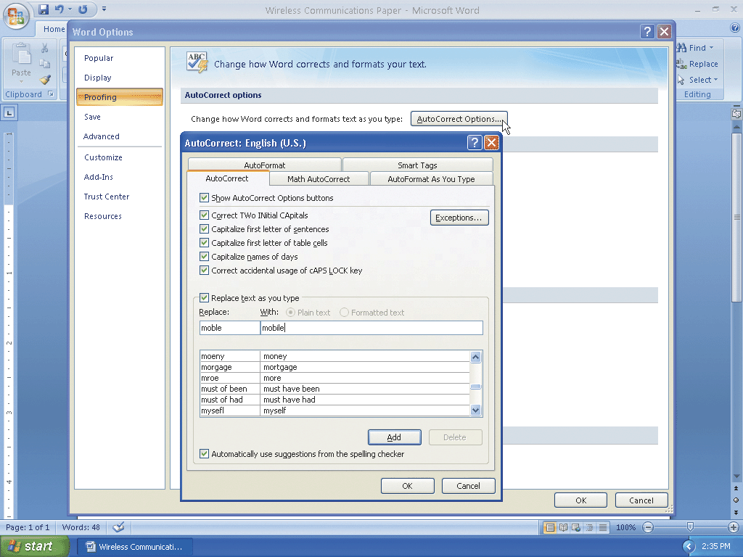
Creating an AutoCorrect Entry

Slide 42
Entering More Text
Press the enter key, so that you can begin typing the text in the second paragraph
Type People use mobile phones, PDAs, and other mobile devices to access text messaging, instant messaging, and picture messaging services and then press the SPACEBAR

Slide 43
Changing the Bibliography Style
Click References on the Ribbon to display the References tab
Click the Bibliography Style box arrow on the References tab to display a gallery of predefined documentation styles
Click MLA in the Bibliography Style gallery to change the documentation style to MLA

Slide 44
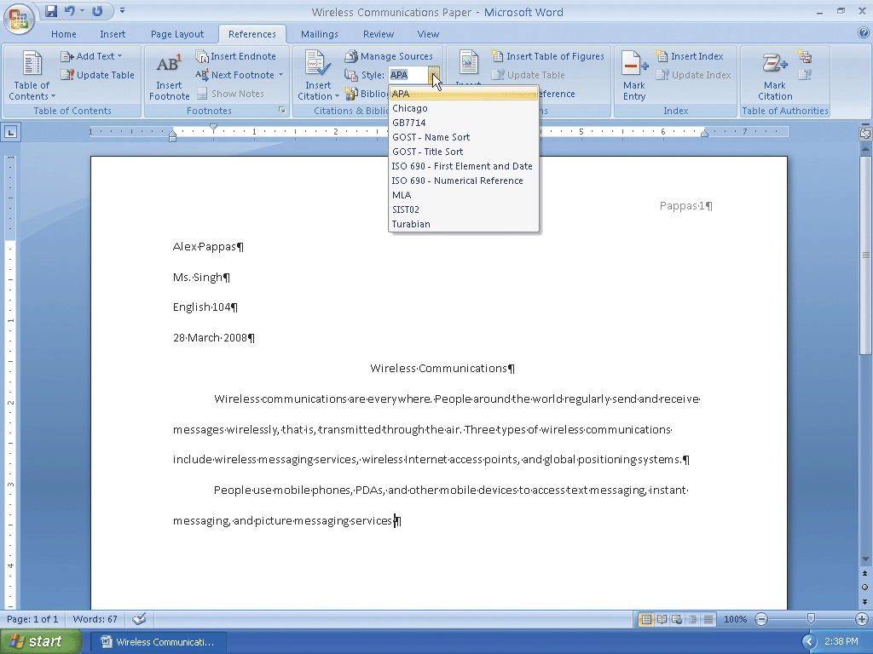
Changing the Bibliography Style

Slide 45
Inserting a Citation and Creating Its Source
Click the Insert Citation button on the References tab to display the Insert Citation menu
Click Add New Source on the Insert Citation menu to display the Create Source dialog box
If necessary, click the Type of Source box arrow and then click Article in a Periodical, so that the list shows fields required for a magazine (periodical)
Click the Author text box. Type Davies, Habika as the author

Slide 46
Inserting a Citation and Creating Its Source
Click the Title text box. Type Text Messaging, Instant Messaging, and Picture Messaging as the article title
Press the TAB key and then type Computing in Today’s World as the periodical title
Press the TAB key and then type 2008 as the year
Press the TAB key and then type January as the month
Press the TAB key twice and then type 34-42 as the pages
Click the OK button to close the dialog box, create the source, and insert the citation in the document at the location of the insertion point

Slide 47
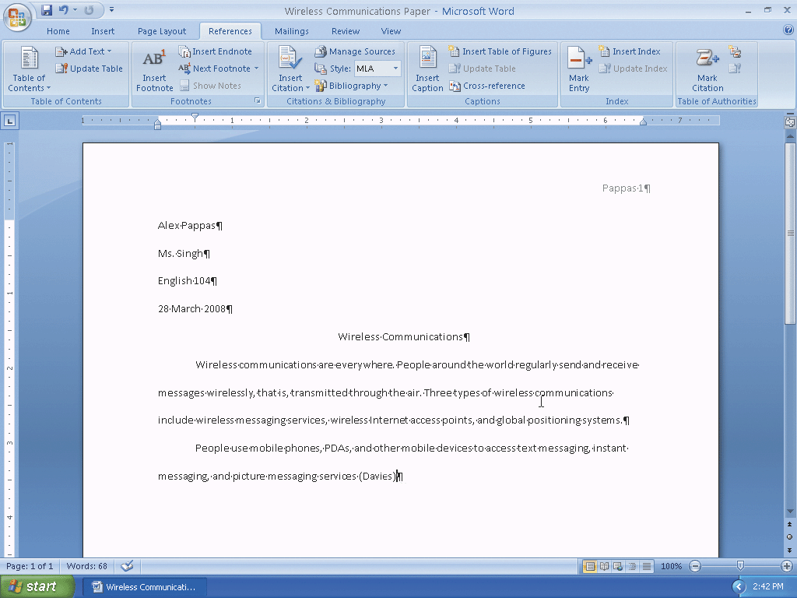
Inserting a Citation and Creating Its Source

Slide 48
Editing a Citation
Click somewhere in the citation to be edited, in this case somewhere in (Davies), to select the citation and display the Citation Options box arrow
Click the Citation Options box arrow to display the Citation Options menu
Click Edit Citation on the Citation Options menu to display the Edit Citation dialog box
Type 34-42 in the Pages text box

Slide 49
Editing a Citation
Click the OK button to close thedialog box and add the page numbers to the citation in the document
Press the END key to move the insertion point to the end of the line, which also deselects the citation
Press the PERIOD key to end the sentence

Slide 50
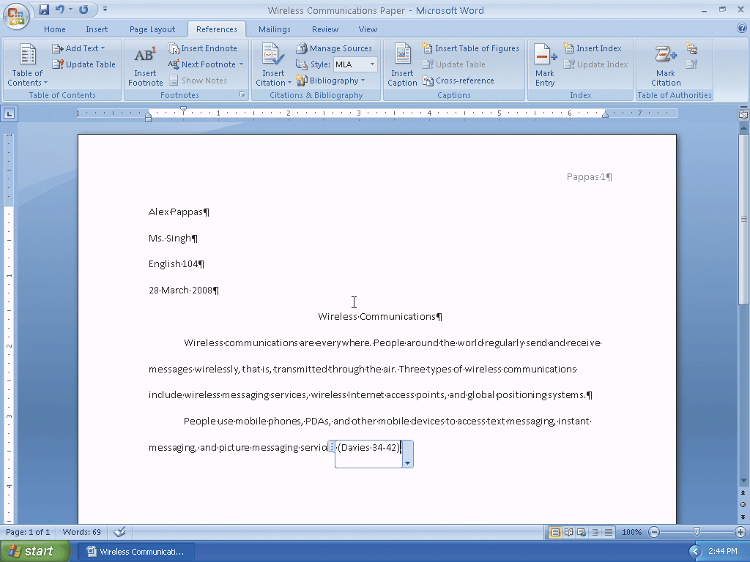
Editing a Citation

Slide 51
Entering More Text
Press the SPACEBAR
Type these three sentences: Through text messaging services, users send and receive short text messages, which usually consist of fewer than 300 characters. Wireless instant messaging is an Internet communications service that allows a wireless mobile device to exchange instant messages with one or more mobile devices or online personal computers. Users send graphics, pictures, video clips, sound files, and short text messages with picture messaging services.

Slide 52
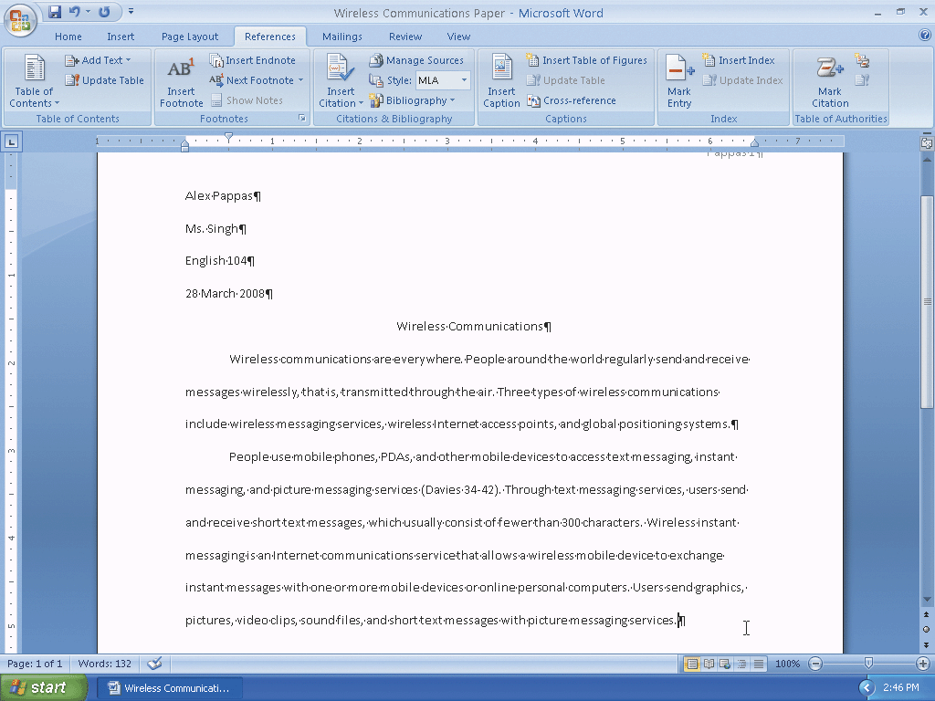
Entering More Text

Slide 53
Inserting a Footnote Reference Mark
With the insertion point positioned, click the Insert Footnote button on the References tab to display a note reference mark (a superscripted 1) in two places: (1) in the document window at the location of the insertion point and (2) at the bottom of the page where the footnote will be positioned, just below a separator line

Slide 54
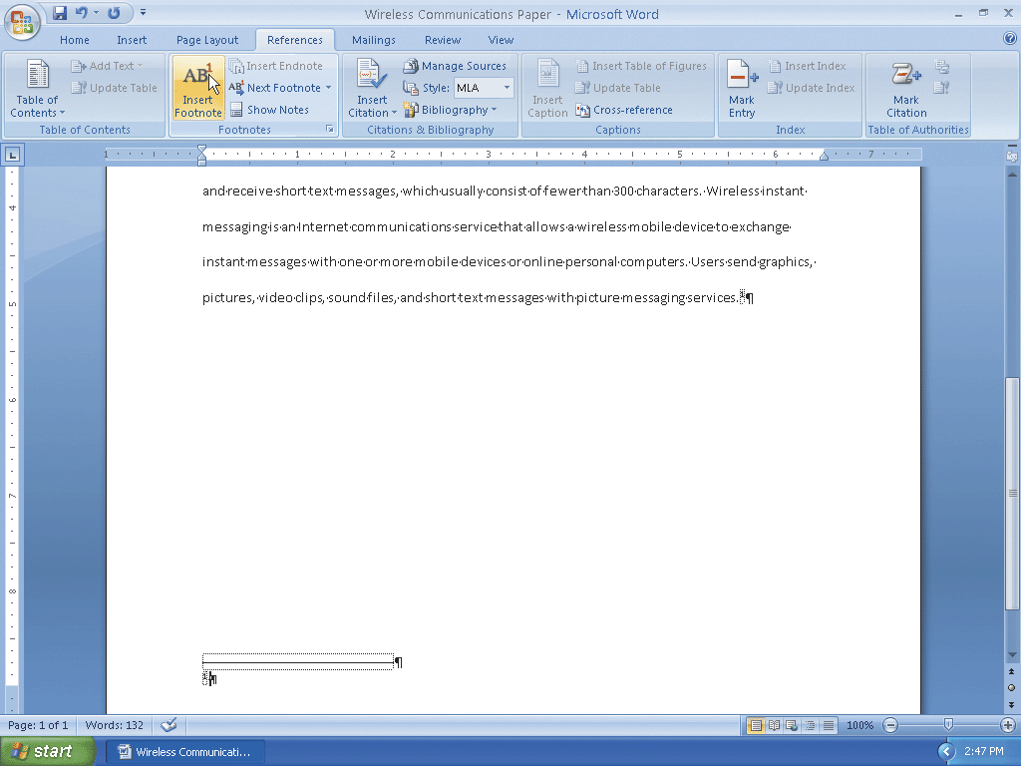
Inserting a Footnote Reference Mark

Slide 55
Entering a Footnote Text
Type the footnote text up to the citation: Podpora and Ruiz indicate that some messaging services use the term, video messaging, to refer separately to the capability of sending video clips and then press the spacebar

Slide 56
Inserting a Citation Placeholder
With the insertion point positioned, click the Insert Citation button on the References tab to display the Insert Citation menu
Click Add New Placeholder on the Insert Citation menu to display the Placeholder Name dialog box
Type Podpora as the tag name for the source
Click the OK button to close the dialog box and insert the tag name in the citation placeholder
Press the PERIOD key to end the sentence

Slide 57
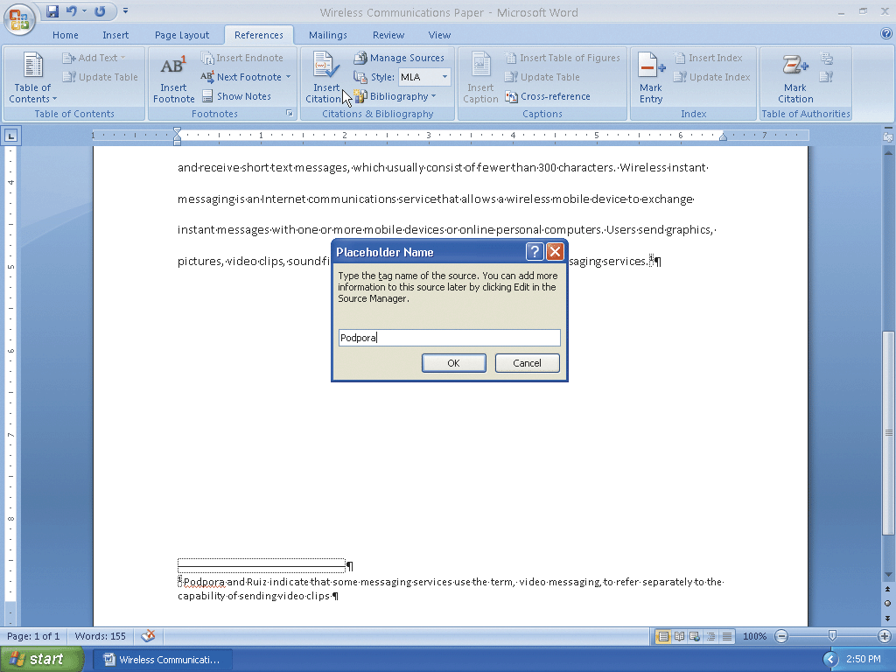
Inserting a Citation Placeholder

Slide 58
Modifying a Style Using a Shortcut Menu
Right-click the note text in the footnote to display a shortcut menu related to footnotes
Click Style on the shortcut menu to display the Style dialog box. If necessary, click Footnote Text in the Styles list
Click the Modify button in the Style dialog box to display the Modify Style dialog box
Click the ‘Style based on’ box arrow and then click Research Paper Paragraphs so that the Footnote Text style is based on the Research Paper Paragraphs style

Slide 59
Modifying a Style Using a Shortcut Menu
Click the ‘Style for following paragraph’ box arrow and then scroll to and click Research Paper Paragraphs so that the additional footnote paragraphs are based on the Research Paper Paragraphs style
Click the Font Size box arrow and then click 11 in the Font Size list to change the font size to 11
Click the Double Space button to set the line spacing to double
Click the OK button in the Modify Style dialog box to close the dialog box
Click the Apply button in the Style dialog box to apply the style changes to the footnote text

Slide 60
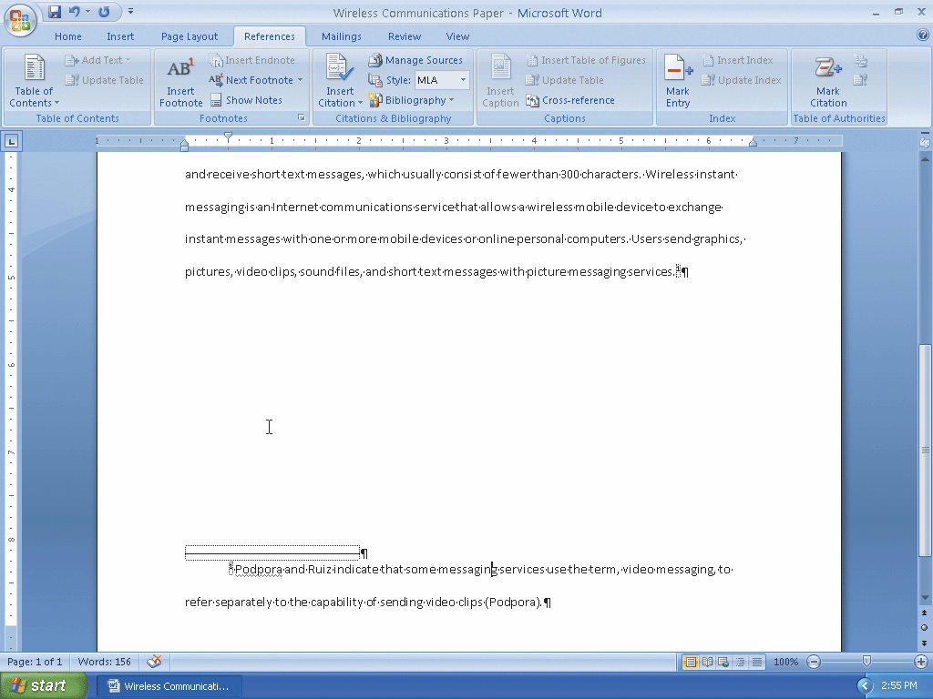
Modifying a Style Using a Shortcut Menu

Slide 61
Editing a Source
Click somewhere in the citation placeholder to be edited, in this case (Podpora), to select the citation placeholder
Click the Citation Options box arrow to display the Citation Options menu
Click Edit Source on the Citation Options menu to display the Edit Source dialog box
If necessary, click the Type of Source box arrow and then click Book, so that the list shows fields required for a book
Click the Author text box. Type Podpora, Maxine C., and Adelbert D. Ruiz as the author

Slide 62
Editing a Source
Click the Title text box. Type Advances in Wireless Internet Access Point Technology as the book title
Press the TAB key and then type 2008 as the year
Press the TAB key and then type Dallas as the city
Press the TAB key and then type Wells Publishing as the publisher
Click the OK button to close the dialog box and create the source

Slide 63
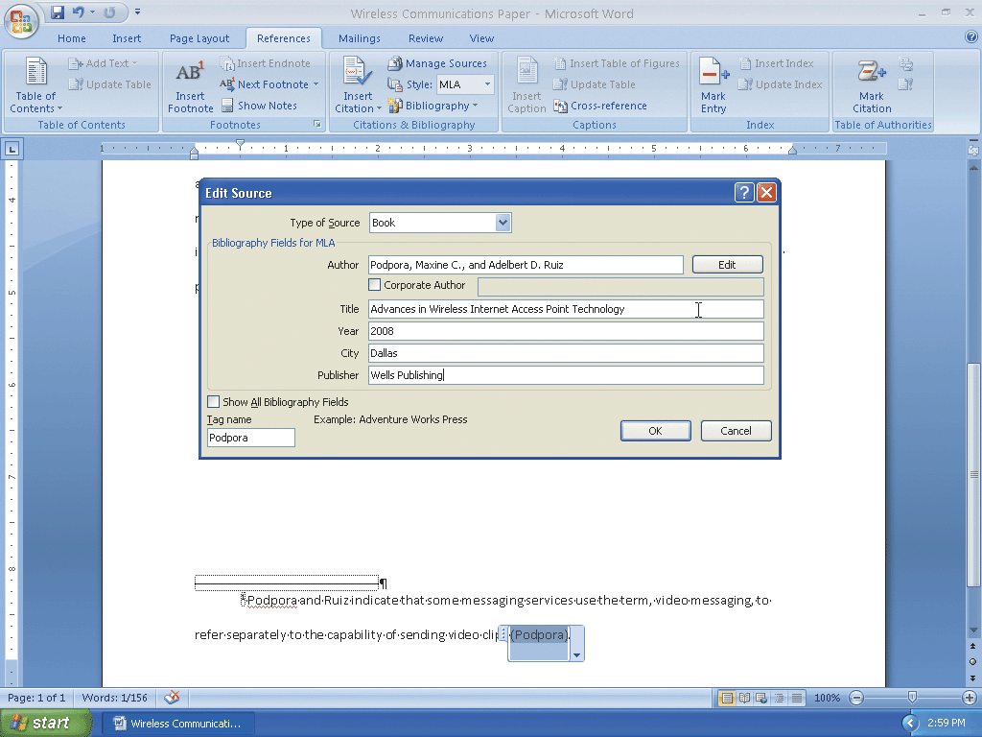
Editing a Source

Slide 64
Editing a Citation
If necessary, click somewhere in the citation to be edited, in this case (Podpora), to select the citation and display the Citation Options box arrow
Click the Citation Options box arrow to display the Citation Options menu
Click Edit Citation on the Citation Options menu to display the Edit Citation dialog box
Type 79-82 in the Pages text box
Click the Author check box to place a check mark in it
Click the OK button to close the dialog box, remove the author name from the citation in the footnote, and add page numbers to the citation

Slide 65
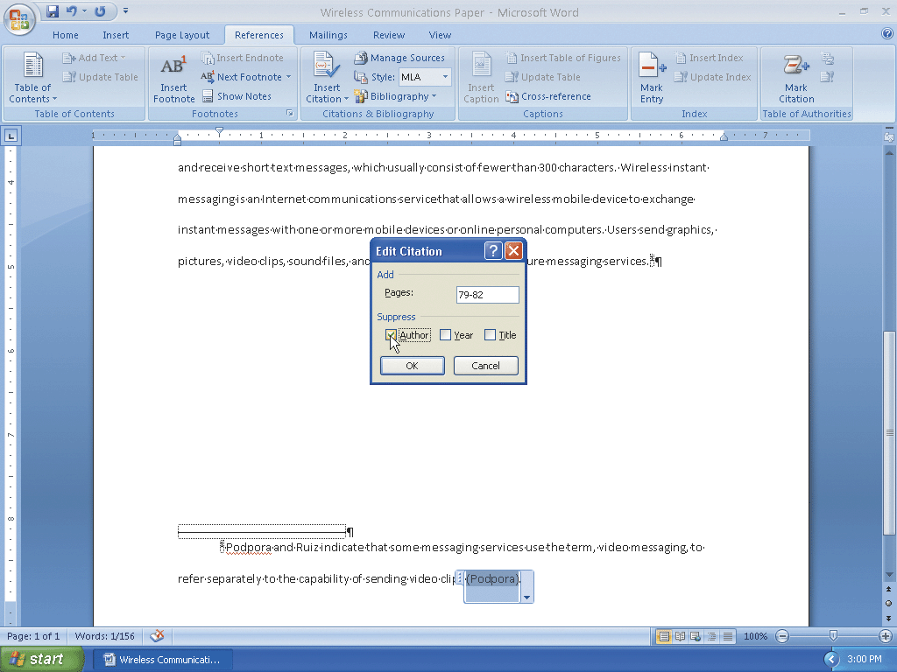
Editing a Citation

Slide 66
Entering More Text
Position the insertion point after the note reference mark in the document, and then press the ENTER key
Type the third paragraph of the research paper: In many public locations, people connect to the Internet through a wireless Internet access point using mobile computers and devices. Two types of wireless Internet access points are hot spots and 3-G networks. A 3-G network, which uses cellular radio technology, enables users to connect to the Internet through a mobile phone or computer equipped with an appropriate PC Card. A hot spot is a wireless network that allows mobile users to check e-mail, browse the Web, and access any Internet service - as long as their computers or devices have the proper wireless capability

Slide 67
Counting Words
Click the Word Count indicator on the status bar to display the Word Count dialog box
If necessary, place a check mark in the ‘Include textboxes, footnotes and endnotes’ check box
Click the Close button to close the dialog box

Slide 68
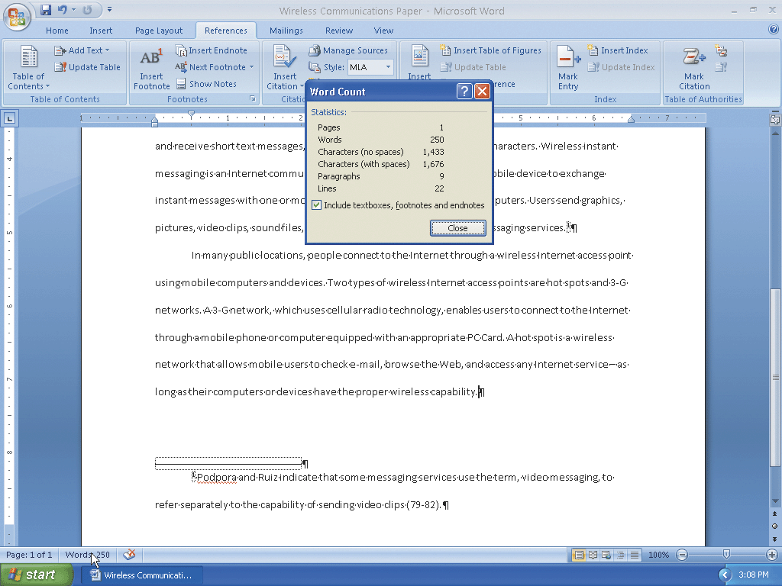
Counting Words

Slide 69
Entering More Text and Inserting a Citation Placeholder
With the insertion point positioned at the end of the third paragraph, press the enter key. Type the fourth paragraph of the research paper: A global positioning system (GPS) is a navigation system that consists of one or more earth-based receivers that accept and analyze signals sent by satellites in order to determine the receiver’s geographic location, according to Shelly and Cashman and then press the SPACEBAR
Click the Insert Citation button on the References tab to display the Insert Citation menu. Click Add New Placeholder on the Insert Citation menu to display the Placeholder Name dialog box
Type Shelly as the tag name for the source

Slide 70
Entering More Text and Inserting a Citation Placeholder
Click the OK button to close the dialog box and insert the tag name in the citation placeholder
Press the PERIOD key to end the sentence.Press the SPACEBAR. Type A GPS receiver is a handheld, mountable, or embedded device that contains an antenna, a radio receiver, and a processor. Many mobile devices, such as mobile phones and PDAs, have GPS capability built into the device.
Press the ENTER key

Slide 71
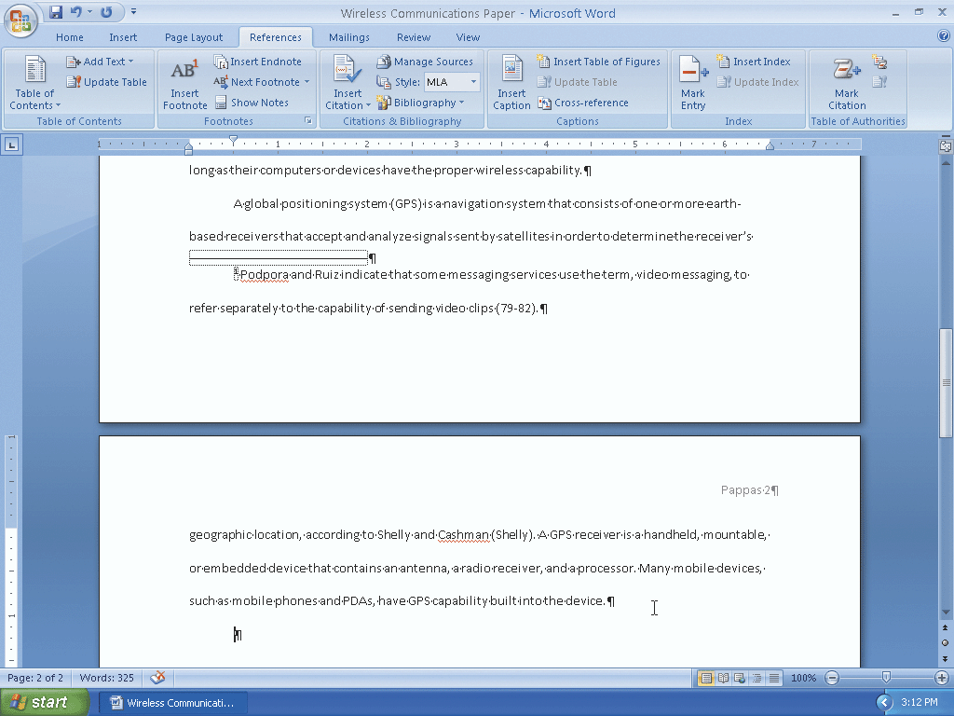
Entering More Text and Inserting a Citation Placeholder

Slide 72
Editing a Source
Click somewhere in the citation placeholder to be edited, in this case (Shelly), to select the citation placeholder
Click the Citation Options box arrow to display the Citation Options menu
Click Edit Source on the Citation Options menu to display the Edit Source dialog box
If necessary, click the Type of Source box arrow, scroll to and then click Web site, so that the list shows fields required for a Web site
Place a check mark in the Show All Bibliography Fields check box to display more fields related to Web sites

Slide 73
Editing a Source
Click the Author text box. Type Shelly, Gary B., and Thomas J. Cashman as the author
Click the Name of Web Page text box. Type How a GPS Works as the Web page title
Click the Production Company text box. Type Course Technology as the production company
Click the Year Accessed text box. Type 2008 as the year
Press the TAB key and then type March as the month accessed

Slide 74
Editing a Source
Press the TAB key and then type 21 as the day accessed
Press the TAB key and then type www.scsite.com/wd2007/pr2/wc.htm as the URL
Click the OK button to close the dialog box and create the source

Slide 75
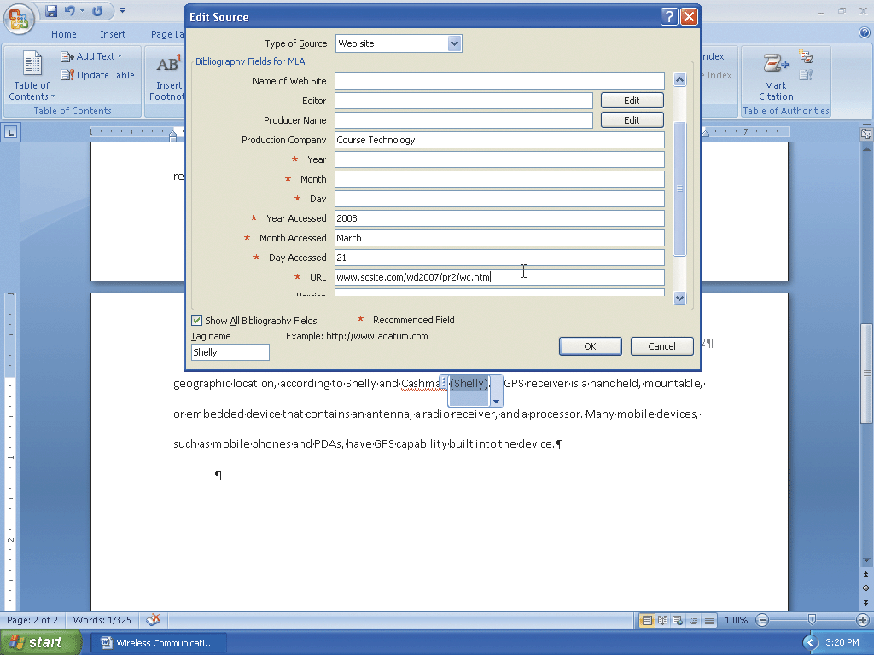
Editing a Source

Slide 76
Editing a Citation
If necessary, click the somewhere in citation to be edited, in this case (Shelly), to select the citation and display the Citation Options box arrow
Click the Citation Options box arrow and then click Edit Citation on the Citation Options menu to display the Edit Citation dialog box
Click the Author check box to place a check mark in it
Click the OK button to close the dialog box, remove the author name from the citation, and show the name of the Web site in the citation

Slide 77
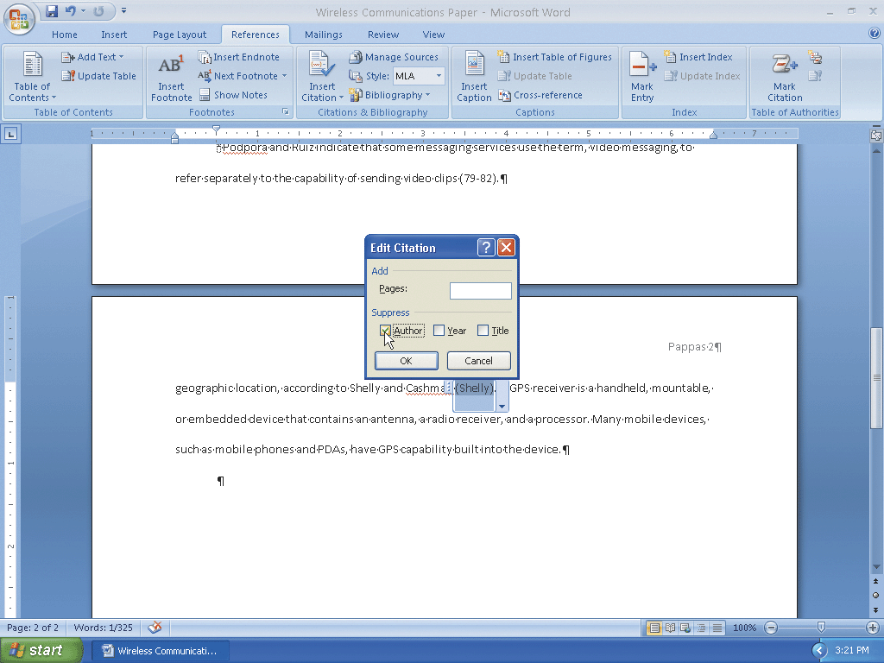
Editing a Citation

Slide 78
Entering More Text
Position the insertion point on the paragraph mark below the fourth paragraph in the research paper
Type the last paragraph of the research paper: Mobile users communicate wirelessly through wireless messaging services, wireless Internet access points, and global positioning systems. Anyone can take advantage of wireless communications using mobile computers and devices

Slide 79
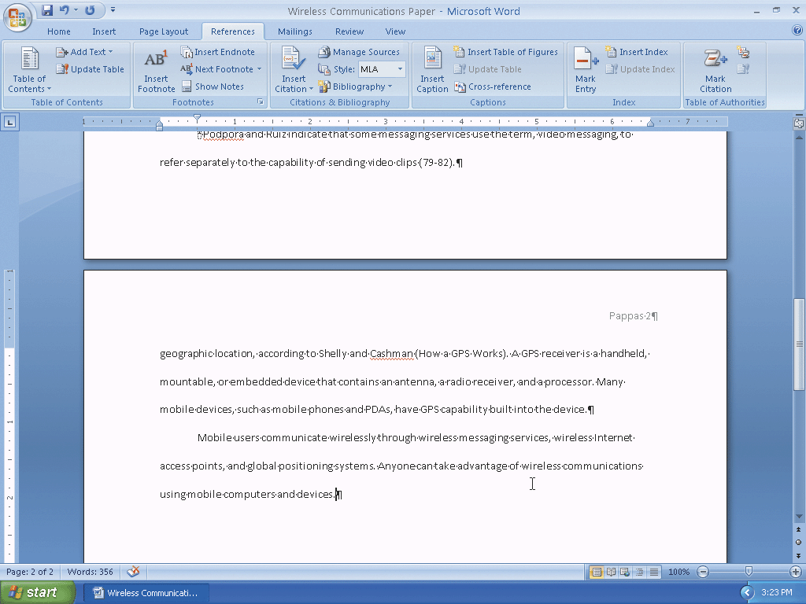
Entering More Text

Slide 80
Saving Existing Documents with the Same File Name
Click the Save button on the Quick Access Toolbar to overwrite the previous Wireless Communications Paper file on the USB flash drive

Slide 81
Page Breaking Manually
With the insertion point at the end of the text of the research paper, press the ENTER key
Then, press CTRL+ENTER to insert a manual page break immediately above the insertion point and position the insertion point immediately below the manual page break
Scroll to position the top of the third page closer to the ruler

Slide 82
Centering the Title of the Works Cited Page
Drag the First Line Indent marker to the 0” mark on the ruler, which is at the left margin, to remove the first-line indent setting
Press CTRL+E to center the paragraph mark
Type Works Cited as the title
Press the ENTER key
Press CTRL+L to left-align the paragraph mark

Slide 83
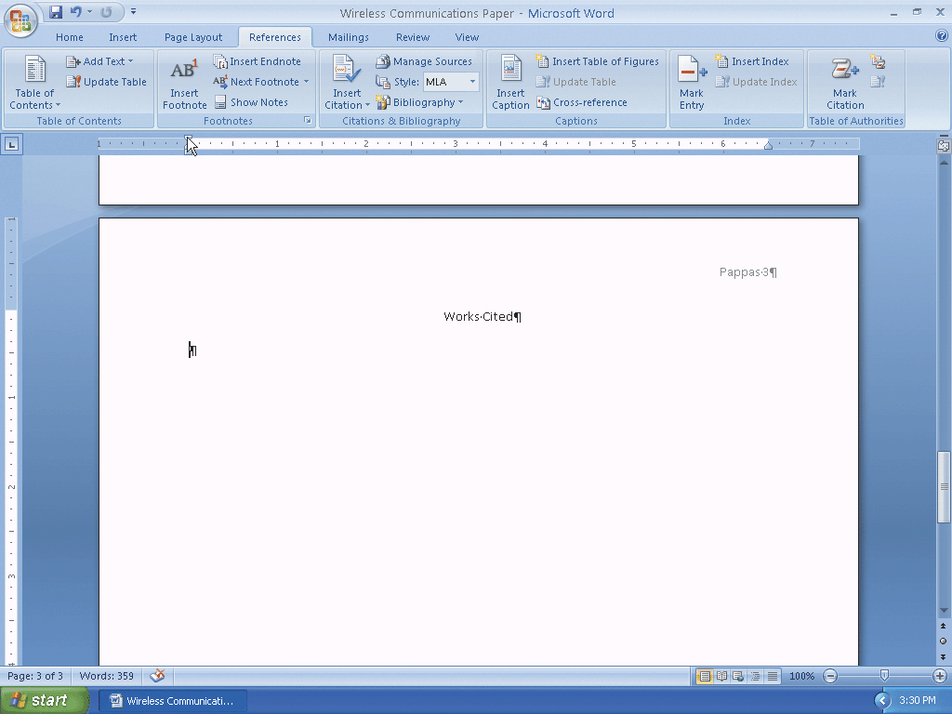
Centering the Title of the Works Cited Page

Slide 84
Creating the Bibliographical List
With the insertion point positioned, click the Bibliography button on the References tab to display the Bibliography gallery
Click Insert Bibliography in the Bibliography gallery to insert a list of sources at the location of the insertion point
If necessary, scroll to display the entire list of sources in the document window

Slide 85
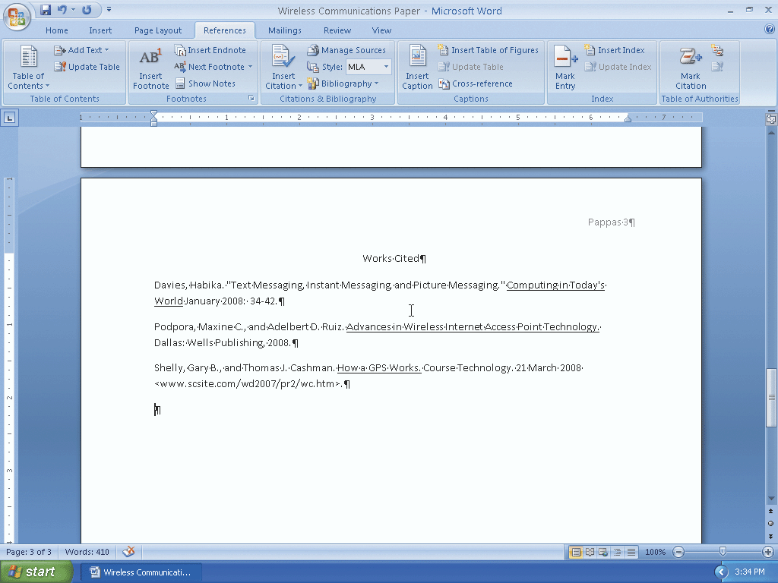
Creating the Bibliographical List

Slide 86
Modifying a Style Using the Styles Task Pane
Click somewhere in the list of sources to position the insertion point in a paragraph formatted with the Bibliography style
Click Home on the Ribbon to display the Home tab.
Click the Styles Dialog Box Launcher to display the Styles task pane.
If necessary, scroll to Bibliography in the Styles task pane. Click Bibliography to select it, if necessary, and then click its box arrow to display the Bibliography menu

Slide 87
Modifying a Style Using the Styles Task Pane
Click the Modify command on the Bibliography menu to display the Modify Style dialog box
Click the ‘Style based on’ box arrow and then click No Spacing to base the Bibliography style on the No Spacing style
Click the ‘Style for following paragraph’ box arrow and then click No Spacing to base additional bibliographical paragraphs on the No Spacing style
Click the Double Space button to set the line spacing to double
Place a check mark in the Automatically update check box so that any future changes you make to the bibliographical paragraphs will update the Bibliography style automatically

Slide 88
Modifying a Style Using the Styles Task Pane
Click the OK button in the Modify Style dialog box to close the dialog box and apply the style changes to the paragraphs in the document
Click the Close button on the Styles task pane title bar to close the task pane

Slide 89
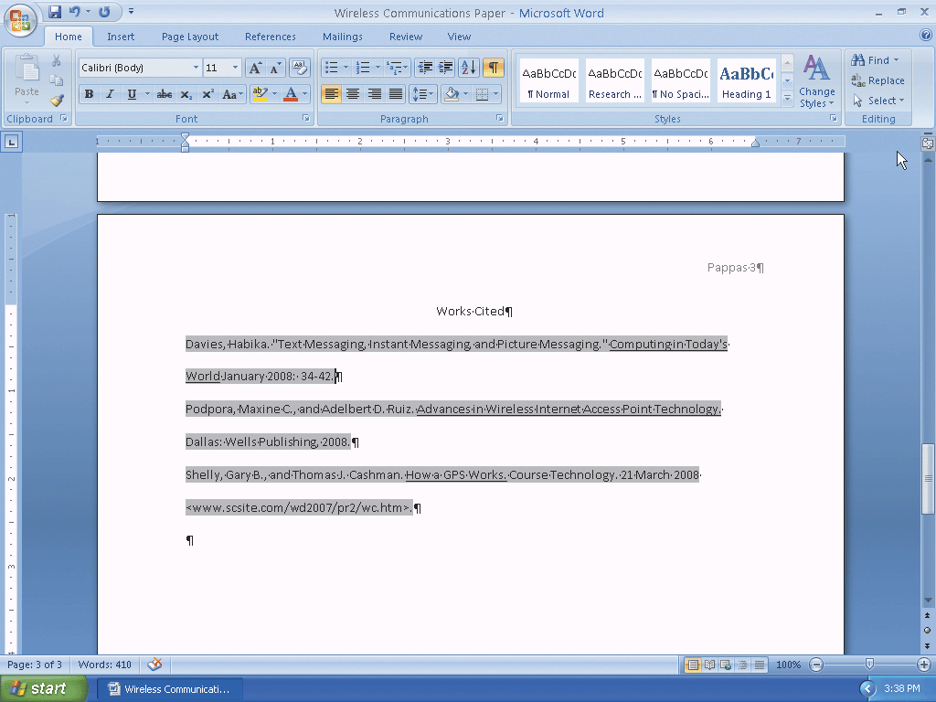
Modifying a Style Using the Styles Task Pane

Slide 90
Creating a Hanging Indent
With the insertion point in the paragraph to format, point to the Hanging Indent marker on the ruler
Drag the Hanging Indent marker to the .5” mark on the ruler to set the hanging indent to one-half inch from the left margin

Slide 91
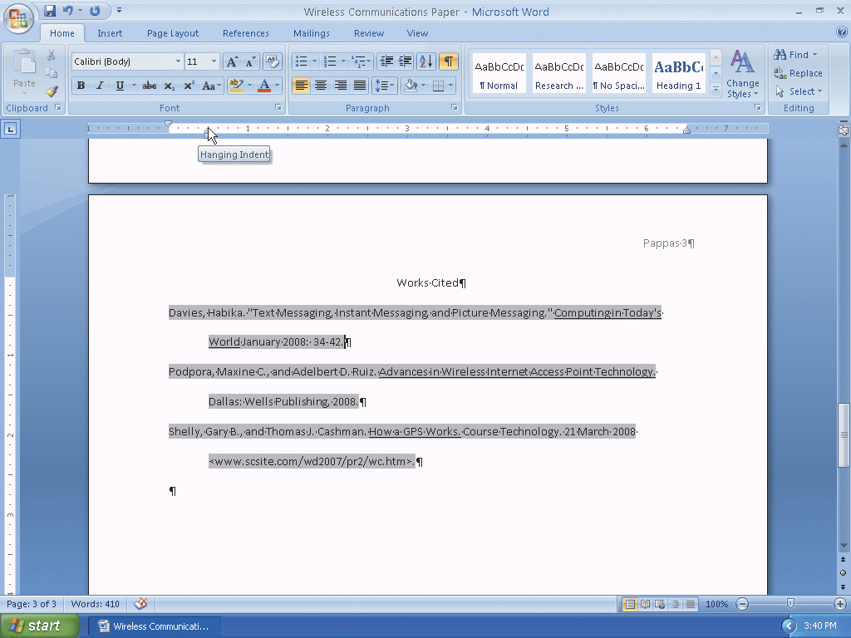
Creating a Hanging Indent

Slide 92
Modifying a Source and Update the Bibliographical List
Click References on the Ribbon to display the References tab
Click the Manage Sources button on the References tab to display the Source Manager dialog box
Click the source you wish to edit in the Current List
Click the Edit button to display the Edit Source dialog box
In the Title text box, add the word, Services, to the end of the title

Slide 93
Modifying a Source and Update the Bibliographical List
Click the OK button to close the Edit Source dialog box
If a Microsoft Office Word dialog box appears, click its Yes button to update all occurrences of the source
Click the Close button in the Source Manager dialog box and update the list of sources in the document

Slide 94
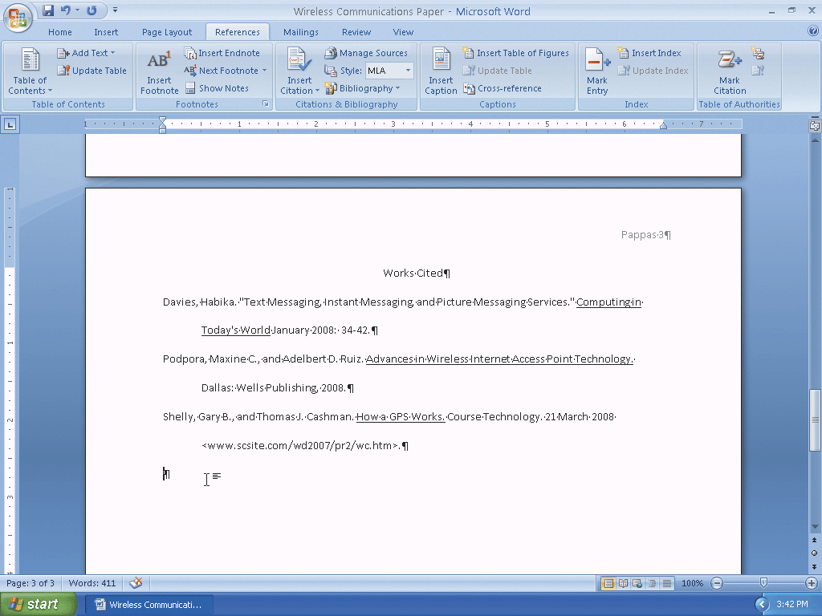
Modifying a Source and Update the Bibliographical List

Slide 95
Using the Select Browse Object Menu
Click the Select Browse Object button on the vertical scroll bar to display the Select Browse Object menu and then position the mouse pointer on the Browse by Footnote icon
Click the Browse by Footnote icon to set the browse object to footnotes
Position the mouse pointer on the Previous Footnote button on the vertical scroll bar
Click the Previous Footnote button to display the footnote reference mark in the document window

Slide 96
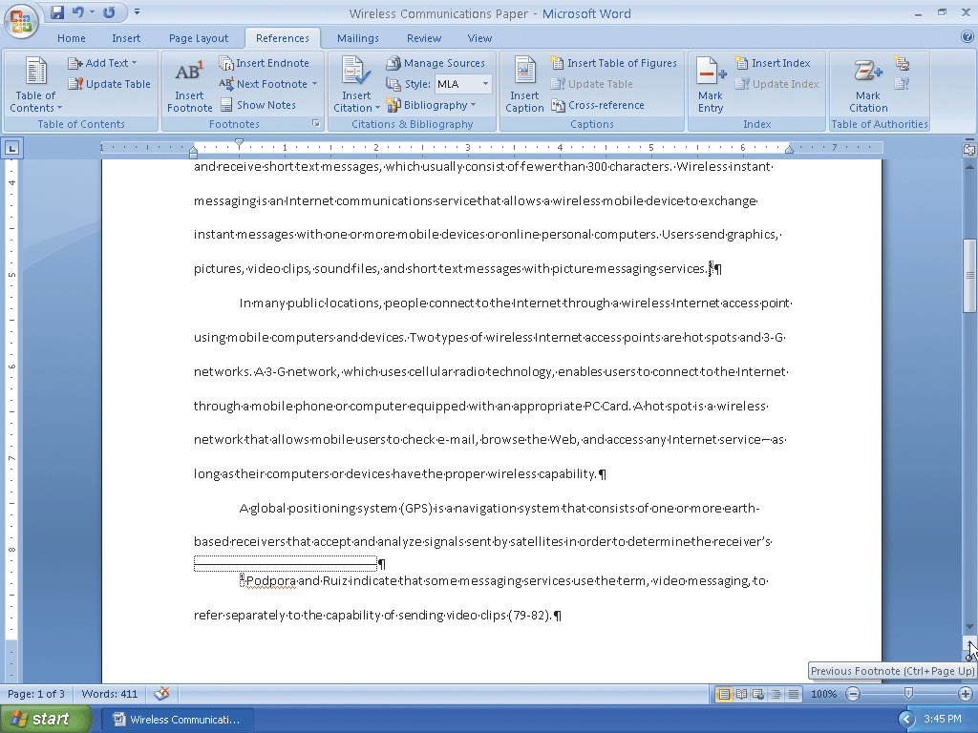
Using the Select Browse Object Menu

Slide 97
Selecting a Sentence
Position the mouse pointer in the sentence to be moved
Press and hold down the CTRL key. While holding down the CTRL key, click the sentence to select the entire sentence
Release the CTRL key

Slide 98
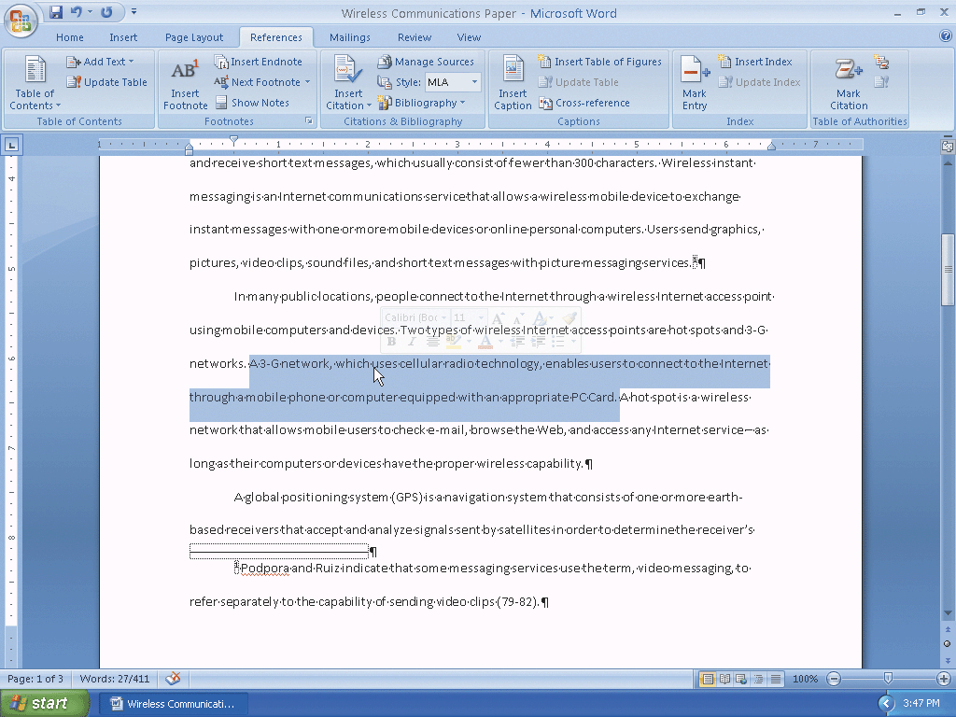
Selecting a Sentence

Slide 99
Moving Selected Text
With the mouse pointer in the selected text, press and hold down the mouse button
Drag the mouse pointer to the location where the selected text is to be moved
Release the mouse button to move the selected text to the location of the mouse pointer
Click outside the selected text to remove the selection

Slide 100
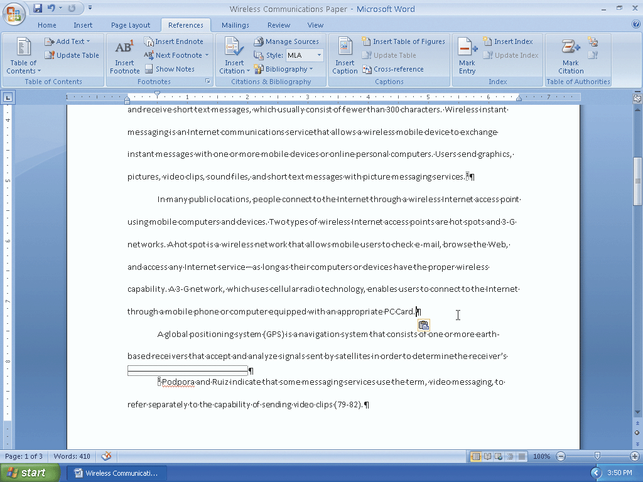
Moving Selected Text

Slide 101
Displaying the Paste Options Menu
Click the Paste Options button to display the Paste Options menu
Press the ESCAPE key to remove the Paste Options menu from the window

Slide 102
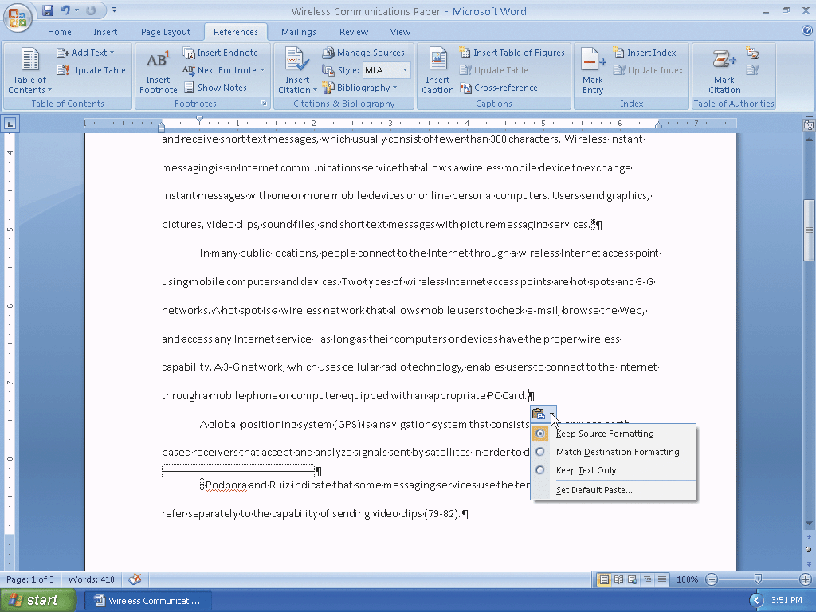
Displaying the Paste Options Menu

Slide 103
Finding and Replacing Text
Click Home on the Ribbon to display the Home tab. Click the Replace button on the Home tab to display the Find and Replace dialog box
Type 3-G in the Find what text box
Press the TAB key. Type 3G in the Replace with text box

Slide 104
Finding and Replacing Text
Click the Replace All button in the Find and Replace dialog box to instruct Word to replace all occurrences of the find what text with the replace with text
Click the OK button in the Microsoft Office Word dialog box
Click the Close button in the Find and Replace dialog box

Slide 105
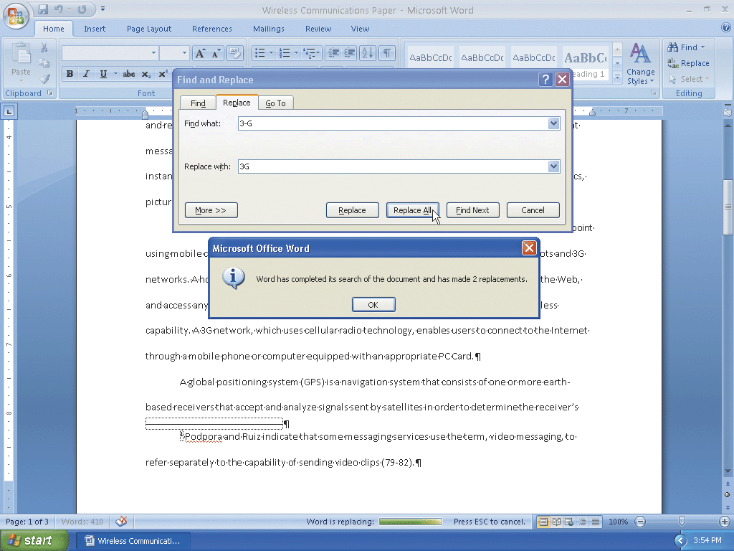
Finding and Replacing Text

Slide 106
Finding and Inserting a Synonym
Right-click the word for which you want to find a synonym (in this case, proper) to display a shortcut menu related to the word you right-clicked
Point to Synonyms on the shortcut menu to display a list of synonyms for the word you right-clicked
Click the synonym you want (appropriate) on the Synonyms submenu to replace the word, proper, in the document with the word, appropriate

Slide 107
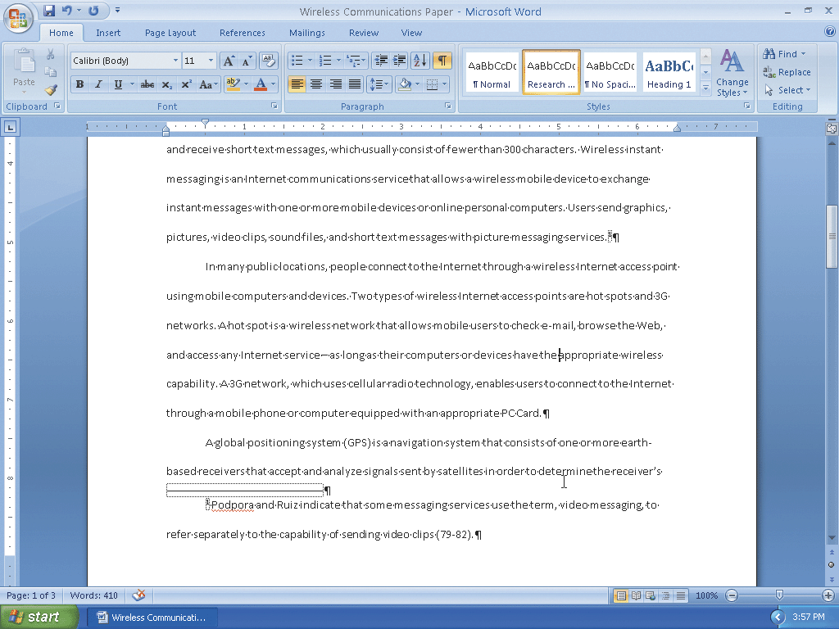
Finding and Inserting a Synonym

Slide 108
Checking Spelling and Grammar at Once
Press CTRL+HOME because you want the spelling and grammar check to begin from the top of the document
Click Review on the Ribbon to display the Review tab
Click the Spelling & Grammar button on the Review tab to begin the spelling and grammar check at the location of the insertion point, which in this case, is at the beginning of the document
With the word, world, selected in the Suggestions list, click the Change button in the Spelling and Grammar dialog box to change the flagged word, wrld, to the selected suggestion, world, and then continue the spelling and grammar check until the next error is identified or the end of the document is reached

Slide 109
Checking Spelling and Grammar at Once
Click the Ignore All button in the Spelling and Grammar dialog box to ignore this and future occurrences of the flagged proper noun and then continue the spelling and grammar check until the next error is identified or the end of the document is reached
When Word flags the proper noun, Podpora, click the Ignore All button
When the spelling and grammar check is finished and Word displays a dialog box, click its OK button

Slide 110
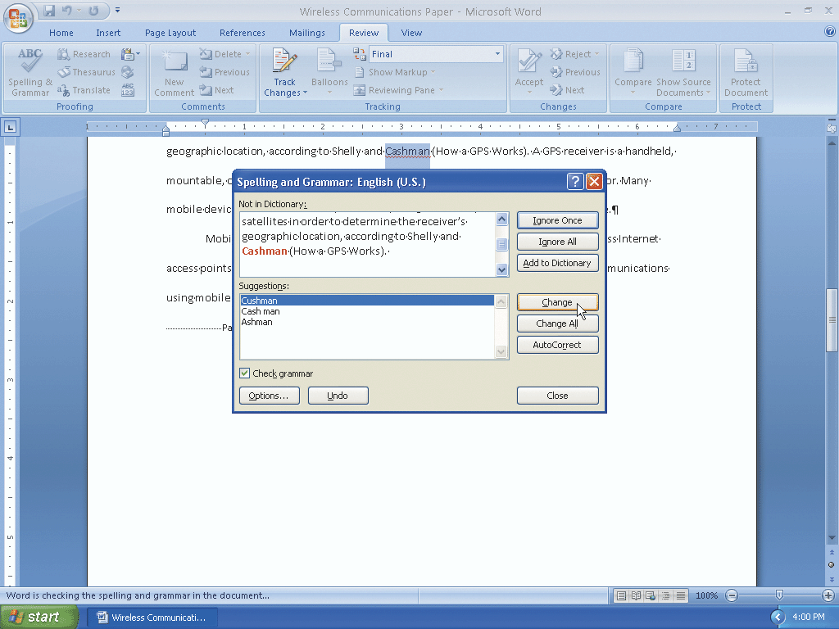
Checking Spelling and Grammar at Once

Slide 111
Using the Research Task Pane to Look Up Information
While holding down the ALT key, click the word you want to look up (in this case, PDAs) to open the Research task pane and display a dictionary entry for the ALT+CLICKED word. Release the ALT key
If the Research task pane does not display a dictionary entry for the ALT+CLICKED word, click the Search for box arrow and then click All Reference Books
Click the Search for box arrow and then click All Research Sites in the list to display Web sites with information about the ALT+CLICKED word
Click the Close button in the Research task pane

Slide 112
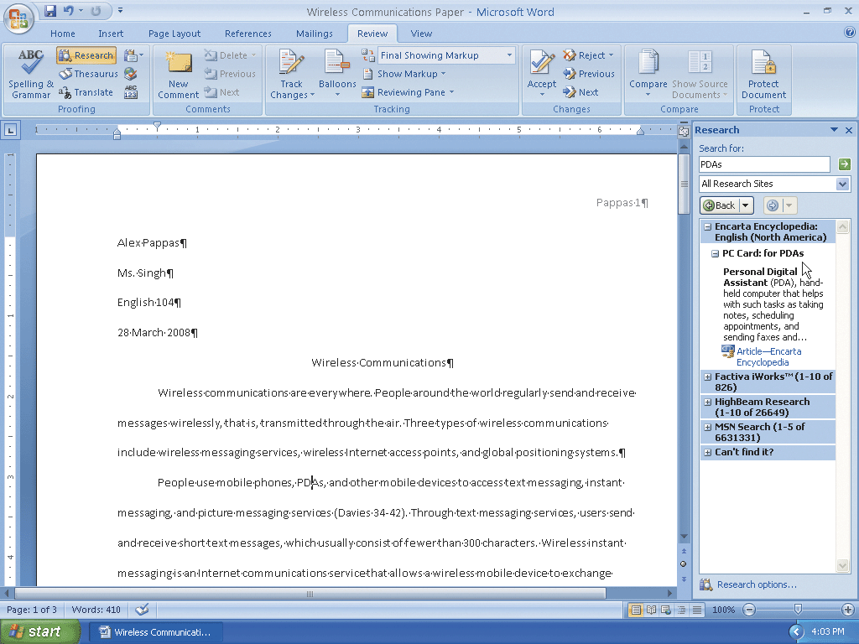
Using the Research Task Pane to Look Up Information

Slide 113
Changing Document Properties
Click the Office Button to display the Office Button menu, point to Prepare on the Office Button menu, and then click Properties on the Prepare submenu to display the Document Information Panel
Click the Author text box, if necessary, and then type your name as the Author property. If a name already is displayed in the Author text box, delete it before typing your name
Click the Subject text box, if necessary delete any existing text, and then type your course and section as the Subject property
Click the Keywords text box, if necessary delete any existing text, and then type instant messaging, Internet access points, global positioning systems as the Keywords property
Click the Close the Document Information Panel button so that the Document Information Panel no longer is displayed

Slide 114
Saving an Existing Document with the Same File Name
Click the Save button on the Quick Access Toolbar to overwrite the previous Wireless Communications Paper file on the USB flash drive

Slide 115
Printing Document Properties and then the Document
Click the Office Button to display the Office Button menu and then point to Print on the Office Button menu to display the Print submenu
Click Print on the Print submenu to display the Print dialog box
Click the Print what box arrow and then click Document properties to instruct Word to print the document properties instead of the document
Click the OK button to print the document properties
Click the Office Button again to display the Office Button menu, point to Print on the Office Button menu, and then click Quick Print on the Print submenu to print the research paper

Slide 116
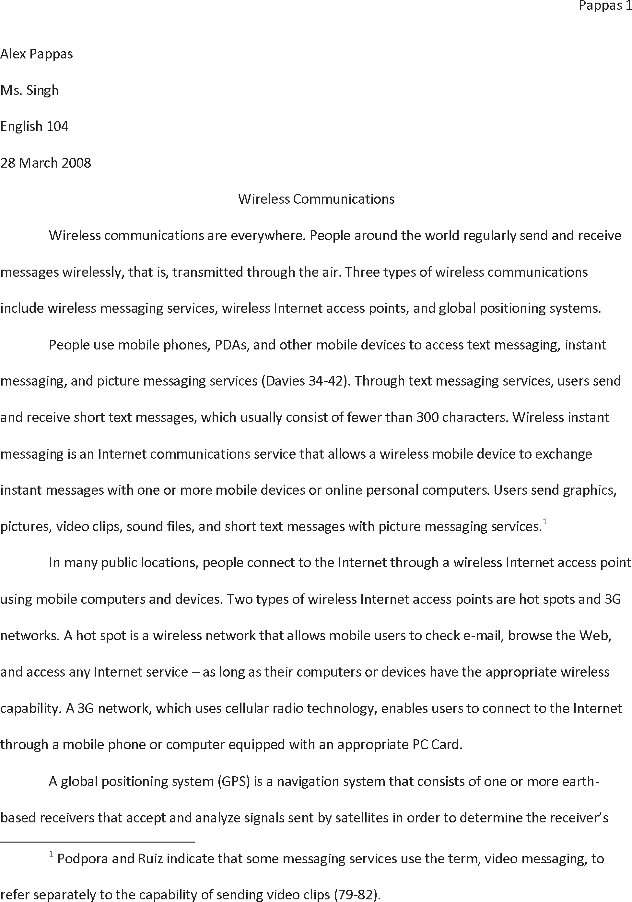
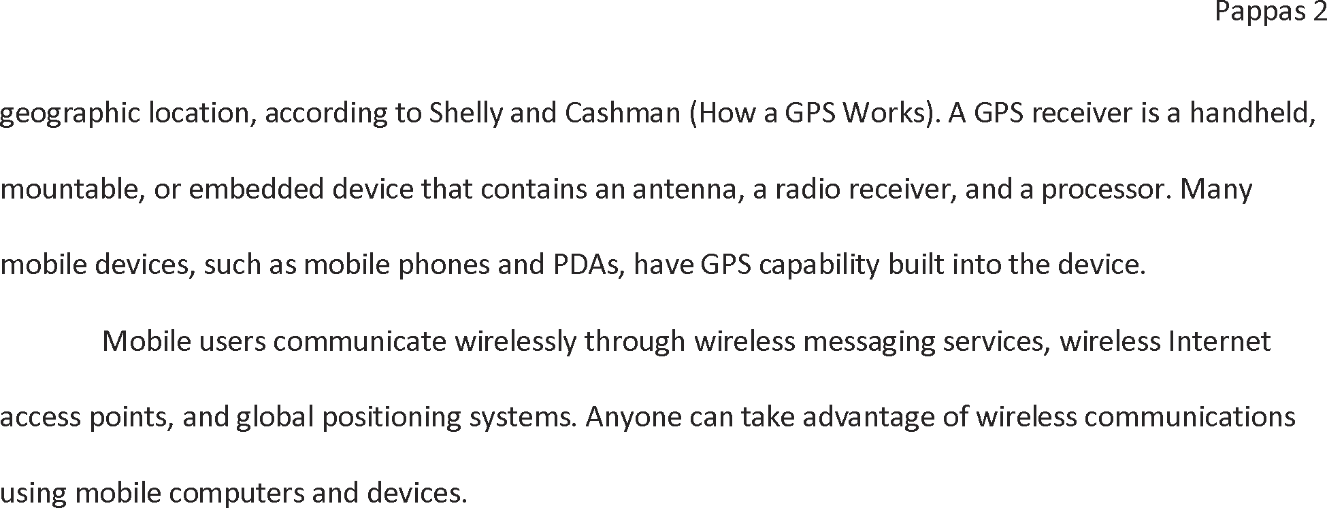
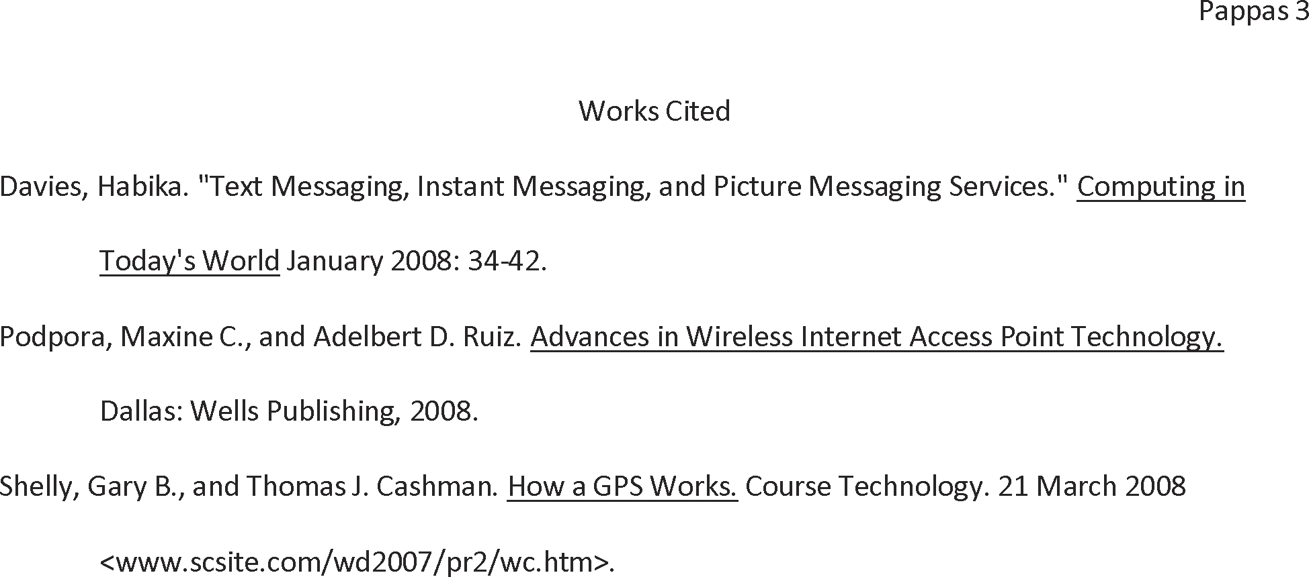
Printing Document Properties and then the Document

Slide 117
Quitting Word
Click the Close button on the right side of the title bar to quit Word
If necessary, click the Yes button in the Microsoft Office Word dialog box so that any changes you have made are saved

Slide 118
Summary
Describe the MLA documentation style for research papers
Change line and paragraph spacing in a document
Use a header to number pages of a document
Apply formatting using shortcut keys
Modify paragraph indentation
Create and modify styles

Slide 119
Summary
Insert and edit citations and their sources
Add a footnote to a document
Insert a manual page break
Create a bibliographical list of sources
Move text
Find and replace text
Use the Research task pane to look up information

Slide 120
Word Chapter 2 Complete

