Slide 1
Microsoft Windows XP
Introduction to
Microsoft Windows XP

Slide 2
Objectives
Start Microsoft Windows XP, log on to the computer, and identify the objects on the desktop
Perform the basic mouse operations: point, click, right-click, double-click, drag, and right-drag
Display the Start menu and start an application program
Open, minimize, maximize, restore, move, size, scroll, and close a window
Display drive and folder contents
Create a folder in Windows Explorer and a WordPad document

Slide 3
Objectives
Browse the Web using Internet Explorer 7.0, a URL, and tabbed browsing
Download folders from scsite.com
Copy, move, rename, and delete files
Search for files using a word or phrase in the fi le or by name
Use Help and Support
Log off from the computer and turn it off

Slide 4
Logging On to the Computer
Click the Brad Wilson icon (or your icon) on the Welcome screen to display the ‘Type your password’ text box
Type 32lake (or your password) in the ‘Type your password’ text box
Click the Next button to log on to the computer and display the Windows XP desktop

Slide 5
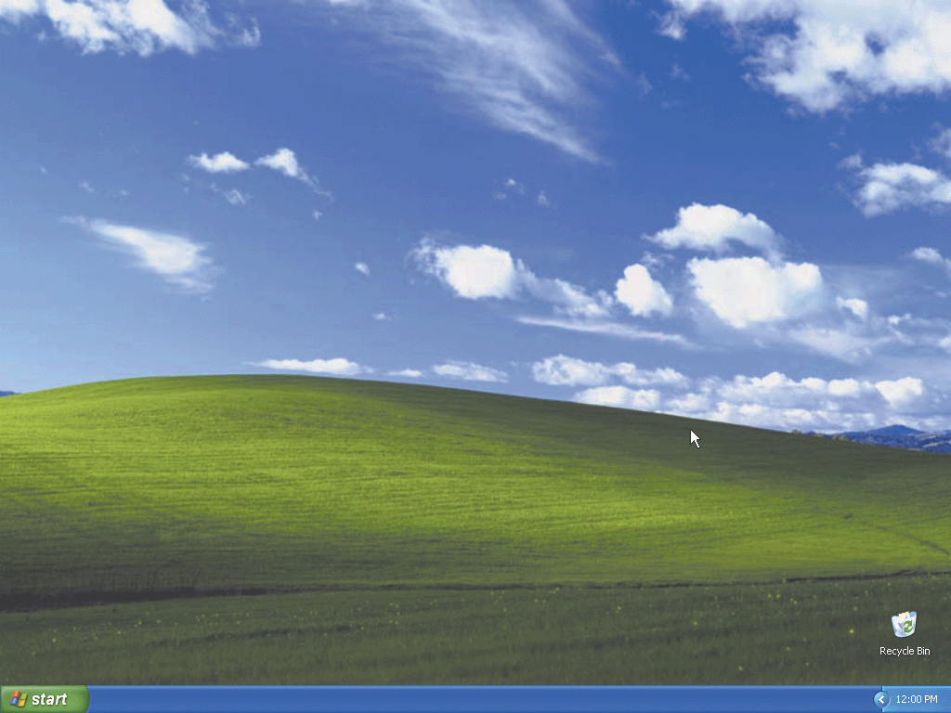
Logging On to the Computer

Slide 6
Displaying the Start Menu
Point to the Start button on the taskbar to display the ToolTip. Click here to begin
Click the Start button on the Windows taskbar to display the Start menu
Point to All Programs on the Start menu to display the All Programs submenu
Point to Accessories on the All Programs submenu to display the Accessories submenu
Click an open area on the desktop to close the Start menu, Accessories submenu, and All Programs submenu

Slide 7
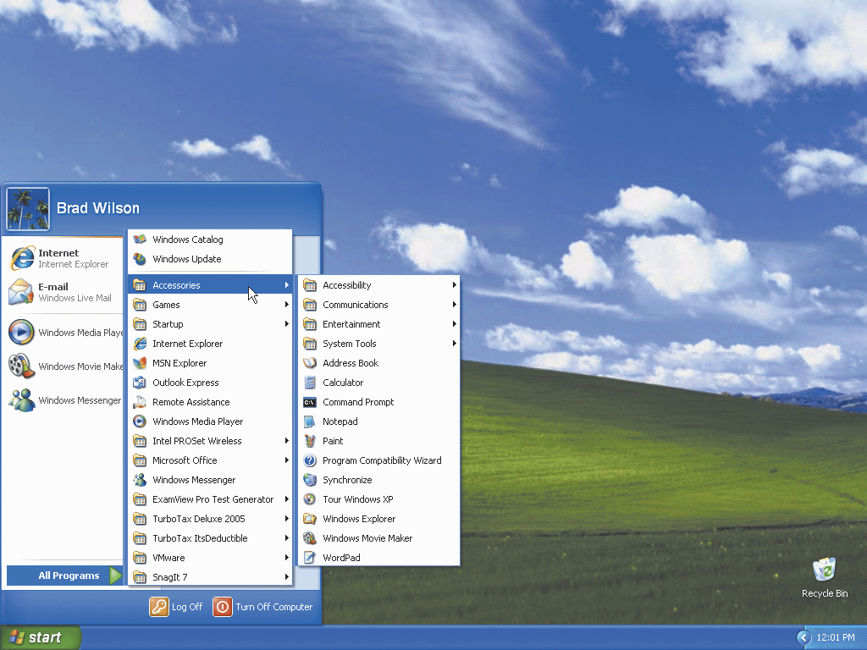
Displaying the Start Menu

Slide 8
Adding an Icon to the Desktop
Click the Start button to display the Start menu
Right-click My Computer on the Start menu to select the My Computer command and display a shortcut menu
Click Show on Desktop to close the shortcut menu and display the My Computer icon on the desktop
Click an open area on the desktop to close the Start menu

Slide 9
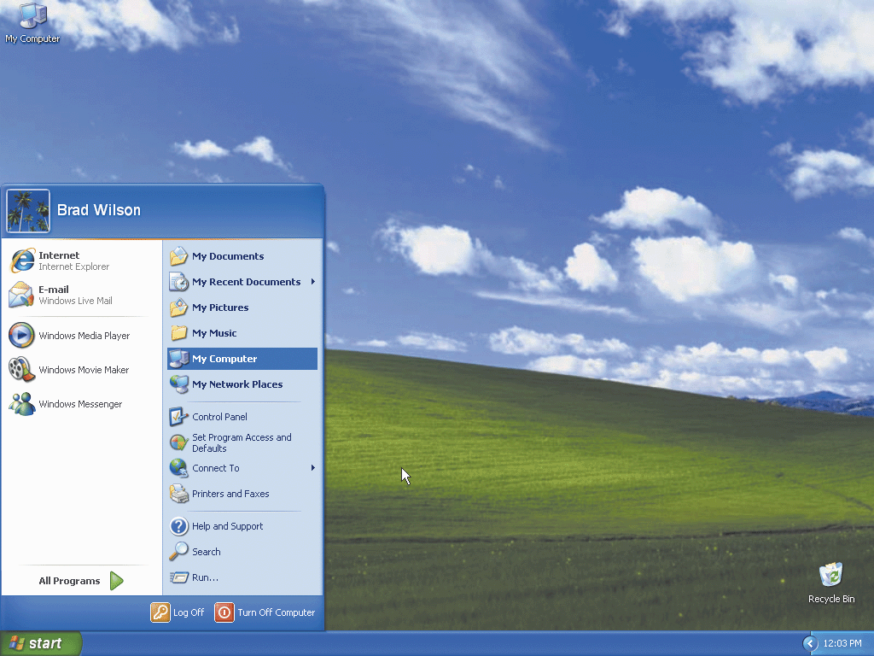
Adding an Icon to the Desktop

Slide 10
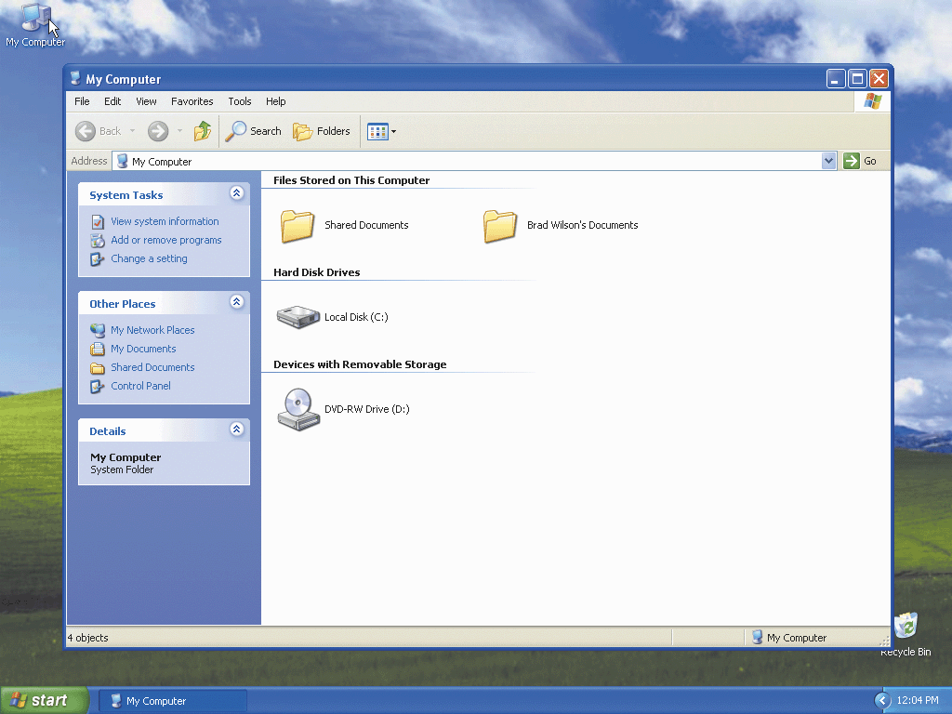
Opening a Window By Double-Clicking a Desktop Icon
Double-click the My Computer icon on the desktop by quickly pressing and releasing the left mouse button twice without moving the mouse

Slide 11
Minimizing and Redisplaying a Window
Click the Minimize button on the title bar of the My Computer window to minimize the My Computer window
Click the My Computer button in the taskbar button area to display the My Computer window

Slide 12
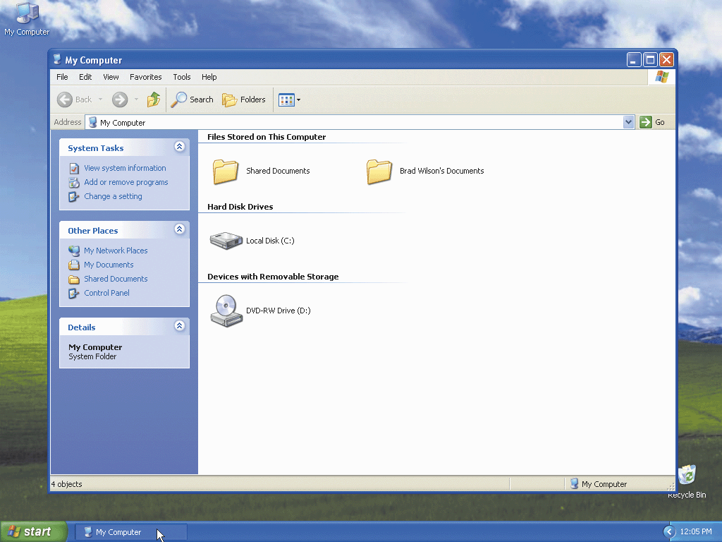
Minimizing and Redisplaying a Window

Slide 13
Maximizing and Restoring a Window
Click the Maximize button on the title bar of the My Computer window to maximize the My Computer window
Click the Restore Down button on the title bar of the My Computer window to return the My Computer window to its previous size

Slide 14

Maximizing and Restoring a Window

Slide 15

Closing a Window
Click the Close button on the title bar of the My Computer window to close the My Computer window

Slide 16
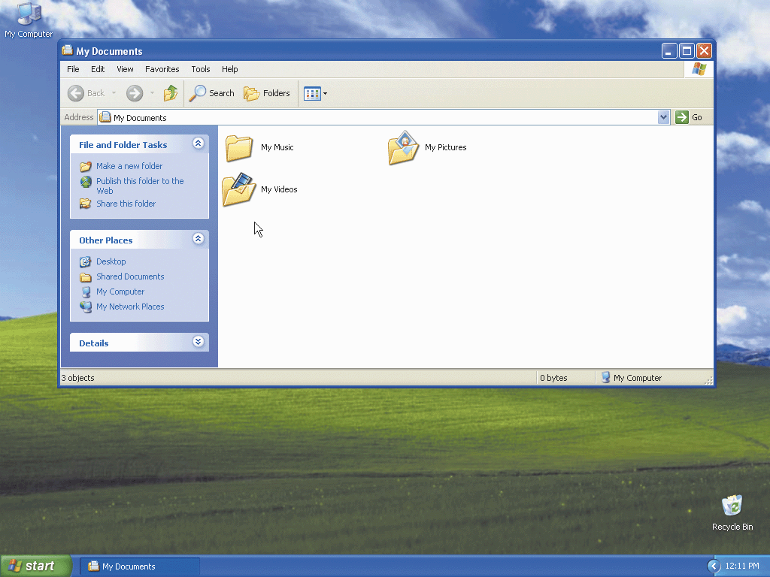
Opening a Window Using the Start Menu
Display the Start menu
Click My Documents on the Start menu to display the My Documents window

Slide 17
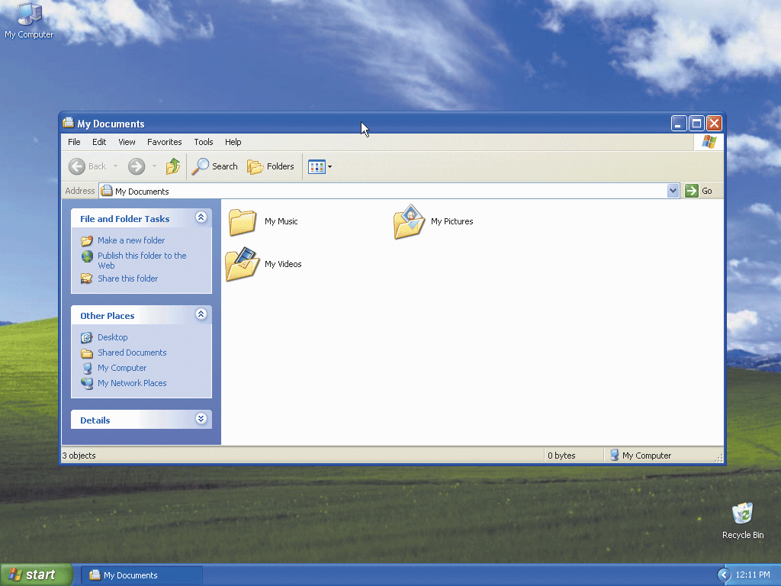
Moving a Window by Dragging
Point to the My Documents window title bar
Hold down the left mouse button, move the mouse so the window moves to the center of the desktop, and release the left mouse button

Slide 18

Expanding an Area
Click the double down arrow button in the Details area to expand the Details area in the left pane of the My Documents window

Slide 19
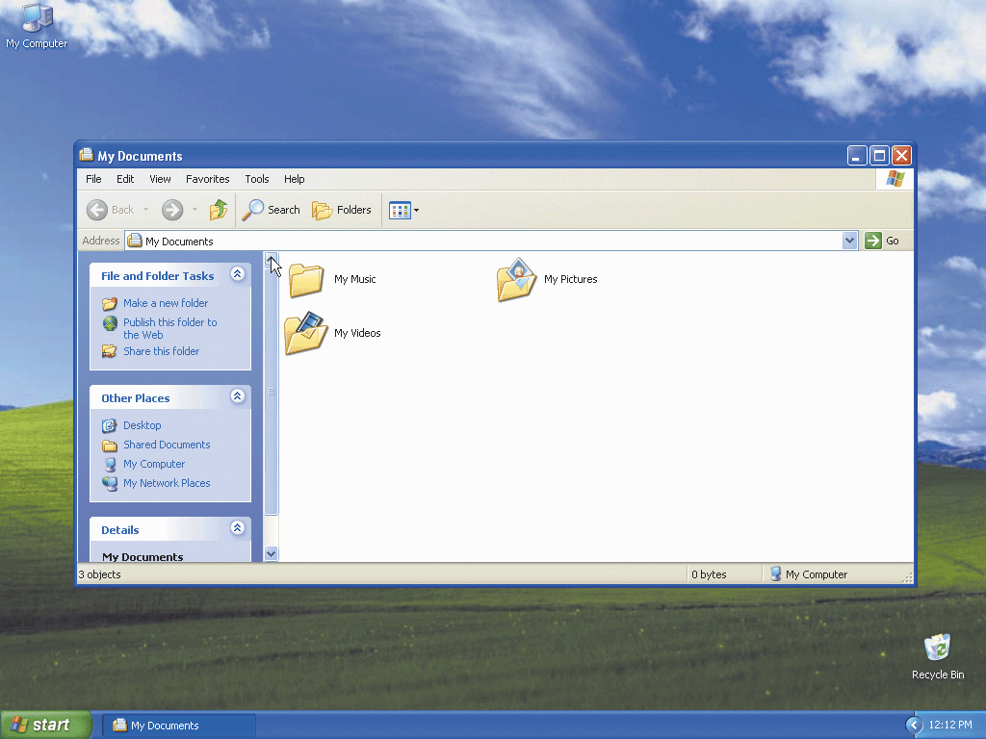
Scrolling Using Scroll Arrows
Click the up scroll arrow two times on the vertical scroll bar to scroll the left pane down
Click the up scroll arrow two more times to move the scroll box to the top of the scroll bar

Slide 20
Sizing a Window by Dragging
Point to the bottom border of the My Documents window until the mouse pointer changes to a two-headed arrow
Drag the bottom border downward until the Details area on your desktop resembles the Details area shown on the following slide

Slide 21
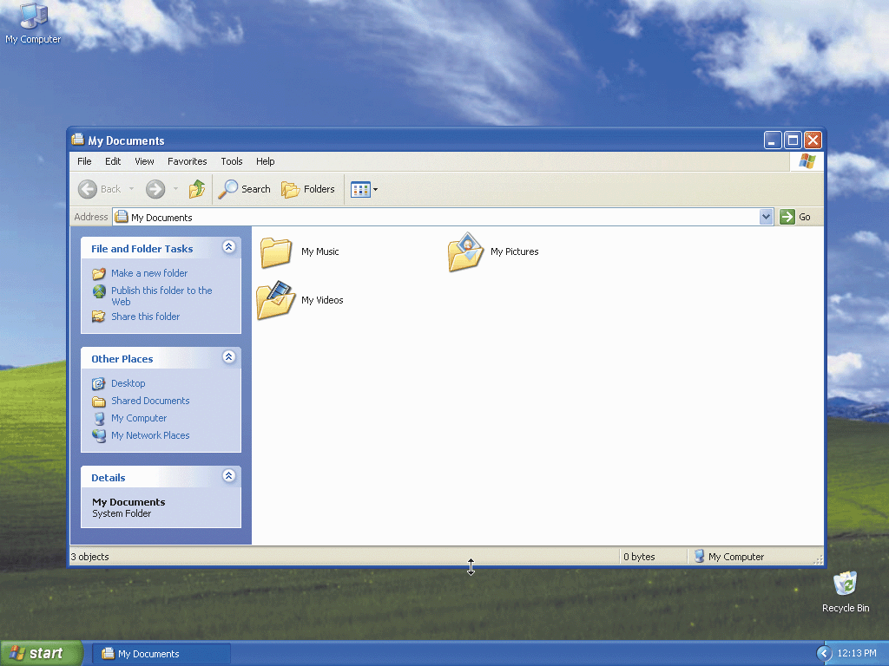
Sizing a Window by Dragging

Slide 22
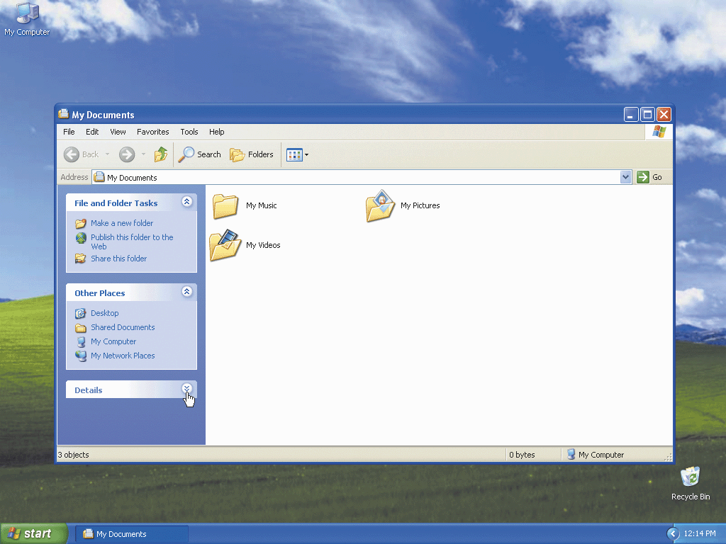
Collapsing an Area
Click the double up arrow button in the Details area to collapse the Details area

Slide 23
Resizing a Window
Position the mouse pointer over the bottom border of the My Documents window border until the mouse pointer changes to a two-headed arrow
Drag the bottom border of the My Documents window up until the window is the same size as shown in Figure 1–22 on page XP 17 and then release the mouse button

Slide 24
Closing a Window
Click the Close button on the right of the title bar in the My Documents window to close the My Documents window

Slide 25
Deleting a Desktop Icon by Right-Dragging
Point to the My Computer icon on the desktop, hold down the right mouse button, drag the My Computer icon over the Recycle Bin icon, and then release the right mouse button to display a shortcut menu
Click Move Here on the shortcut menu to close the shortcut menu and display the Confirm Delete dialog box
Click the Yes button to delete the My Computer icon and close the Confirm Delete dialog box

Slide 26
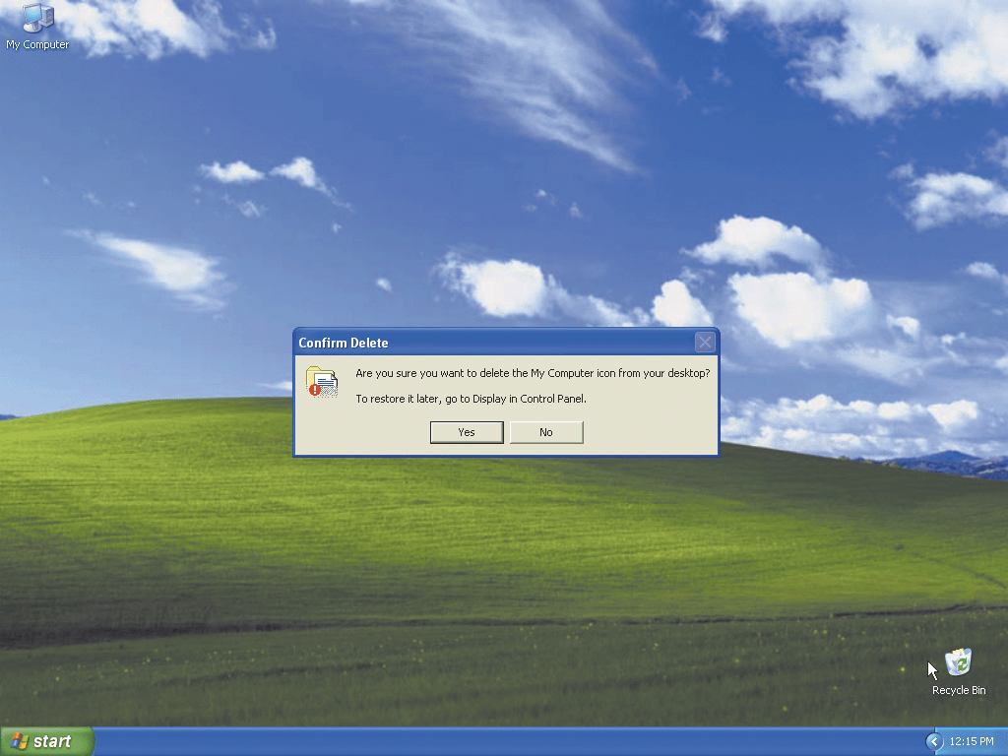
Deleting a Desktop Icon by Right-Dragging

Slide 27
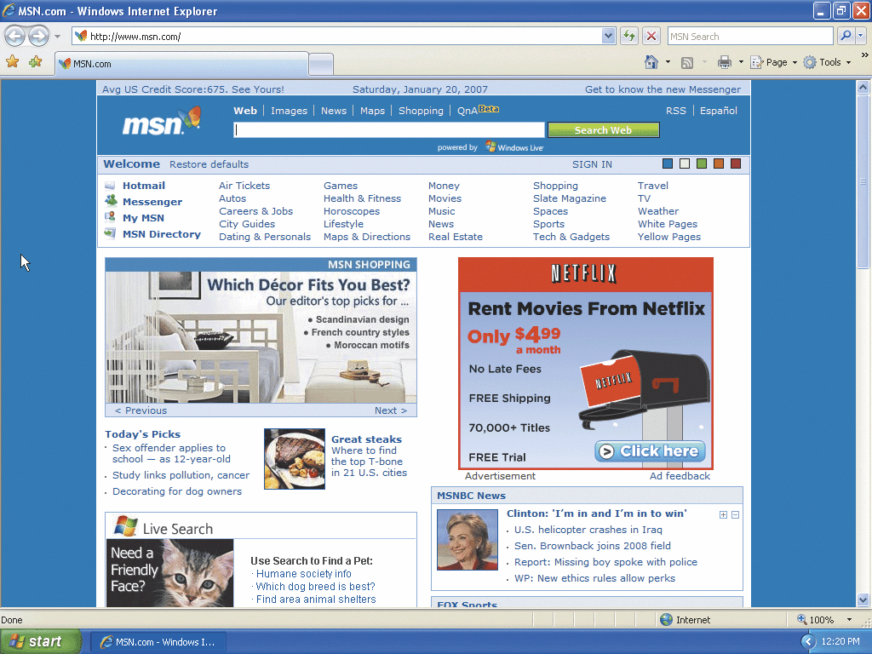
Starting an Application
Using the Start Menu
Display the Start menu
Click the Internet icon in the pinned items list on the Start menu to start the Windows Internet Explorer program

Slide 28
Browsing the Web by Entering a URL
Click the Address Path text box to select the URL in the Address Path text box
Type www.scsite.com in the Address Path text box to display the new URL in the Address text box
Click the Go to button to display the SC Site –Shelly Cashman Series Student Resources page

Slide 29
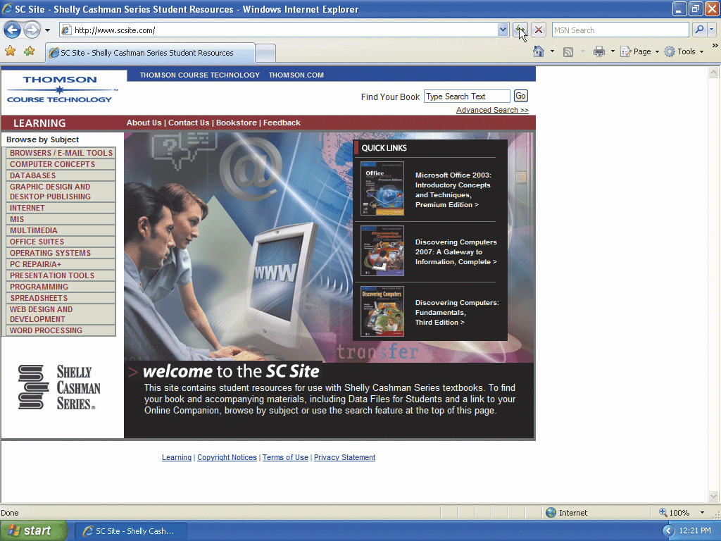
Browsing the Web by Entering a URL

Slide 30
Opening a Link in a New Tab
Click the Web Search box and type Shelly Cashman Series in the Web Search box
Click the Search button to the right of the Web Search box to display the results of the Web search
If necessary, scroll to view the Course Technology –Shelly Cashman Series link
Right-click the Course Technology – Shelly Cashman Series link to display a shortcut menu
Click the Open in New Tab command on the shortcut menu to close the shortcut menu and display the Course Technology – Shelly Cashman Series tab on the Standard toolbar

Slide 31
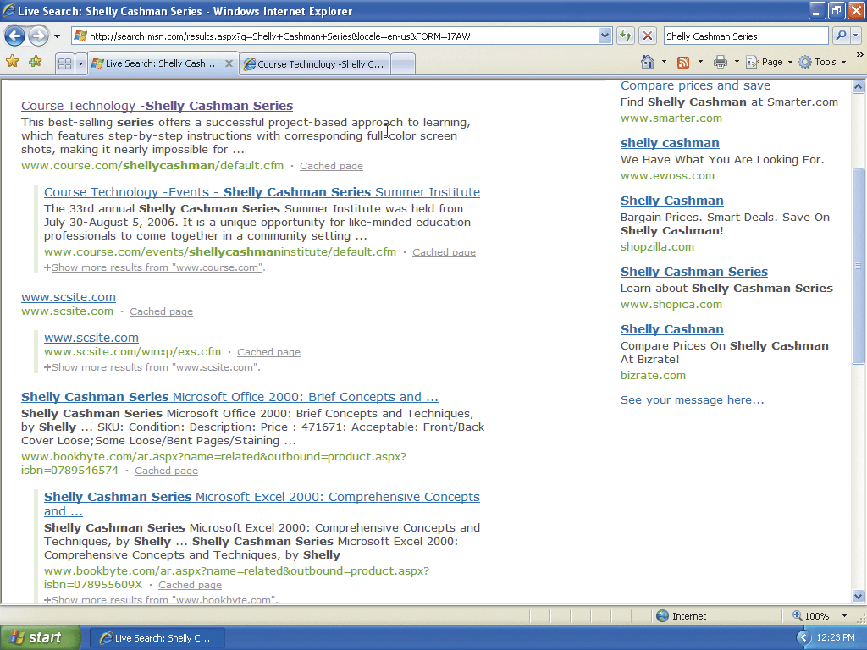
Opening a Link in a New Tab

Slide 32
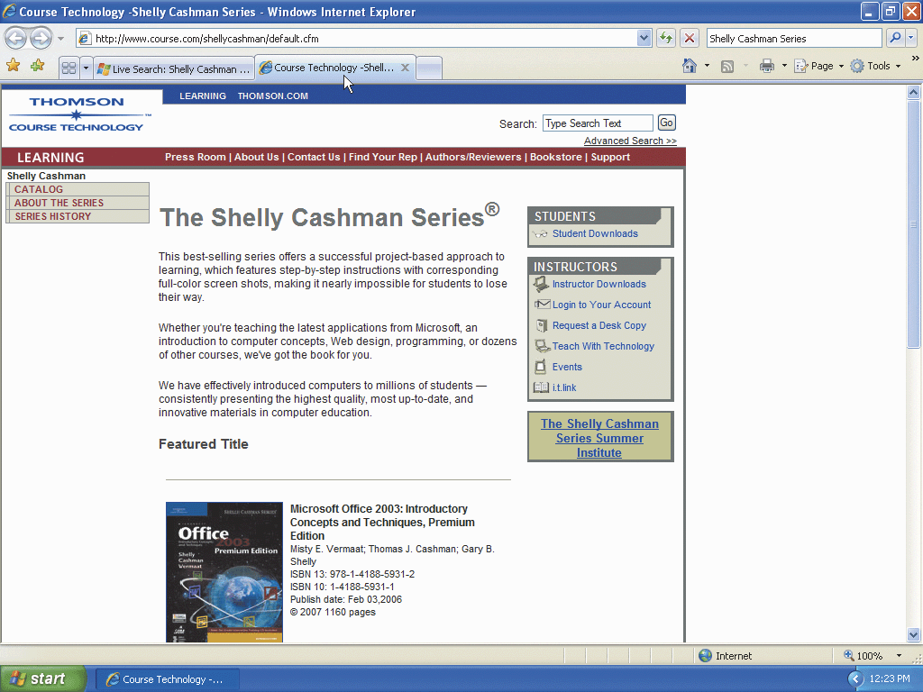
Switching Between Tabs
Click the Course Technology – Shelly Cashman Series tab to activate the tab and display The Shelly Cashman Series® in the display area

Slide 33
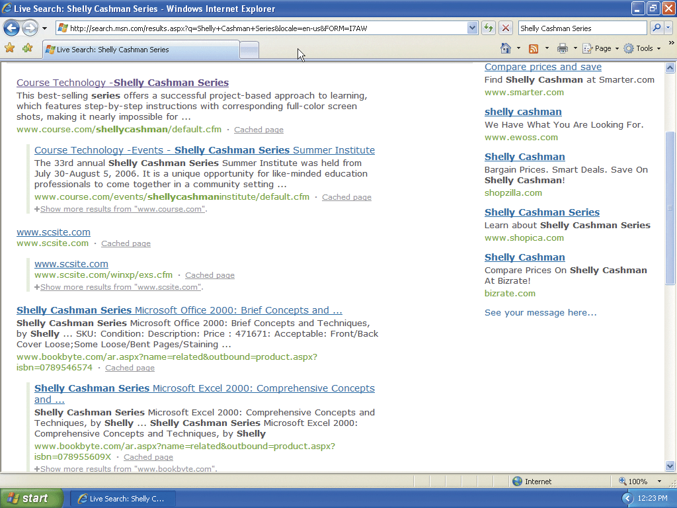
Closing a Tab
Click the Close Tab button in the Course Technology –Shelly Cashman Series tab to close the Course Technology –Shelly Cashman Series Web page
Click the Close button on the title bar to close the Live Search: Shelly Cashman Series – Windows Internet Explorer window

Slide 34
Starting Windows Explorer and Maximizing Its Window
Display the Start menu
Click My Computer on the Start menu to display the My Computer window
If necessary, double-click the My Computer title bar to maximize the My Computer window
If the status bar is not located at the bottom of the My Computer window, click View on the menu bar, and then click Status Bar to display the status bar
Click the Folders button on the Standard Buttons toolbar to display the Folders pane

Slide 35
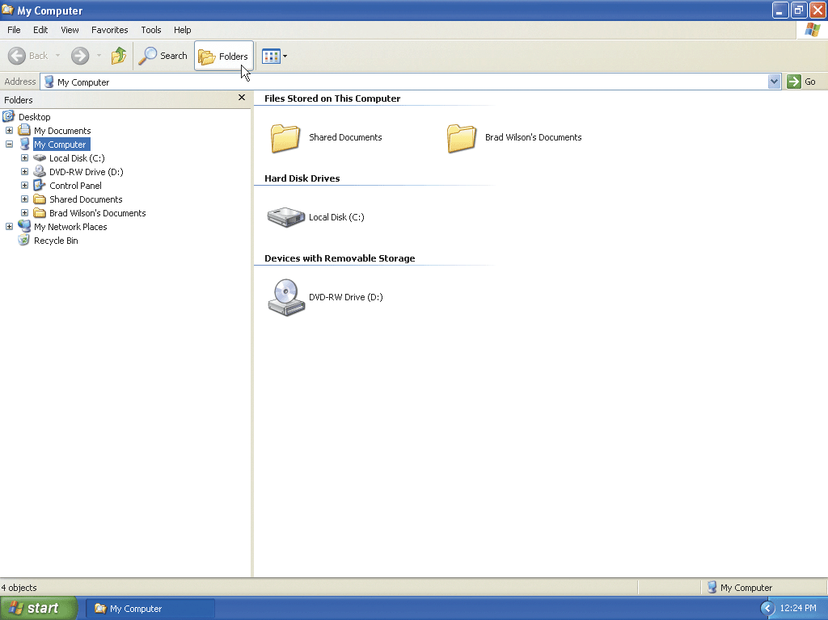
Starting Windows Explorer and Maximizing Its Window

Slide 36
Plugging a USB Flash Drive into a USB Port
Plug the USB flash drive into a USB port on the computer to display the UDISK (E:) dialog box
In the UDISK (E:) window, click the Folders button on the Standard Buttons toolbar to display the Folders pane
Click the Close button in the UDISK (E:) window to close the UDISK (E:) window

Slide 37
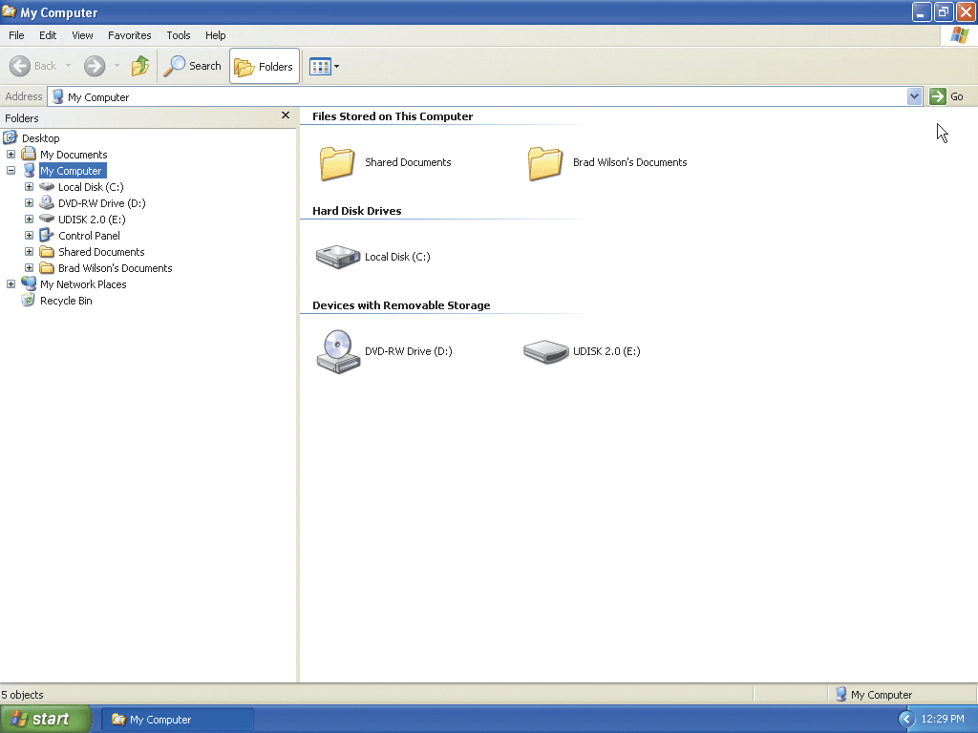
Plugging a USB Flash Drive into a USB Port

Slide 38
Creating a Folder on a Removable Drive
Click the UDISK (E:) icon in the Folders pane to select the UDISK (E:) drive
Right-click an open area of the right pane to display a shortcut menu
Point to New on the shortcut menu to display the New shortcut menu
Click Folder on the New submenu to display the selected new Folder folder
Type Freshman in the folder icon highlighted area to name the folder
Press the ENTER key to create the Freshman folder in the UDISK (E:) drive

Slide 39
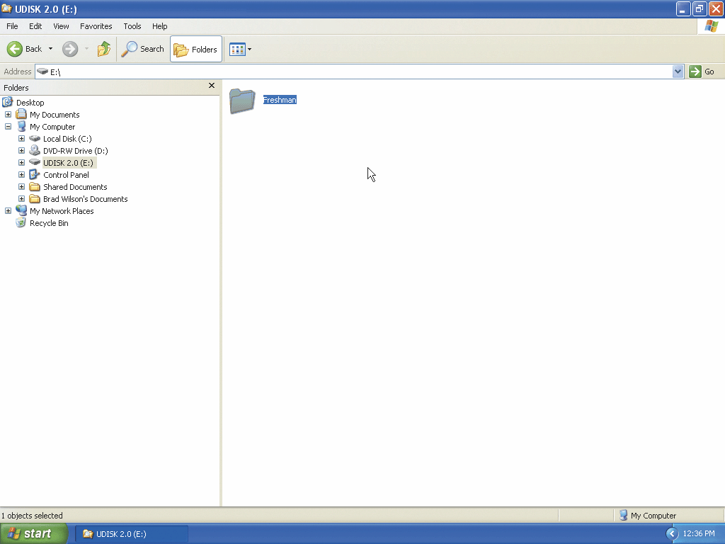
Creating a Folder on a Removable Drive

Slide 40
Downloading a Hierarchy of Folders into the Freshman Folder
Start Internet Explorer by clicking the Start button on the taskbar and then clicking the Internet icon on the Start menu
Click the Address Path text box on the Address bar, type scsite.com in the Address Path text box, and then click the Go to button
When the SC Site - Shelly Cashman Series Student Resources Web page is displayed, locate the Browse by Subject area, and then click the Office Suites link
When the expanded Office Suites link is displayed, click the link containing the name of your textbook (for example, Microsoft Office 2007)
If necessary, scroll down to view the Microsoft Office 2007: Introductory Concepts and Techniques link

Slide 41
Downloading a Hierarchy of Folders into the Freshman Folder
Click the Microsoft Office 2007: Introductory Concepts and Techniques link
Scroll down to display the Data Files for Students (Windows) area and then click the Windows XP Project 1 Files and Folders link
When the File Download – Security Warning dialog box is displayed, click the Run button
When the Internet Explorer – Security Warning dialog box is displayed, click the Run button
When the WinZip Self-Extractor dialog box is displayed, type the removable media drive letter of your removable media drive followed by a colon, backslash, and folder name (Freshman) (for example, E:\ Freshman)

Slide 42
Downloading a Hierarchy of Folders into the Freshman Folder
Click the Unzip button in the WinZip Self-Extractor dialog box
When a smaller WinZip Self-Extractor dialog box is displayed, click the OK button
Click the Close button in the WinZip Self-Extractor dialog box
Click the Close button in the Microsoft Internet Explorer window

Slide 43

Downloading a Hierarchy of Folders into the Freshman Folder

Slide 44
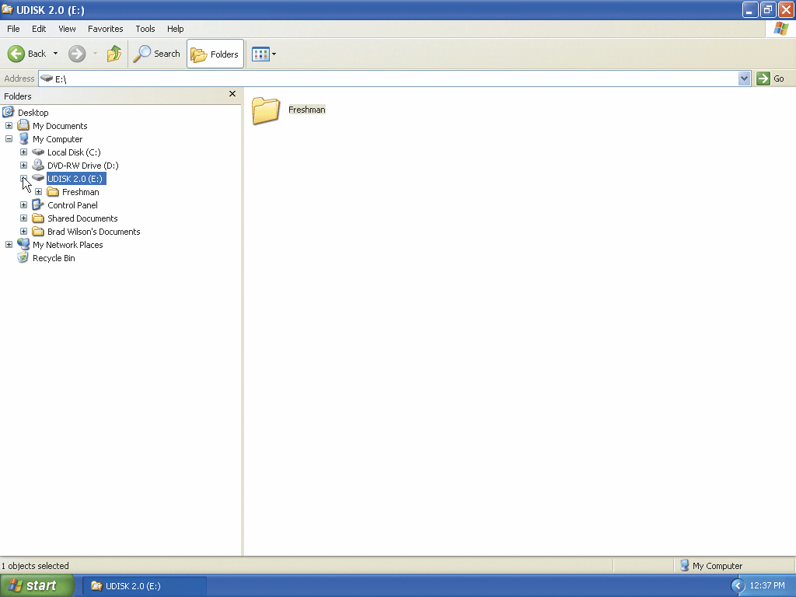
Expanding a Drive
Click the plus sign in the small box to the left of the UDISK (E:) icon in the Folders pane to display the Freshman folder

Slide 45
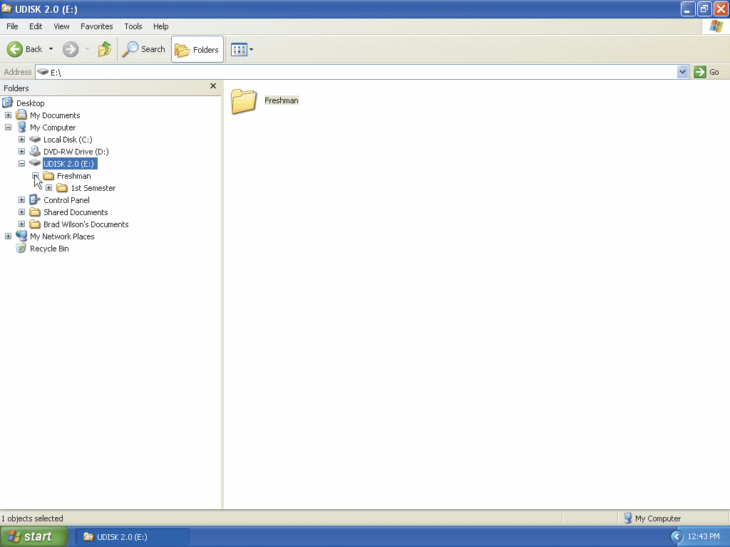
Expanding a Folder
Click the plus sign in the small box to the left of the Freshman icon to expand the Freshman folder

Slide 46
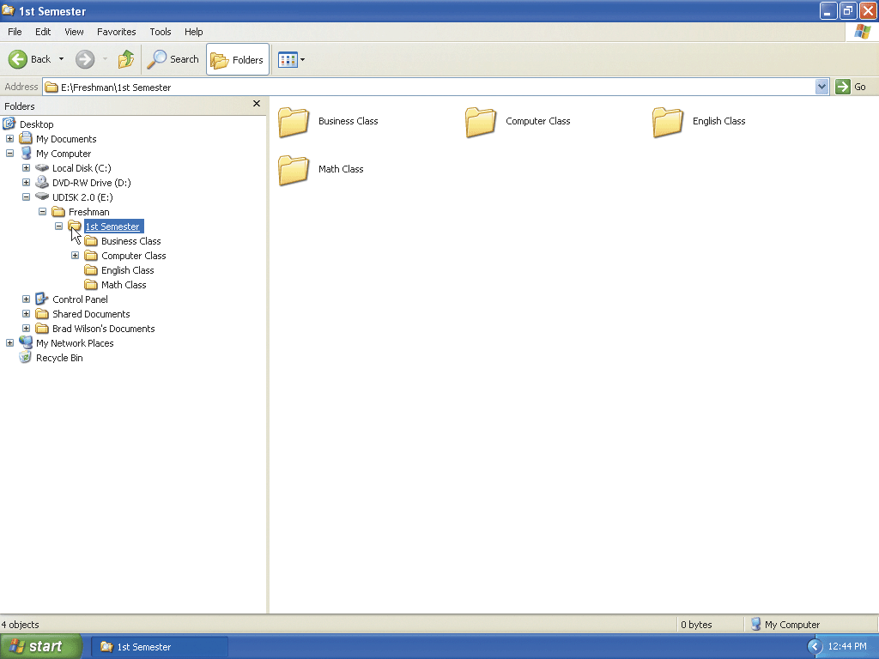
Displaying the Contents of a Folder
Click the 1st Semester icon in the Folders pane to display the contents of the 1st Semester folder

Slide 47
Starting WordPad
Display the Start menu
To display the All Programs submenu, point to All Programs on the Start menu
Point to Accessories on the All Programs submenu to display WordPad on the Accessories submenu
Click WordPad to start the WordPad application and display a new blank document in the WordPad window
If the WordPad window is not maximized, click the Maximize button next to the Close button on its title bar to maximize the window

Slide 48
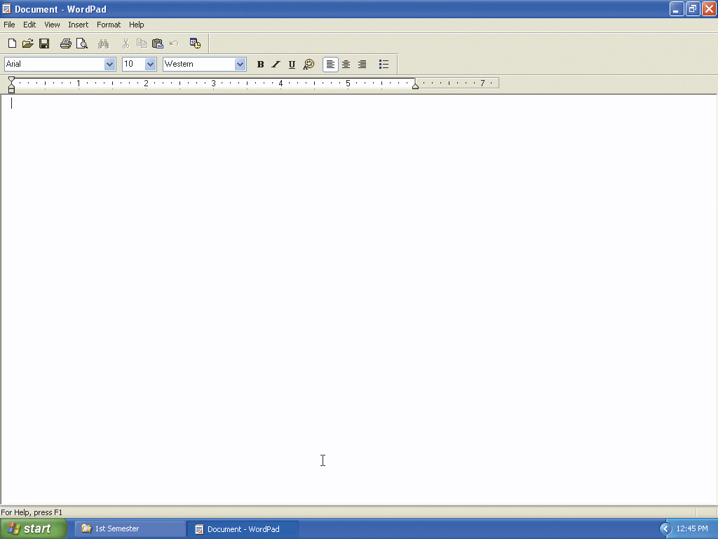
Starting WordPad

Slide 49
Typing Text
Type Friday, April 11 and then press the ENTER key twice
Type Finish - The Bike Delivers Data Base and then press the ENTER key
Type Read - Next Project and then press the ENTER key

Slide 50
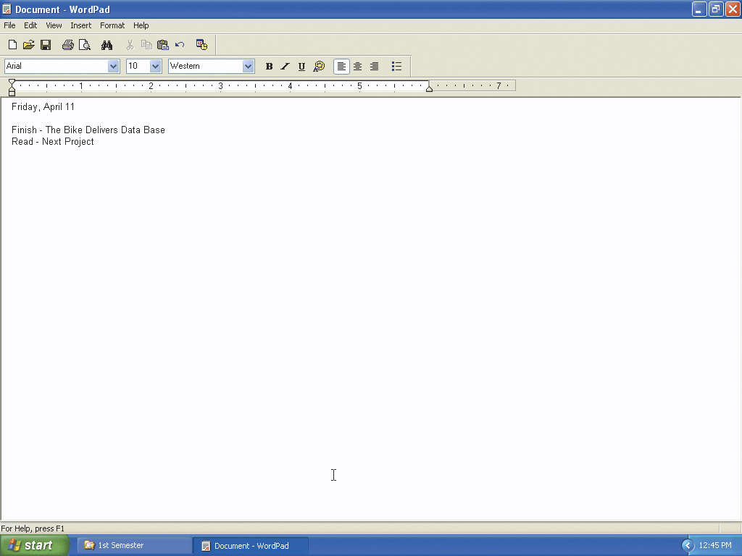
Typing Text

Slide 51
Saving a WordPad Document in a New Folder
Click the Save button on the Toolbar to display the Save As dialog box
Type Friday, April 11 in the File name text box. Do not press the ENTER key after typing the file name
Click the Save in box arrow to display a list of available drives and folders in which you can save the document
Click UDISK (E:) in the Save in list to display the contents of the UDISK(E:) drive in the Save As dialog box

Slide 52
Saving a WordPad Document in a New Folder
Double-click the Freshman folder in the Save As dialog box to display the Freshman folder name in the Save in text box and display the contents of the Freshman folder in the Save As dialog box
Double-click the 1st Semester folder icon in the Save As dialog box to display the 1st Semester folder name in the Save in text box and display the contents of the 1st Semester folder in the Save As dialog box
Double-click the Computer Class folder icon in the Save As dialog box to display the Computer Class folder name in the Save in text box and display the contents of the Computer Class folder in the Save As dialog box
Click the Create New Folder button on the Save As dialog box toolbar to create a new folder within the Computer Class folder

Slide 53
Saving a WordPad Document in a New Folder
Type Homework as the name of the folder and then press the ENTER key
Click the Open button in the Save As dialog box to open the Homework folder
Click the Save button in the Save As dialog box to save the Friday, April 11 file to its new location in the Homework folder
Click the Close button in the Friday, April 11 - WordPad window to close the window

Slide 54

Saving a WordPad Document in a New Folder

Slide 55
Verifying the Contents of a Folder
Click the plus sign in the small box next to the Computer Class icon in the Folders pane to display the folders within the Computer Class folder
Click the Homework icon in the Folders pane to select the Homework folder and display the contents of the Homework folder in the right pane

Slide 56
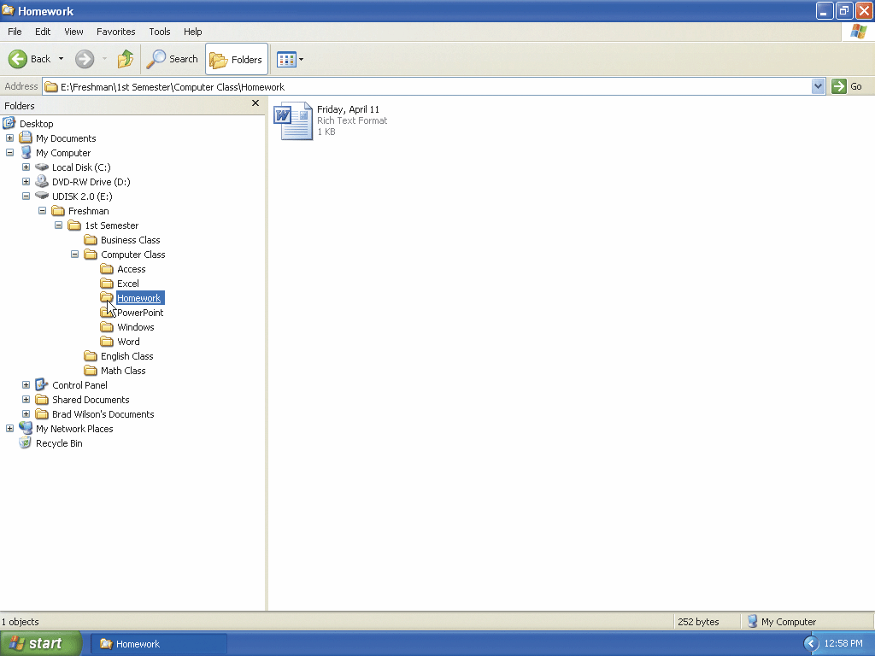
Verifying the Contents of a Folder

Slide 57
Copying a File in Windows Explorer by Right-Dragging
Click the Access icon in the Folders pane to select the Access folder and display its contents in the right pane
Right-drag the The Bike Delivers icon from the right pane onto the top of the Homework folder icon in the Folders bar to open the shortcut menu
Click Copy Here on the shortcut menu to copy The Bike Delivers file to the Homework folder

Slide 58
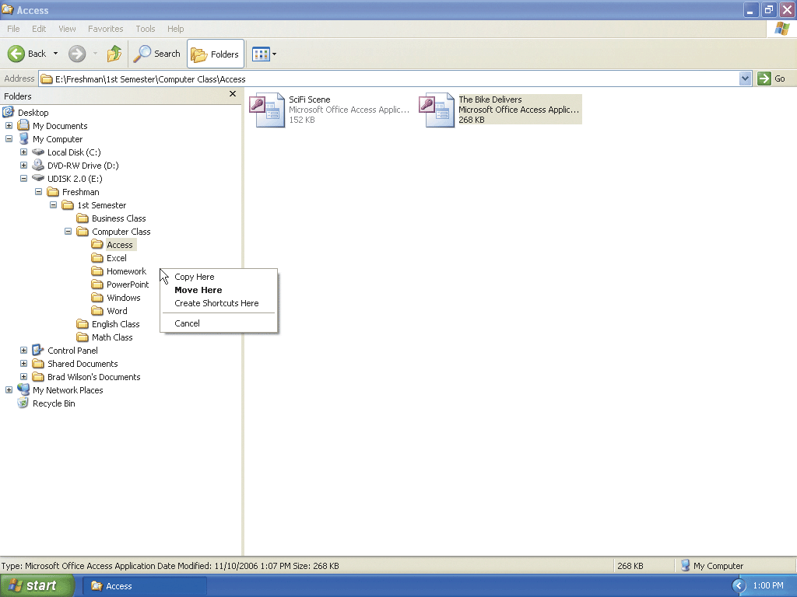
Copying a File in Windows Explorer by Right-Dragging

Slide 59
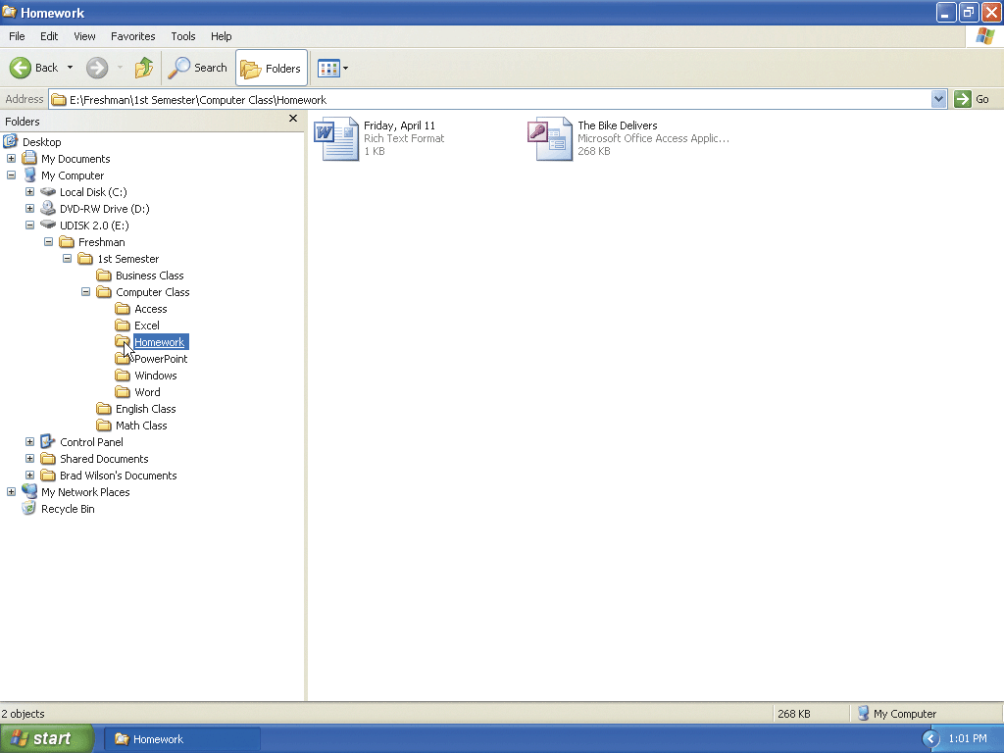
Displaying the Contents of a Folder
Click the Homework icon in the Folders pane to display the contents of the Homework folder

Slide 60
Renaming a File
Click the Word folder in the left pane to display the Barn and Silo, Fall Harvest, and Lake at Sunset files in the right pane
Right-click the Fall Harvest icon in the right pane to select the Fall Harvest icon and display a shortcut menu
Click Rename on the shortcut menu to select the file name for renaming
Type Great Fall Harvest and then press the ENTER key

Slide 61
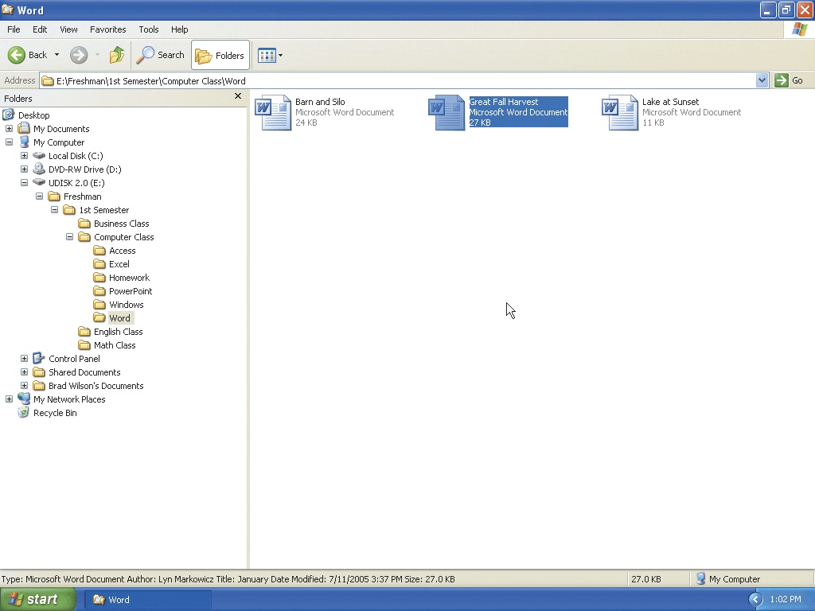
Renaming a File

Slide 62
Deleting a File by Right-Clicking
Right-click the Lake at Sunset icon in the right pane to select the icon and display a shortcut menu
Click Delete on the shortcut menu to begin the delete process by displaying the Confirm File Delete dialog box
Click the Yes button in the Confirm File Delete dialog box to remove the Lake at Sunset

Slide 63
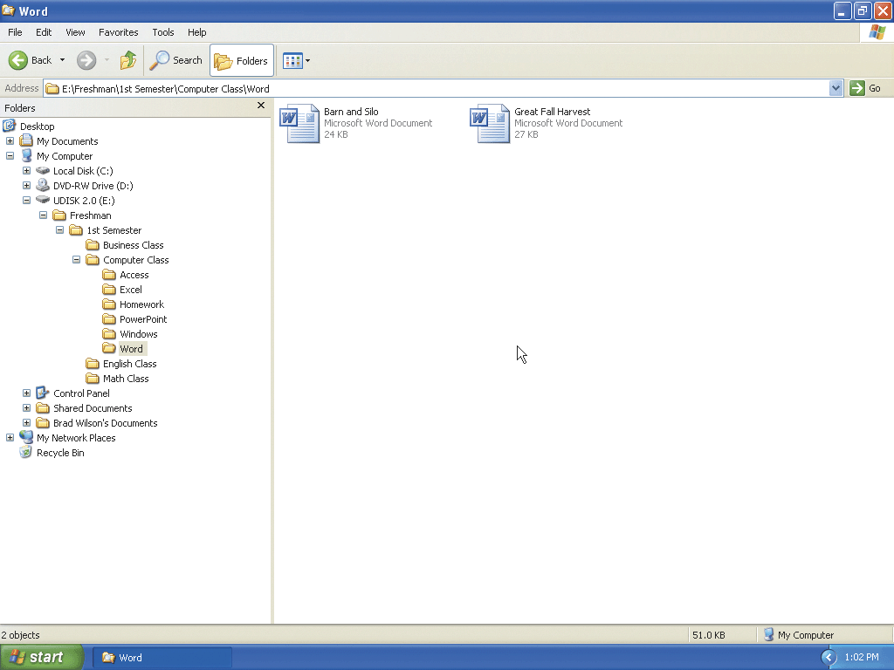
Deleting a File by Right-Clicking

Slide 64
Closing Expanded Folders
Click the minus sign to the left of the Computer Class icon in the left pane to collapse the Computer Class folder
Click the minus sign to the left of the 1st Semester icon to collapse the icon
Click the minus sign to the left of the Freshman icon to collapse the icon
Click the minus sign to the left of the UDISK (E:) to collapse the icon

Slide 65
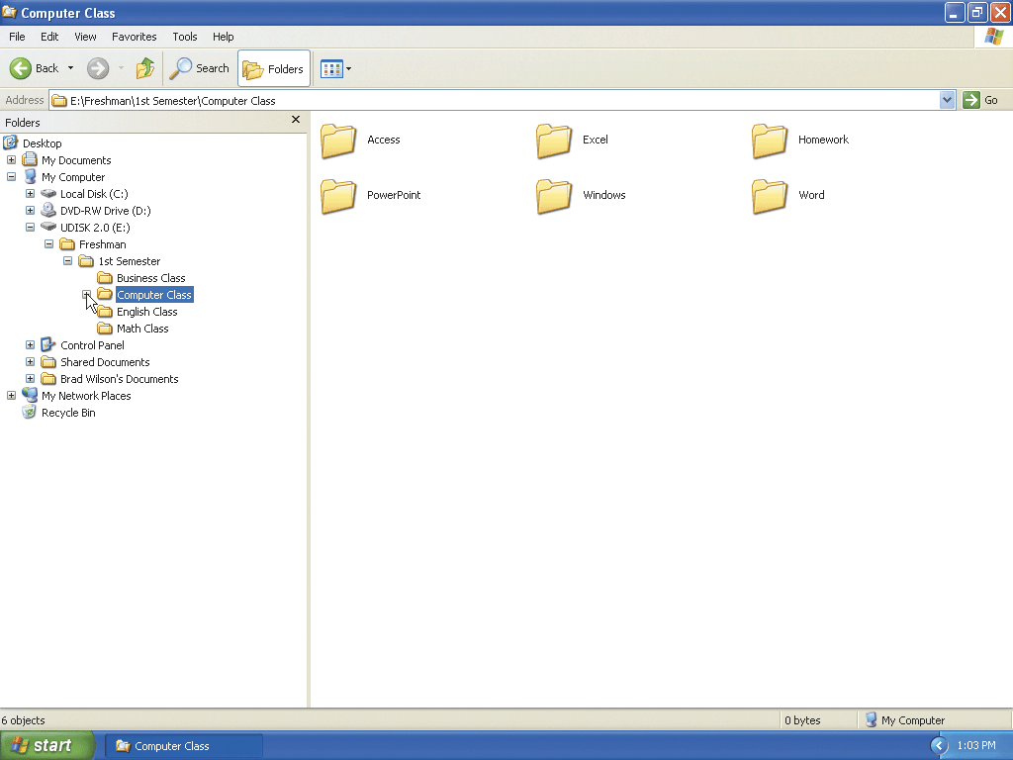
Closing Expanded Folders

Slide 66
Quitting Windows Explorer
Click the Close button on the UDISK (E:) window title bar to close the UDISK (E:) window

Slide 67
Searching for a File by Name
Display the Start menu
Click Search on the Start menu to display the Search Results window
If necessary, maximize the Search Results window
Click the All files and folders entry in the Search Companion balloon to display an insertion point in the ‘All or part of file name’ text box.
Type Great Fall Harvest in the ‘All or part of the the file name’ text box

Slide 68
Searching for a File by Name
Click the Look in box arrow in the Search Companion pane to display the list of locations in which to search
Click UDISK (E:) in the Look in list to close the Look in list and select the UDISK (E:) drive name in the Look in box
Click the Search button to search drive E: for the Great Fall Harvest file
Click the Close button on the Search Results window title bar to close the Search Results window

Slide 69
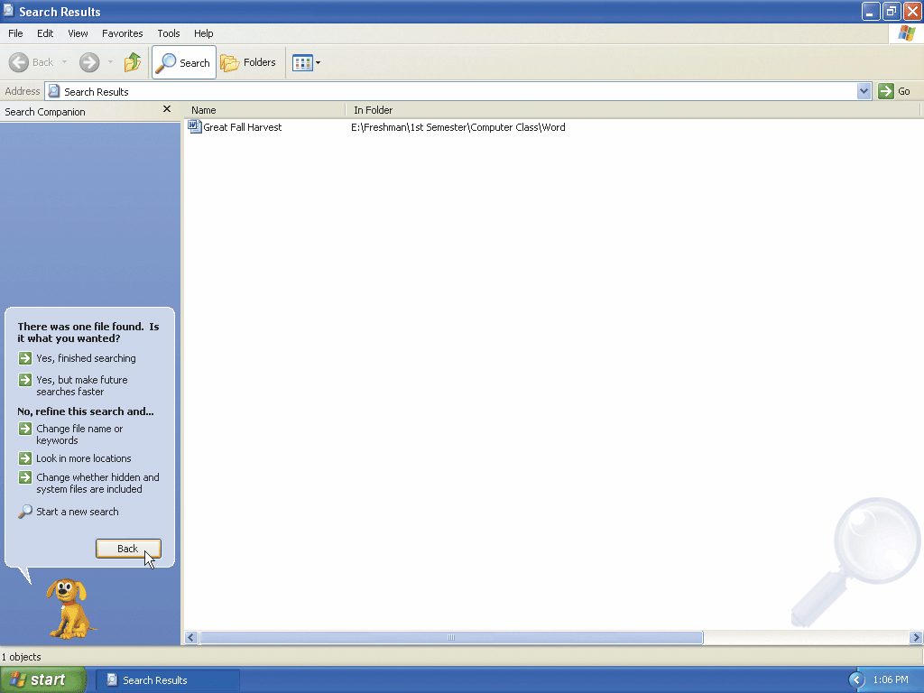
Searching for a File by Name

Slide 70
Searching for a File Using a Word or Phrase in the File
Display the Start menu
Click the Search button on the Start menu to display the Search Results window
If necessary, maximize the Search Results window
Click All files and folders in the Search companion balloon to begin a search
Click the ‘A word or phrase in the file’ text box to prepare to type text
Type apply in the ‘A word or phrase in the file’ text box

Slide 71
Searching for a File Using a Word or Phrase in the File
Click the Look in box arrow to display the Look in list
Click UDISK (E:) in the Look in list to designate UDISK (E:) drive as the drive to search
Click the Search button in the Search Companion balloon to perform a search
Click the Close button on the Search Results window title bar to close the Search Results window
Remove the USB flash drive from the USB port

Slide 72
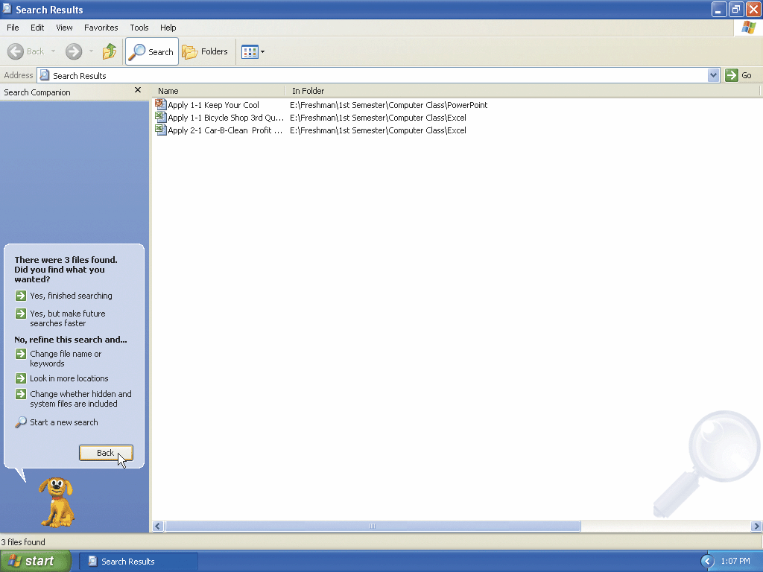
Searching for a File Using a Word or Phrase in the File

Slide 73
Starting Help and Support
Display the Start menu
Click Help and Support to display the Help and Support Center window
If necessary, click the Maximize button on the Help and Support Center title bar to maximize the Help and Support Center window

Slide 74
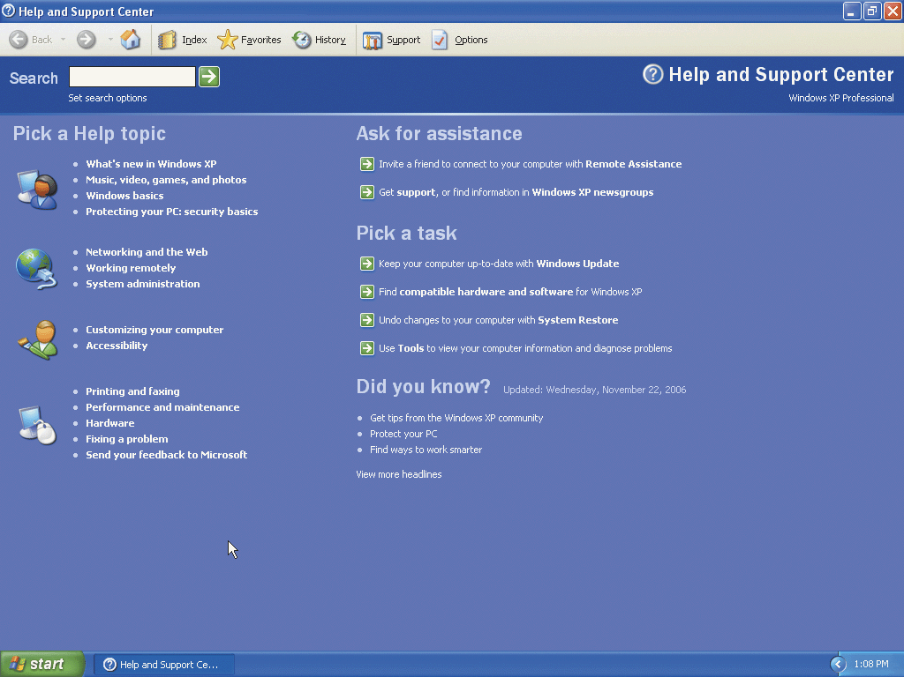
Starting Help and Support

Slide 75
Browsing for Help Topics in the Table of Contents
Click Windows basics in the Pick a Help topic area to display the Navigation Pane and topic pane in the Help and Support Center window
Click the Tips for using Help category to display the Tips for using Help page
Click Find what you need in Help and Support Center to display the To find what you need in Help and Support Center topic
Read the information in the To find what you need in Help and Support Center topic in the topic pane

Slide 76
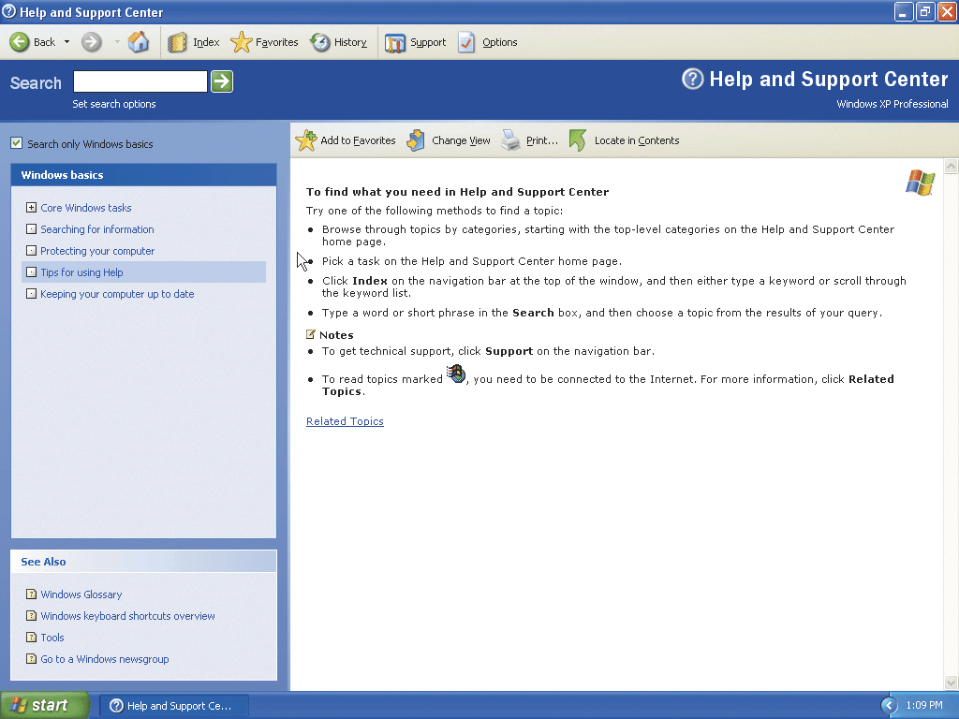
Browsing for Help Topics in the Table of Contents

Slide 77
Searching for Help Topics Using the Index
Click the Index button on the Navigation toolbar to display the Index pane
Type home networking in the ‘Type in the keyword to find’ text box in the Navigation Pane
Click overview in the list to select the overview entry in the Index entries list
Click the Display button to display the home networking overview topic in the topic pane

Slide 78
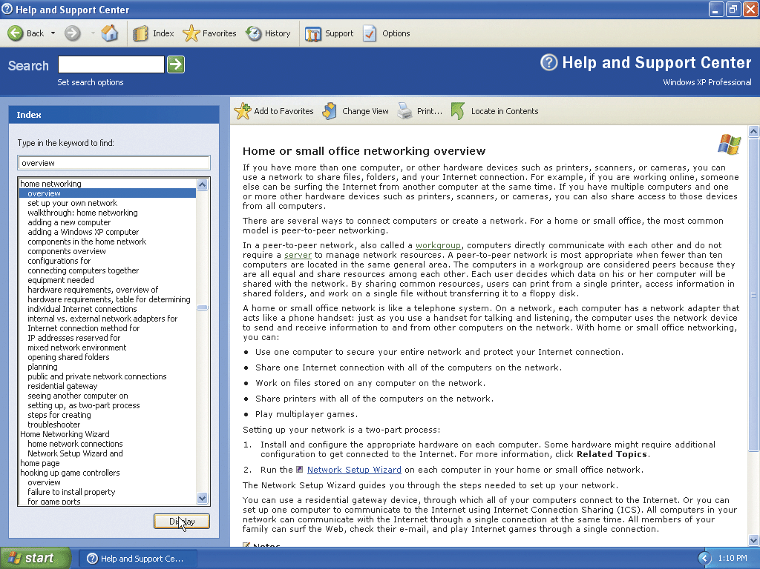
Searching for Help Topics Using the Index

Slide 79
Displaying the Related Topics Link
Scroll to the bottom of the Home or small office networking overview topic to display the Related Topics link
Click the Related Topics link to display a pop-up window containing a list of related topics

Slide 80
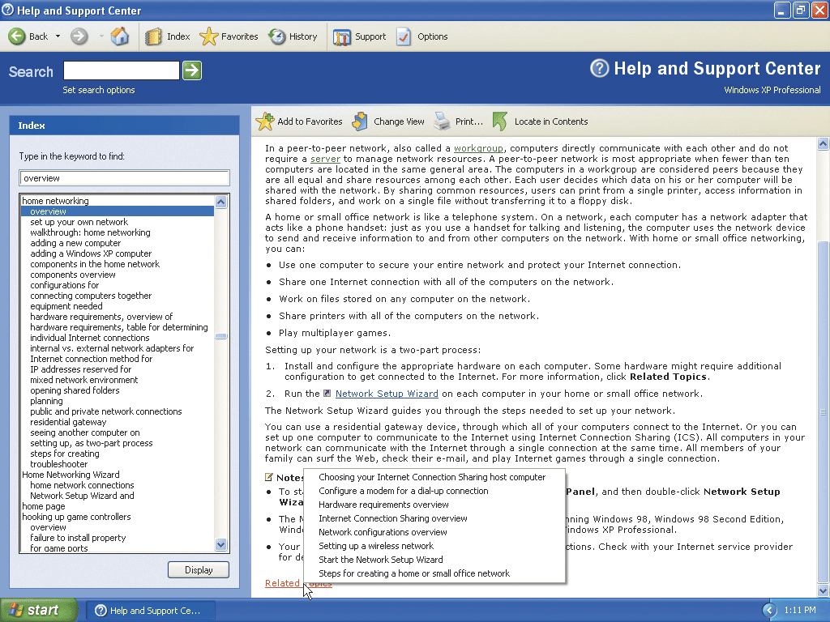
Displaying the Related Topics Link

Slide 81
Closing the Help and Support Center
Click the Close button on the title bar of the Help and Support Center window to close the Help and Support Center window

Slide 82
Logging Off from the Computer
Display the Start menu
Click Log Off on the Start menu to display the Log Off Windows dialog box
Click the Log Off button in the Log Off Windows dialog box to log off from the computer and display the Welcome screen

Slide 83
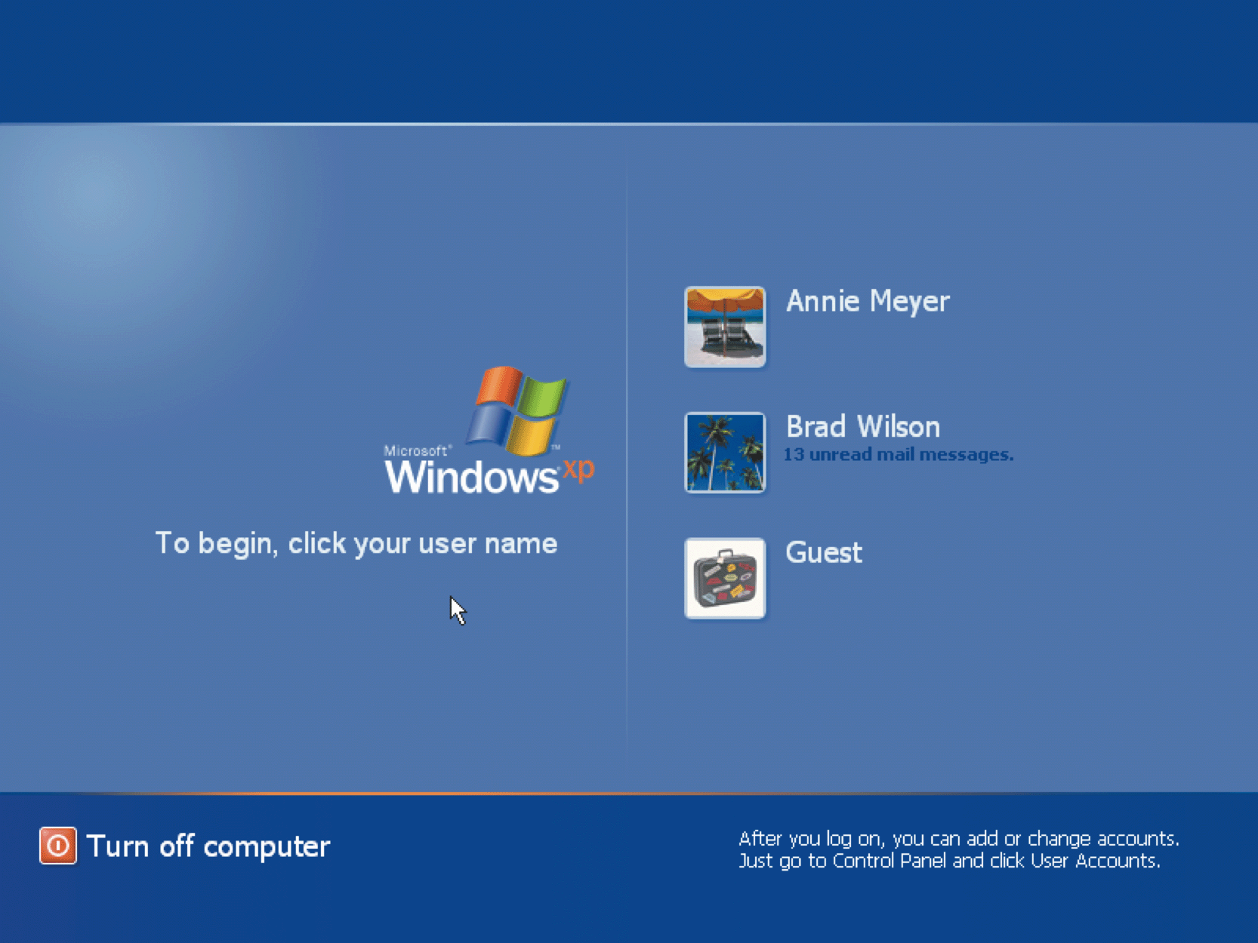
Logging Off from the Computer

Slide 84
Turning Off the Computer
Click the Turn off computer link on the Welcome screen
Click the Turn Off button in the Turn off computer dialog box

Slide 85
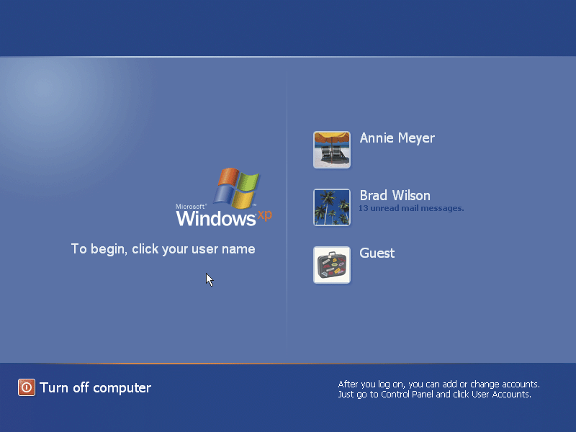
Turning Off the Computer

Slide 86
Summary
Start Microsoft Windows XP, log on to the computer, and identify the objects on the desktop
Perform the basic mouse operations: point, click, right-click, double-click, drag, and right-drag
Display the Start menu and start an application program
Open, minimize, maximize, restore, move, size, scroll, and close a window
Display drive and folder contents
Create a folder in Windows Explorer and a WordPad document

Slide 87
Summary
Browse the Web using Internet Explorer 7.0, a URL, and tabbed browsing
Download folders from scsite.com
Copy, move, rename, and delete files
Search for files using a word or phrase in the fi le or by name
Use Help and Support
Log off from the computer and turn it off

Slide 88
Microsoft Windows XP Complete

