Slide 1
PowerPoint Web Feature
Creating Web Pages
Using PowerPoint

Slide 2
Objectives
Preview and save a presentation as a Web page
Customize the Quick Access Toolbar
Display Web pages created in PowerPoint in a browser
Complete file management tasks within PowerPoint

Slide 3
Plan Ahead
Develop an effective presentation
Preview and review the Web pages created from your PowerPoint presentation
Publish your Web page

Slide 4
Adding a Button to the Quick Access Toolbar
Connect a USB flash drive to one of the computer’s USB ports
Start PowerPoint and then open the presentation, Yoga, from the Data Files for Students
Click the Customize Quick Access Toolbar button to display the Customize Quick Access Toolbar menu
Click the More Commands command on the Customize Quick Access Toolbar menu

Slide 5
Adding a Button to the Quick Access Toolbar
When the PowerPoint Options dialog box is displayed, click the ‘Choose commands from’ box arrow to display the ‘Choose commands from’ list
Click Commands Not in the Ribbon in the ‘Choose commands from’ list to display a list of commands not in the Ribbon
Scroll to the bottom of the list, click Web Page Preview, and then click the Add button to add the button to the Quick Access Toolbar
Click the OK button to close the PowerPoint Options dialog box and display the Quick Access Toolbar with the Web page Preview button added to it

Slide 6

Adding a Button to the Quick Access Toolbar

Slide 7
Previewing the Web Page
Click the Web Page Preview button on the Quick Access Toolbar to display the Web page in your browser
If necessary, click the Maximize button on your browser’s title bar
Click the Full Screen Slide Show button to have Slide 1 fill the entire screen. If the Information Bar appears asking for an add-on from Microsoft, see our instructor
Press the SPACE BAR to display the Slide 2 title text. Continue pressing the SPACE BAR to view each line of Slide 2 body text

Slide 8
Previewing the Web Page
Continue pressing the SPACE BAR to view each slide in the presentation
When the black slide is displayed, press the SPACE BAR again to return to Web Page preview of Slide 1 in the browser window
Click the Close button on the right side of the browser title bar to close the browser and make PowerPoint active again

Slide 9

Previewing the Web Page

Slide 10
Saving a PowerPoint Presentation as a Web Page in a Newly Created Folder
With the Yoga presentation open, click the Office Button
Click Save As on the Office Button menu to display the Save As dialog box
Type Yoga Web Page in the File name text box
Click the ‘Save as type’ box arrow and then scroll down and click Single File Web Page
If the name of your USB flash drive does not appear in the Save in box, click the Save in box arrow and then select UDISK 2.0 (E:) (your USB flash drive name and letter may be different)

Slide 11
Saving a PowerPoint Presentation as a Web Page in a Newly Created Folder
Click the Create New Folder button to display the New Folder dialog box
When PowerPoint displays the New Folder dialog box, type Web Feature in the Name text box
Click the OK button in the New Folder dialog box.
Click the Save button in the Save As dialog box to save the presentation in a single file in HTML format in the Web Feature folder on the USB flash drive
If the Microsoft Office PowerPoint dialog box is displayed, click the Yes button

Slide 12
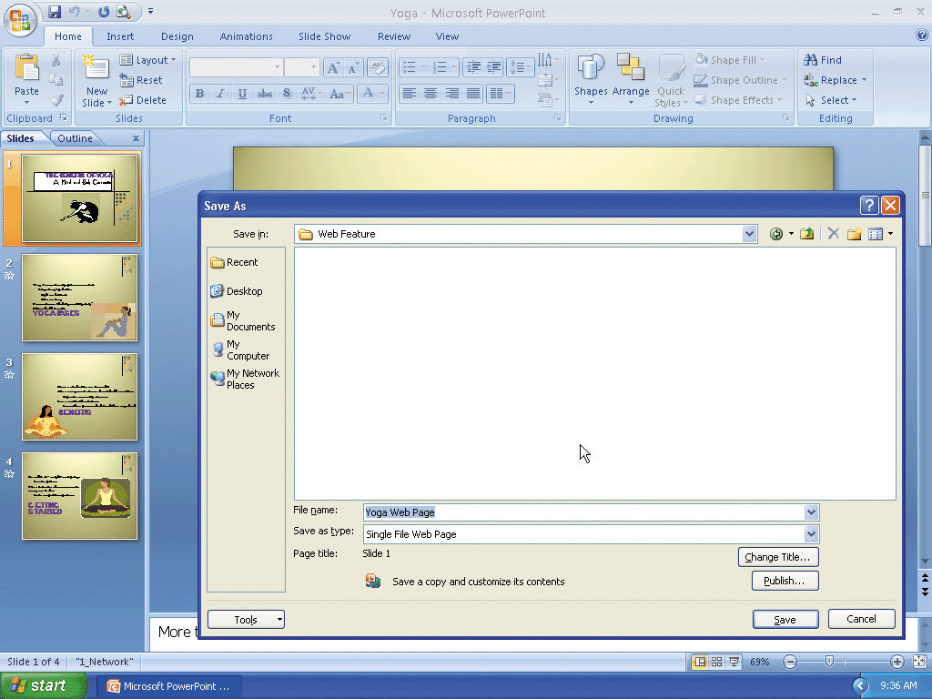
Saving a PowerPoint Presentation as a Web Page in a Newly Created Folder

Slide 13
Resetting the Quick Access Toolbar and Quitting PowerPoint
Click the Customize the Quick Access Toolbar button on the Ribbon
Click the More Commands command
When the PowerPoint Options dialog box is displayed, click the Reset button. If the Reset Customizations dialog box is displayed, click the Yes button
Click the OK button on the PowerPoint Options dialog box to close it
Click the Close button on the Microsoft PowerPoint title bar

Slide 14
Viewing the Web Page Using a Browser
If necessary, connect the USB flash drive to one of the computer’s USB ports
Click the Start button on the Windows taskbar, point to All Programs on the Start menu, and then click Internet Explorer on the All Programs submenu
When the Internet Explorer window appears, type E:\Web Feature\Yoga Web Page.mht in the Address box and then press the ENTER key to display the Web page in your browser
If the Information Bar appears, right-click it and then click Allow Blocked Content on the shortcut menu

Slide 15
Viewing the Web Page Using a Browser
If the Security Warning dialog box is displayed, click the Yes button
Click the Expand/Collapse Outline button at the bottom of the window to display the text of each slide in outline form in the navigation frame
Click the Next Slide button three times to view all four slides in your browser
Click the Close button on the right side of the browser title bar to close the browser

Slide 16
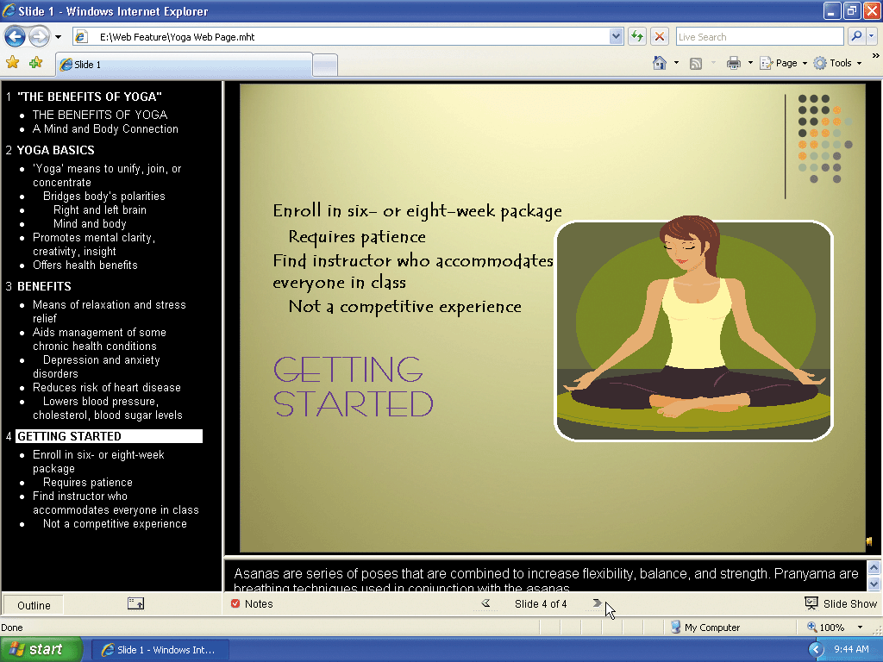
Viewing the Web Page Using a Browser

Slide 17
Summary
Preview and save a presentation as a Web page
Customize the Quick Access Toolbar
Display Web pages created in PowerPoint in a browser
Complete file management tasks within PowerPoint

Slide 18
PowerPoint Web Feature Complete

