Slide 1
Outlook Chapter 1
Managing E-Mail and
Contacts with Outlook

Slide 2
Objectives
Start and quit Outlook
Open, read, print, reply to, and delete electronic mail messages
View a file attachment
Create and insert an e-mail signature
Compose, format, and send e-mail messages
Insert a file attachment in an e-mail message
Flag, categorize, sort, and filter e-mail messages

Slide 3
Objectives
Set e-mail importance, sensitivity, and delivery options
Create a personal folder
Create and print a contact list
Use the Find a Contact feature
Organize the contact list
Track activities of a contact
Use Outlook’s Help

Slide 4
Plan Ahead
Choose the words for the Subject line
Ensure that the content of the message is appropriate for the recipient
Choose the words for the text
Identify how to format various elements of the text
Alert the recipient when sending large file attachments

Slide 5
Starting and Customizing Outlook
Click the Start button on the Windows taskbar to display the Start menu
Point to All Programs on the Start menu to display the All Programs submenu
Point to Microsoft Office on the All Programs submenu to display the Microsoft Office submenu
Click Microsoft Office Outlook 2007 to start Outlook. If necessary, click the Mail button in the Navigation Pane and then click the Inbox folder in the All Mail Folders pane to display the Inbox message pane
If the Inbox – Microsoft Office Outlook window is not maximized, click the Maximize button next to the Close button on its title bar to maximize the window
Drag the right border of the Inbox message pane to the right so that the Inbox message pane and the Reading pane have the same width

Slide 6
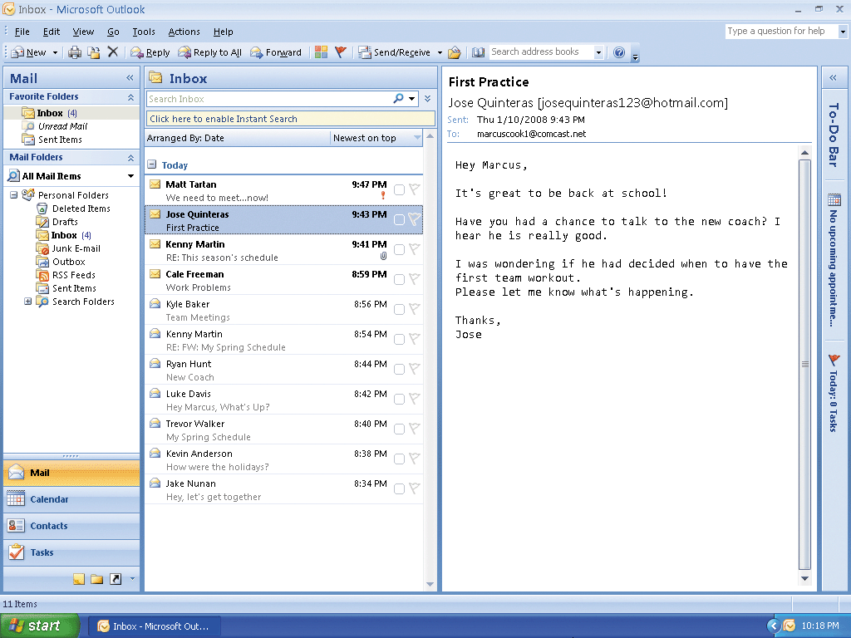
Starting and Customizing Outlook

Slide 7
Opening (Reading) an E-mail Message
Double-click the Jose Quinteras message heading in the Inbox Message pane to display the First Practice window
If necessary, maximize the window

Slide 8
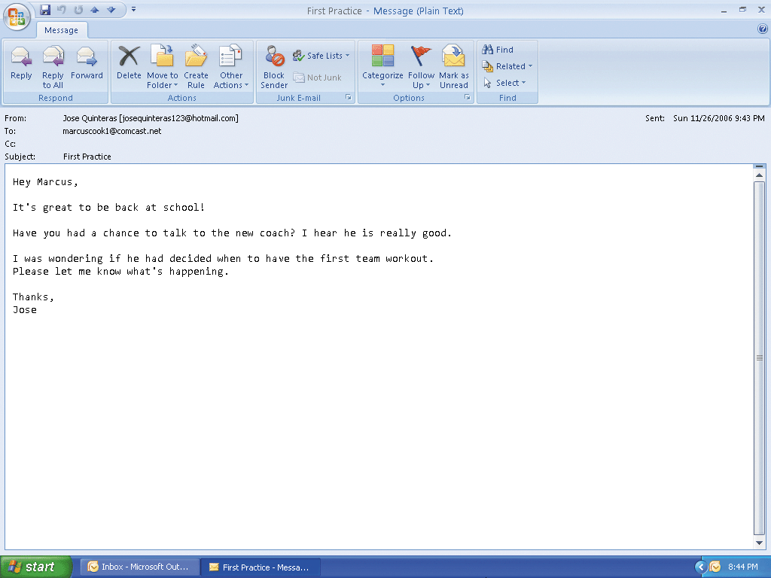
Opening (Reading) an E-mail Message

Slide 9
Closing an E-mail Message
Click the Close button on the title bar to close the Message window

Slide 10
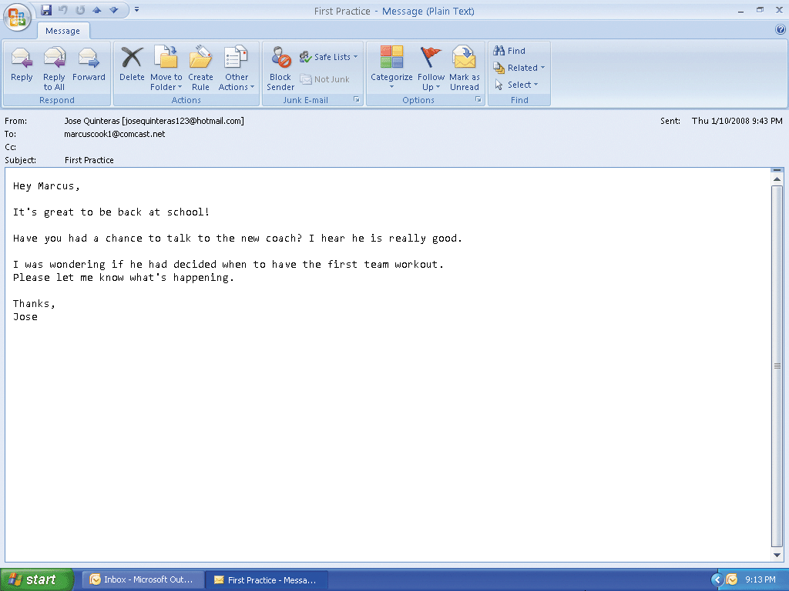
Closing an E-mail Message

Slide 11
Printing an E-mail Message
Point to the Print button on the Standard toolbar
Click the Print button to print the message

Slide 12
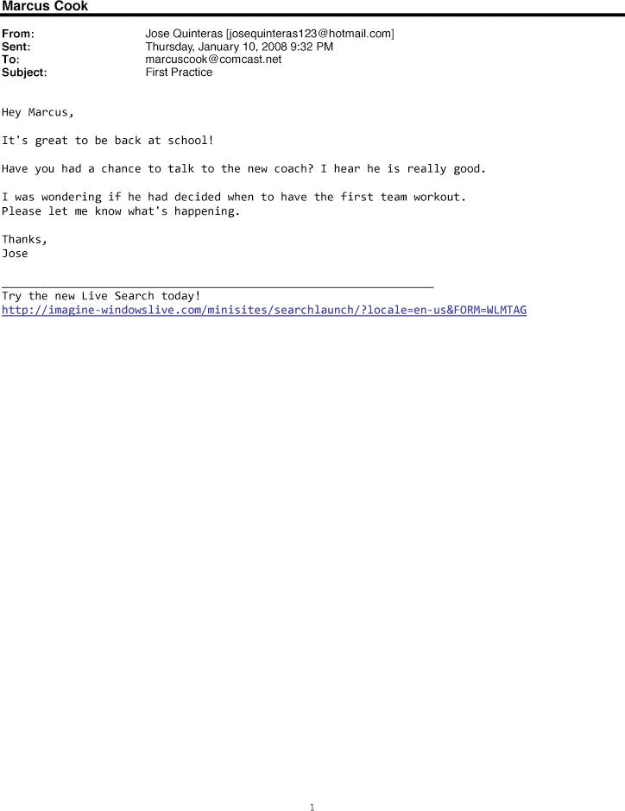
Printing an E-mail Message

Slide 13
Replying to an E-mail Message
If necessary, click the Jose Quinteras message heading in the message pane
Click the Reply button on the Standard toolbar to open the RE: First Practice – Message window
When Outlook displays the Message window for the reply, if necessary, double-click the title bar to maximize the window
Type the e-mail reply
Click the Send button to send the message and return to the Inbox window

Slide 14
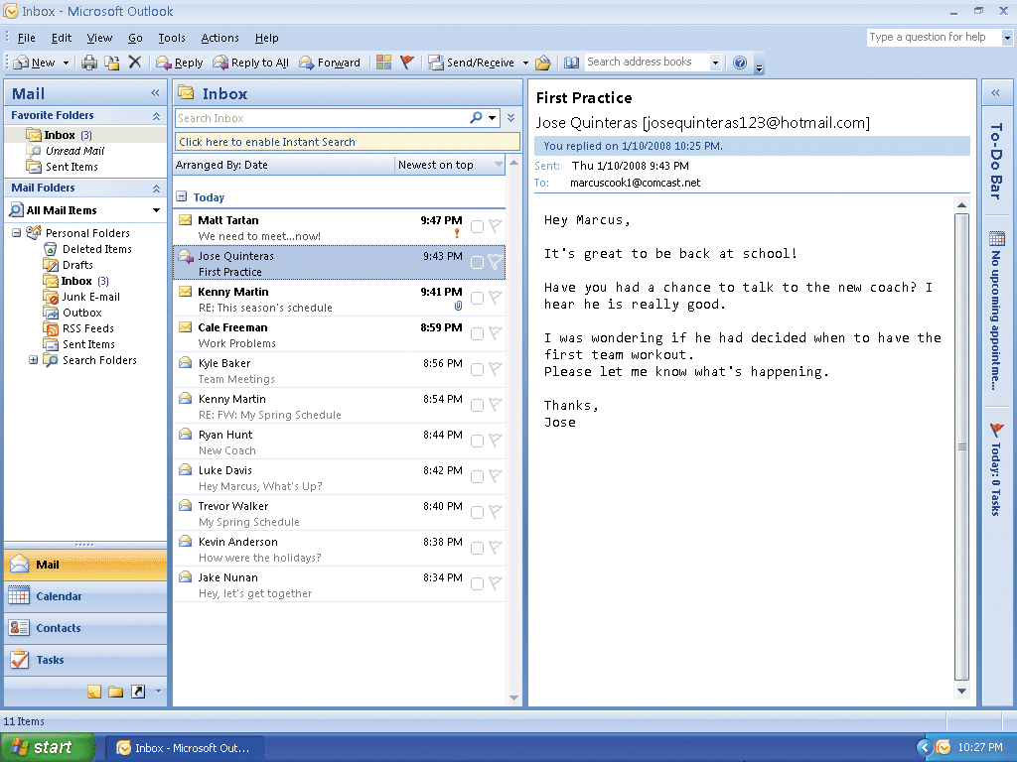
Replying to an E-mail Message

Slide 15
Changing Message Formats
With a new Message window active, click the Options tab
Click the appropriate command (Plain Text, HTML, or Rich Text) in the Format group

Slide 16
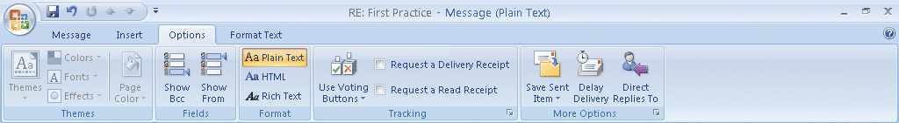
Changing Message Formats

Slide 17
Forwarding an E-Mail Message
With the Inbox window active, click the Jose Quinteras message header in the message pane
Click the Forward button on the Standard toolbar
When Outlook displays the Message window for the forwarded message, type kennymartin123@hotmail.com in the To text box as the recipient’s e-mail address. (If you are stepping through this task, use an actual e-mail address in the To text box)
Enter the forwarding message in the message body
Click the Send button to forward the original message along with the new message to Kenny

Slide 18
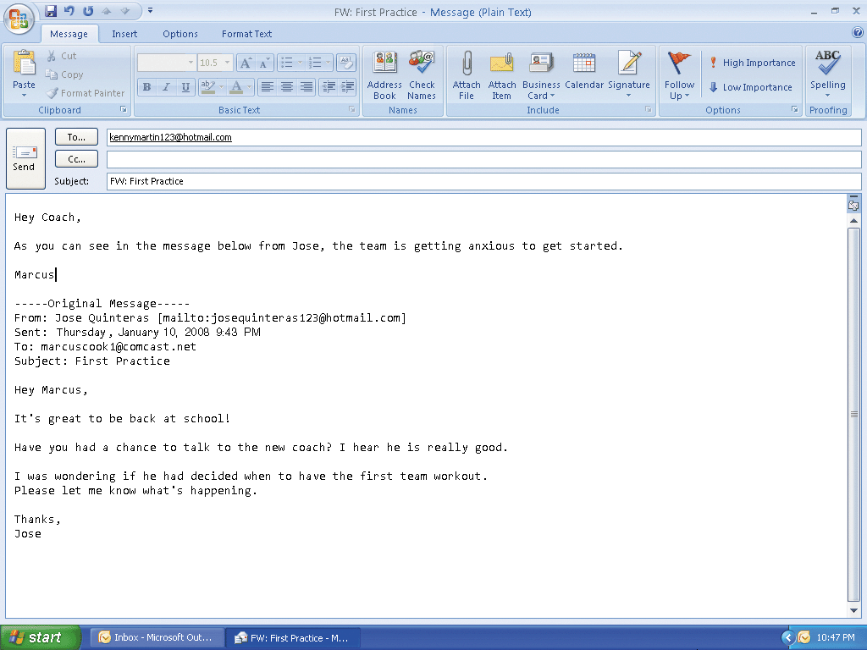
Forwarding an E-Mail Message

Slide 19
Deleting an E-Mail Message
With the Inbox window active, click the Jose Quinteras message heading in the message pane to select the message
Click the Delete button on the Standard toolbar to remove the message from your Inbox

Slide 20
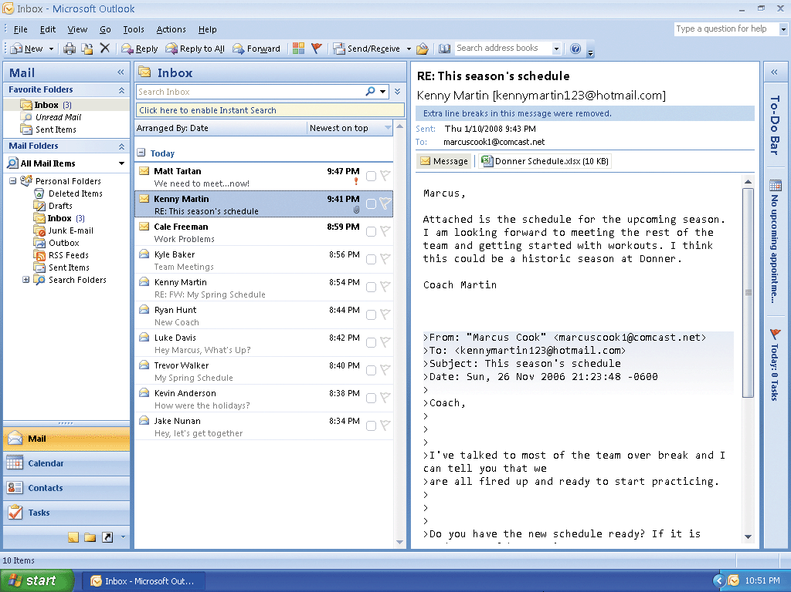
Deleting an E-Mail Message

Slide 21
Viewing a File Attachment
With the Inbox window active, double-click the Kenny Martin message heading in the Message pane
If necessary, maximize the RE: This season’s schedule – Message window
Double-click the Donner Schedule icon in the Attachments area to open the Donner Schedule Microsoft Excel file
If Outlook displays the Opening Mail Attachment dialog box, click the Open button
After viewing the worksheet, click the Close button on the right side of the title bar in the Excel window to close the attachment and Excel
Click the Close button in the Message window

Slide 22
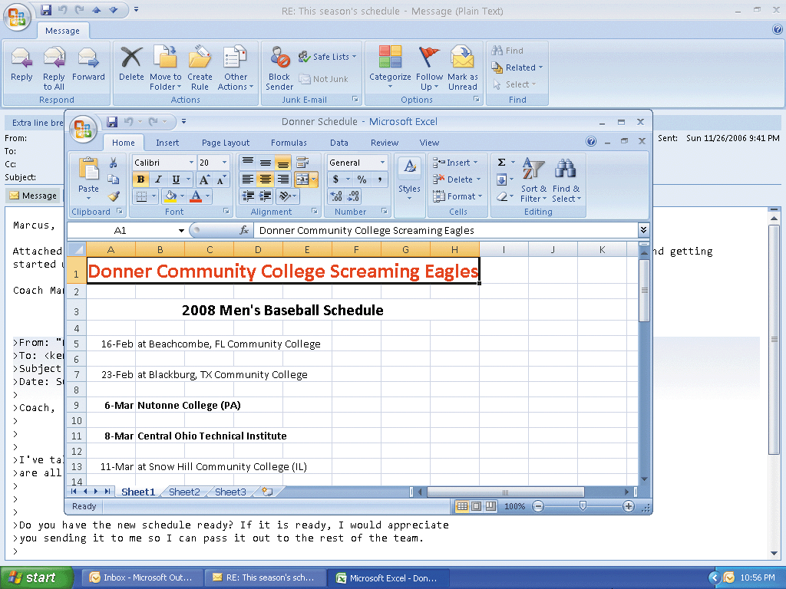
Viewing a File Attachment

Slide 23
Creating and Inserting an E-Mail Signature
With the Inbox window active, click Tools on the menu bar to display the Tools menu
Click Options on the Tools menu to display the Options dialog box
Click the Mail Format tab to display the Mail Format sheet
Click the Signatures button to display the Signatures and Stationery dialog box
Click the New button to display the New Signature dialog box

Slide 24
Creating and Inserting an E-Mail Signature
When Outlook displays the New Signature dialog box, type Team in the ‘Type a name for this signature’ text box
Click the OK button
Click in the Edit signature area of the Signatures and Stationery dialog box and type Marcus Cook – Team Captain as the signature
In the Choose default signature area of the Signatures and Stationery dialog box, select the appropriate e-mail account (if you are stepping through this project, ask your instructor for the appropriate e-mail account)

Slide 25
Creating and Inserting an E-Mail Signature
If necessary, select Team in the New messages box and the Replies/forwards box to select it as the default signature
Click the OK button to close the Signatures and Stationery dialog box. Click OK in the Options dialog box to close the dialog box

Slide 26
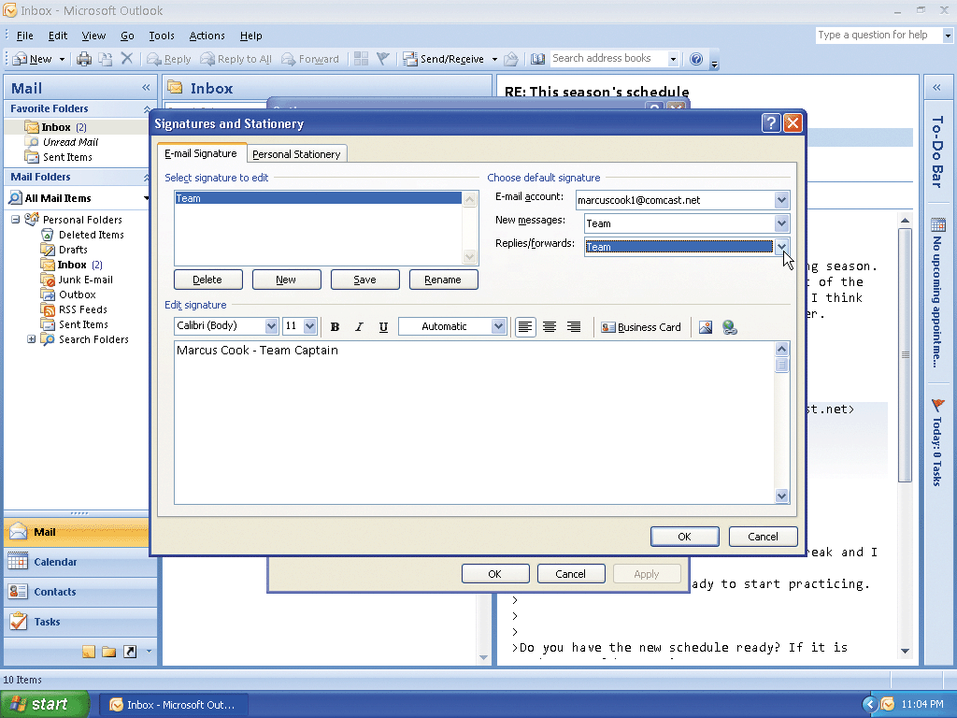
Creating and Inserting an E-Mail Signature

Slide 27
Composing an E-Mail Message
With the Inbox window active, point to the New Mail Message button on the Standard toolbar
Click the New Mail Message button to open the Untitled – Message window
Type kennymartin123@ hotmail.com in the To text box, click the Subject text box, and then type Draft Practice Schedule in the Subject text box
Press the TAB key to move the insertion point into the message body area. insertion point destination e-mail address entry in Subject text box appears on title bar subject of e-mail message
Type the e-mail message

Slide 28
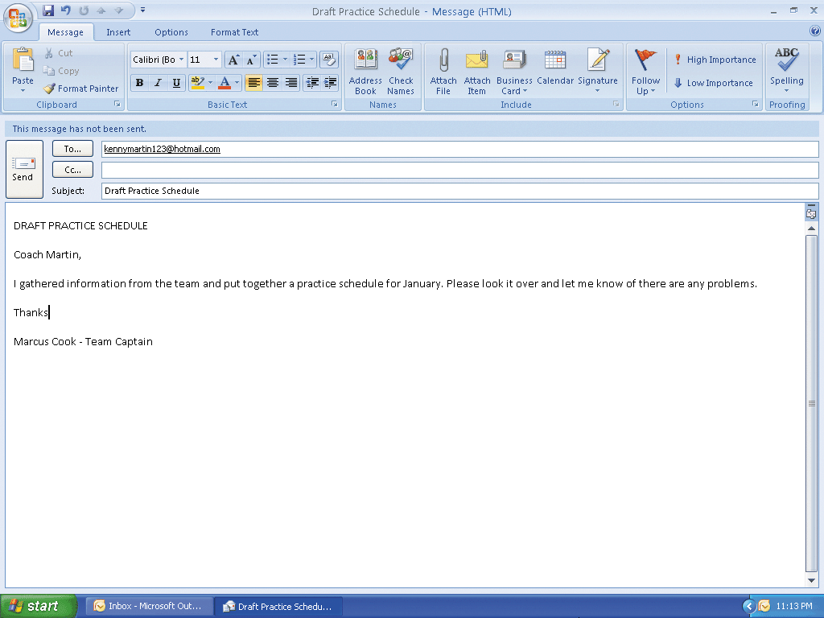
Composing an E-Mail Message

Slide 29
Formatting an E-Mail Message
Highlight the text, DRAFT PRACTICE SCHEDULE, in the message body and then click the Format Text tab
Click the Center button in the Paragraph group on the Format Text tab to center the selected text
Click the Font Color button in the Font group on the Format Text tab to change the color of the selected text to red
Click the Font Size box arrow in the Font group on the Format Text tab to display the Font Size list
Scroll down the Font Size list, click 36, and then click the selected text to remove the selection

Slide 30
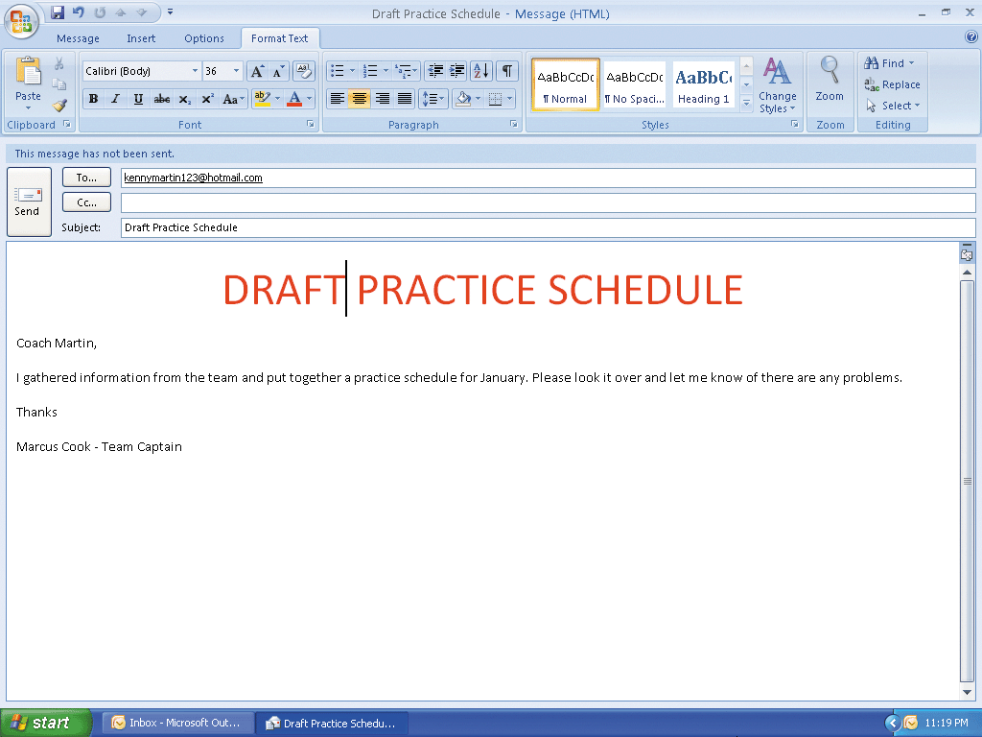
Formatting an E-Mail Message

Slide 31
Attaching a File to an E-Mail Message and Sending the Message
Click the Insert tab on the Ribbon and then click the Attach File button in the Include group to display the Insert File dialog box
With your USB flash drive connected to one of the computer’s USB ports, if necessary, click the Look in box arrow and then click UDISK 2.0 (E:) to select the USB flash drive, drive E in this case, in the Look in list as the device that contains the file
Click Draft Practice Schedule in the Insert File dialog box
Click the Insert button in the Insert File dialog box to insert the file into the message
Click the Send button to send the message and close the Message window

Slide 32
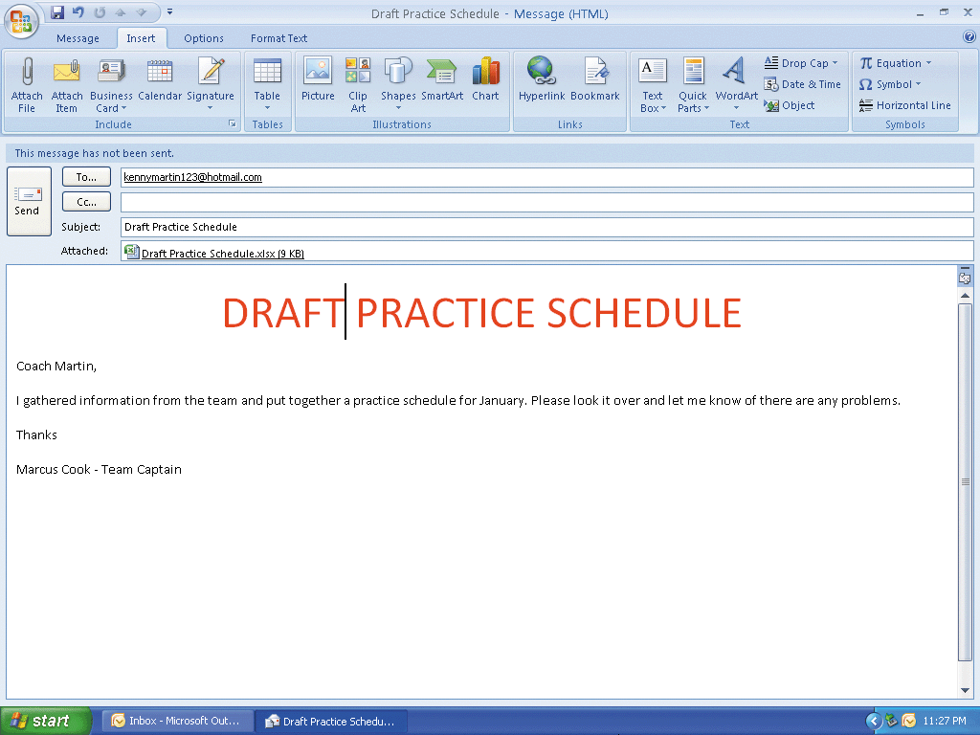
Attaching a File to an E-Mail Message and Sending the Message

Slide 33
Categorizing E-Mail Messages
With the Inbox window active, right-click the Kenny Martin message heading to display the message shortcut menu.
Point to Categorize to display the Categories submenu
Click the Red Category command on the Categories submenu. If the Rename Category dialog box appears, click No.
Repeat Steps 1 and 2 to categorize the remaining messages in the message pane

Slide 34
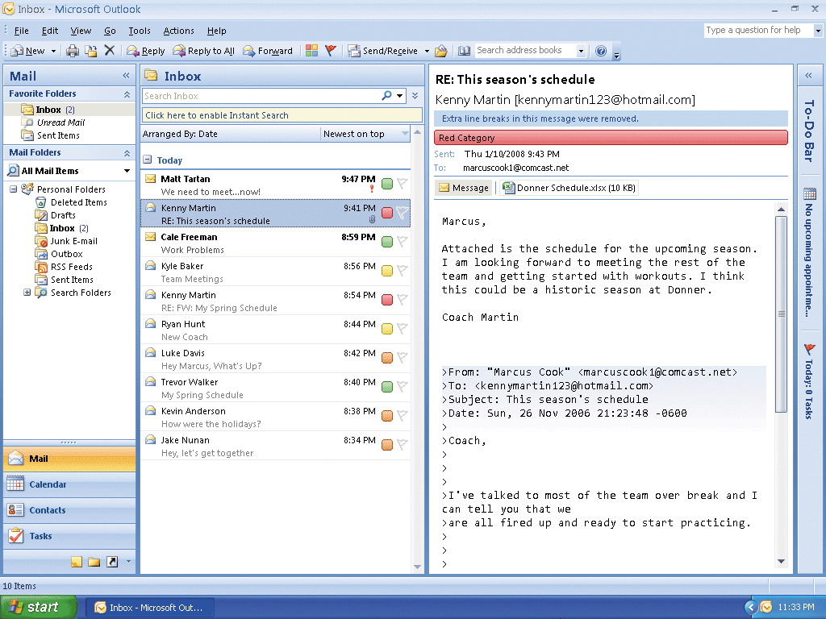
Categorizing E-Mail Messages

Slide 35
Flagging E-Mail Messages
With the Inbox window active, right-click the Kenny Martin message heading to display the message shortcut menu
Point to Follow Up to display the Follow Up submenu
Click the Today command on the Follow Up submenu to assign a Follow Up flag with today as the due date.
Repeat Steps 1 and 2 to add Follow Up flags to the remaining messages in the message pane
Select different flags as necessary

Slide 36
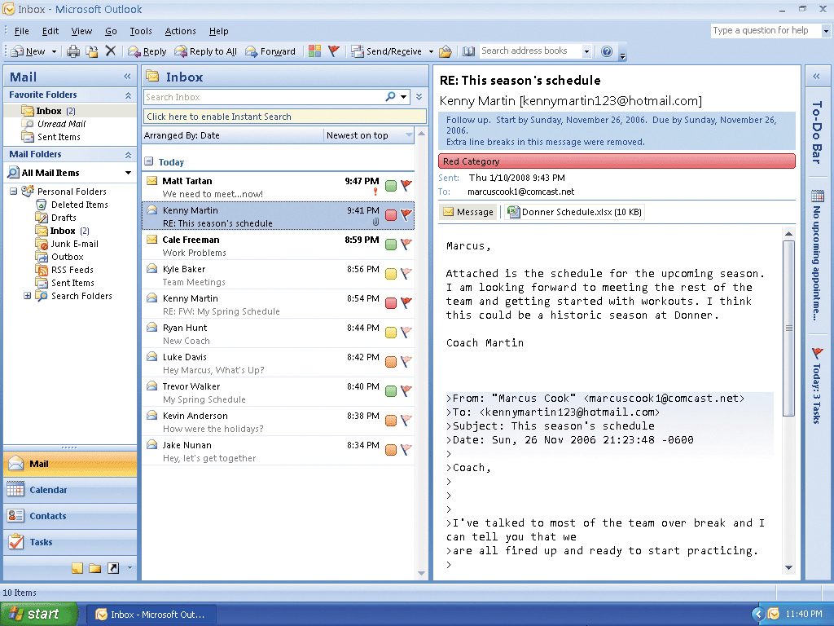
Flagging E-Mail Messages

Slide 37
Sorting E-Mail Messages by Category Color
With the Inbox window active, click View on the menu bar to open the View menu. Point to Arrange By to display the Arrange By submenu
Click Categories on the Arrange By submenu to sort the messages by Category
Return to the previous view by repeating Step 1 and then clicking Date on the Arrange By submenu

Slide 38
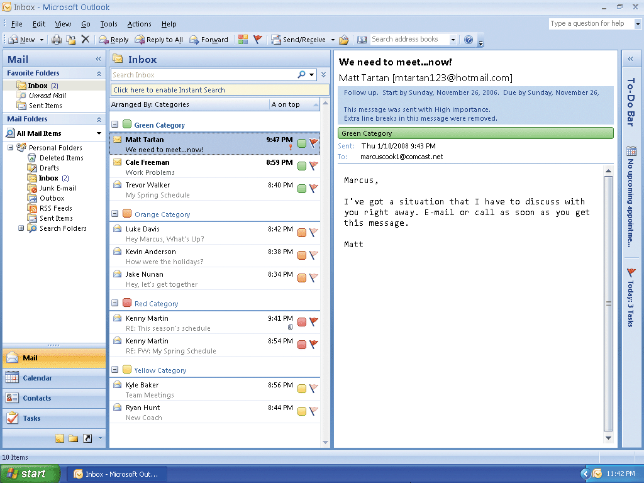
Sorting E-Mail Messages by Category Color

Slide 39
Creating and Applying a View Filter
With the Inbox window active, click View on the menu bar
Point to Arrange By on the View menu and then click Custom on the Arrange By submenu to display the Customize View: Messages dialog box
Click the Filter button to display the Filter dialog box.
Click the From text box
Type Kenny Martin in the From text box to specify that only e-mail messages from Kenny Martin are to appear

Slide 40
Creating and Applying a View Filter
Click the OK button in the Filter dialog box and the Customize View: Message dialog box to close both boxes and apply the view filter
Repeat Steps 1 and 2 to display the Filter dialog box
Click the Clear All button in the Filter dialog box to remove the view filter
Close the Filter and Customize View: Message dialog boxes

Slide 41
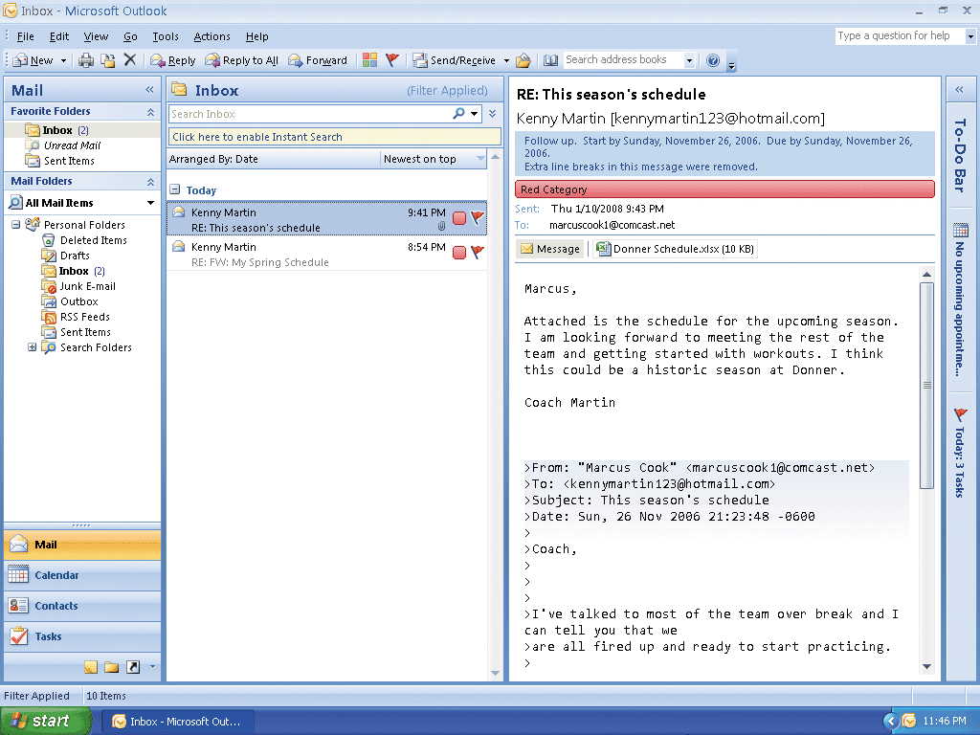
Creating and Applying a View Filter

Slide 42
Setting Message Importance, Sensitivity and Delivery Options in a Single Message
With the Inbox window active, click the New Mail Message button on the Standard toolbar
Enter the message information
Click the Options Dialog Box Launcher on the Ribbon to display the Message Options dialog box
Click the Importance box arrow and then select High in the Importance list
Click the Sensitivity box arrow and then select Private in the Sensitivity list

Slide 43
Setting Message Importance, Sensitivity and Delivery Options in a Single Message
Click the ‘Do not deliver before‘ check box in the Delivery options area to select it
Select January 14, 2008 in the calendar and 12:00 PM as the time in the respective delivery boxes
Click the Close button to close the dialog box
Click the Send button to send the message

Slide 44
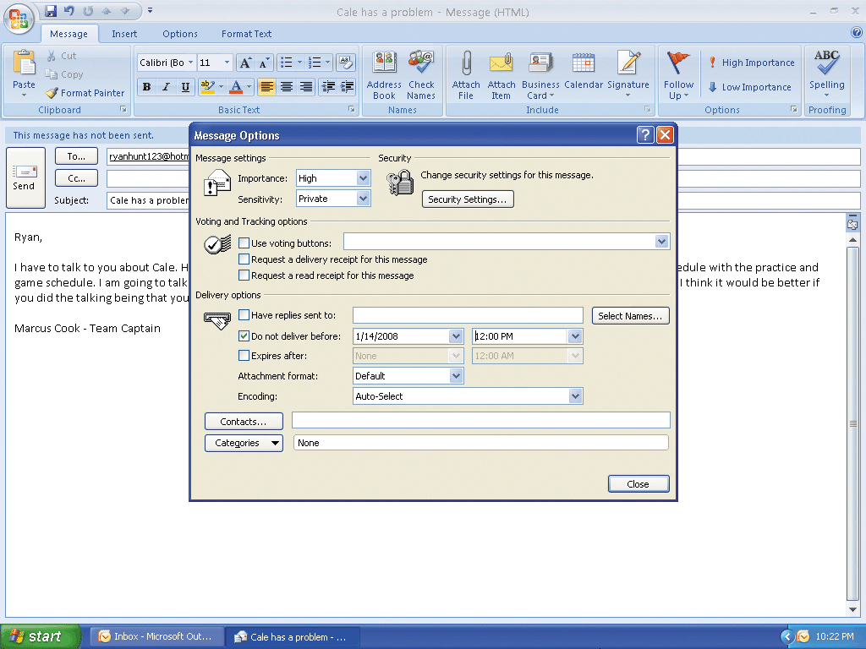
Setting Message Importance, Sensitivity and Delivery Options in a Single Message

Slide 45
Changing the Default Level of Importance and Sensitivity
With the Inbox window active, click Tools on the menu bar and then click Options on the Tools menu to display the Options dialog box
In the Preferences sheet, click the E-mail Options button to display the E-mail Options dialog box
Click the Advanced E-mail Options button to open the Advanced E-mail Options dialog box
Click the Set importance box arrow to display the importance options
Select High in the Set importance list

Slide 46
Changing the Default Level of Importance and Sensitivity
Click the Set sensitivity box arrow to display the sensitivity options
Select Private in the Set sensitivity list
Click the OK button in all three open dialog boxes to close them and return to the Inbox window

Slide 47
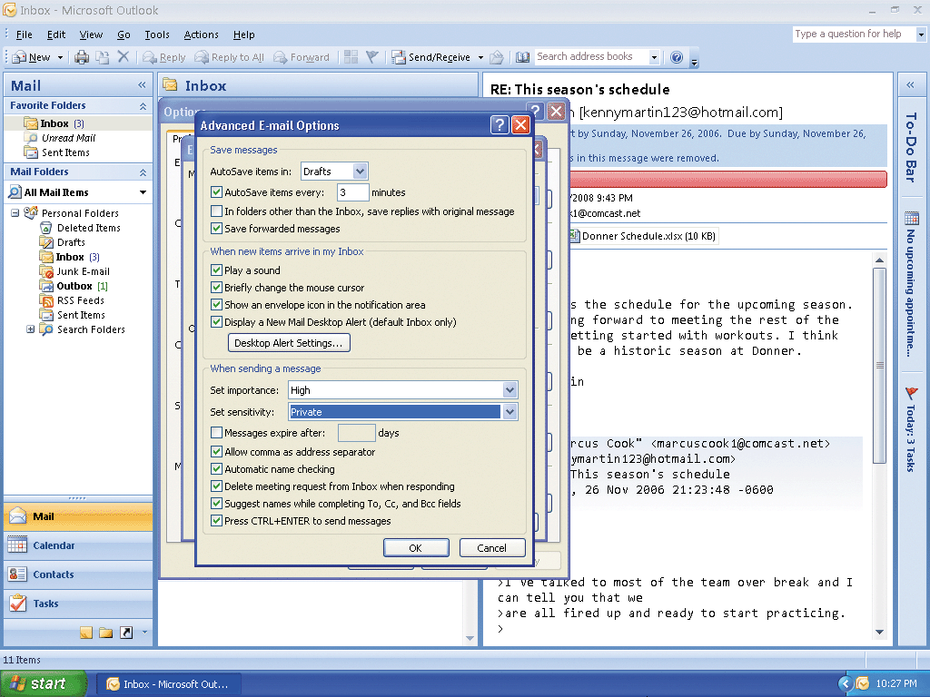
Changing the Default Level of Importance and Sensitivity

Slide 48
Creating a Personal Folder
Click the Contacts button in the Navigation Pane to open the Contacts window
When Outlook displays the Contacts window, right-click Contacts in the My Contacts pane to display the Contacts shortcut menu
Click New Folder on the Contacts shortcut menu to display the Create New Folder dialog box. Type Marcus' Contacts in the Name text box
If necessary, select Contact Items in the Folder contains list
Click Contacts in the Select where to place the folder list

Slide 49
Creating a Personal Folder
Click the OK button to close the Create New Folder dialog box
In the Contacts window, click Marcus’ Contacts in the My Contacts list

Slide 50
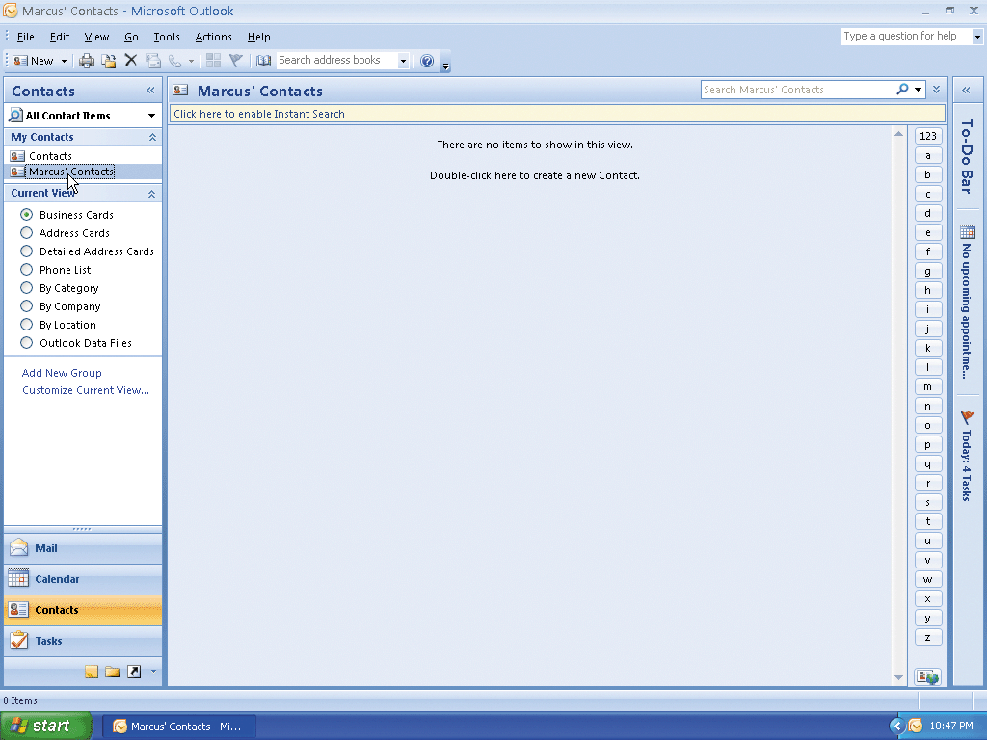
Creating a Personal Folder

Slide 51
Creating a Contact List
With the Contacts window active and Marcus’ Contacts folder selected, click the New Contact button on the Standard toolbar to open the Untitled- Contact window. If necessary, maximize the window
Type Kenny Martin in the Full Name text box
Click the Home text box in the Phone numbers area
Type 9375554120 as the home telephone number
Click the Addresses box arrow and select Home
Click the text box in the Addresses area, type 8465 W. 63rd St. and then press the ENTER key

Slide 52
Creating a Contact List
Type Donner, OH 44772 to complete the address entry.
Click the E-mail text box
Type kennymartin123@hotmail.com as the e-mail address and then press the TAB key to complete the contact information for Kenny Martin
Click the Save & Close button on the Ribbon to display the Marcus’ Contacts window with the Kenny Martin business card in the Marcus’ Contacts pane
Click the New Contact button on the Standard toolbar
Repeat Steps 2 through 4 to enter the 11 remaining contacts in Table 1–3

Slide 53
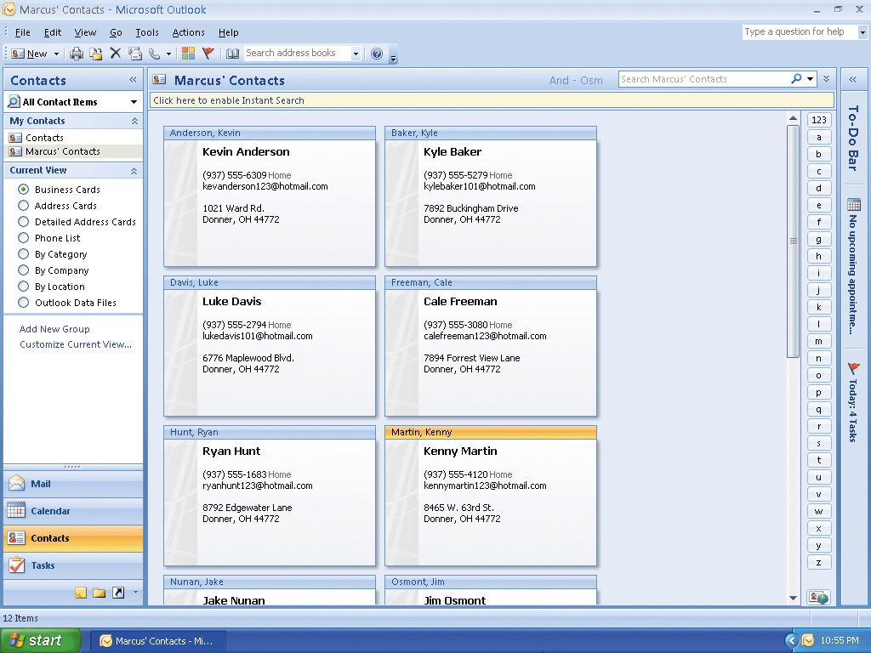
Creating a Contact List

Slide 54
Changing the View and Sorting the Contact List
With the Marcus’ Contacts – Microsoft Outlook window active, click Phone List in the Current View pane of the Navigation Pane
With the Phone List in ascending sequence by the File As field, click the File As column heading in the Contacts pane to display the contact list in descending sequence by last name
After reviewing the contact list in Phone List view, click Business Cards in the Current View pane in the Navigation Pane to return to Business Cards view

Slide 55
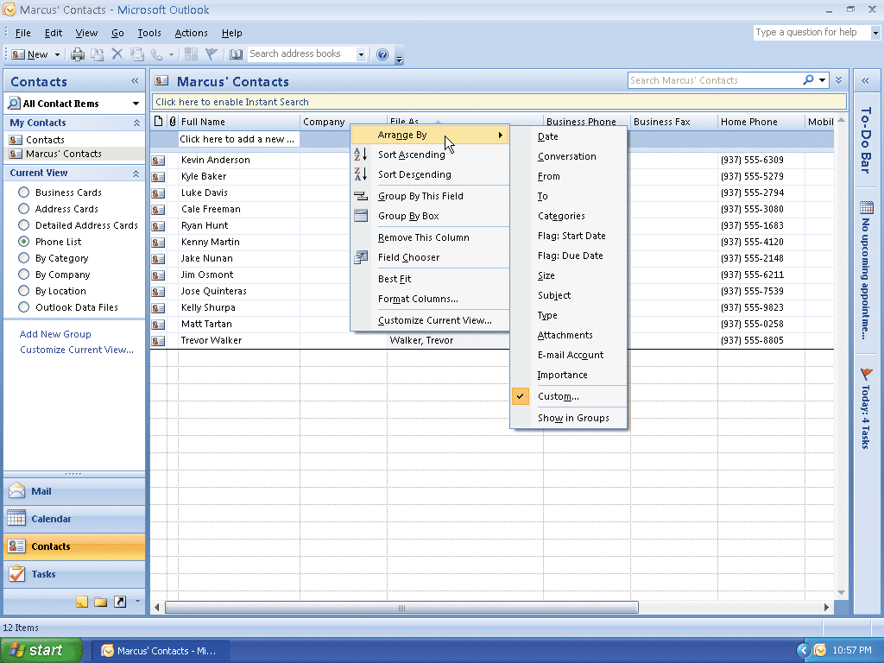
Changing the View and Sorting the Contact List

Slide 56
Finding a Contact
Click the Find a Contact box on the Standard toolbar
Type shu in the text box
Press the ENTER key to start the search process
Outlook opens the Kelly Shurpa – Contact window
Click the Close button to return to Business Card view

Slide 57
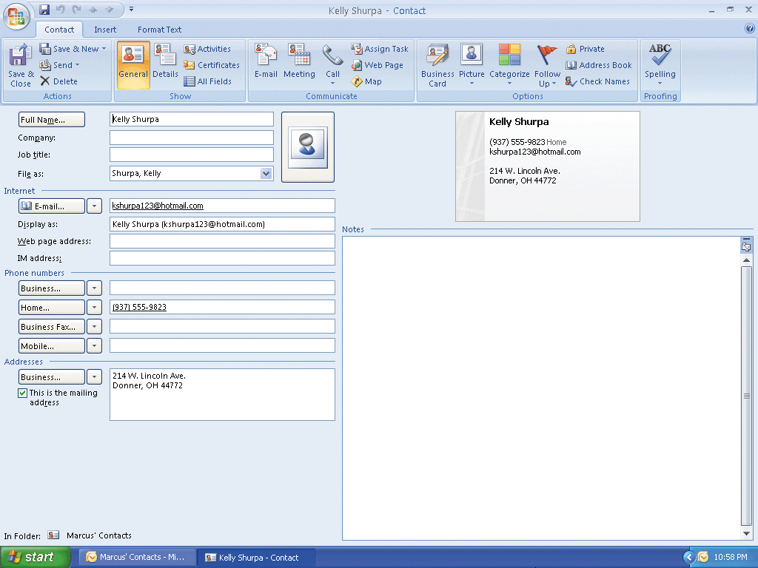
Finding a Contact

Slide 58
Organizing Contacts
Click Tools on the menu bar and then click Organize on the Tools menu
Click the name bar of the Kevin Anderson contact record
Hold down the CTRL key and then click the name bars of Cale Freeman and Ryan Hunt
Release the CTRL key
Click the ‘Add contacts selected below to’ box arrow to display a list of categories
Click Blue Category in the list
Click the Add button to add the selected records to the Blue Category

Slide 59
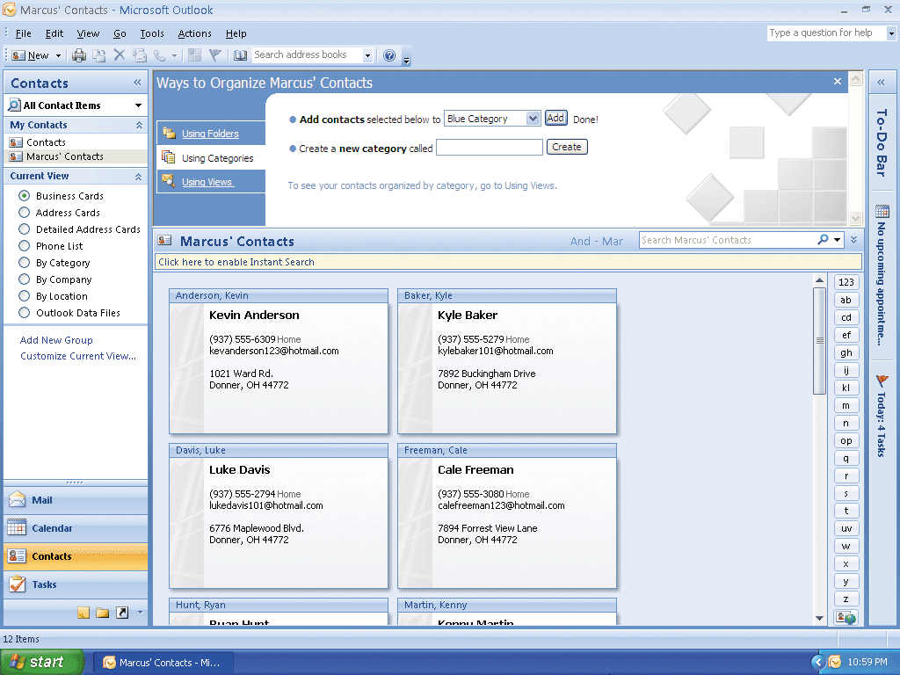
Organizing Contacts

Slide 60
Displaying the Contacts in a Category
With the Contacts window active, click Tools on the menu bar and then point to Instant Search to display the Instant Search submenu
Click Instant Search on the Instant Search submenu
Type Blue Category in the Instant Search text box and then press the ENTER key to display the three contacts that belong to the Blue Category
After viewing the contacts in the Blue Category, click the Clear Search button to return to the full Contacts window

Slide 61
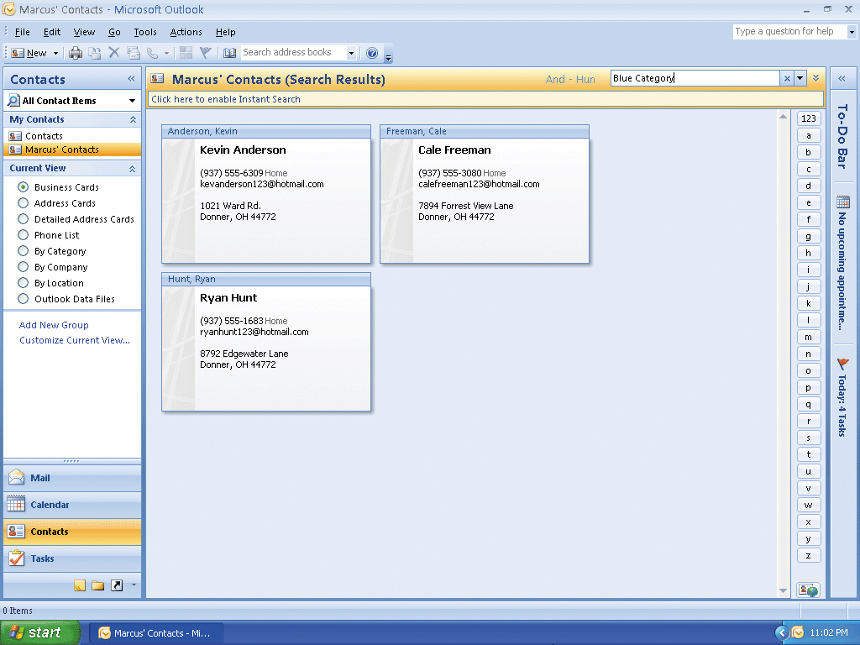
Displaying the Contacts in a Category

Slide 62
Previewing and Printing the Contact List
With the Contacts window active, click the Print button on the Standard toolbar to display the Print dialog box
Click the Preview button to display a preview of the printout
After viewing the preview of the printed contacts list, click the Close button
If the preview is acceptable, ready the printer
Click the Print button on the Standard toolbar
When Outlook displays the Print dialog box, click the OK button

Slide 63
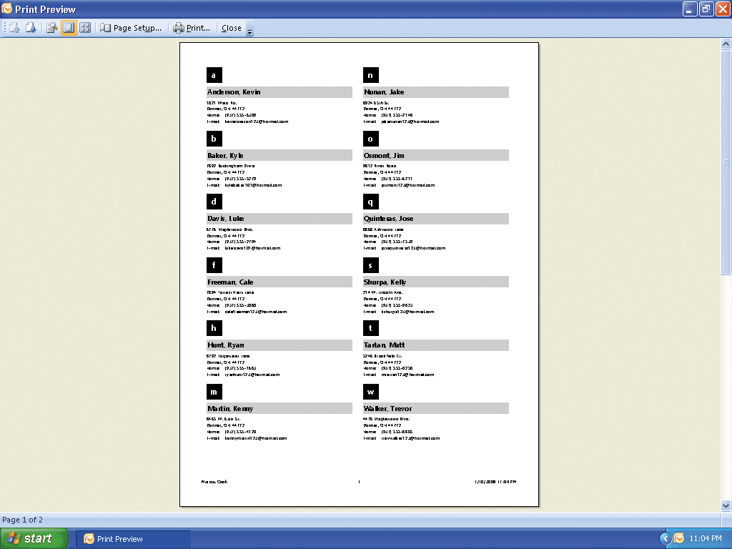
Previewing and Printing the Contact List

Slide 64
Using the Contact List to Address an E-Mail Message
Click the Mail button in the Navigation Pane to display the Inbox window
Click the New Mail Message button on the Standard toolbar to display the Untitled – Message window
When Outlook displays the Untitled – Message window, if necessary, double-click its title bar to maximize it. To button signature insertion point Untitled – Message window
Click the To button to display the Select Names dialog box
Click the Address Book box arrow

Slide 65
Using the Contact List to Address an E-Mail Message
Click Marcus’ Contacts in the list
Click the Matt Tartan entry in the contact list
Click the To button in the Message Recipients area to add Matt Tartan as the message recipient
Click the OK button to close the Select Names dialog box

Slide 66
Using the Contact List to Address an E-Mail Message
Click the Subject text box and then type Carwash Fund-raiser as the entry
Press the TAB key to move the cursor to the message area
Type the message
Click the Send button to send the message and close the Message window

Slide 67
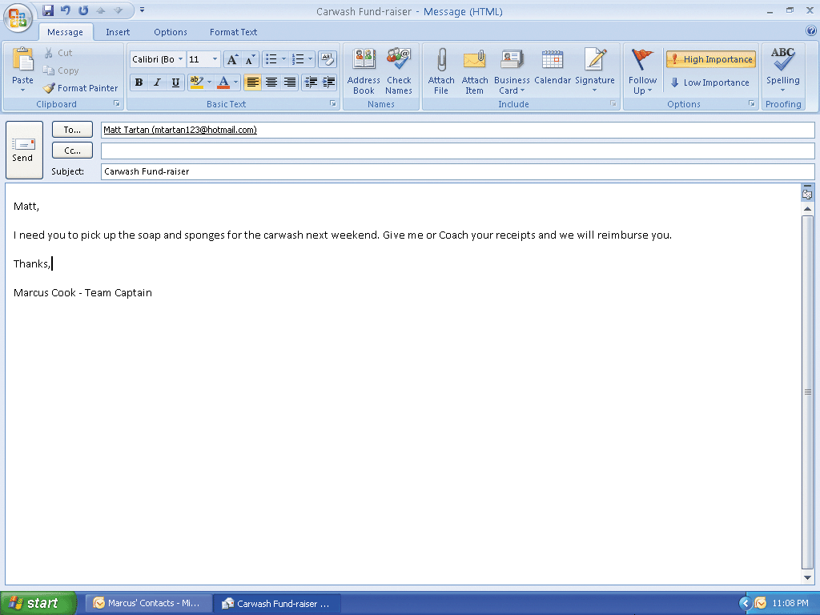
Using the Contact List to Address an E-Mail Message

Slide 68
Creating a Distribution List
With the Contacts window active, click the New Contact button arrow on the Standard toolbar to display the New Contact menu Click Distribution List to display the Untitled – Distribution List window. Type Chemistry Lab Group in the Name text box, and then click the Select Members button on the Ribbon to display the Select Members dialog box
Click the Address Book box arrow and click Marcus’ Contacts
Select Jake Nunan and then click the Members button to add Jake to the Chemistry Lab Group distribution list
Add Kyle Baker and Trevor Walker to the list in the same manner
Click the OK button to close the Select Members dialog box and display the Chemistry Lab Group – Distribution List window showing the members of the Chemistry Lab Group distribution list

Slide 69
Creating a Distribution List
Click the Save & Close command on the Ribbon to close the Chemistry Lab Group – Distribution List window and activate the Contacts window
Click the Address Book button on the Standard toolbar to display the Address Book dialog box
Select Marcus’ Contacts in the Address Book list to display the contact list, which now includes the Chemistry Lab Group distribution list
Click the Close button to close the Address Book window

Slide 70
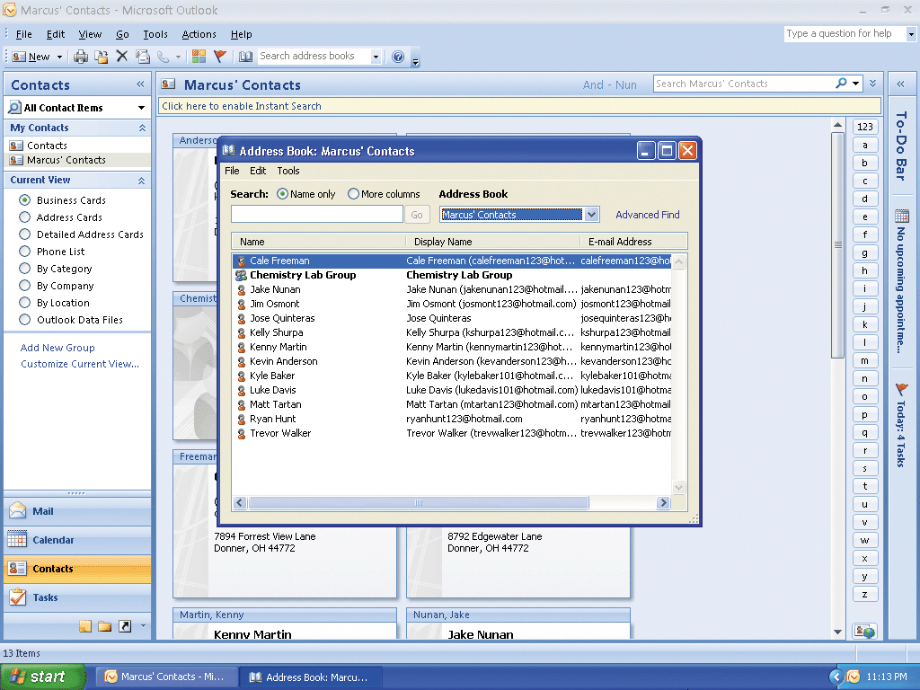
Creating a Distribution List

Slide 71
Saving a Contact List as a Text File and Displaying it in WordPad
Connect the USB flash drive containing the Data Files for Students to one of the computer’s USB ports
With the Contacts window active, click the name bar of the first contact in the contact list
Press CTRL+A to select all the contacts
Click File on the menu bar to display the File menu
Click Save As on the File menu to display the Save As dialog box

Slide 72
Saving a Contact List as a Text File and Displaying it in WordPad
Type Marcus‘ Contacts in the File name text box.
If necessary, select Text Only in the Save as type box
Click the Save in box arrow and then select UDISK 2.0 (E:). (Your USB flash drive may have a different name and letter)
Click the Save button in the Save As dialog box
Click the Start button on the Windows taskbar, point to All Programs on the Start menu, point to Accessories on the All Programs submenu, and then click WordPad on the Accessories submenu to open the Wordpad text editor

Slide 73
Saving a Contact List as a Text File and Displaying it in WordPad
When WordPad starts, click the Maximize button on the title bar, click File on the menu bar, and then click Open
When WordPad displays the Open dialog box, click the Files of type box arrow, select All Files, click the Look in box arrow, and then click UDISK 2.0 (E:) (your USB flash drive may have a different name and letter) in the Look in list
Double-click Marcus’ Contacts to display Marcus’ Contacts as a text file
After viewing the text file, click the WordPad Close button

Slide 74
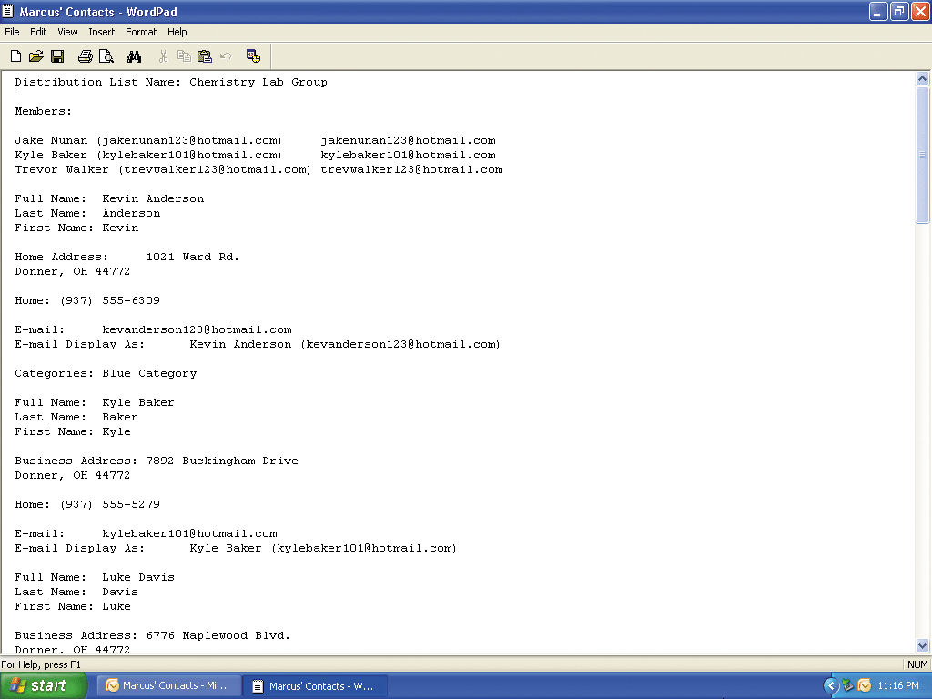
Saving a Contact List as a Text File and Displaying it in WordPad

Slide 75
Tracking Activities for a Contact
With the Contacts window active, double-click the Kenny Martin contact heading
Click the Activities command on the Ribbon to display the Activities sheet showing a list of items related to Kenny Martin

Slide 76
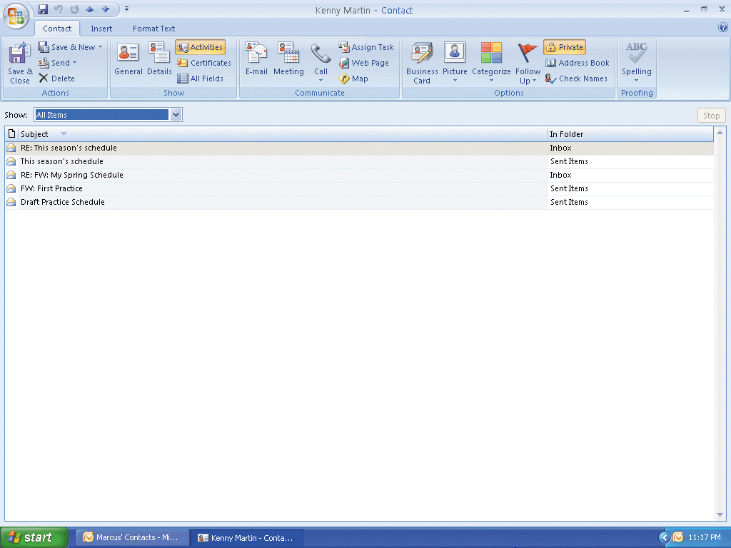
Tracking Activities for a Contact

Slide 77
Searching for Outlook Help
Click the Microsoft Office Outlook Help button on the Standard toolbar to open the Outlook Help window
Type format text in the ‘Type words to search for’ text box at the top of the Outlook Help window
Press the ENTER key to display the search results
Click the Maximize button on the Outlook Help window title bar to maximize the Help window
Click the Apply bold, italic, or underline formatting to text link to display information regarding formatting text
Click the Close button on the Outlook Help window title bar to close the Outlook Help window and redisplay the Contacts window

Slide 78
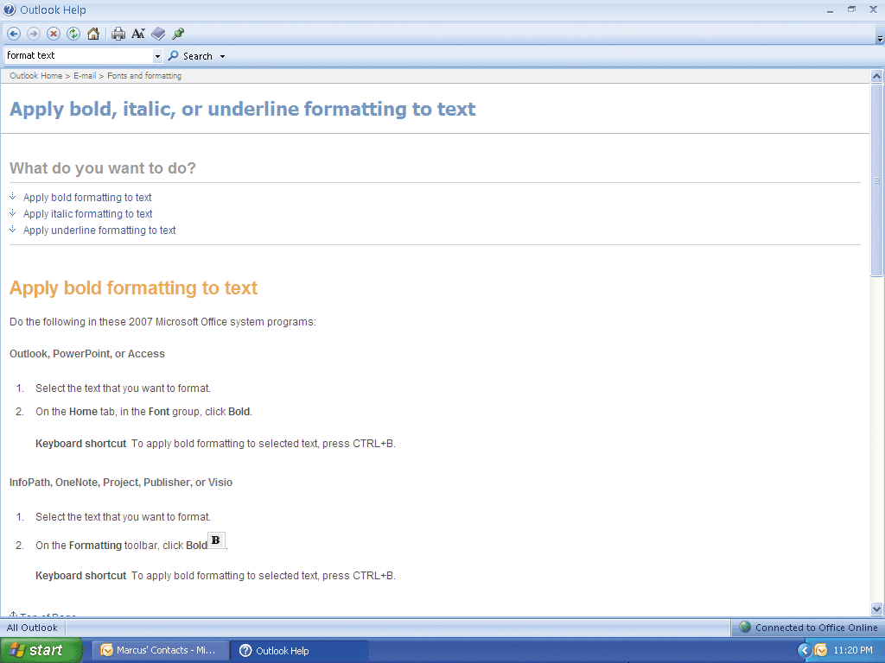
Searching for Outlook Help

Slide 79
Quitting Outlook
Click the Close button on the right side of the title bar to quit Outlook
If necessary, click the Exit Without Sending button in the Microsoft Office Outlook dialog box so that any messages saved in your Outbox are not sent

Slide 80
Summary
Start and quit Outlook
Open, read, print, reply to, and delete electronic mail messages
View a file attachment
Create and insert an e-mail signature
Compose, format, and send e-mail messages
Insert a file attachment in an e-mail message
Flag, categorize, sort, and filter e-mail messages

Slide 81
Summary
Set e-mail importance, sensitivity, and delivery options
Create a personal folder
Create and print a contact list
Use the Find a Contact feature
Organize the contact list
Track activities of a contact
Use Outlook’s Help

Slide 82
Outlook Chapter 1 Complete

