Slide 1
Integration
Integrating Office
2007 Applications and
the World Wide Web

Slide 2
Objectives
Integrate the Office 2007 applications to create a Web site
Add hyperlinks to a Word document
Embed an Excel chart into a Word document
Add a hyperlink to a PowerPoint slide
Create Web pages from a PowerPoint presentation

Slide 3
Objectives
Add a hyperlink to an Access report
Create a Web page from an Access report
Test a Web site in a browser

Slide 4
Plan Ahead
Choose hyperlink names and locations
Ascertain the navigational structure of the Web pages
Determine appropriate fi le names for Web pages
Organize the layout of the home page
Plan the layout of the Access report

Slide 5
Starting word, Opening an Existing Document, and Saving the Document with Another Name
Connect the USB flash drive containing the Data Files for Students to an available USB port on your computer. See the inside back cover of this book for instructions for downloading the Data Files for Students or see your instructor for information on accessing the files required in this book
Start Word. Click the Office Button and then click Open on the Office Button menu

Slide 6
Starting word, Opening an Existing Document, and Saving the Document with Another Name
Click the Look in box arrow and then click UDISK 2.0 (E:) in the Look in list. (Your USB drive may have a different name and letter)
Double-click Makin-It Real Estate Letterhead to open the Makin-It Real Estate Letterhead document
Click the Office Button and then click Save As on the Office Button menu. Type Makin-It Real Estate Home Page in the File name text box and then click the Save button in the Save As dialog box to save the document as Makin-It Real Estate Home Page.
Click the Web Layout button on the status bar to view the document in Web layout view
Click the Show/Hide ¶ button on the Ribbon to show hidden formatting symbols

Slide 7
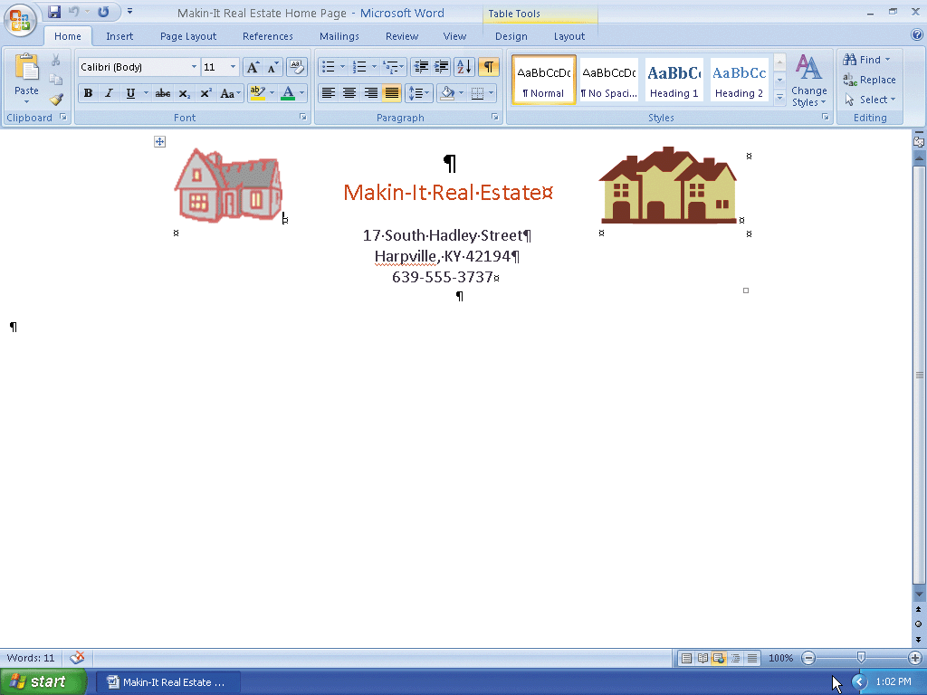
Starting word, Opening an Existing Document, and Saving the Document with Another Name

Slide 8
Inserting a Table into a Word Document
Position the insertion point on the second paragraph mark below the company telephone number
Click the Insert tab on the Ribbon and then click the Table button on the Ribbon
Drag the mouse pointer through the first two cells in the Table gallery and do not release the mouse button
Release the mouse button to insert the table and close the Table gallery

Slide 9
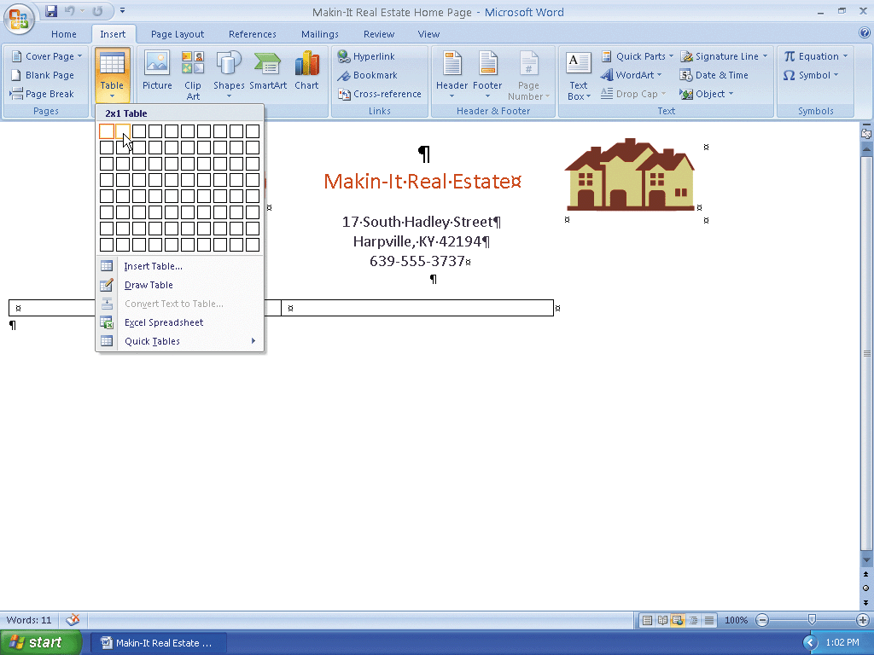
Inserting a Table into a Word Document

Slide 10
Removing the Table Border, View Gridlines, and AutoFit the Table Contents
Select both cells in the new table
If necessary, click the Design tab on the Ribbon
Click the Borders button arrow on the Ribbon to display the Borders gallery
Click No Border in the Borders gallery to remove the borders from the table

Slide 11
Removing the Table Border, View Gridlines, and AutoFit the Table Contents
Click the Layout tab on the Ribbon
Click the View Gridlines button on the Ribbon to display gridlines in both tables in the document
Click the AutoFit button arrow on the Ribbon to display the AutoFit gallery
Click AutoFit Contents in the AutoFit gallery to shrink the selected cells to fit their contents

Slide 12
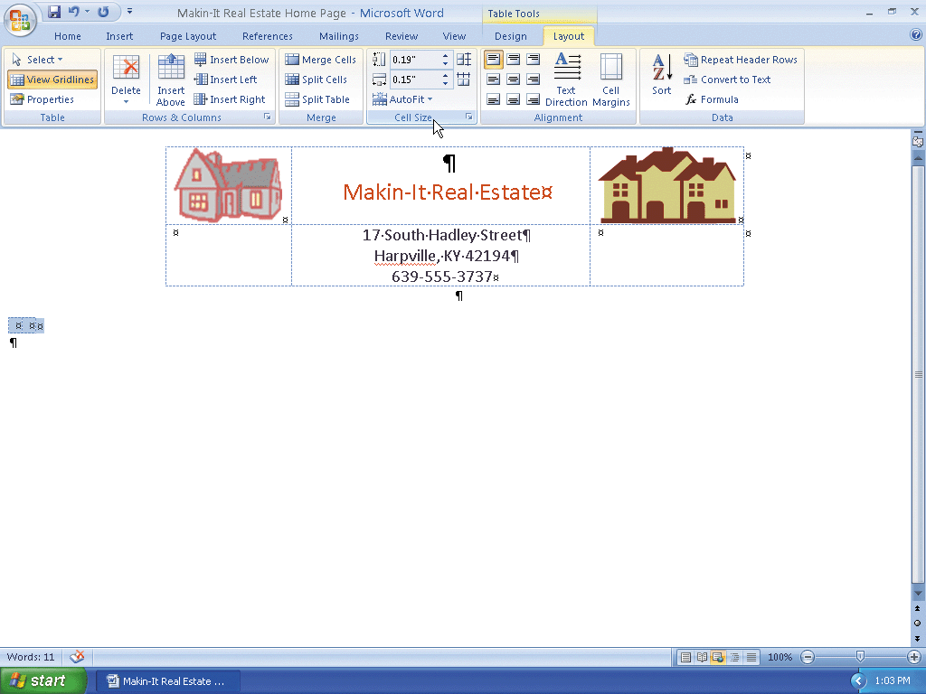
Removing the Table Border, View Gridlines, and AutoFit the Table Contents

Slide 13
Inserting Text for Hyperlinks
If necessary, click the leftmost cell in the table to place the insertion point in the cell
Type Company Services and then press the ENTER key twice
Type Homes for Sale and then press the ENTER key twice.
Type E-Mail for Information but do not press the ENTER key to complete the entry of the three text phrases that will be used as hyperlinks

Slide 14
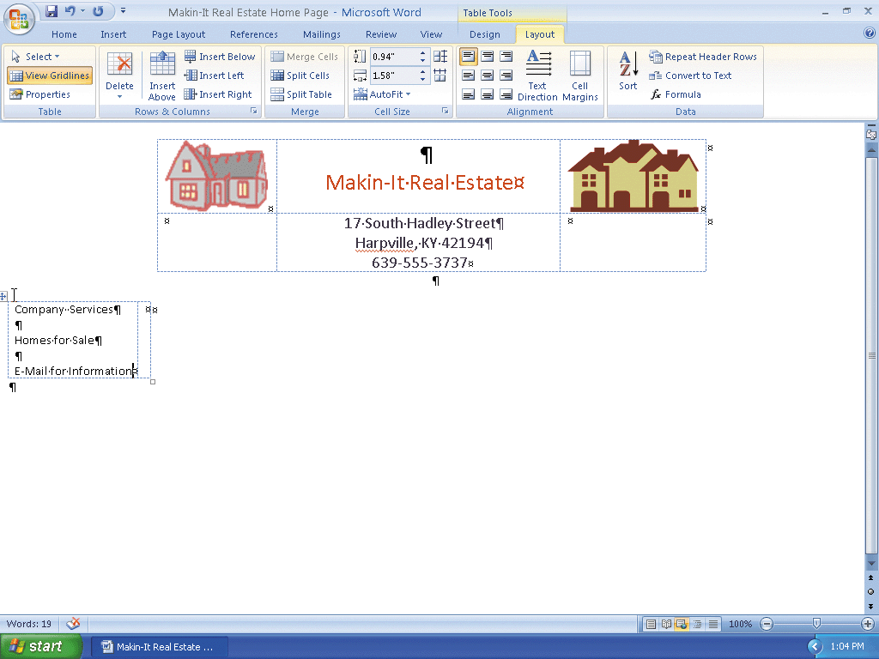
Inserting Text for Hyperlinks

Slide 15
Creating a Hyperlink to PowerPoint Web Pages
Drag through the text, Company Services, in the table to select the text
Click the Insert tab on the Ribbon.
Click the Hyperlink button on the Ribbon to display the Insert Hyperlink dialog box
If necessary, click the Existing File or Web Page button on the Link to bar
Type CompanyServices.htm in the Address text box
Click the OK button to assign the hyperlink to the Company Services phrase

Slide 16
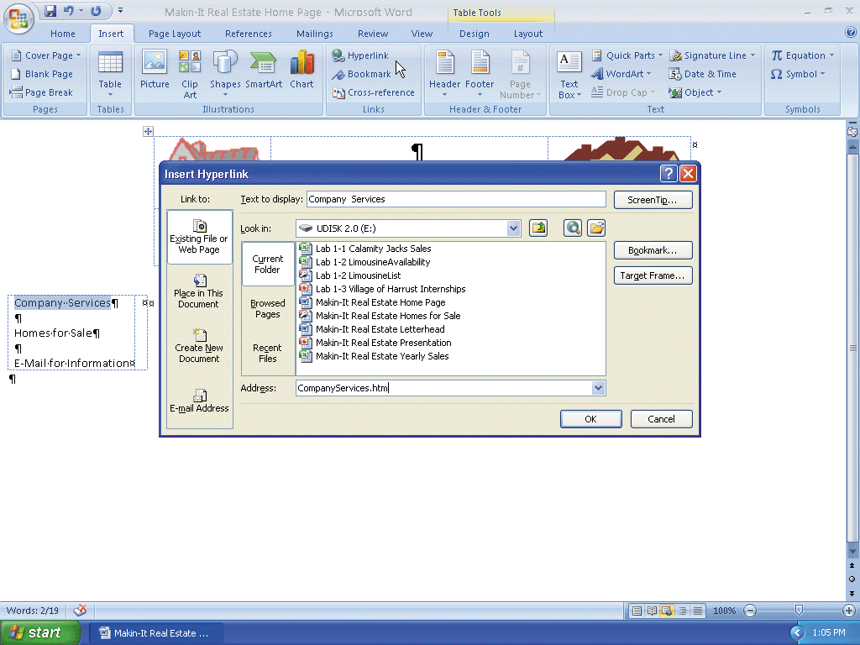
Creating a Hyperlink to PowerPoint Web Pages

Slide 17
Inserting the Remaining Hyperlinks
Drag through the text, Homes for Sale, in the table. Click the Hyperlink button on the Ribbon
Type Makin-It Real Estate - Homes for Sale.htm in the Address text box and then click the OK button
Drag through the text, E-Mail for Information. Click the Hyperlink button on the Ribbon and then click the E-mail Address button on the Link to bar
Type manager@isp.com in the E-mail address text box
Type Request for Information in the Subject box and then click the OK button

Slide 18
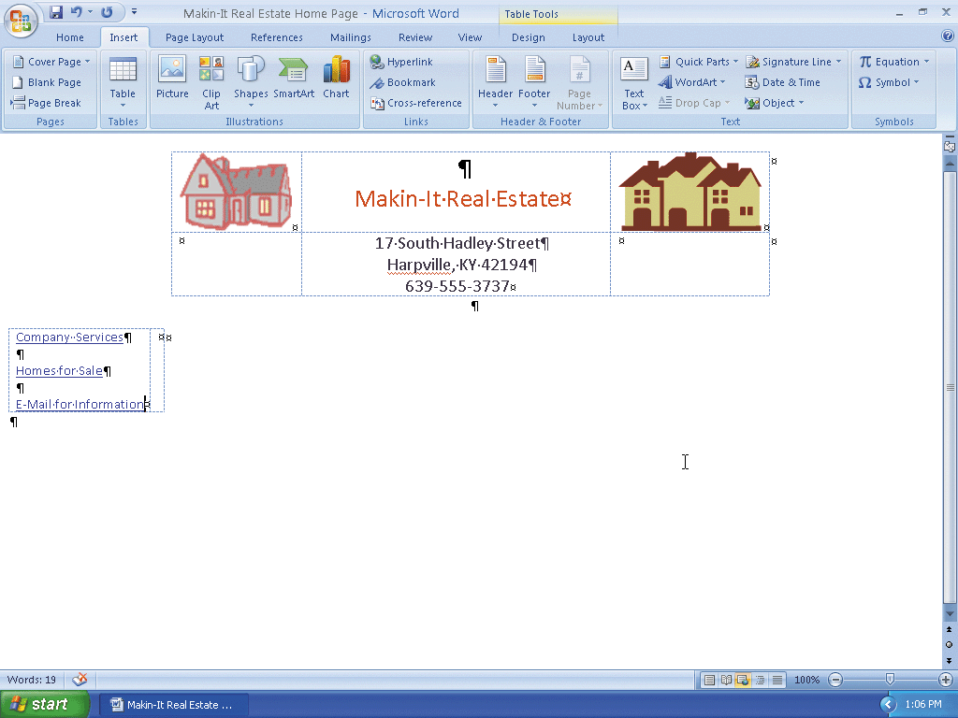
Inserting the Remaining Hyperlinks

Slide 19
Starting Excel and Opening an Existing Workbook
Start Excel. Click the Office Button and then click Open on the Office Button menu
Click the Look in box arrow and then click UDISK 2.0 (E:) in the Look in list. (Your USB drive may have a different name and letter)
Double-click Makin-It Real Estate Yearly Sales to open the Makin-It Real Estate Yearly Sales workbook

Slide 20
Embedding an Excel Chart into a Word Document
If necessary, click the Total Yearly Sales Chart tab to make the sheet tab active
Click the white area around the chart area to select the chart and then click the Copy button on the Ribbon to place a copy of the Bar chart on the Office Clipboard
Click the Makin-It Real Estate Home Page button on the taskbar.
If necessary, click the right cell of the lower table to place the insertion point in the right cell of the table.
Click the Home tab on the Ribbon

Slide 21
Embedding an Excel Chart into a Word Document
Click the Paste button arrow on the Ribbon to display the Paste gallery
Click Paste Special to display the Paste Special dialog box.
If necessary, click Microsoft Office Excel Chart Object in the As list
Click the OK button to embed the Bar chart into the document

Slide 22
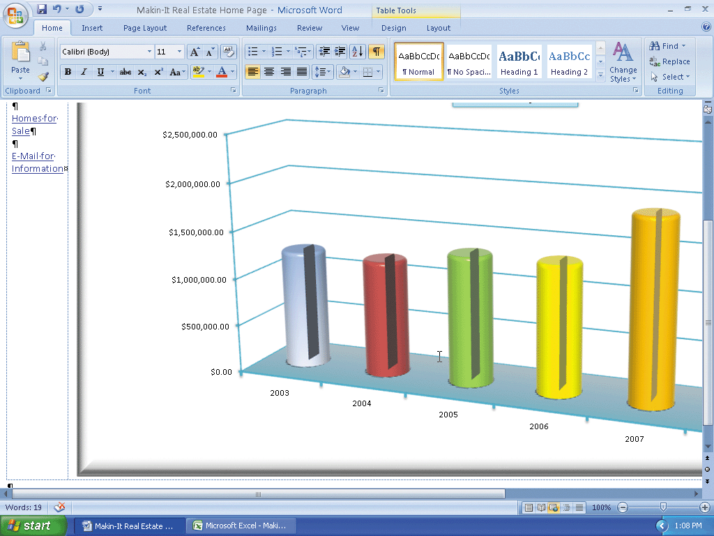
Embedding an Excel Chart into a Word Document

Slide 23
Changing the Size of an Embedded Object
Click the View Ruler button above the vertical scroll box.
If necessary, use the vertical scroll bar on the right side of the Word window to scroll to the top of the document.
Drag the Move Table Column slider to the right so the border aligns with the left border of the upper table.
Right-click the Bar chart to display the shortcut menu
Click Worksheet Object on the shortcut menu to display the Worksheet Object shortcut menu and then point to the Edit command

Slide 24
Changing the Size of an Embedded Object
Click Edit to begin editing the chart in place
Click anywhere in the chart to select it
Use the scroll bars on the bottom and right sides of the Word window to scroll to the bottom-right of the chart
Drag the lower-right sizing handle of the chart up and to the left until the chart is sized

Slide 25
Changing the Size of an Embedded Object
If necessary, use the scroll bars on the bottom and right sides of the Word window to scroll to the top of the document
Click next to the E-Mail for Information hyperlink in the first column of the table to display the Word Ribbon

Slide 26
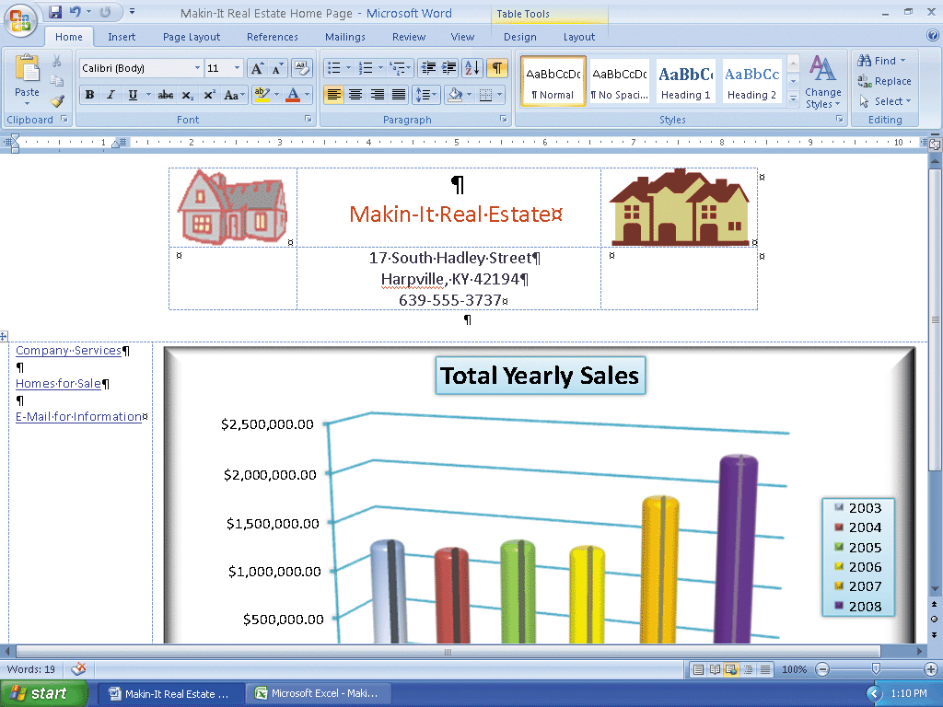
Changing the Size of an Embedded Object

Slide 27
Quitting Excel
Right-click the Microsoft Excel - Makin-It Real Estate Yearly Sales button on the taskbar
Click Close on the shortcut menu. If prompted to save changes, click the No button
If the Microsoft Excel dialog box displays regarding saving the large amount of information on the Clipboard, click the No button

Slide 28
Adding a Button to the Quick Access Toolbar
Click the Customize Quick Access Toolbar button arrow to display the Customize Quick Access Toolbar menu
Click the More Commands command on the Customize Quick Access Toolbar menu
When the Word Options dialog box is displayed, click the ‘Choose commands from’ box arrow to display the Choose commands from list

Slide 29
Adding a Button to the Quick Access Toolbar
Click Commands Not in the Ribbon in the ‘Choose commands from’ list to display a list of commands not in the Ribbon
Scroll to the bottom of the list, click Web Page Preview, and then click the Add button to add the button to the Quick Access Toolbar
Click the OK button to close the Word Options dialog box

Slide 30
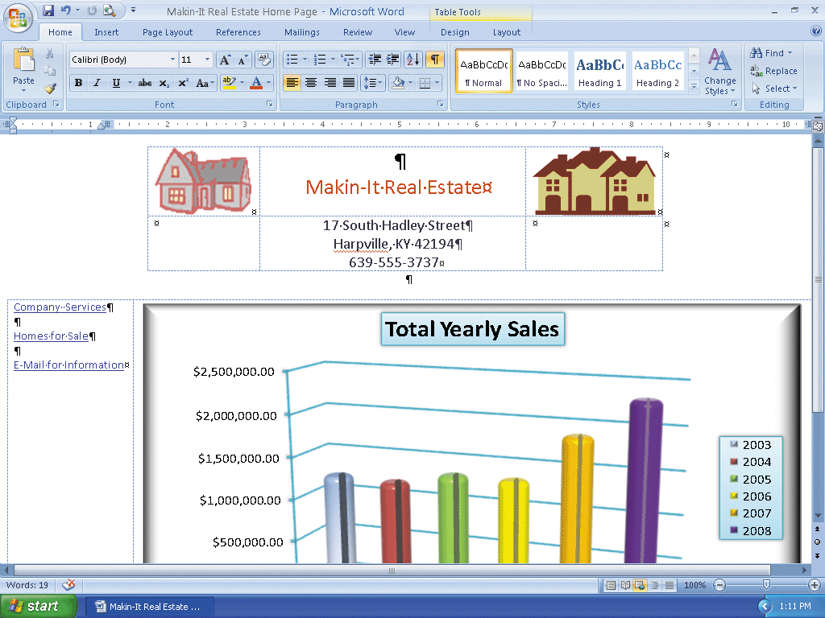
Adding a Button to the Quick Access Toolbar

Slide 31
Previewing the Web Page
Click the Web Page Preview button on the Quick Access Toolbar to display the Web page in your browser
If necessary, click the Maximize button on your browser’s title bar
Click the browser’s Close button

Slide 32
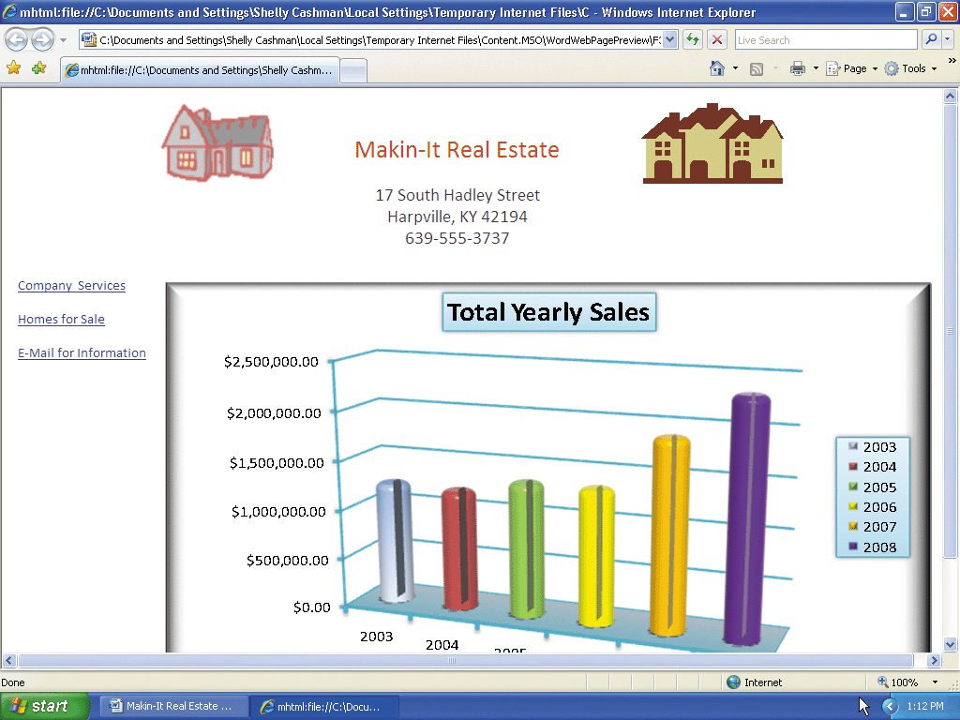
Previewing the Web Page

Slide 33
Saving a Document with a New File Name
Click the Office Button and then click the Save As command.
Type Makin-It Real Estate Home Page in the File name text box if necessary.
Select Web Page in the Save as type box.
If necessary, click the Save in box arrow and then click UDISK 2.0 (E:) in the Save in list. (Your USB flash drive may have a different name and letter)
Click the Save button in the Save As dialog box. If the Microsoft Office Word dialog box displays, click the Continue button

Slide 34
Resetting the Quick Access Toolbar and Quitting Word
Click the Customize the Quick Access Toolbar button arrow on the Ribbon
Click the More Commands command
When the Word Options dialog box is displayed, click the Reset button. If the Reset
Customizations dialog box is displayed, click the OK button
Click the OK button on the Word Options dialog box to close it
Click the View Ruler button to close the ruler
Click the Close button on the Microsoft Word title bar

Slide 35
Starting PowerPoint and Opening an Existing Presentation
Start PowerPoint. Click the Office Button and then click Open on the Office Button menu.
Click the Look in box arrow and then click UDISK 2.0 (E:) in the Look in list. (Your USB drive may have a different name and letter.)
Double-click Makin-It Real Estate Presentation to open the Makin-It Real Estate Presentation presentation

Slide 36
Adding Text for a Hyperlink into a PowerPoint Presentation
Click the Insert tab on the Ribbon
Click Text Box on the Ribbon
Draw the outline of the text box in the location
If necessary, click inside the text box
Type Home as the hyperlink text

Slide 37

Adding Text for a Hyperlink into a PowerPoint Presentation

Slide 38
Inserting a Hyperlink into a PowerPoint Presentation
Double-click the word, Home, inside the text box you just inserted
If necessary, click the Insert tab on the Ribbon
Click the Hyperlink button on the Ribbon to display the Insert Hyperlink dialog box
If necessary, click the Existing File or Web Page button on the Link to bar.
Type e:\Makin-It Real Estate Home Page.htm in the Address text box. (Your USB drive may have a different name and letter.) Click the OK button to add the hyperlink to the text in the text box

Slide 39

Inserting a Hyperlink into a PowerPoint Presentation

Slide 40
Adding a Button to the Quick Access Toolbar and Viewing the Web Page in Your Browser
Click the Customize Quick Access Toolbar button arrow to display the Customize Quick Access Toolbar menu
Click the More Commands command on the Customize Quick Access Toolbar menu
When the PowerPoint Options dialog box is displayed, click the -Choose commands from box arrow to display the Choose commands from list
Click Commands Not in the Ribbon in the Choose commands from list to display a list of commands not in the Ribbon. Scroll to the bottom of the list, click Web Page Preview, and then click the Add button to add the button to the Quick Access Toolbar

Slide 41
Adding a Button to the Quick Access Toolbar and Viewing the Web Page in Your Browser
Click the OK button to close the PowerPoint Options dialog box
Click the Web Page Preview button on the Quick Access Toolbar to display the Web page in your browser
If necessary, click the Maximize button on your browser’s title bar

Slide 42

Adding a Button to the Quick Access Toolbar and Viewing the Web Page in Your Browser

Slide 43
Saving the PowerPoint Presentation as a Web Page
Click the Microsoft PowerPoint button on the taskbar.
Click the Office Button and then click the Save As command
If necessary, type CompanyServices in the File name text box
Select Web Page in the ‘Save as type’ box
If necessary, click the Save in box arrow and then click UDISK 2.0 (E:) in the Save in list
(Your USB flash drive may have a different name and letter)
Click the Save button in the Save As dialog box to save the PowerPoint presentation as a Web page

Slide 44
Removing a Button from the Quick Access Toolbar. Quitting PowerPoint, and Closing Your Browser
Click the Customize the Quick Access Toolbar button arrow on the Ribbon.
Click the More Commands command.
When the PowerPoint Options dialog box is displayed, click the Reset button. If the Reset Customizations dialog box is displayed, click the OK button.
Click the OK button on the PowerPoint Options dialog box to close it.
Click the Close button on the PowerPoint title bar.
Click the Close button on the browser title bar

Slide 45
Starting Access and Opening an Existing Database
Start Access. Click the Office Button and then click Open on the Office Button menu
Click the Look in box arrow and then click UDISK 2.0 (E:) in the Look in list. (Your USB drive may have a different name and letter)
Double-click Makin-It Real Estate Homes for Sale to open the Makin-It Real Homes for Sale database

Slide 46
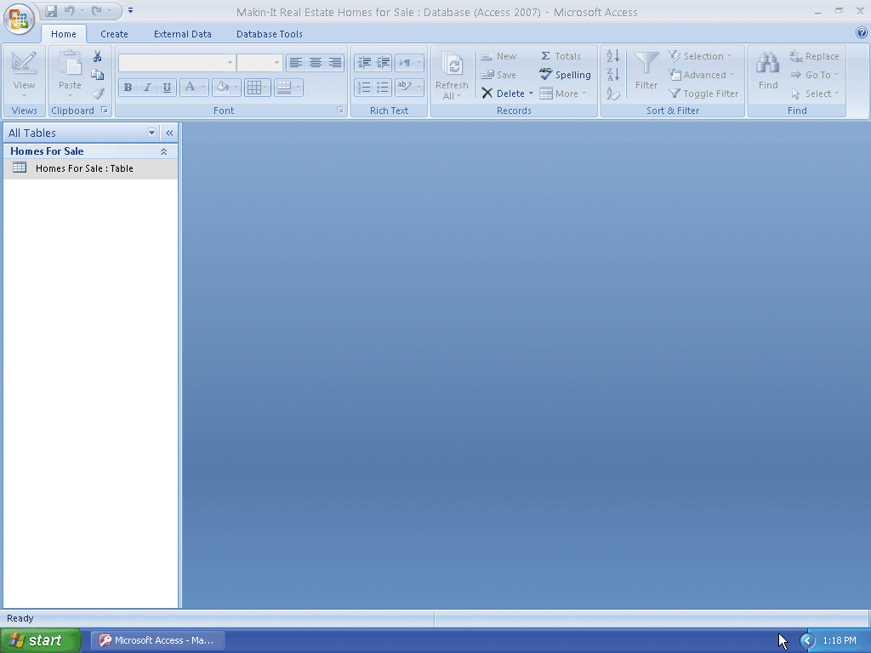
Starting Access and Opening an Existing Database

Slide 47
Creating a Report Using the Report Wizard
Click the Create tab on the Ribbon
Click the Report Wizard button on the Ribbon
When the Report Wizard dialog box is displayed, click the Add All Fields button to move all the fields in the table to the Selected Fields list
Click the Next button
Click Style in the box on the left and then click the Add button to group the report by Style

Slide 48
Creating a Report Using the Report Wizard
Click the Next button to display options for sorting records
Click the Next button
Click the Landscape option button in the Orientation area to select it
Click the Next button
If necessary, click the Access 2007 style in the list on the right

Slide 49
Creating a Report Using the Report Wizard
Click the Next button and then type Makin-It Real Estate – Homes For Sale in the ‘What title do you want for your report?’ text box
If necessary, click the ‘Modify the report’s design’ option button to select it
Click the Finish button to display the report in Design view
If necessary, close the Field List task pane

Slide 50
Adding a Hyperlink to a Report and Changing the Text Background Color
Click the leftmost text box in the Page Footer area of the report to select it.
Press the DELETE key to delete the text box.
Click the leftmost text box in the Page Footer area of the report to select it.
Press the DELETE key to delete the text box that contains the NOW() function

Slide 51
Adding a Hyperlink to a Report and Changing the Text Background Color
Click the Insert Hyperlink button on the Ribbon to display the Insert Hyperlink dialog box
If necessary, click the Existing File or Web Page button in the Link to bar
Click the ‘Text to display’ text box and then type Home as the text to display for the hyperlink
Click the Address box and then type e:\Makin-It Real EstateHome Page.htm

Slide 52
Adding a Hyperlink to a Report and Changing the Text Background Color
Click the OK button to insert the hyperlink
Drag the hyperlink to the lower-left corner of the Page Footer area of the report
Click anywhere in the Style header in the Page header area to select it
Click the Plus icon in the upper-left corner of the Style header to select all items in the body of the report

Slide 53
Adding a Hyperlink to a Report and Changing the Text Background Color
Click the Fill/Back Color button arrow on the Ribbon and then click the White color (column 1, row 1) in the Standard Colors area of the Fill/Back Color palette to change the background color of the selected items to white.
Click the report title in the Report Header area
While holding down the SHIFT key, click the Home hyperlink in the Page Footer area to select it.
Click the Fill/Back Color button on the Ribbon to change the background color of the selected items to white

Slide 54
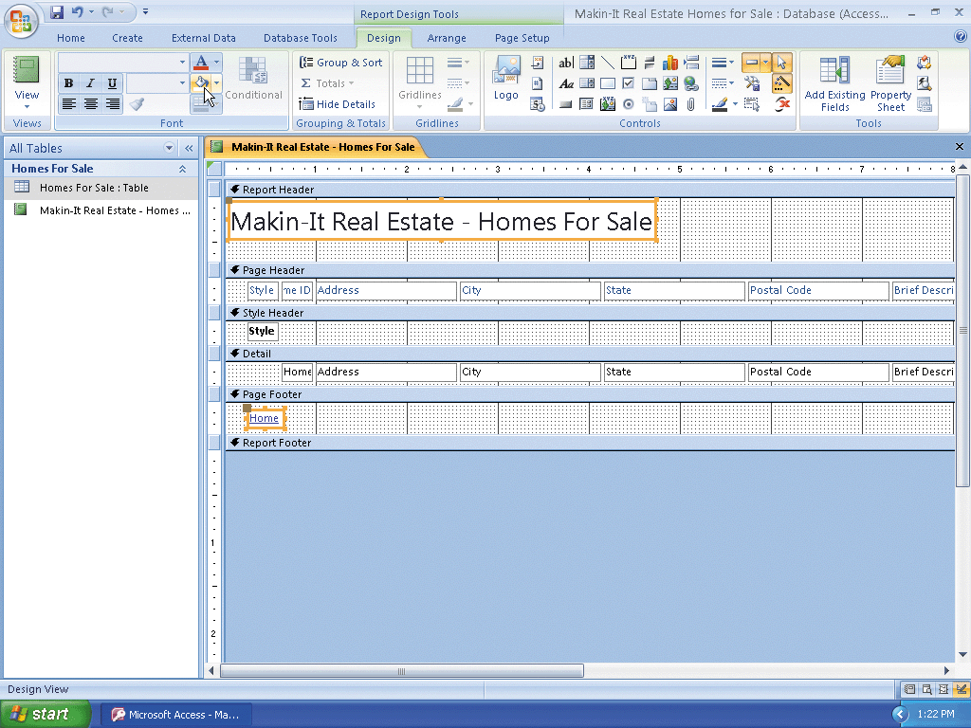
Adding a Hyperlink to a Report and Changing the Text Background Color

Slide 55
Saving the Report and View it in Your Browser
Right-click the Makin-It Real Estate - Homes For Sale report in the All Tables list
Point to the Export command on the shortcut menu
If necessary, click Export, then click HTML Document.
When the Export - HTML Document dialog box is displayed, double-click the File name text box and then type E:\Makin-It Real Estate – Homes For Sale.html
Click the ‘Open the destination file after the export operation is complete’ check box to select it

Slide 56
Saving the Report and View it in Your Browser
Click OK
When the HTML Output Options dialog box is displayed, click the OK button to open the report in your browser

Slide 57
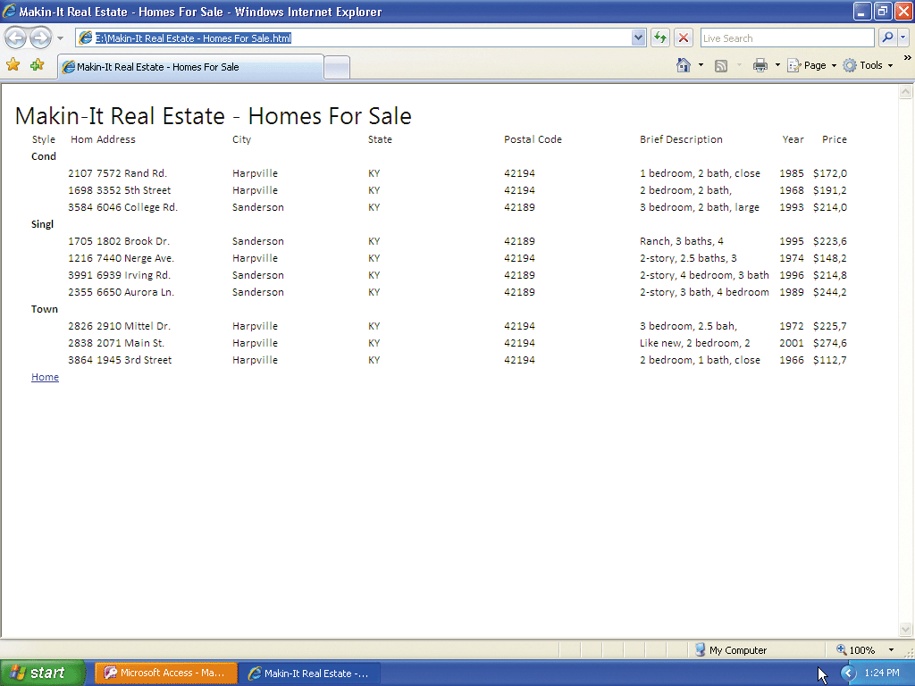
Saving the Report and View it in Your Browser

Slide 58
Closing Your Browser and Quitting Access
Click your browser’s Close button
If the Export – HTML Document dialog box is displayed, click the Close button
Click the Close button on the Access title bar to quit Access. Save changes to the report if
you are prompted to save the changes

Slide 59
Testing the Website
Start your browser.
Click the Address bar of your browser.
Type e:\Makin-It Real Estate Home Page.htm in the Address bar, and then press the ENTER key to display the home page of the Makin-It Real Estate Web site in your browser

Slide 60
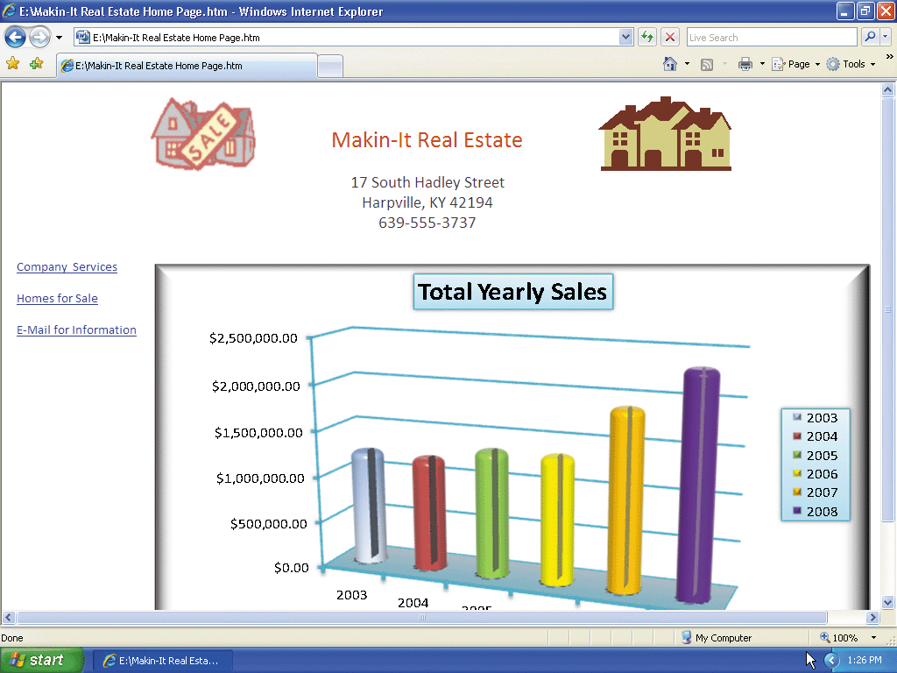
Testing the Website

Slide 61
Verifying the Hyperlinks
Click the Company Services hyperlink
Click the navigation buttons to view all slides on the Web page
On the first slide on the PowerPoint Web page, click the Home hyperlink
Click the Homes for Sale hyperlink
On the Access report page, click the Home hyperlink
Click the E-Mail for Information hyperlink to display a new e-mail message with manager@isp.com in the To text box

Slide 62
Quitting E-mail and Closing Your Browser
Click the Close button on your e-mail program‘s title bar. Click No if asked to save changes
Click the Close button on your browser’s title bar

Slide 63
Summary
Integrate the Office 2007 applications to create a Web site
Add hyperlinks to a Word document
Embed an Excel chart into a Word document
Add a hyperlink to a PowerPoint slide
Create Web pages from a PowerPoint presentation

Slide 64
Summary
Add a hyperlink to an Access report
Create a Web page from an Access report
Test a Web site in a browser

Slide 65
Integration Chapter Complete

