Slide 1
Excel Web Feature
Creating Web Pages
Using Excel

Slide 2
Objectives
Customize the Quick Access Toolbar
Publish a worksheet and chart as a Web page
Display Web pages published in Excel in a browser
Complete file management tasks within Excel

Slide 3
Adding a Button to the
Quick Access Toolbar
Connect a USB flash drive with the Data Files for Students on it to one of the computer’s USB ports
Start Excel and then open the workbook, Stonegate Plumbing 1st Quarter Sales, from the Data Files for students
Click the Customize Quick Access Toolbar button to display the Customize Quick Access Toolbar menu
Click the More Commands command on the Customize Quick Access Toolbar menu

Slide 4
Adding a Button to the
Quick Access Toolbar
When the Excel Options dialog box is displayed, click the ‘Choose commands from’ box arrow to display the ‘Choose commands from’ list
Click Commands Not in the Ribbon in the ‘Choose commands from’ list to display a list of commands not on the Ribbon
Scroll to the bottom of the list, click Web Page Preview, and then click the Add button to add the button to the Quick Access Toolbar
Click the OK button to close the Excel Options dialog box and display the Quick Access Toolbar with the Web Page Preview button added to it

Slide 5
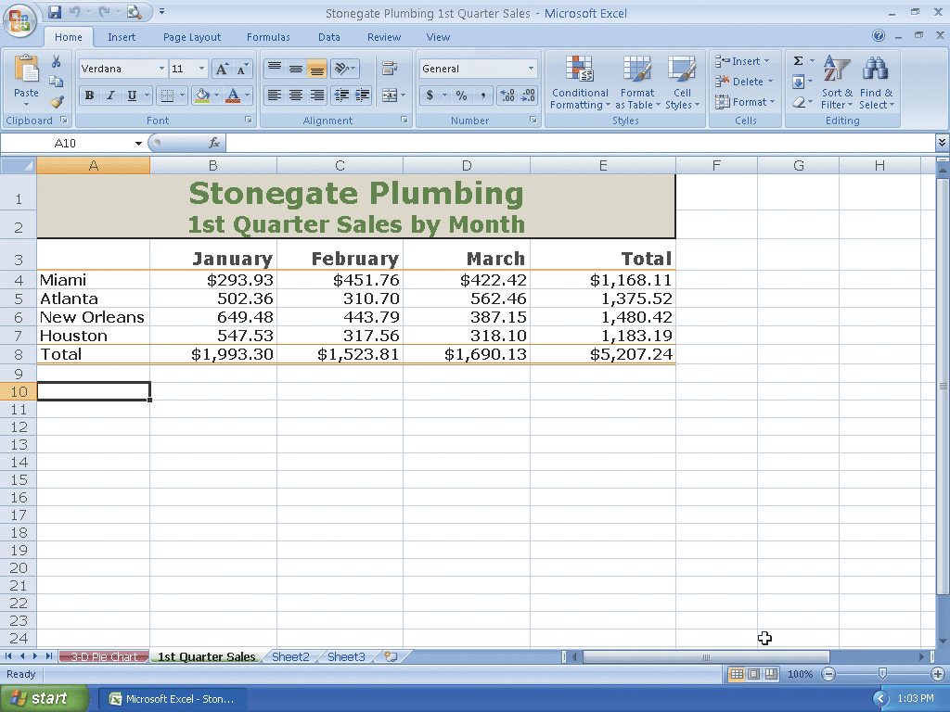
Adding a Button to the
Quick Access Toolbar

Slide 6
Previewing the Web Page
Click the Web Page Preview button on the Quick Access Toolbar to display the Web page in your browser
If necessary, click the Maximize button on your browser’s title bar
Click the 3-D Pie Chart tab at the bottom of the Web page to display the 3-D Pie chart in the browser
After viewing the Web page preview of the Stonegate Plumbing 1st Quarter Sales workbook, click the Close button on the right side of the browser title bar to close the browser and make Excel active again

Slide 7
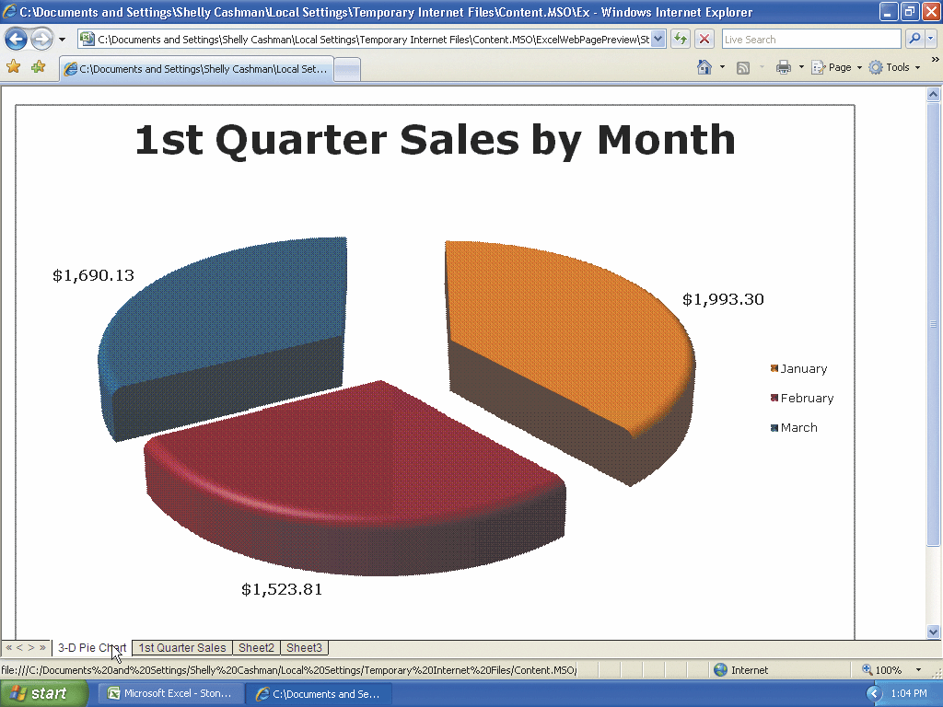
Previewing the Web Page

Slide 8
Saving an Excel Workbook as a Web Page in a Newly Created Folder
With the Stonegate Plumbing 1st Quarter Sales workbook open, click the Office Button
Click Save As on the Office Button menu to display the Save As dialog box
Type Stonegate Plumbing 1st Quarter Sales Web Page in the File name box
Click the ‘Save as type’ box arrow and then click Single File Web Page
Click the Save in box arrow, select UDISK 2.0 (E:) (your USB flash drive name and letter may be different), and then click the Create New Folder button to display the New Folder dialog box

Slide 9
Saving an Excel Workbook as a Web Page in a Newly Created Folder
When Excel displays the New Folder dialog box, type Web Feature in the Name text box
Click the OK button in the New Folder dialog box
Click the Save button in the Save As dialog box to save the workbook in a single file in HTML format in the Web Feature folder on the USB flash drive
If the Microsoft Office Excel dialog box is displayed, click the Yes button

Slide 10
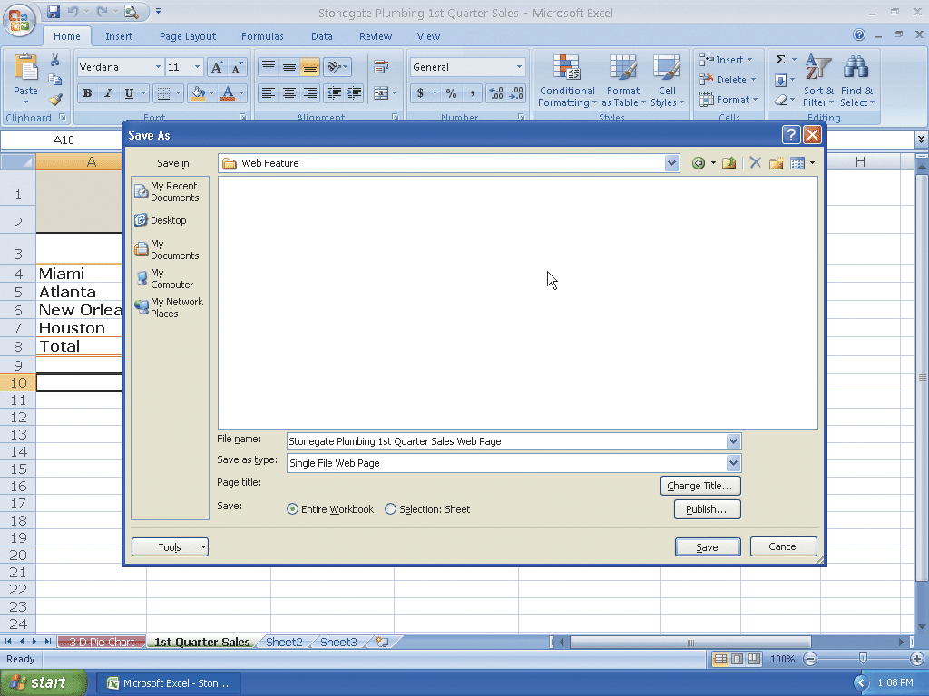
Saving an Excel Workbook as a Web Page in a Newly Created Folder

Slide 11
Resetting the Quick Access Toolbar and Quitting Excel
Click the Customize the Quick Access Toolbar button on the Ribbon
Click the More Commands command
When the Excel Options dialog box is displayed, click the Reset button. If the Reset Customizations dialog box is displayed, click the Yes button
Click the OK button in the Excel Options dialog box to close it
Click the Close button on the Microsoft Excel title bar

Slide 12
Viewing and Manipulating the Web Page Using a Browser
If necessary, connect the USB flash drive with the Data Files for Students to one of the computer’s USB ports
Click the Start button on the Windows taskbar, point to All Programs on the Start menu, and then click Internet Explorer in the All Programs submenu
When the Internet Explorer window opens, type e:\web feature\stonegate plumbing 1st quarter sales web page.mht in the Address box and then press the ENTER key to display the Web page in your browser
If the Information Bar appears, right-click it and then click Allow Blocked Content on the shortcut menu

Slide 13
Viewing and Manipulating the Web Page Using a Browser
If the Security Warning dialog box is displayed, click the Yes button
Click the 3-D Pie Chart sheet tab at the bottom of the window to display the 3-D Pie chart in your browser
Use the scroll arrows to display the lower portion of the chart
Click the Close button on the right side of the browser title bar to close the browser

Slide 14
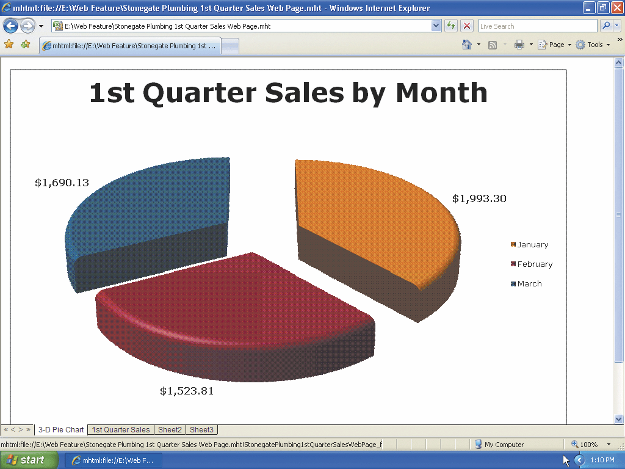
Viewing and Manipulating the Web Page Using a Browser

Slide 15
Summary
Customize the Quick Access Toolbar
Publish a worksheet and chart as a Web page
Display Web pages published in Excel in a browser
Complete file management tasks within Excel

Slide 16
Excel Web Feature Complete

