Slide 1
Excel Chapter 3
What-If Analysis,
Charting, and Working
with Large Worksheets

Slide 2
Objectives
Rotate text in a cell
Create a series of month names
Copy, paste, insert, and delete cells
Format numbers using format symbols
Freeze and unfreeze titles
Show and format the system date
Use absolute cell references in a formula

Slide 3
Objectives
Use the IF function to perform a logical test
Use the Format Painter button to format cells
Create a 3-D Pie chart on a separate chart sheet
Color and rearrange worksheet tabs
Change the worksheet view
Answer what-if questions
Goal seek to answer what-if questions

Slide 4
Plan Ahead
Plan the layout of the worksheet
Determine the necessary formulas and functions needed
Identify how to format various elements of the worksheet
Specify how the chart should convey necessary information
Perform what-if analysis and goal seeking using the best techniques

Slide 5
Starting Excel
Click the Start button on the Windows taskbar to display the Start menu
Point to All Programs on the Start menu and then point to Microsoft Office in the All Programs submenu
Click Microsoft Office Excel 2007 on the Microsoft Office submenu
If the Excel window is not maximized, click the Maximize button next to the Close button on its title bar to maximize the window
If the worksheet window in Excel is not maximized, click the Maximize button next to the Close button on its title bar to maximize the worksheet window within Excel

Slide 6
Entering the Worksheet Titles, Changing Workbook Properties, Applying a Theme, and Saving the Workbook
Click cell A1 and then enter Campus Clothiers as the worksheet title
Click cell A2 and then enter Semiannual Projected Gross Margin, Expenses, and Operating Income as the worksheet subtitle and then press the ENTER key
Click the Office Button, click Prepare on the Office Button menu, and then click Properties
Update the document properties with your name and any other relevant information
Click the Close button in the Document Properties pane

Slide 7
Entering the Worksheet Titles, Changing Workbook Properties, Applying a Theme, and Saving the Workbook
Apply the Trek theme to the worksheet by clicking the Themes button on the Page Layout tab on the Ribbon and then return to the Home tab on the Ribbon
With a USB flash drive connected to one of the computer’s USB ports, click the Save button on the Quick Access Toolbar
When Excel displays the Save As dialog box, type Campus Clothiers Semiannual Financial Projection in the File name text box
If necessary, click UDISK 2.0 (E:) in the Save in list (your USB flash drive may have a different name and letter). Click the Save button in the Save As dialog box to save the workbook

Slide 8
Rotating Text and Using the Fill Handle to Create a Series of Month Names
Select cell B3
Type January as the cell entry and then click the Enter box
Click the Format Cells: Alignment Dialog Box Launcher on the Ribbon to display the Format Cells dialog box
Click the 45° point in the Orientation area to move the Text hand in the Orientation area to the 45° point and to display 45 in the Degrees box
Click the OK button to rotate the text in cell B3 at a 45° angle and automatically increase the height of row 3 to best fit the rotated text
Point to the fill handle on the lower-right corner of cell B3

Slide 9
Rotating Text and Using the Fill Handle to Create a Series of Month Names
Drag the fill handle to the right to select the range C3:G3. Do not release the mouse button
Release the mouse button to create a month name series January through June in the range B3:G3 and copy the format in cell B3 to the range C3:G3
Click the Auto Fill Options button below the lower-right corner of the fill area to display the Auto Fill Options menu
Click the Auto Fill Options button to hide the Auto Fill Options menu
Click cell H3, type Total, and then press the RIGHT ARROW key

Slide 10
Increasing Column Widths and Entering Rows Titles
Move the mouse pointer to the boundary between column heading A and column heading B so that the mouse pointer changes to a split double arrow
Drag the mouse pointer to the right until the ScreenTip displays, Width: 35.00 (322 pixels). Do not release the mouse button
Release the mouse button to change the width of column A
Click column heading B and then drag through column heading G to select columns B through G

Slide 11
Increasing Column Widths and Entering Rows Titles
Move the mouse pointer to the boundary between column headings B and C and then drag the mouse to the right until the ScreenTip displays, Width: 14.00 (133 pixels). Do not release the mouse button
Release the mouse button to change the width of columns B through G
Use the technique described in Step 1 to increase the width of column H to 15.00
Enter the row titles in the range A4:A18 as shown in two slides, but without the indents

Slide 12
Increasing Column Widths and Entering Rows Titles
Click cell A5 and then click the Increase Indent button on the Ribbon
Select the range A9:A13 and then click the Increase Indent button on the Ribbon
Click cell A19 to finish entering the row titles

Slide 13
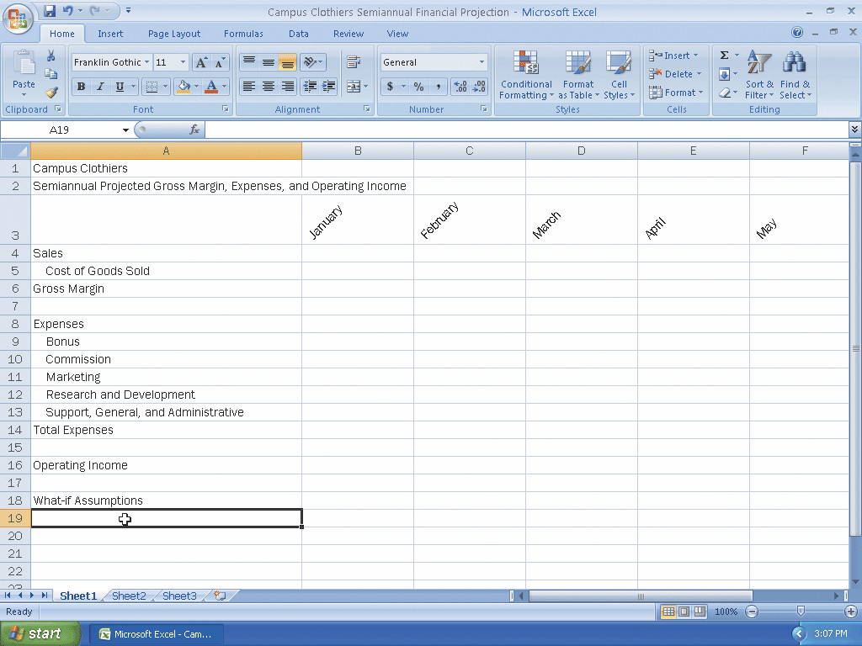
Increasing Column Widths and Entering Rows Titles

Slide 14
Copying a Range of Cell to a Nonadjacent Destination Area
Select the range A9:A13 and then click the Copy button on the Home tab on the Ribbon to copy the values and formats of the range A9:A13 to the Office Clipboard
Click cell A19, the top cell in the destination area
Click the Paste button on the Ribbon to copy the values and formats of the last item placed on the Office Clipboard (range A9:A13) to the destination area A19:A23
Scroll down so row 5 appears at the top of the window
Press the ESC key to remove the marquee from the source area and disable the Paste button on the Ribbon

Slide 15
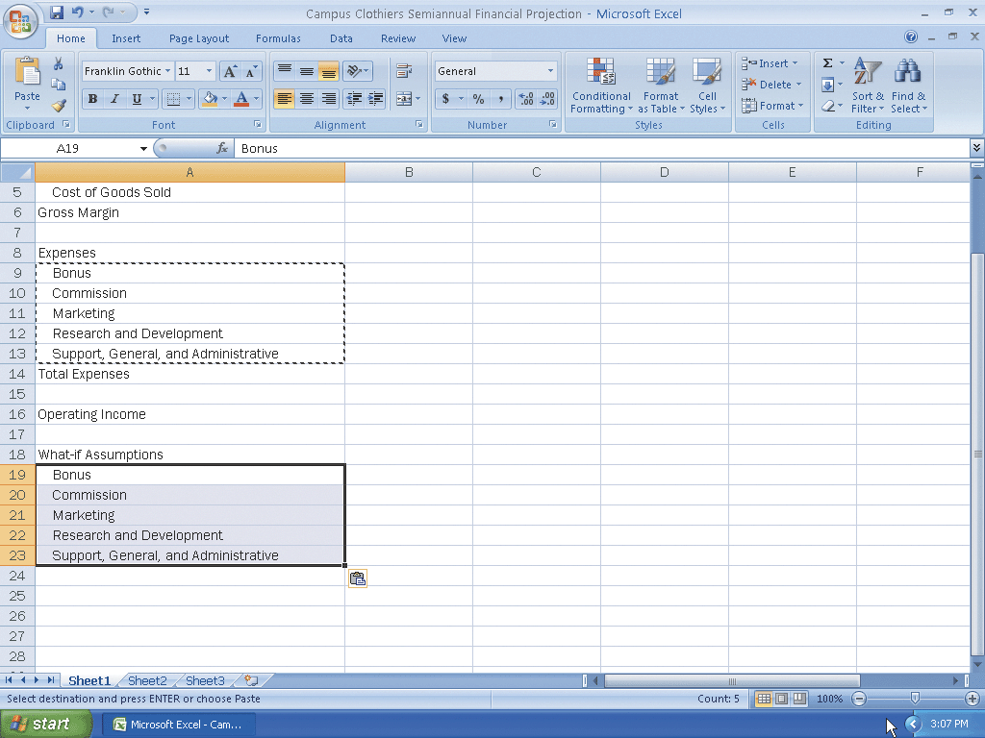
Copying a Range of Cell to a Nonadjacent Destination Area

Slide 16
Inserting a Row
Right-click row heading 21, the row below where you want to insert a row, to display the shortcut menu and the Mini toolbar
Click Insert on the shortcut menu to insert a new row in the worksheet by shifting the selected row 21 and all rows below it down one row
Click cell A21 in the new row and then enter Margin as the row title
Right-click row heading 24 and then click Insert on the shortcut menu to insert a new row in the worksheet
Click cell A24 in the new row and then enter Revenue for Bonus as the row title

Slide 17
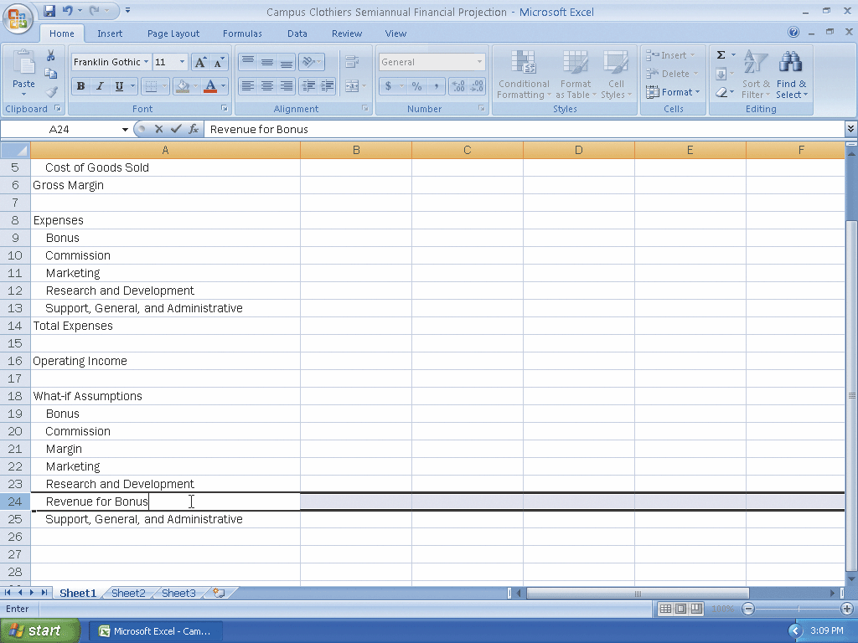
Inserting a Row

Slide 18
Entering Numbers with Format Symbols
Enter 100,000.00 in cell B19, 3.25% in cell B20,61.00% in cell B21, 9.00% in cell B22, 5.75% in cell B23, 4,750,000.00 in cell B24, and 17.00% in cell B25 to display the entries using a format based on the format symbols entered with the numbers

Slide 19
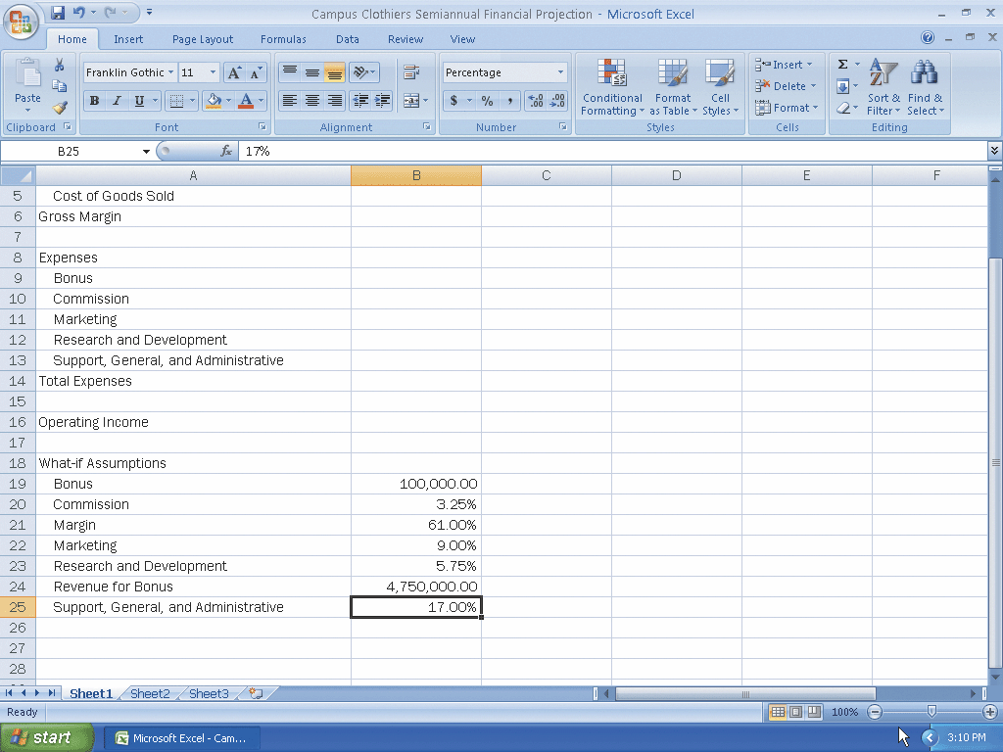
Entering Numbers with Format Symbols

Slide 20
Freezing Column and Row Titles
Press CTRL+HOME to select cell A1 and ensure that Excel displays row 1 and column A on the screen
Select cell B4
Click the View tab on the Ribbon and then click the Freeze Panes button on the Ribbon to display the Freeze Panes gallery
Click Freeze Panes in the Freeze Panes gallery to freeze column A and rows 1 through 3

Slide 21
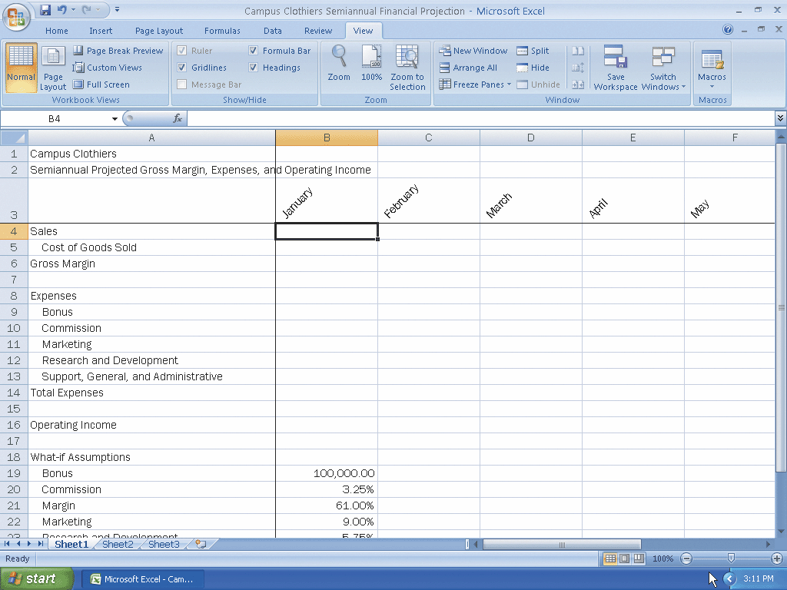
Freezing Column and Row Titles

Slide 22
Entering the Projected Monthly Sales
If necessary, click the Home tab on the Ribbon.
Enter 3383909.82 in cell B4, 6880576.15 in cell C4, 9742702.37 in cell D4, 4818493.53 in cell E4, 4566722.63 in cell F4, and 8527504.39 in cell G4
Click cell H4 and then click the Sum button on the Ribbon twice to total the semiannual sales in cell H4

Slide 23
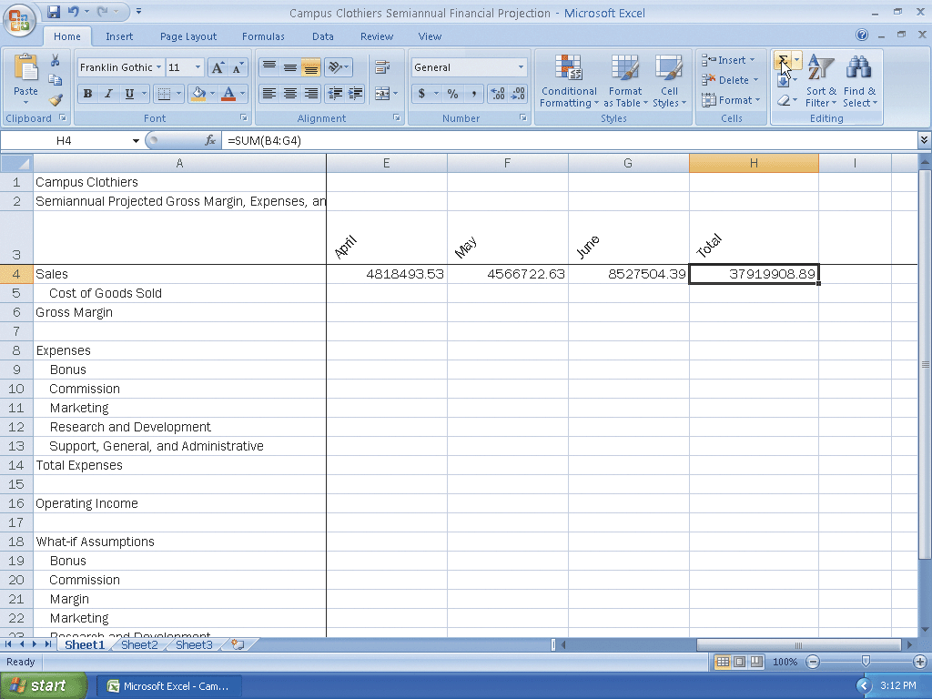
Entering the Projected Monthly Sales

Slide 24
Entering and Formatting the System Date
Click cell H2 and then click the Insert Function box in the formula bar
When Excel displays the Insert Function dialog box, click the Or select a category box arrow, and then select Date & Time in the list
Scroll down in the Select a function list and then click NOW
Click the OK button

Slide 25
Entering and Formatting the System Date
When Excel displays the Function Arguments dialog box, click the OK button to display the system date and time in cell H2, using the default date and time format mm/dd/yyyy hh:mm.
Right-click cell H2 to display the shortcut menu
Click Format Cells on the shortcut menu
When Excel displays the Format Cells dialog box, if necessary, click the Number tab
Click Date in the Category list. Scroll down in the Type list and then click 3/14/2001 to display a sample of the data in the active cell (H2) using the selected format in the Sample area
Click the OK button in the Format Cells dialog box to display the system date in the form mm/dd/yyyy

Slide 26
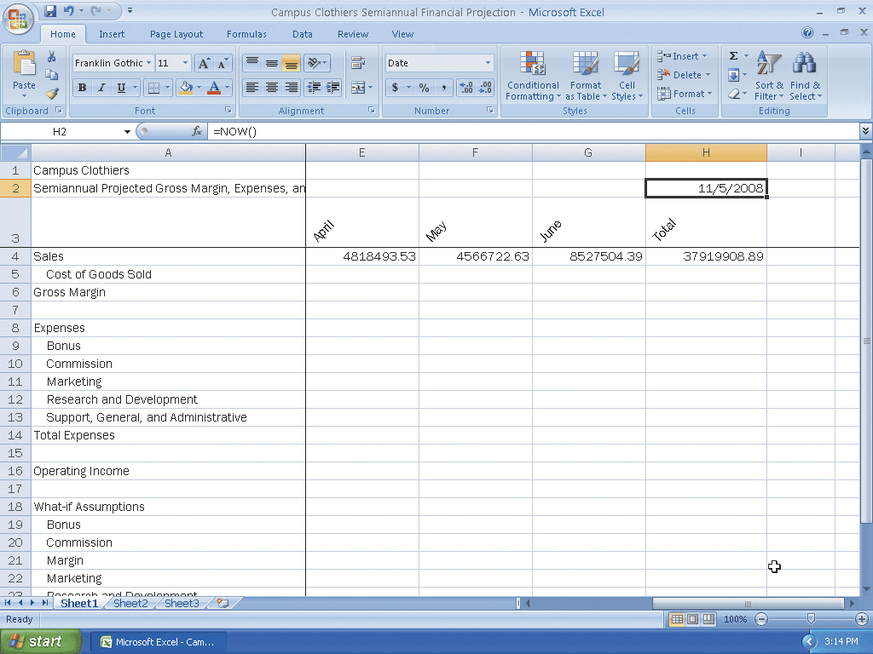
Entering and Formatting the System Date

Slide 27
Entering a Formula Containing Absolute Cell References
Press CTRL+HOME and then click cell B5
Type = (equal sign), click cell B4, type *(1-b21 and then press F4 to change b21 from a relative cell reference to an absolute cell reference
Type ) to complete the formula
Click the Enter box in the formula bar to display the result, 1319724.83, in cell B5, instead of the formula
Click cell B6, type = (equal sign), click cell B4, type — and then click cell B5
Click the Enter box in the formula bar to display the gross margin for January, 2064184.99, in cell B6

Slide 28
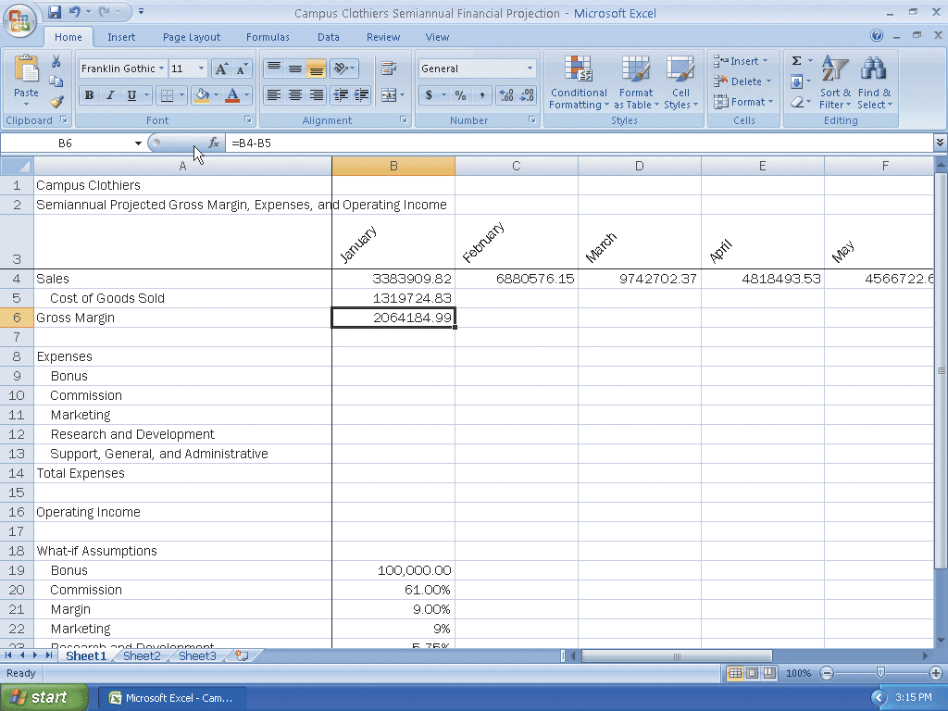
Entering a Formula Containing Absolute Cell References

Slide 29
Entering an IF Function
Click cell B9. Type =if(b4>=$b$24, $b$19,0) in the cell
Click the Enter box in the formula bar to display 0 in cell B9 (Figure 3–29),because the value in cell B4 (3383909.82) is less than the value in cell B24 (4,750,000)

Slide 30
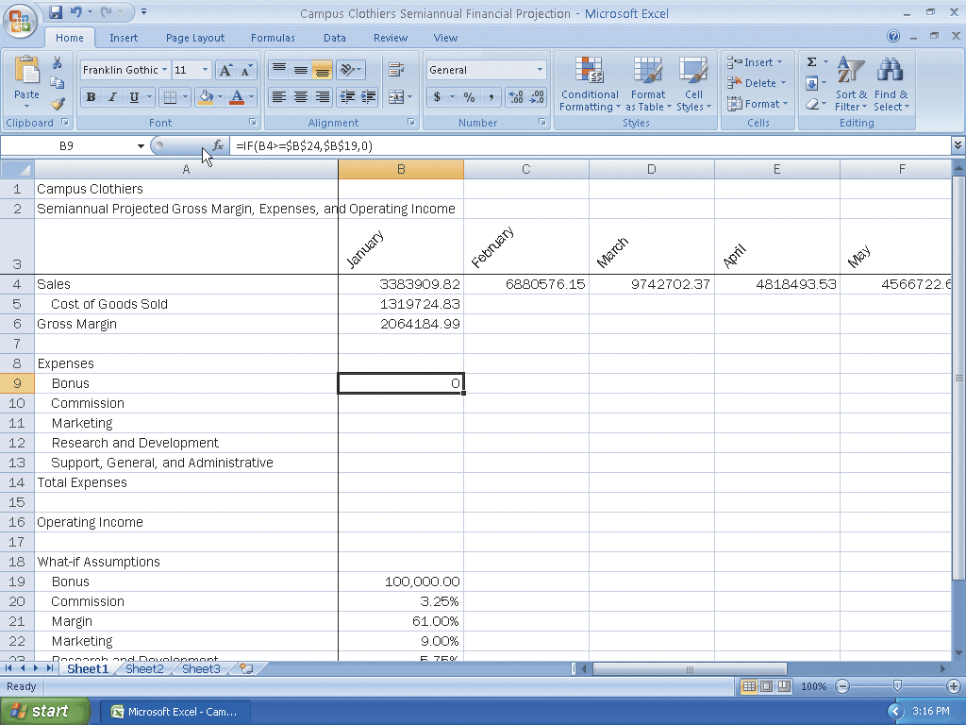
Entering an IF Function

Slide 31
Entering the Remaining January Formulas
Click cell B10. Type =b4*$b$20 and then press the DOWN ARROW key. Type =b4*$b$22 and then press the DOWN ARROW key. Type =b4*$b$23 and then press the DOWN ARROW key. Type =b4*$b$25 and then press the DOWN ARROW key
With cell B14 selected, click the Sum button on the Home tab on the Ribbon twice. Click cell B16. Type =b6-b14 and then press the ENTER key
Press CTRL+ACCENT MARK (`) to instruct Excel to display the formulas version of the worksheet
When you are finished viewing the formulas version, press CTRL+ACCENT MARK (`) to instruct Excel to display the values version of the worksheet

Slide 32
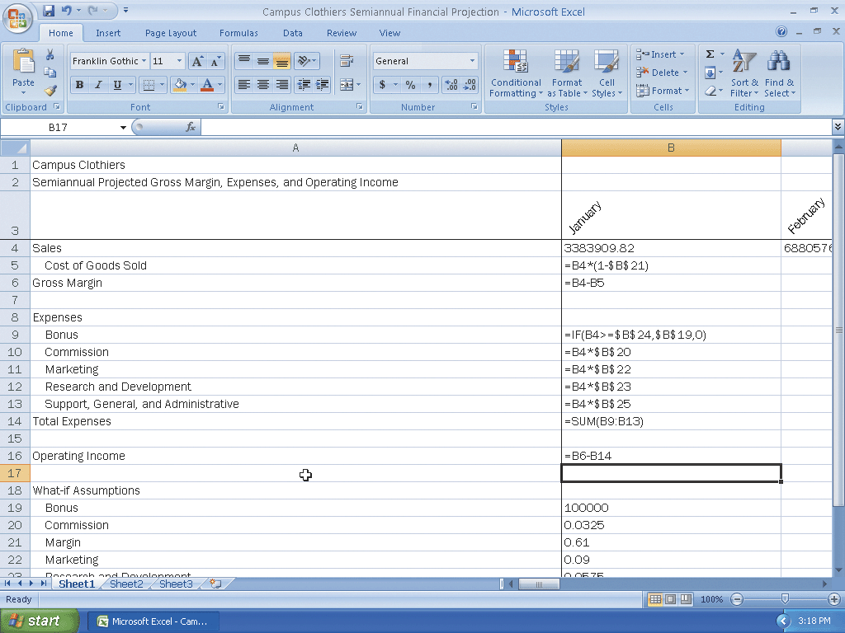
Entering the Remaining January Formulas

Slide 33
Copying Formulas with Absolute Cell References Using the Fill Handle
Select the range B5:B16 and then point to the fill handle in the lower-right corner of cell B16
Drag the fill handle to the right to select the destination area C5:G16 to copy the formulas from the source area (B5:B16) to the destination area (C5:G16) and display the calculated amounts and Auto Fill Options button

Slide 34
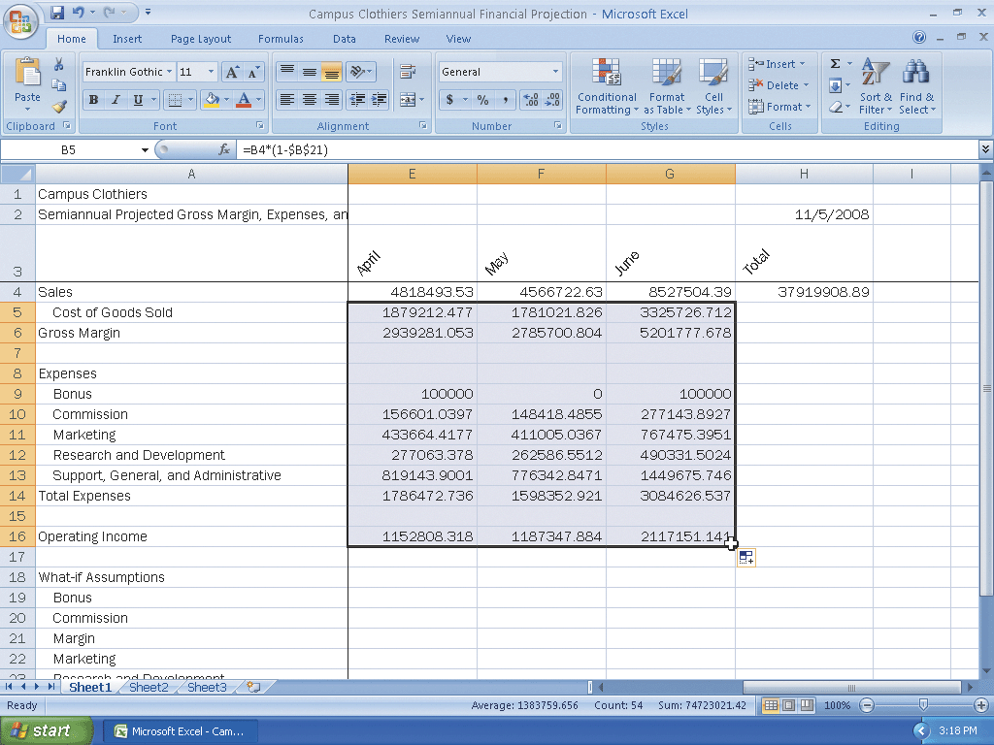
Copying Formulas with Absolute Cell References Using the Fill Handle

Slide 35
Determining Row Totals in Nonadjacent Cells
Select the range H5:H6. Hold down the CTRL key and select the range H9:H14 and cell H16
Click the Sum button on the Ribbon to display the row totals in column H

Slide 36
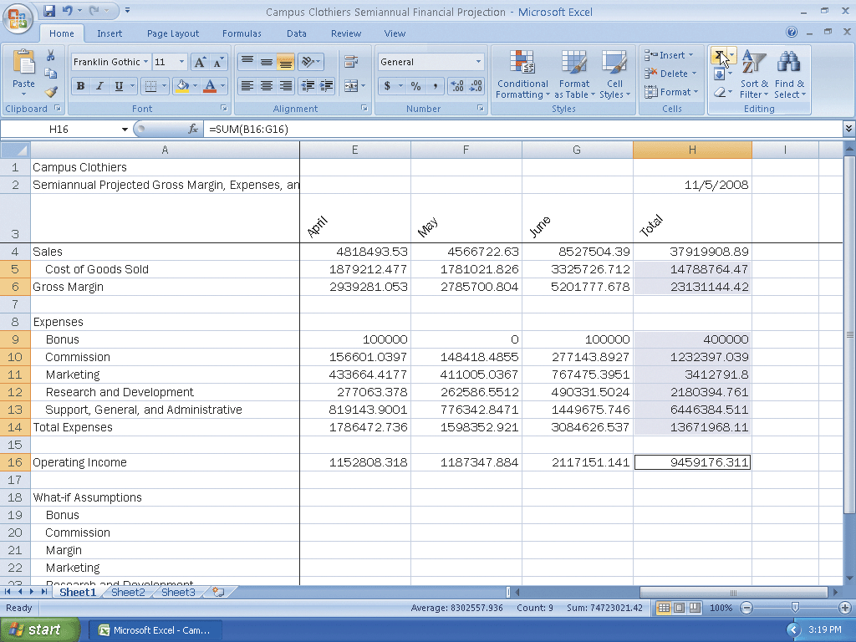
Determining Row Totals in Nonadjacent Cells

Slide 37
Unfreezing the Worksheet Titles and Saving the Workbook
Press CTRL+HOME to select cell B4 and view the upper-left corner of the screen
Click the View tab on the Ribbon and then click the Freeze Panes button on the Ribbon to display the Freeze Panes gallery
Click Unfreeze Panes in the Freeze Panes gallery to unfreeze the titles
Click the Home tab on the Ribbon and then click the Save button on the Quick Access Toolbar

Slide 38
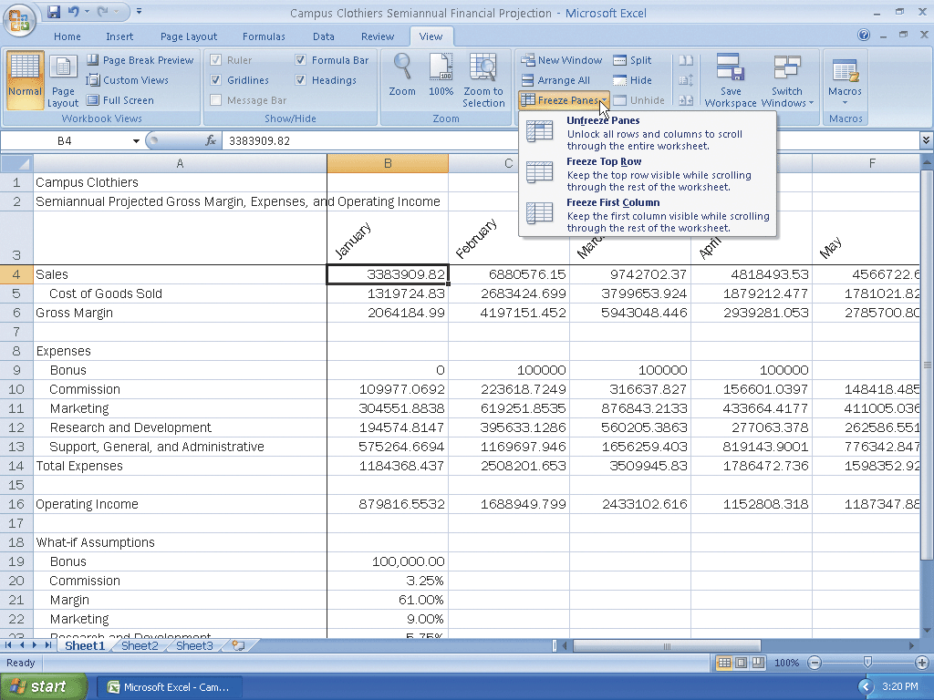
Unfreezing the Worksheet Titles and Saving the Workbook

Slide 39
Assigning Formats to Nonadjacent Ranges
Select the range B4:H4
While holding down the CTRL key, select the nonadjacent ranges B6:H6,B9:H9, B14:H14, and B16:H16, and then release the CTRL key
Click the Format Cells: Number Dialog Box Launcher on the Ribbon to display the Format Cells dialog box
Click Currency in the Category list, select 2 in the Decimal places box, click $ in the Symbol list to ensure a dollar sign shows, and click the black font color ($1,234.10) in the Negative numbers list
Click the OK button
Select the range B5:H5
While holding down the CTRL key, select the range B10:H13, and then release the CTRL key

Slide 40
Assigning Formats to Nonadjacent Ranges
Click the Format Cells: Number Dialog Box Launcher on the Ribbon to display the Format Cells dialog box
When Excel displays the Format Cells dialog box, click Currency in the Category list, select 2 in the Decimal places box, click None in the Symbol list so a dollar sign does not show, and click the black font color (1,234.10) in the Negative numbers list
Click the OK button
Press CTRL+HOME to select cell A1 to display the formatted numbers

Slide 41
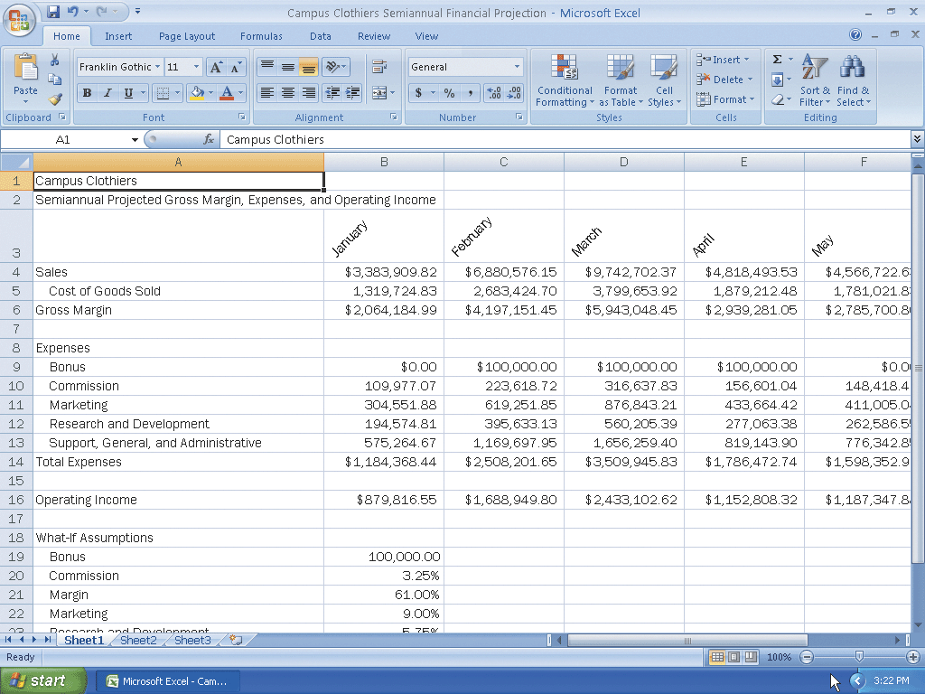
Assigning Formats to Nonadjacent Ranges

Slide 42
Formatting the Worksheet Titles
Click the column A heading to select column A
Click the Bold button on the Ribbon to bold all of the data in column A
Click cell A1 to select it. Click the Font Size box arrow on the Ribbon, and then click 36 in the Font Size list
Click cell A2, click the Font Size box arrow, and then click 18 in the Font Size list

Slide 43
Formatting the Worksheet Titles
Select the range A1:H2 and then click the Fill Color button arrow on the Ribbon
Click Orange, Accent 1 (column 5, row 1) on the Fill Color palette
Click the Font Color button arrow on the Ribbon and then select White, Background 1 (column 1, row 1) on the Font Color palette

Slide 44
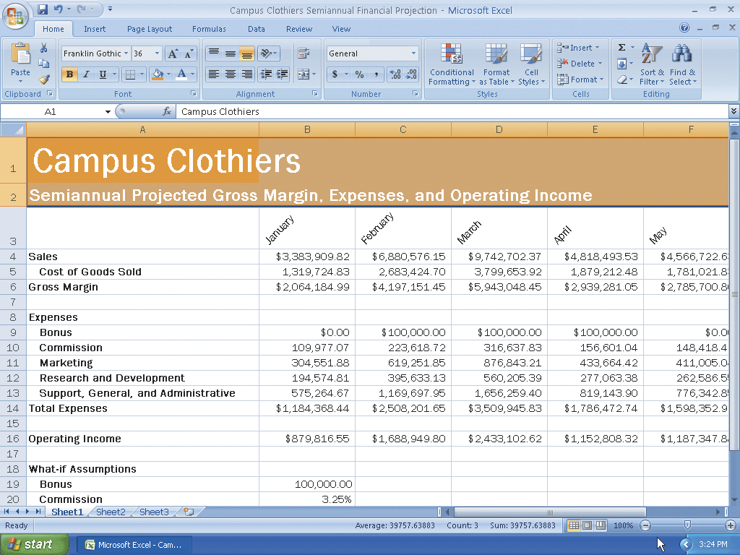
Formatting the Worksheet Titles

Slide 45
Assigning Cell Styles to Nonadjacent Rows and Colors to a Cell
Select the range A3:H3 and apply the Heading 3 cell style
Select the range A6:H6 and while holding down the CTRL key, select the ranges A14:H14 and A16:H16
Apply the Total cell style
Click cell A4, click the Fill Color button arrow on the Ribbon, and then click the Orange, Accent 1 color (column 5, row 1) on the Fill Color palette
Click the Font Color button arrow on the Ribbon, and then click the White, Background 1 color (column 1, row 1) on the Font Color palette

Slide 46
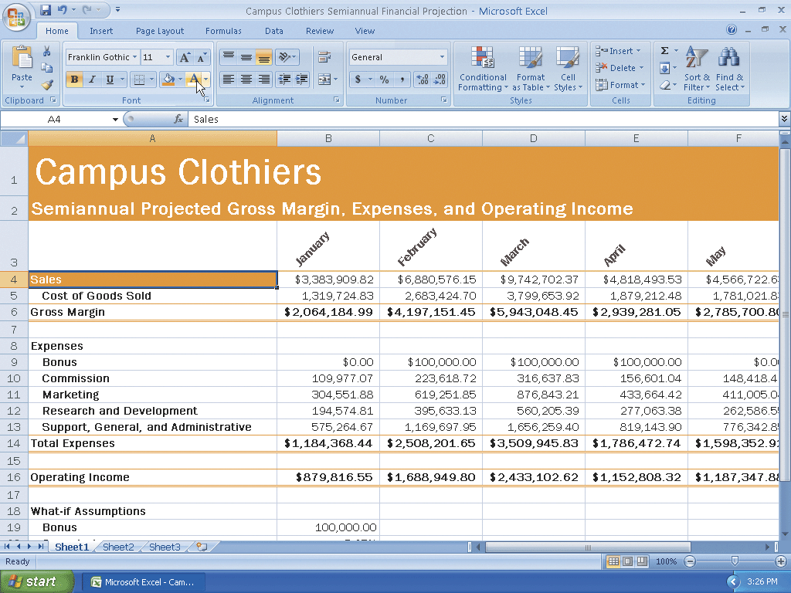
Assigning Cell Styles to Nonadjacent Rows and Colors to a Cell

Slide 47
Copying a Cell’s Format Using the Format Painter Button
Select cell A4
Click the Format Painter button on the Ribbon and then move the mouse pointer onto the worksheet to cause the mouse pointer to change to a block plus sign with a paintbrush
Click cell A6 to assign the format of cell A4 to cell A6
With cell A6 selected, click the Format Painter button on the Ribbon and then click cell A14
With cell A14 selected, click the Format Painter button on the Ribbon and then click cell A16

Slide 48
Copying a Cell’s Format Using the Format Painter Button
Select the range B16:H16, click the Fill Color button on the Ribbon, and then click the Orange, Accent 1 color (column 5, row 1) on the Fill Color palette
Click the Font Color button on the Ribbon, and then click the Background 1 color (column 1, row 1) on the Font Color palette

Slide 49
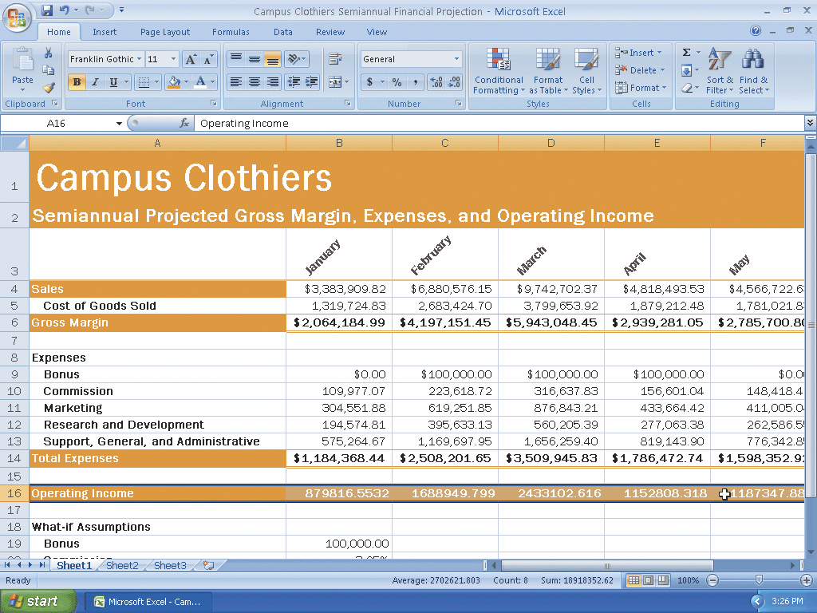
Copying a Cell’s Format Using the Format Painter Button

Slide 50
Formatting the What-If Assumptions Table and Saving the Workbook
Scroll down to view rows 18 through 25 and then click cell A18
Click the Font Size box arrow on the Ribbon and then click 14 in the Font Size list. Click the Italic button and then click the Underline button on the Ribbon
Select the range A19:B25, click the Font Size button on the Ribbon, and then click 8 in the Font Size list
Click cell D25 to deselect the range A19:B25 and display the What-If Assumptions
Click the Save button on the Quick Access Toolbar

Slide 51
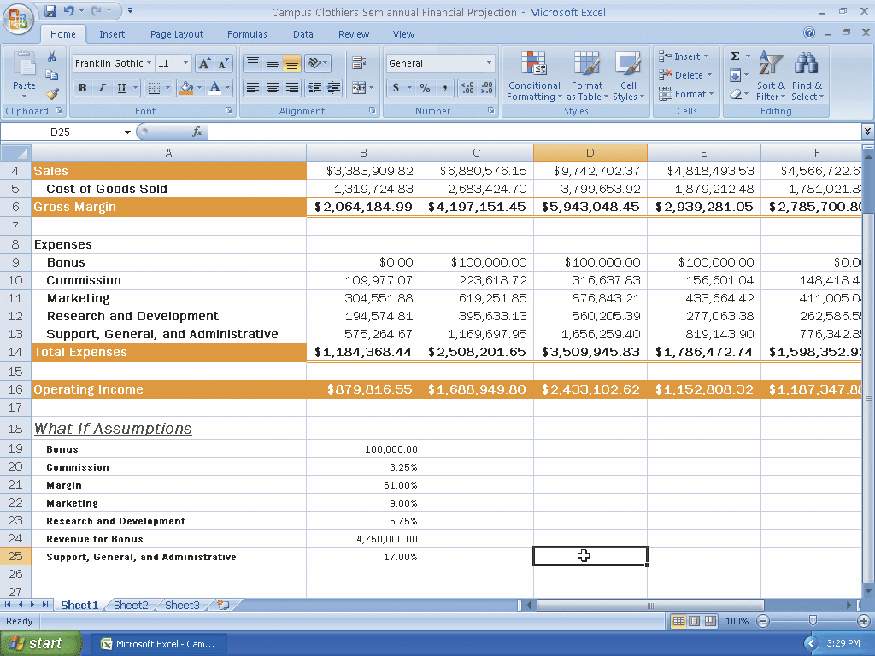
Formatting the What-If Assumptions Table and Saving the Workbook

Slide 52
Drawing a 3-D Pie Chart on a Separate Chart Sheet
Select the range B3:G3
While holding down the CTRL key, select the range B16:G16
Click the Insert tab on the Ribbon
Click the Pie button on the Ribbon to display the Pie gallery

Slide 53
Drawing a 3-D Pie Chart on a Separate Chart Sheet
When Excel draws the chart, click the Move Chart button on the Ribbon to display the Move Chart dialog box
Click the New sheet option button and then type 3-D Pie Chart in the New sheet name textbox
Click the OK button to move the chart to a new chart sheet with the name 3-D Pie Chart

Slide 54
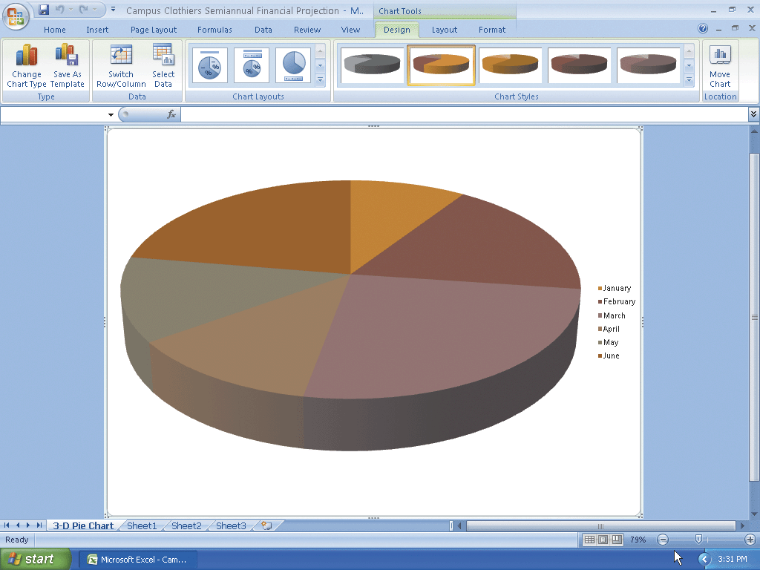
Drawing a 3-D Pie Chart on a Separate Chart Sheet

Slide 55
Inserting a Chart Title and Data Labels
Click anywhere in the chart area outside the chart
Click the Layout tab on the Ribbon and then click the Chart Title button
Click the Centered Overlay Title command in the Chart Title gallery
Select the text in the chart title and then type Semiannual Financial Projection as the new chart title

Slide 56
Inserting a Chart Title and Data Labels
Select the text in the new title and then click the Home tab on the Ribbon
Click the Underline button to assign an underline font style to the chart title
Click the Layout tab on the Ribbon and then click the Legend button to display the Legend gallery
Point to None in the Legend gallery
Click None to turn off the legend on the chart
Click the Data Labels button on the Ribbon and then click Outside End in the Data Labels gallery to display data labels outside the chart at the end of each slice

Slide 57
Inserting a Chart Title and Data Labels
If necessary, right-click any data label to select all of the data labels on the chart and to display the shortcut menu
Click the Format Data Labels command on the shortcut menu to display the Format Data Labels dialog box
If necessary, click the Series Name, Value, and Show Leader Lines check boxes to deselect them and then click the Category Name and Percentage check boxes to select them
Click the Close button to close the Format Data Labels dialog box and display the chart

Slide 58
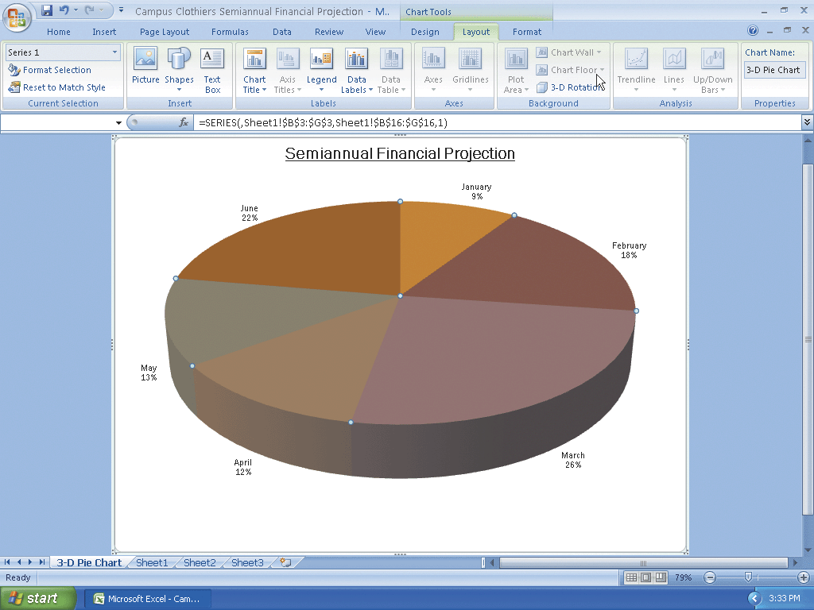
Inserting a Chart Title and Data Labels

Slide 59
Rotating the 3-D Pie Chart
Click the 3-D Rotation button on the Ribbon to display the Format Chart Area dialog box
Click the Increase X Rotation button in the Rotation area of the Format Chart Area dialog box until the X rotation is at 250°
Click the Close button in the Format Chart Area dialog box to display the rotated chart

Slide 60
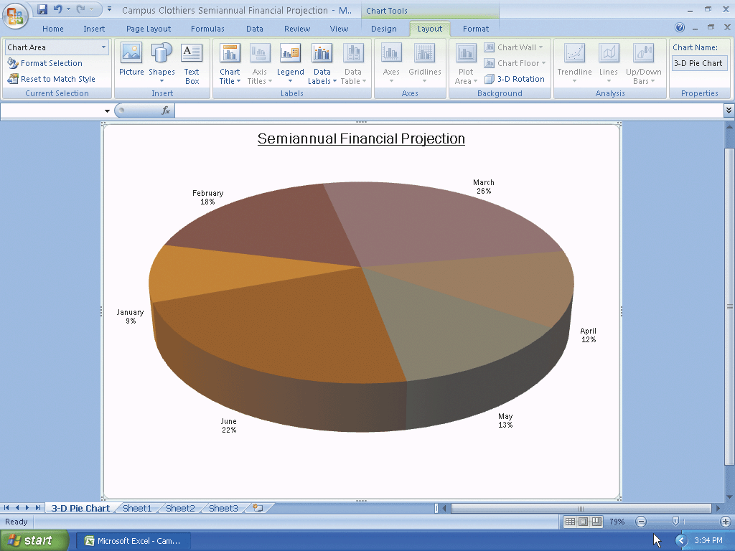
Rotating the 3-D Pie Chart

Slide 61
Applying a 3-D Format to the Pie Chart
Right-click the chart to display the shortcut menu
Click the Format Data Series command on the shortcut menu to display the Format Data Series dialog box and then click the 3-D Format category on the left side of the dialog box
Click the Top button in the Bevel area to display the Bevel gallery
Click the Circle bevel button (column 1, row 1) in the Bevel gallery to add a bevel to the chart
Type 50 pt in the top Width box in the Bevel area of the dialog box and then type 50 pt in the uppermost Height box in the Bevel area of the dialog box to increase the width and height of the bevel on the chart
Click the Material button in the Surface area of the Format Data Series dialog box and then point to the Soft Edge button
Click the Close button in the Format Data Series dialog box

Slide 62
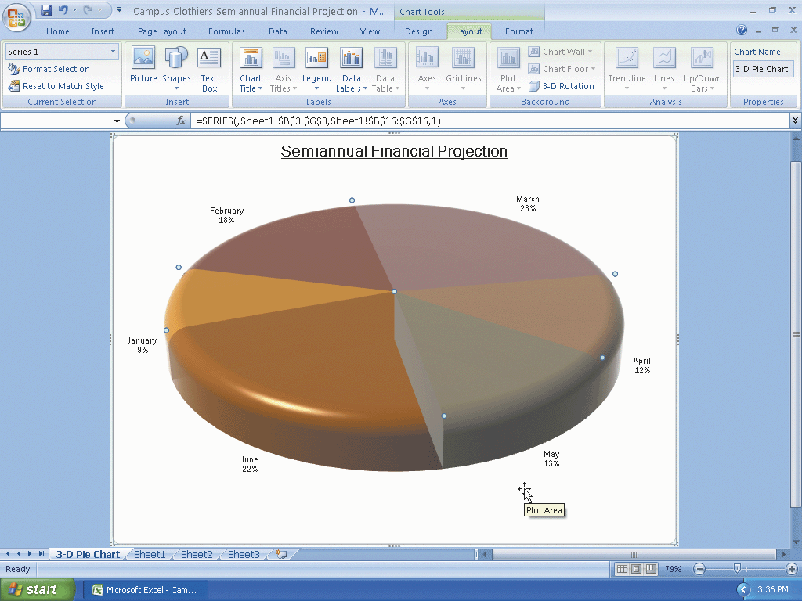
Applying a 3-D Format to the Pie Chart

Slide 63
Exploding the 3-D Pie Chart and Changing the Color of the Slice
Click the slice labeled June twice (do not double-click) to select only the June slice
Right-click the slice labeled June to display the shortcut menu and then point to Format Data Point
When Excel displays the Format Data Point dialog box, drag the Point Explosion slider to the right until the Point Explosion box reads 28%
Click the Fill category on the left side of the dialog box
Click the Solid fill option button and then click the Color button to display the color palette

Slide 64
Exploding the 3-D Pie Chart and Changing the Color of the Slice
Point to the Orange color in the Standard Colors area
Click the Orange color on the color palette and then click the Close button on the Format Data Point dialog box to change the color of the slice labeled June to orange

Slide 65
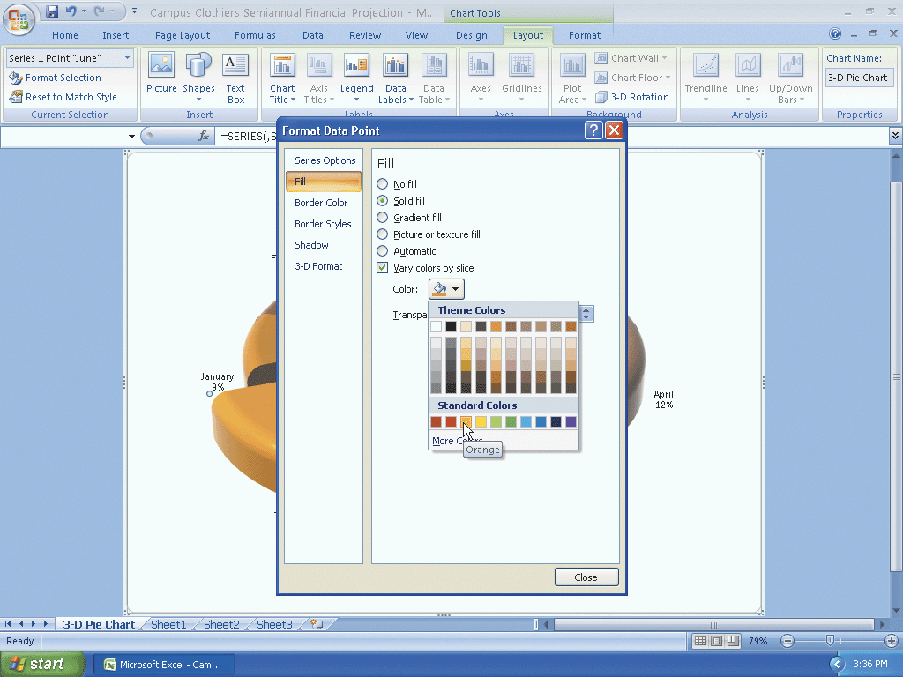
Exploding the 3-D Pie Chart and Changing the Color of the Slice

Slide 66
Changing the Colors of the Remaining Slices
Click the slice labeled January twice (do not double-click) to select only the January slice
Right-click the slice labeled January to display the shortcut menu and then point to Format Data Point
Click the Fill category on the left side of the dialog box
Click the Solid fill option button and then click the Color button to display the color palette
Click the Green color on the color palette and then click the Close button in the Format Data Point dialog box to change the color of the slice labeled January to green
Repeat the previous steps for the remaining four slices. Assign the following colors in the Standard Colors area of the color palette to each slice: February – Yellow; March – Light Blue; April – Red; May – Blue

Slide 67
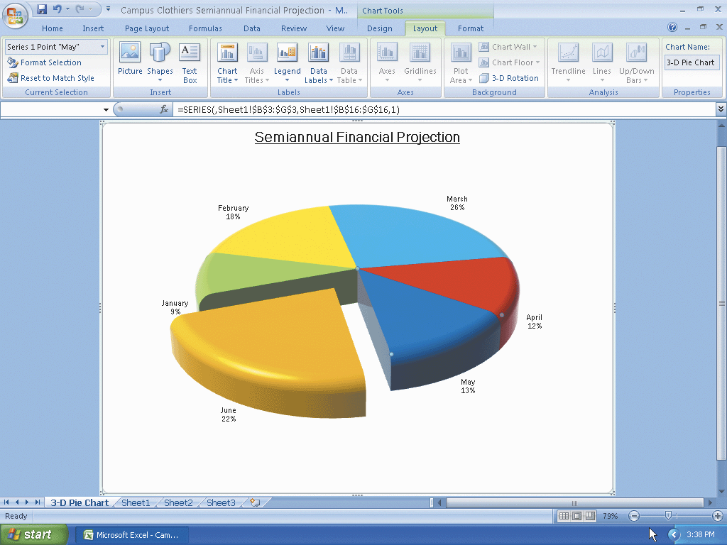
Changing the Colors of the Remaining Slices

Slide 68
Renaming and Reordering the Sheets and Color their Tabs
Right-click the tab labeled 3-D Pie Chart at the bottom of the screen to display the shortcut menu
Point to the Tab Color command to display the color palette
Click Brown, Accent 2 (column 6, row 1) in the Theme Colors area to change the color of the tab to brown
Double-click the tab labeled Sheet1 at the bottom of the screen.
Type Semiannual Financial Projection as the new sheet name and then press the ENTER key
Right-click the tab and then click Tab Color on the shortcut menu

Slide 69
Renaming and Reordering the Sheets and Color their Tabs
Point to the Orange, Accent 1 (column 5, row 1) color in the Theme Colors area of the palette
Click Orange, Accent 1 (column 5, row 1) in the Theme Colors area to change the color of the tab to orange
Drag the Semiannual Financial Projection tab to the left in front of the 3-D Pie Chart tab to rearrange the sequence of the sheets and then click cell E18

Slide 70
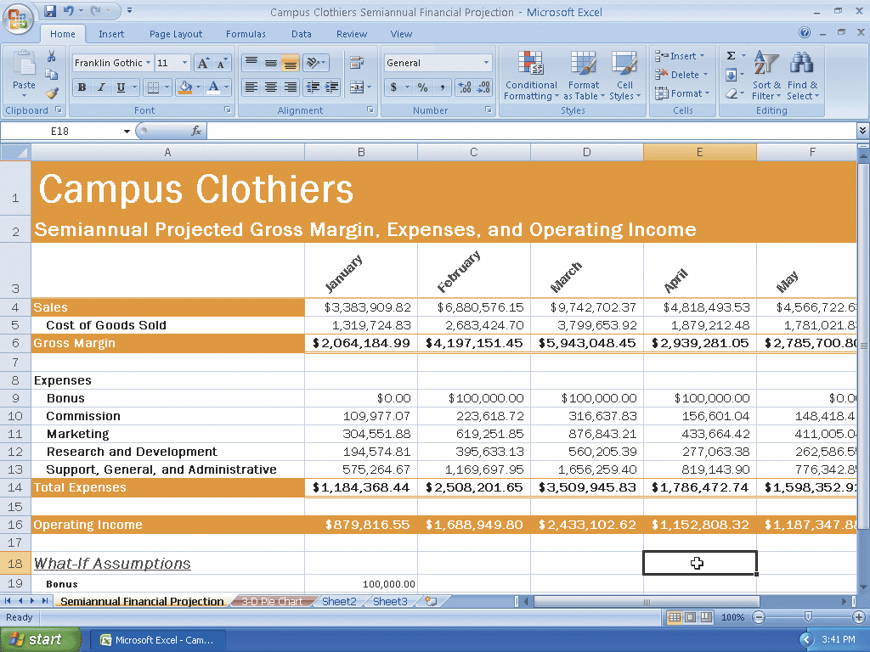
Renaming and Reordering the Sheets and Color their Tabs

Slide 71
Checking Spelling in Multiple Sheets
With the Semiannual Financial Projection sheet active, press CTRL+HOME to select cell A1
Hold down the CTRL key and then click the 3-D Pie Chart tab
Click the Review tab on the Ribbon and then click the Spelling button on the Ribbon
Correct any errors and then click the OK button when the spell check is complete
Click the Save button on the Quick Access Toolbar

Slide 72
Previewing and Printing the Workbook
Ready the printer. If both sheets are not selected, hold down the CTRL key and then click the tab of the inactive sheet
Click the Page Layout tab on the Ribbon and then click the Page Setup Dialog Box Launcher. Click the Page tab and then click Landscape. Click Fit to in the Scaling area
Click the Print Preview button in the Page Setup dialog box. When the preview of the first of the selected sheets appears, click the Next Page button at the top of the Print Preview window to view the next sheet. Click the Previous Page button to redisplay the first sheet
Click the Print button at the top of the Print Preview window. When Excel displays the Print dialog box, click the OK button to print the worksheet and chart
Right-click the Semiannual Financial Projection tab. Click Ungroup Sheets on the shortcut menu to deselect the 3-D Pie Chart tab
Click the Save button on the Quick Access Toolbar

Slide 73
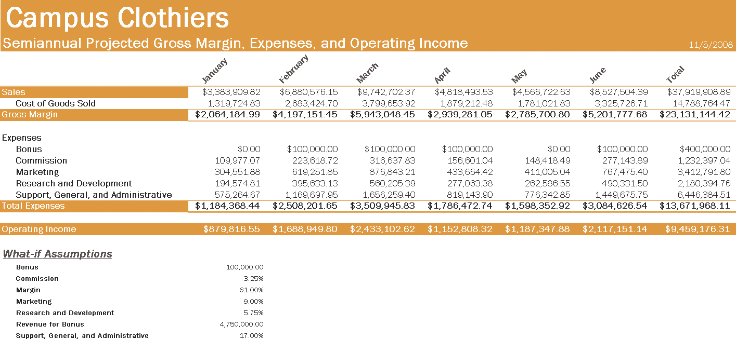
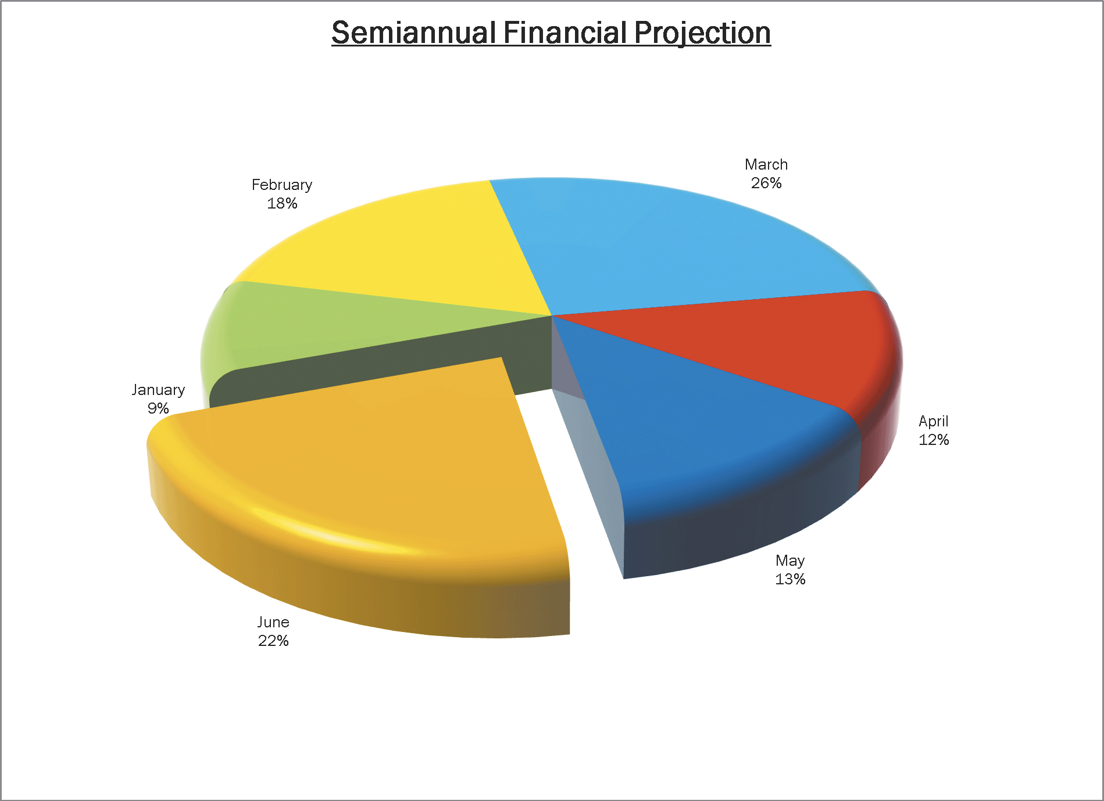
Previewing and Printing the Workbook

Slide 74
Shrinking and Magnifying the Viewing of a Worksheet or Chart
If cell A1 is not active, press CTRL+HOME
Click the View tab on the Ribbon and then click the Zoom button on the Ribbon to display a list of Magnifications in the Zoom dialog box
Click 75% and then click the OK button to shrink the display of the worksheet to 75% of its normal display
Click the Zoom In button on the status bar until the worksheet displays at 100%

Slide 75
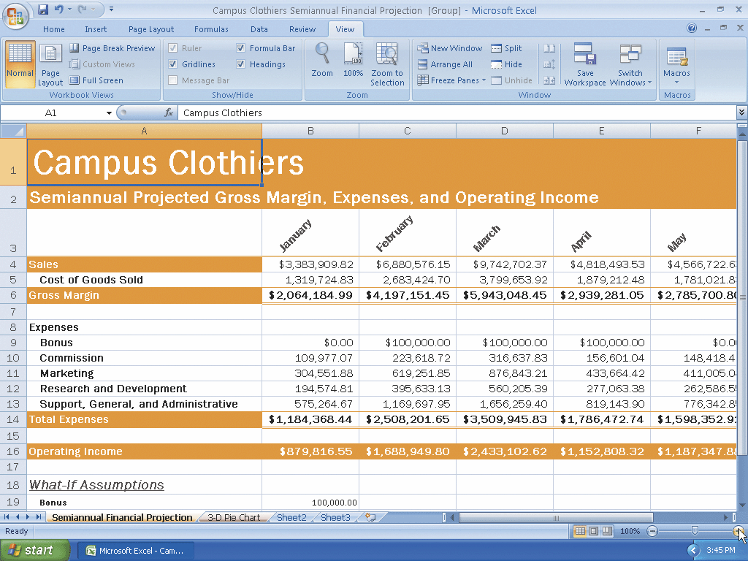
Shrinking and Magnifying the Viewing of a Worksheet or Chart

Slide 76
Splitting a Window into Panes
Select cell D7, the intersection of the four proposed panes
If necessary, click the View tab on the Ribbon and then point to the Split button on the Ribbon
Click the Split button to divide the window into four panes
Use the scroll arrows to show the four corners of the worksheet at the same time

Slide 77
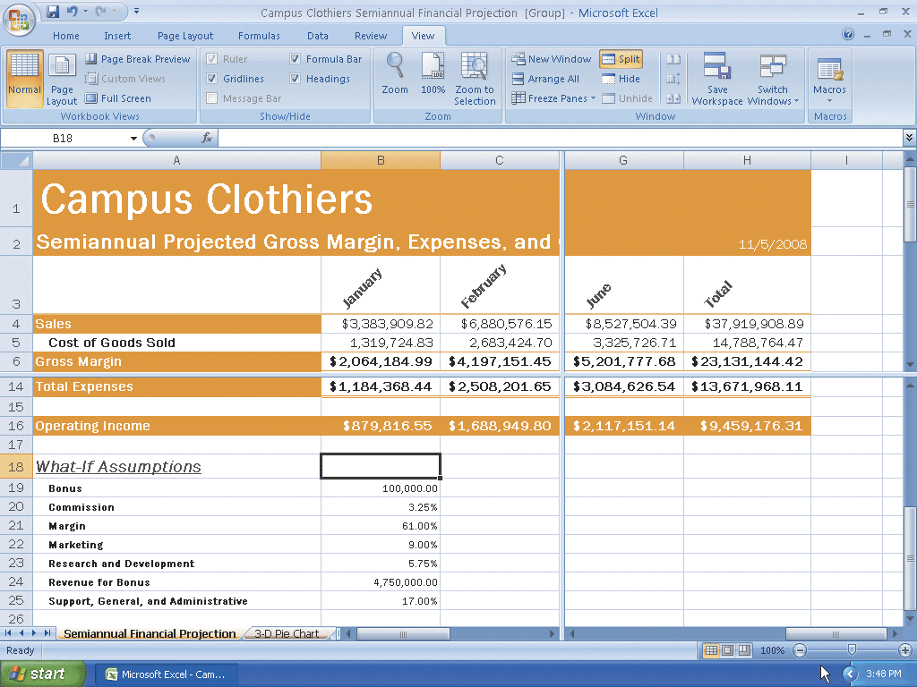
Splitting a Window into Panes

Slide 78
Removing the Panes from the Window
Position the mouse pointer at the intersection of the horizontal and vertical split bars
When the mouse pointer changes to a four-headed arrow, double-click to remove the four panes from the window

Slide 79
Analyzing Data in a Worksheet by Changing Values
Use the vertical scroll bar to move the window so cell A6 is in the upper-left corner of the screen
Drag the vertical split box from the lower-right corner of the screen to the left so that the vertical split bar is positioned as shown on the following slide
Use the right scroll arrow to view the totals in column H in the right pane
Enter 75000 in cell B19, 2.25 in cell B20, and 14.50 in cell B25 which causes the semiannual operating income in cell H16 to increase from $9,459,176.31 to $10,886,373.12

Slide 80
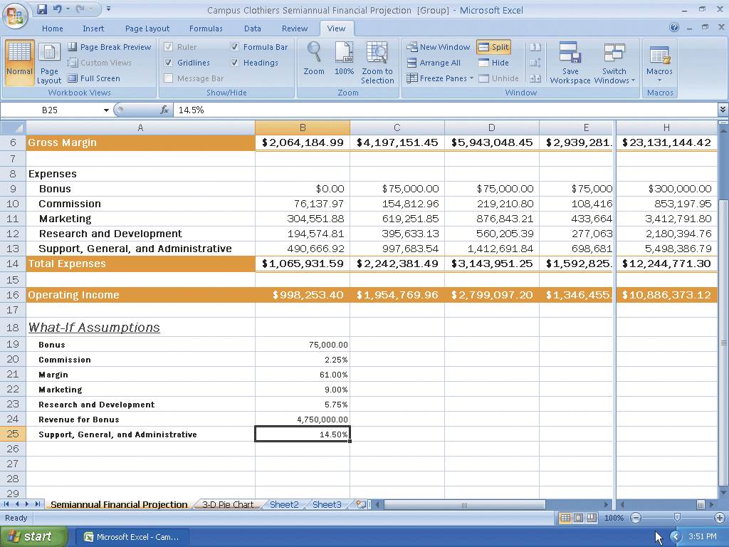
Analyzing Data in a Worksheet by Changing Values

Slide 81
Goal Seeking
Close the workbook without saving changes and then reopen it
Drag the vertical split box so that the vertical split bar is positioned as shown
Show column H in the right pane
Click cell H16, the cell that contains the semiannual operating income
Click the Data tab on the Ribbon and then click the What-If Analysis button on the Ribbon to display the What-If Analysis menu

Slide 82
Goal Seeking
Click Goal Seek to display the Goal Seek dialog box with the Set cell box set to the selected cell, H16
When Excel displays the Goal Seek dialog box, click the To value text box, type 10500000 and then click the By changing cell box
Scroll down so row 4 is at the top of the screen
Click cell B25 on the worksheet to assign cell B25 to the By changing cell box
Click the OK button to goal seek for the value $10,500,000.00 in cell H16
Click the Cancel button in the Goal Seek Status dialog box

Slide 83
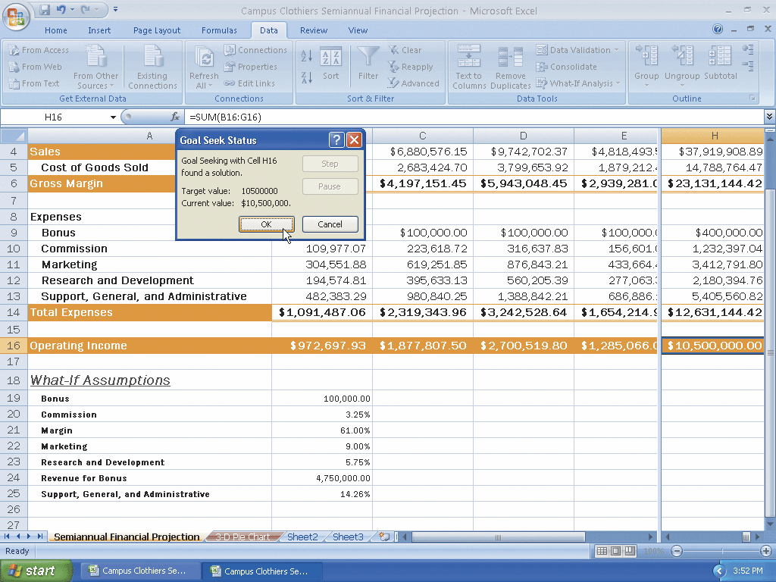
Goal Seeking

Slide 84
Quitting Excel
Click the Close button on the title bar
If the Microsoft Excel dialog box is displayed, click the No button

Slide 85
Summary
Rotate text in a cell
Create a series of month names
Copy, paste, insert, and delete cells
Format numbers using format symbols
Freeze and unfreeze titles
Show and format the system date
Use absolute cell references in a formula

Slide 86
Summary
Use the IF function to perform a logical test
Use the Format Painter button to format cells
Create a 3-D Pie chart on a separate chart sheet
Color and rearrange worksheet tabs
Change the worksheet view
Answer what-if questions
Goal seek to answer what-if questions

Slide 87
Excel Chapter 3 Complete

