Slide 1
Excel Chapter 1
Creating a Worksheet and
an Embedded Chart

Slide 2
Objectives
Start and quit Excel
Describe the Excel worksheet
Enter text and numbers
Use the Sum button to sum a range of cells
Copy the contents of a cell to a range of cells using the fill handle

Slide 3
Objectives
Save a workbook
Format cells in a worksheet
Create a 3-D Clustered Column chart
Change document properties
Save a workbook a second time using the same file name

Slide 4
Objectives
Print a worksheet
Open a workbook
Use the AutoCalculate area to determine statistics
Correct errors on a worksheet
Use Excel Help to answer questions

Slide 5
Plan Ahead
Select titles and subtitles for the worksheet
Determine the contents for rows and columns
Determine the calculations that are needed
Determine where to save the workbook
Identify how to format various elements of the worksheet
Decide on the type of chart needed
Establish where to position and how to format the chart

Slide 6
Starting Excel
Click the Start button on the Windows taskbar to display the Start menu
Point to All Programs on the Start menu to display the All Programs submenu
Point to Microsoft Office in the All Programs submenu to display the Microsoft Office submenu
Click Microsoft Office Excel 2007 to start Excel and display a new blank workbook titled Book1 in the Excel window
If the Excel window is not maximized, click the Maximize button next to the Close button on its title bar to maximize the window
If the worksheet window in Excel is not maximized, click the Maximize button next to the Close button on its title bar to maximize the worksheet window within Excel

Slide 7
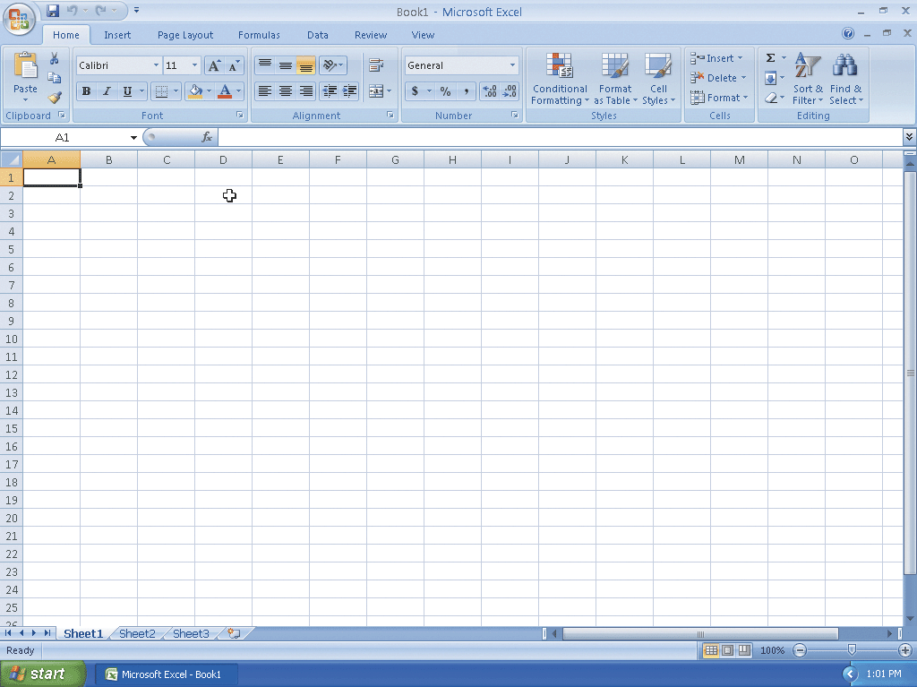
Starting Excel

Slide 8
Entering the Worksheet Titles
Click cell A1 to make cell A1 the active cell
Type Walk and Rock Music in cell A1, and then point to the Enter box in the formula bar
Click the Enter box to complete the entry and enter the worksheet title in cell A1
Click cell A2 to select it
Type First Quarter Rock-It MP3 Sales as the cell entry
Click the Enter box to complete the entry and enter the worksheet subtitle in cell A2

Slide 9
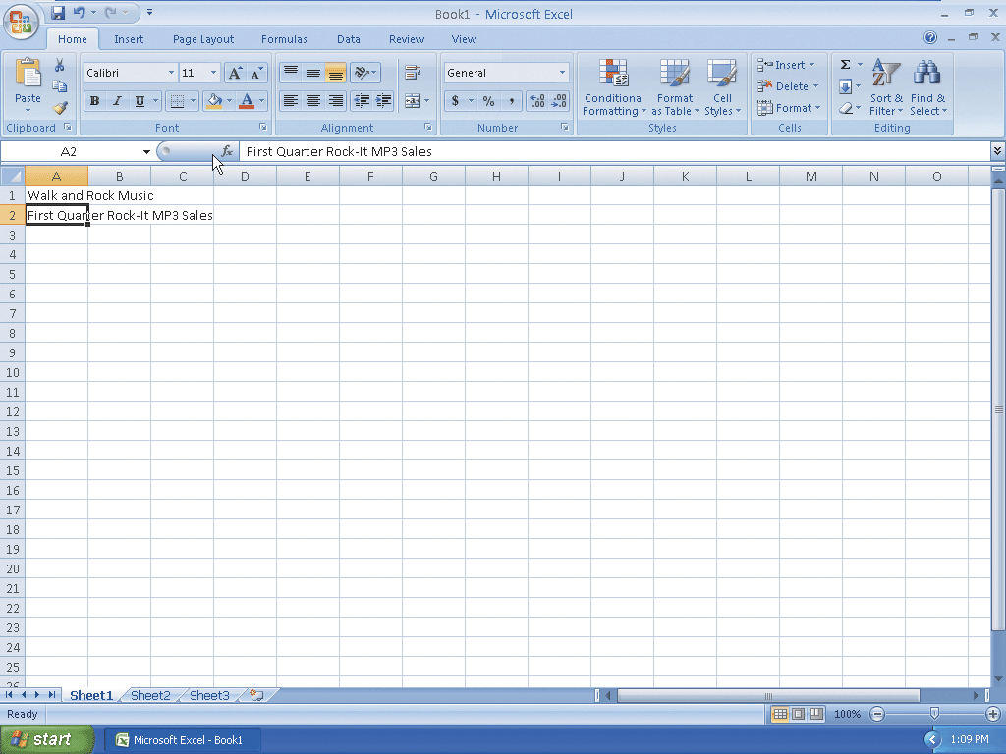
Entering the Worksheet Titles

Slide 10
Entering Column Titles
Click cell B3 to make cell B3 the active cell
Type Northeast in cell B3
Press the RIGHT ARROW key to enter the column title, Northeast, in cell B3 and make cell C3 the active cell
Repeat Steps 2 and 3 to enter the remaining column titles in row 3; that is, enter Southeast in cell C3, Midwest in cell D3, South in cell E3, West in cell F3, and Total in cell G3 (complete the last entry in cell G3 by clicking the Enter box in the formula bar)

Slide 11
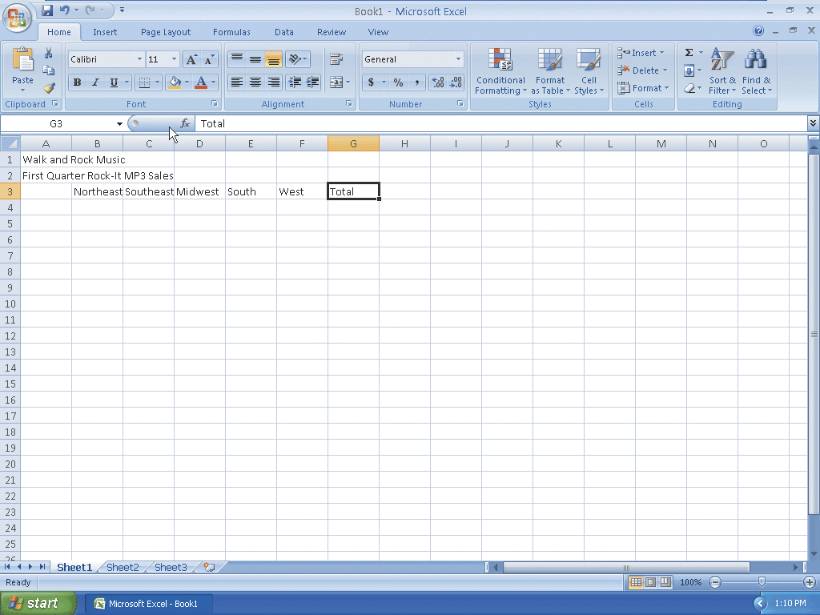
Entering Column Titles

Slide 12
Entering Row Titles
Click cell A4 to select it
Type Video and then press the DOWN ARROW key to enter the row title and make cell A5 the active cell
Repeat Step 1 to enter the remaining row titles in column A; that is, enter Mini in cell A5, Micro in cell A6, Flash in cell A7, Accessories in cell A8, and Total in cell A9

Slide 13
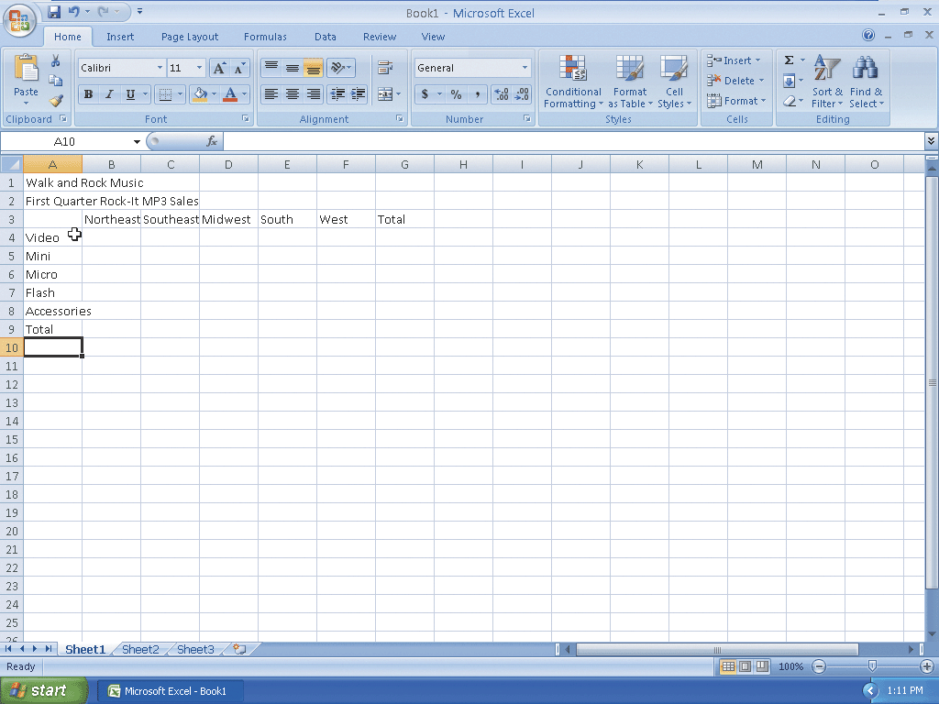
Entering Row Titles

Slide 14
Entering Numbers
Click cell B4
Type 66145.15 and then press the RIGHT ARROW key to enter the data in cell B4 and make cell C4 the active cell
Enter 79677.1 in cell C4, 34657.66 in cell D4, 52517.2 in cell E4, and 99455.49 in cell F4
Click cell B5
Enter the remaining first quarter sales numbers provided in Table 1–1 on page EX 23 for each of the four remaining offerings in rows 5, 6, 7, and 8 to display the quarterly sales in the worksheet

Slide 15
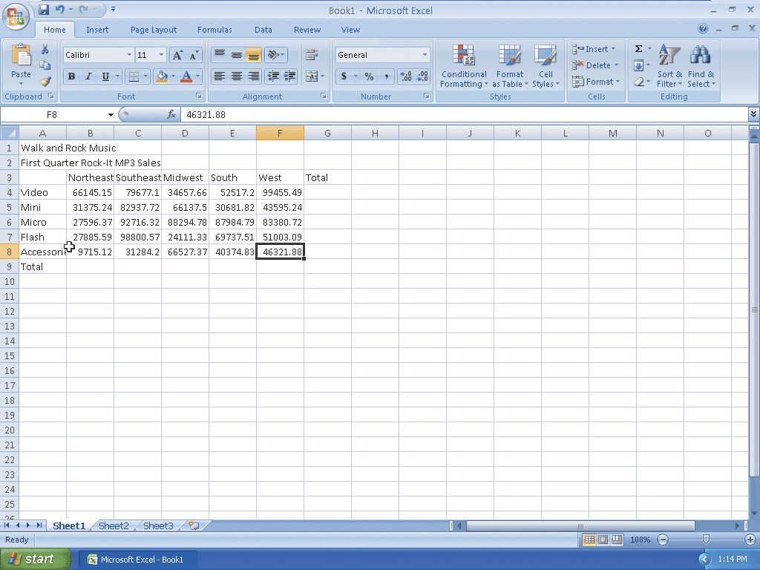
Entering Numbers

Slide 16
Summing a Column of Numbers
Click cell B9 to make it the active cell and then point to the SUM button on the Ribbon
Click the Sum button on the Ribbon to display =SUM(B4:B8) in the formula bar and in the active cell B9
Click the Enter box in the formula bar to enter the sum of the first quarter sales for the five product types for the Northeast region in cell B9
Select cell B9 to display the SUM function assigned to cell B9 in the formula bar

Slide 17
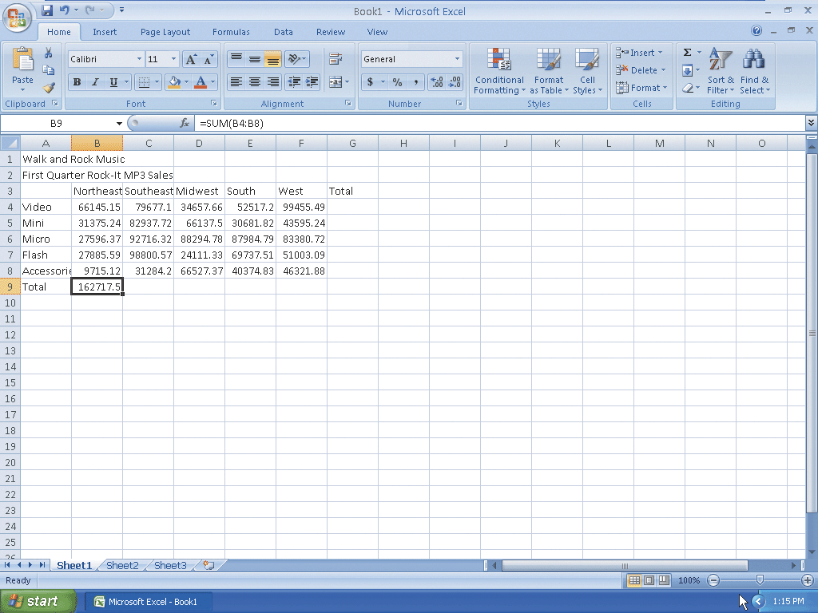
Summing a Column of Numbers

Slide 18
Copying a Cell to Adjacent Cells in a Row
With cell B9 active, point to the fill handle
Drag the fill handle to select the destination area, range C9:F9, to display a shaded border around the destination area, range C9:F9, and the source area, cell B9. Do not release the mouse button
Release the mouse button to copy the SUM function in cell B9 to the range C9:F9 and calculate the sums in cells C9, D9, E9, and F9

Slide 19
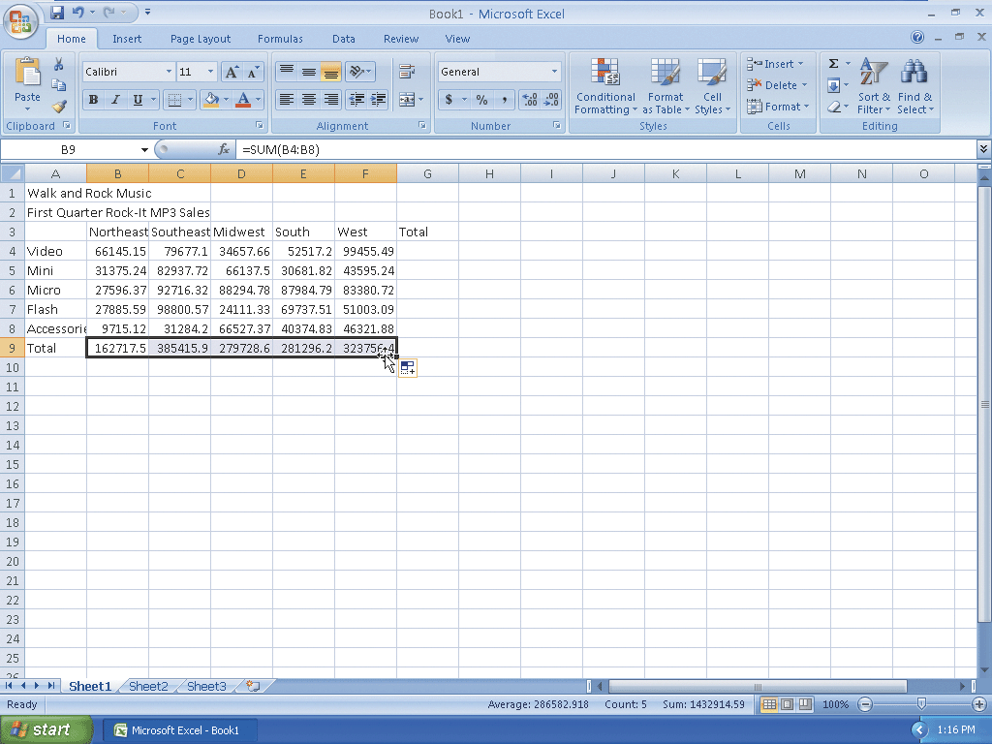
Copying a Cell to Adjacent Cells in a Row

Slide 20
Determining Multiple Totals at the Same Time
Click cell G4 to make it the active cell
With the mouse pointer in cell G4 and in the shape of a block plus sign, drag the mouse pointer down to cell G9 to highlight the range G4:G9 with a transparent view
Click the Sum button on the Ribbon to calculate and display the sums of the corresponding rows of sales in cells G4, G5, G6, G7, G8, and G9
Select cell A10 to deselect the range G4:G9

Slide 21
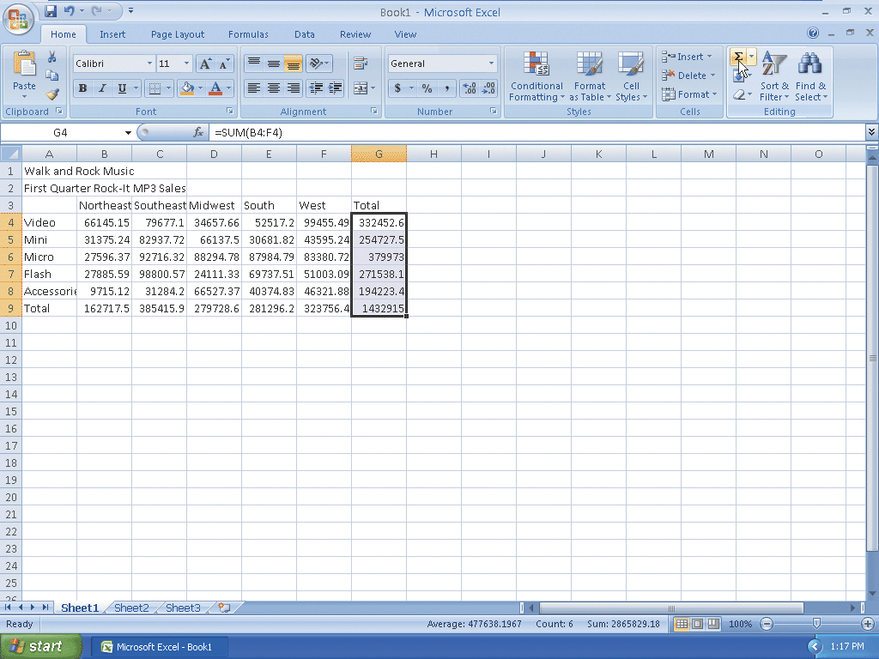
Determining Multiple Totals at the Same Time

Slide 22
Saving a Workbook
With a USB flash drive connected to one of the computer’s USB ports, click the Save button on the Quick Access Toolbar to display the Save As dialog box
Type Walk and Rock Music 1st Quarter Sales in the File name text box to change the file name. Do not press the ENTER key after typing the file name
Click the Save in box arrow to display a list of available drives and folders
Click UDISK 2.0 (E:) in the Save in list to select the USB flash drive, Drive E in this case, as the new save location
Click the Save button in the Save As dialog box to save the workbook on the USB flash drive with the file name, Walk and Rock Music 1st Quarter Sales

Slide 23
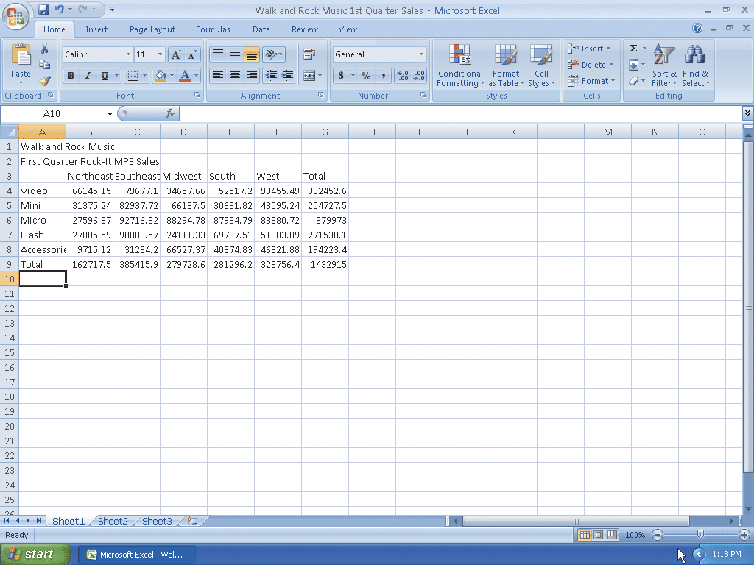
Saving a Workbook

Slide 24
Changing a Cell Style
Click cell A1 to make cell A1 the active cell
Click the Cell Styles button on the Ribbon to display the Cell Styles gallery
Point to the Title cell style in the Titles and Headings area of the Cell Styles gallery to see a live preview of the cell style in cell A1
Click the Title cell style to apply the cell style to cell A1

Slide 25
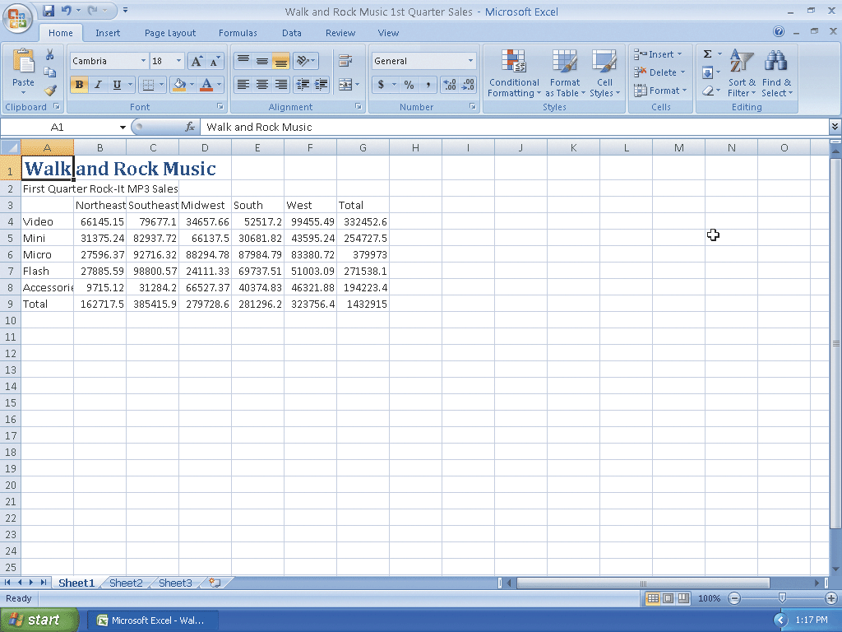
Changing a Cell Style

Slide 26
Changing the Font Type
Click cell A2 to make cell A2 the active cell
Click the Font box arrow on the Ribbon to display the Font gallery
Point to Cambria in the Theme Fonts area of the Font gallery to see a live preview of the Cambria font in cell A2
Click Cambria in the Theme Fonts area to change the font type of the worksheet subtitle in cell A2 from Calibri to Cambria

Slide 27
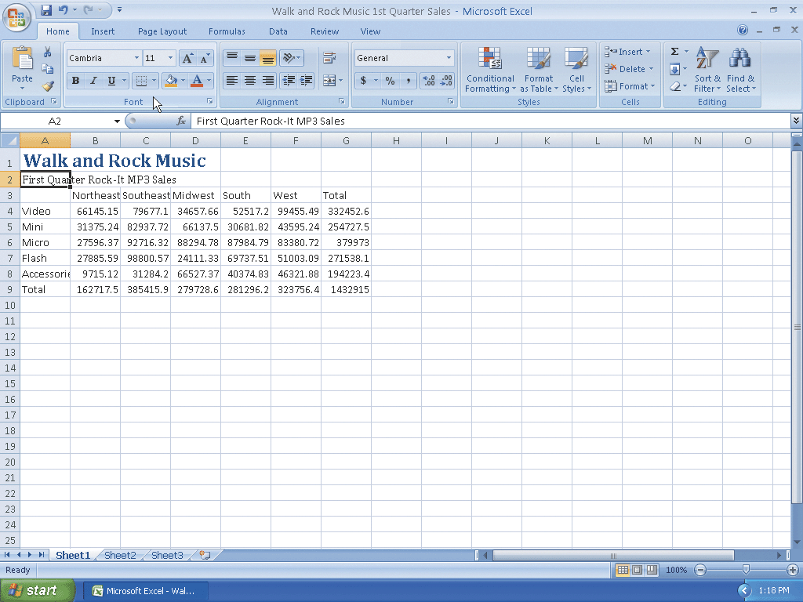
Changing the Font Type

Slide 28
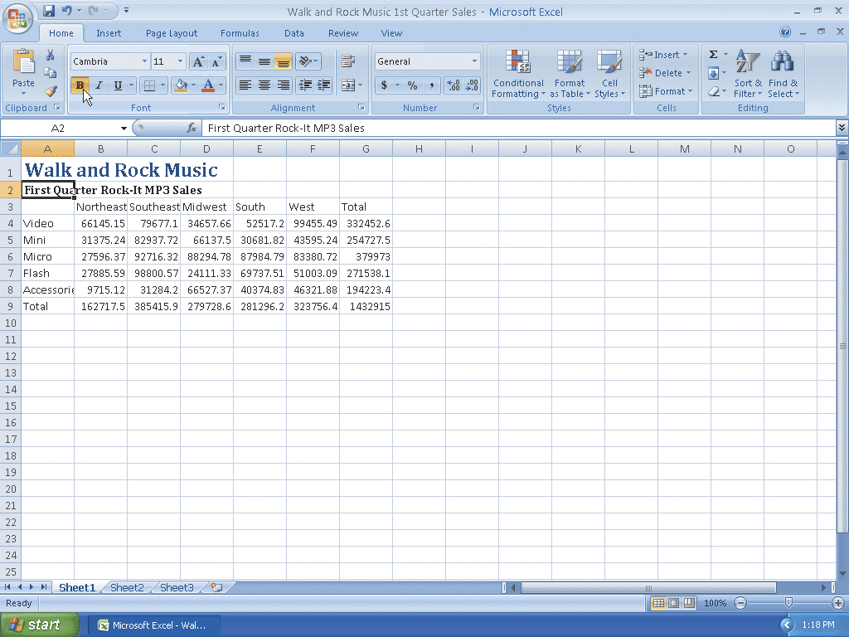
Bolding a Cell
With cell A2 active, click the Bold button on the Ribbon to change the font style of the worksheet subtitle to bold

Slide 29
Increasing the Font Size of a Cell Entry
With cell A2 selected, click the Font Size box arrow on the Ribbon to display the Font Size list
Point to 14 in the Font Size list to see a live preview of cell A2 with a font size of 14
Click 14 in the Font Size list to change the font in cell A2 from 11 point to 14 point

Slide 30
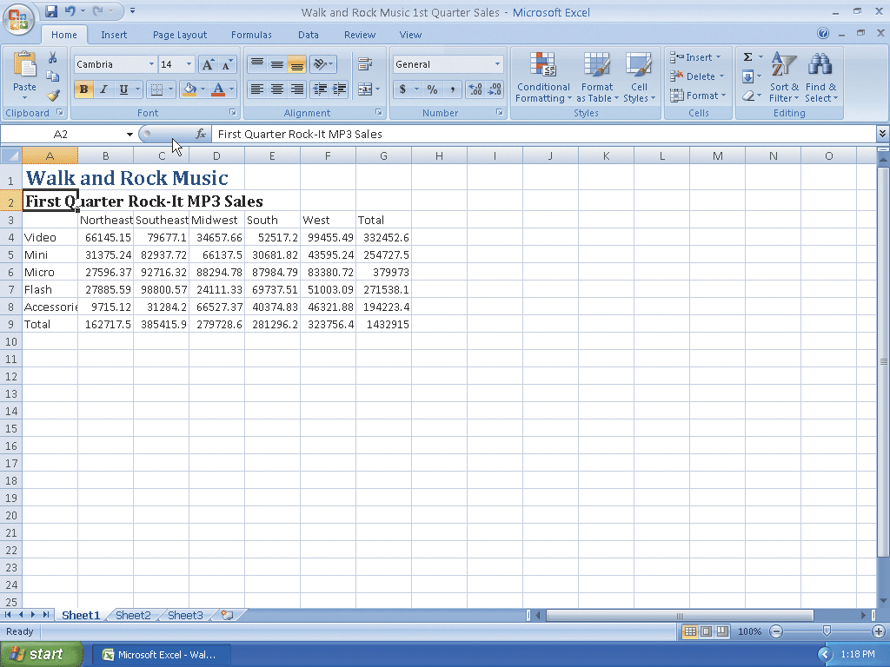
Increasing the Font Size of a Cell Entry

Slide 31
Changing the Font Color of a Cell Entry
With cell A2 selected, click the Font Color button arrow on the Ribbon to display the Font Color palette
Point to Dark Blue, Text 2 (dark blue color in column 4, row 1) in the Theme Colors area of the Font Color palette to see a live preview of the font color in cell A2
Click Dark Blue, Text 2 (column 4, row 1) on the Font Color palette to change the font of the worksheet subtitle in cell A2 from black to dark blue

Slide 32
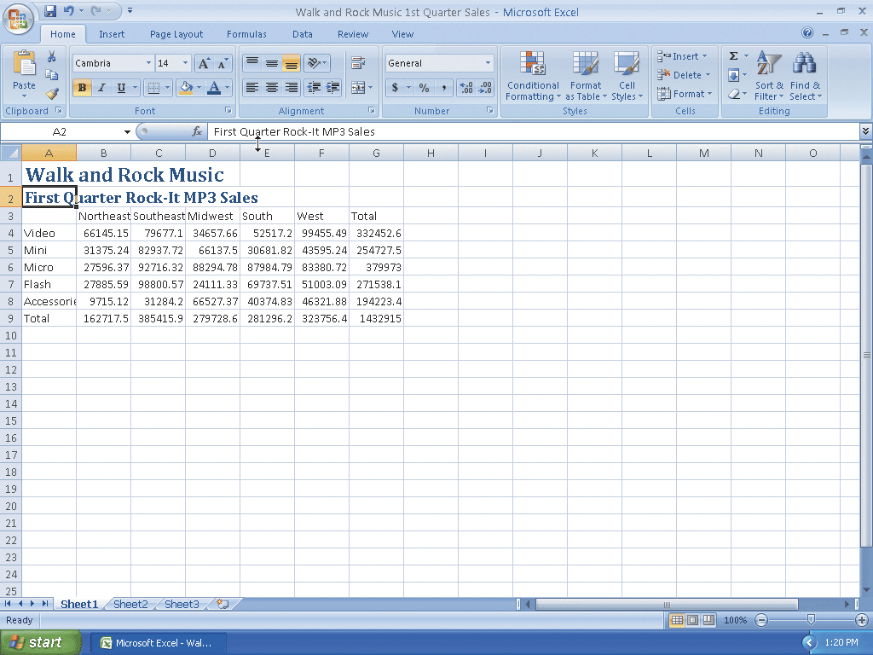
Changing the Font Color of a Cell Entry

Slide 33
Centering Cell Entries across Columns by Merging Cells
Select cell A1 and then drag to cell G1 to highlight the range A1:G1
Click the Merge and Center button on the Ribbon to merge cells A1 through G1 and center the contents of cell A1 across columns A through G
Repeat the first two steps to merge and center the worksheet subtitle across cells A2 through G2

Slide 34
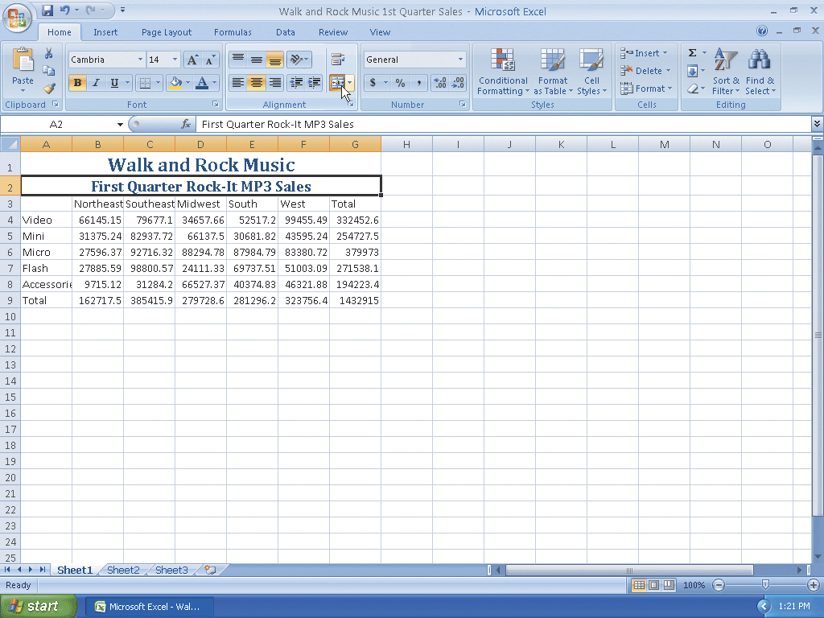
Centering Cell Entries across Columns by Merging Cells

Slide 35
Formatting Column Titles and the Total Row
Click cell A3 and then drag the mouse pointer to cell G3 to select the range A3:G3
Point to the Cell Styles button on the Ribbon
Click the Cell Styles button to display the Cell Styles gallery
Point to the Heading 3 cell style in the Titles and Headings area of the Cell Styles gallery to see a live preview of the cell style in the range A3:G3
Click the Heading 3 cell style to apply the cell style to the range A3:G3

Slide 36
Formatting Column Titles and the Total Row
Click cell A9 and then drag the mouse pointer to cell G9 to select the range A9:G9
Point to the Cell Styles button on the Ribbon
Click the Cell Styles button on the Ribbon to display the Cell Styles gallery and then click the Total cell style in the Titles and Headings area to apply the Total cell style to the cells in the range A9:G9
Click cell A11 to select the cell

Slide 37
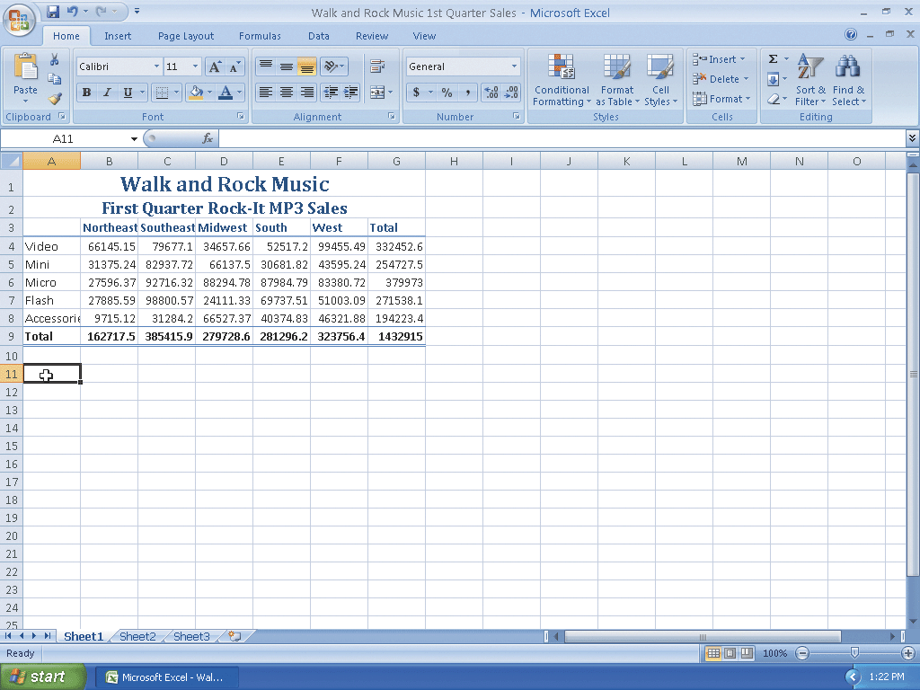
Formatting Column Titles and the Total Row

Slide 38
Formatting Numbers in the Worksheet
Select cell B4 and drag the mouse pointer to cell G4 to select the range B4:G4
Point to the Accounting Number Format button on the Ribbon to display the Enhanced ScreenTip
Click the Accounting Number Format button on the Ribbon to apply the Accounting Number Format to the cells in the range B4:G4
Select the range B5:G8

Slide 39
Formatting Numbers in the Worksheet
Click the Comma Style button on the Ribbon to apply the Comma Style to the range B5:G8
Select the range B9:G9
Click the Accounting Number Format button on the Ribbon to apply the Accounting Number Format to the cells in the range B9:G9
Select cell A11

Slide 40
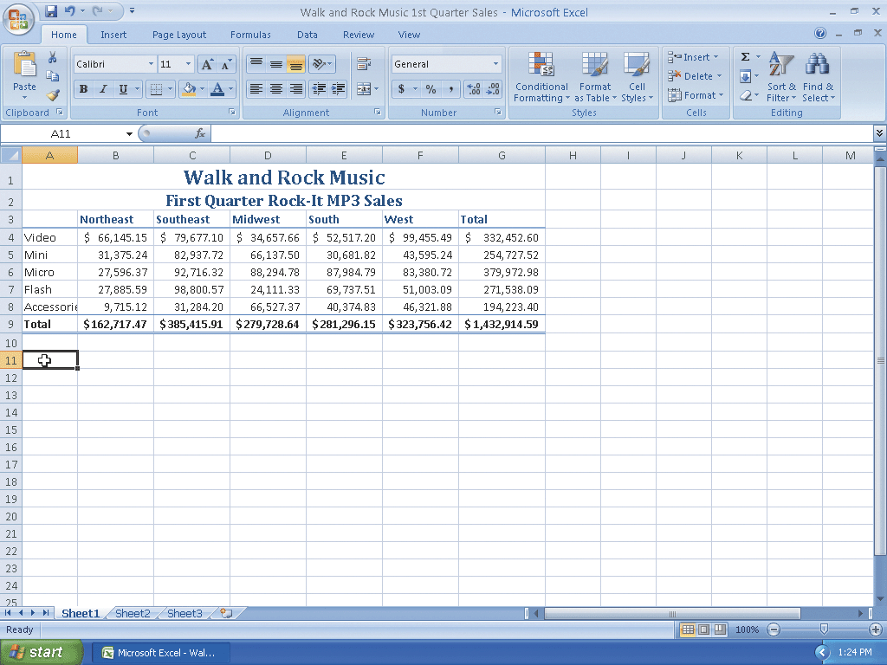
Formatting Numbers in the Worksheet

Slide 41
Adjusting Column Width
Point to the boundary on the right side of the column A heading above row 1 to change the mouse pointer to a split double arrow
Double-click on the boundary to adjust the width of column A to the width of the largest item in the column

Slide 42
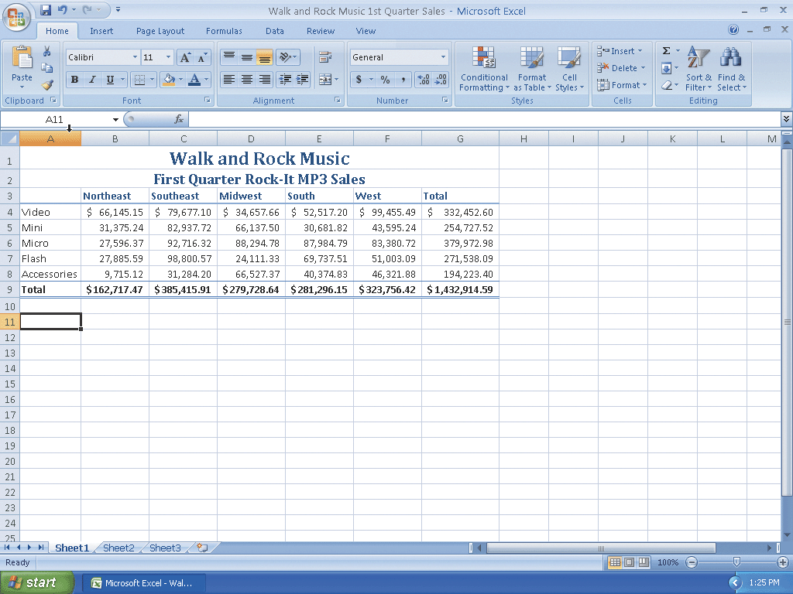
Adjusting Column Width

Slide 43
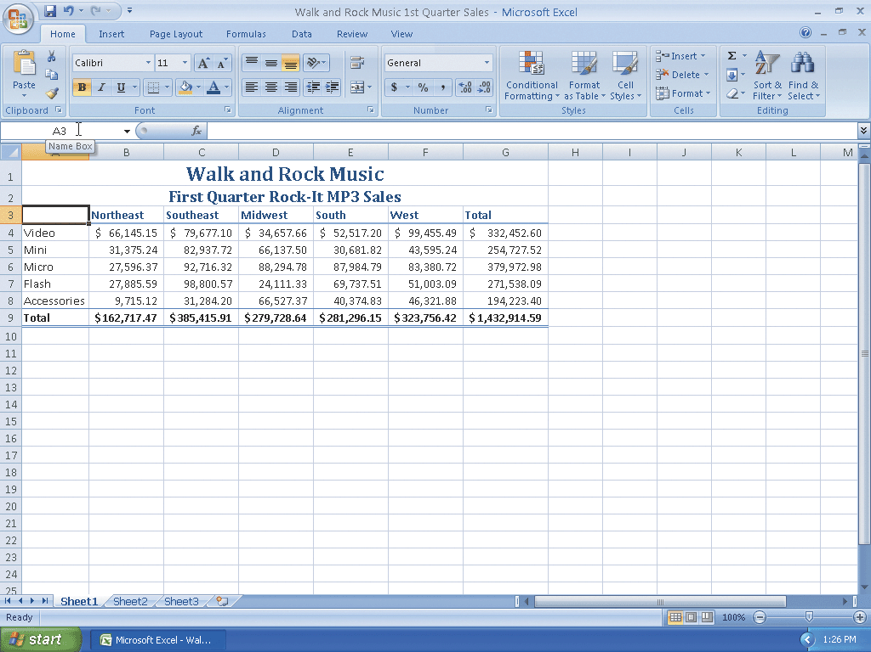
Using the Name Box to Select a Cell
Click the Name box in the formula bar and then type a3 as the cell to select
Press the ENTER key to change the active cell from A11 to cell A3

Slide 44
Adding a 3-D Clustered Column Chart to the Worksheet
Click cell A3 and then drag the mouse pointer to the cell F8 to select the range A3:F8
Click the Insert tab to make the Insert tab the active tab
Click the Column button on the Ribbon to display the Column gallery
Point to the 3-D Clustered Column chart type in the 3-D Column area of the Column gallery
Click the 3-D Clustered Column chart type in the 3-D Column area of the Column gallery to add a 3-D Clustered Column chart to the middle of the worksheet in a selection rectangle

Slide 45
Adding a 3-D Clustered Column Chart to the Worksheet
Click the top-right edge of the selection rectangle but do not release the mouse to grab the chart and change the mouse pointer to a cross hair with four arrowheads
Continue holding down the left mouse button while dragging the chart down and to the left to position the upper-left corner of the dotted line rectangle over the upper-left corner of cell A11. Release the mouse button to complete the move of the chart
Click the middle sizing handle on the right edge of the chart and do not release the mouse button
While continuing to hold down the mouse button, press the ALT key and drag the right edge of the chart to the right edge of column G and then release the mouse button to resize the chart
Point to the middle sizing handle on the bottom edge of the selection rectangle and do not release the mouse button

Slide 46
Adding a 3-D Clustered Column Chart to the Worksheet
While continuing to hold down the mouse button, press the ALT key and drag the bottom edge of the chart up to the bottom edge of row 22 and then release the mouse button to resize the chart
Click the More button in the Chart Styles gallery to expand the gallery and point to Style 2 in the gallery (column 2, row 1)
Click Style 2 in the Chart Styles gallery to apply the chart style Style 2 to the chart
Click cell I9 to deselect the chart and complete the worksheet

Slide 47
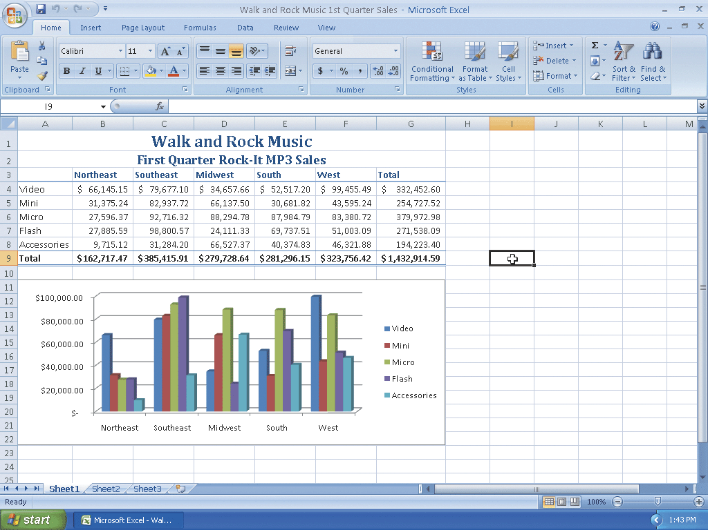
Adding a 3-D Clustered Column Chart to the Worksheet

Slide 48
Changing Document Properties
Click the Office Button to display the Office Button menu
Point to Prepare on the Office Button menu to display the Prepare submenu
Click Properties on the Prepare submenu to display the Document Information Panel
Click the Author text box and then type your name as the Author property. If a name already is displayed in the Author text box, delete it before typing your name
Click the Subject text box, if necessary delete any existing text, and then type your course and section as the Subject property
Click the Keywords text box, if necessary delete any existing text, and then type First Quarter Rock-It MP3 Sales
Click the Close the Document Information Panel button so that the Document Information Panel no longer is displayed

Slide 49
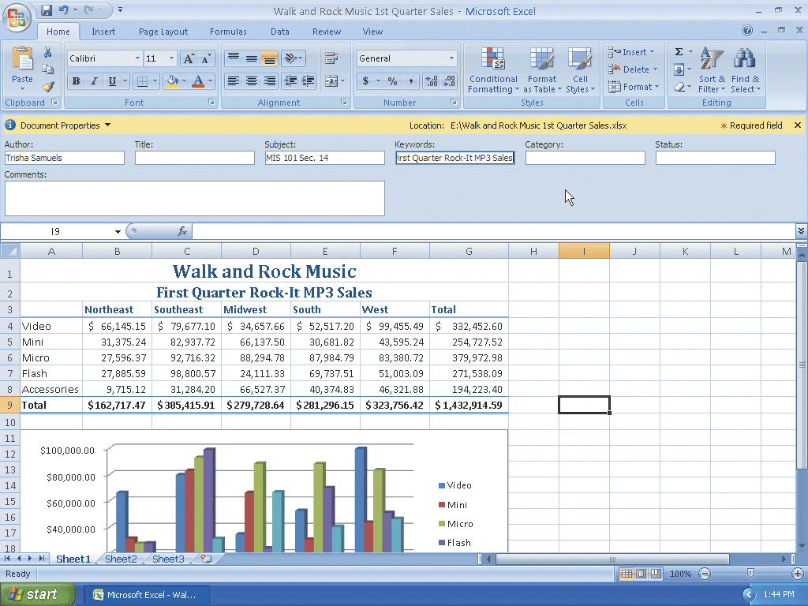
Changing Document Properties

Slide 50

Saving an Existing Workbook with the Same File Name
With your USB flash drive connected to one of the computer’s USB ports, click the Save button on the Quick Access Toolbar to overwrite the previous Walk and Rock Music 1st Quarter Sales file on the USB flash drive

Slide 51
Printing a Worksheet
Click the Office Button to display the Office button menu
Point to Print on the Office Button menu to display the Print submenu
Click Quick Print on the Print submenu to print the document

Slide 52
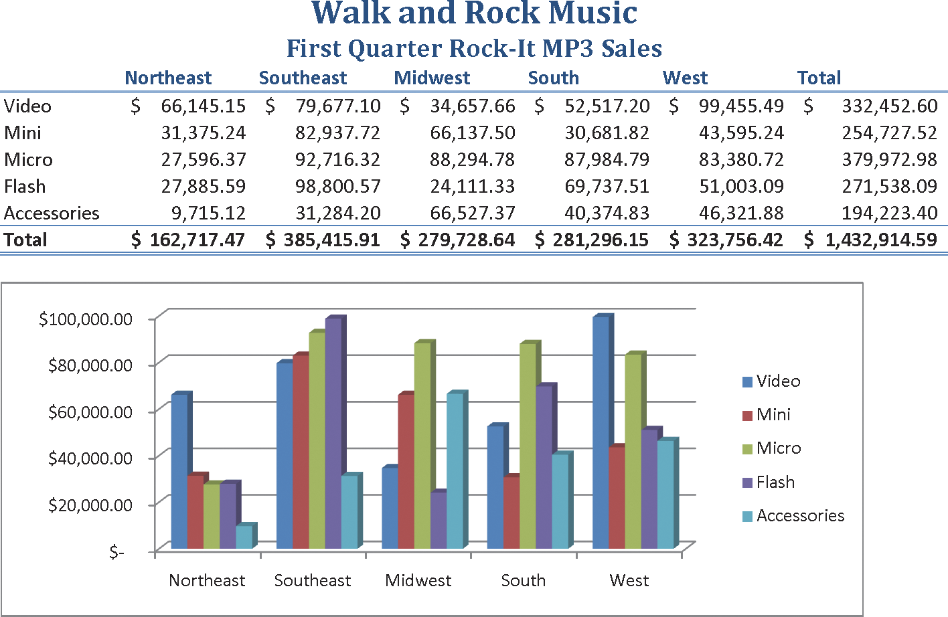
Printing a Worksheet

Slide 53

Quitting Excel
Point to the Close button on the right side of the Excel title bar
Click the Close button to quit Excel

Slide 54
Starting Excel
Click the Start button on the Windows taskbar to display the Start menu
Point to All Programs on the Start menu to display the All Programs submenu and then point to Microsoft Office in the All Programs submenu to display the Microsoft Office submenu
Click Microsoft Office Excel 2007 on the Microsoft Office submenu to start Excel and display a new blank worksheet in the Excel window
If the Excel window is not maximized, click the Maximize button on its title bar to maximize the window

Slide 55
Opening a Workbook from Excel
With your USB flash drive connected to one of the computer’s USB ports, click the Office Button to display the Office Button menu
Click Open on the Office Button menu to display the Open dialog box
If necessary, click the Look in box arrow and then click UDISK 2.0 (E:) to select the USB flash drive, Drive E in this case, in the Look in list as the new open location
Click Walk and Rock Music 1st Quarter Sales to select the file name
Click the Open button to open the selected file and display the worksheet in the Excel window

Slide 56

Opening a Workbook from Excel

Slide 57
Using the AutoCalculate Area to Determine a Maximum
Select the range B6:F6 and then right-click the AutoCalculate area on the status bar to display the Status Bar Configuration shortcut menu
Click Maximum on the shortcut menu to display the Maximum value in the range B6:F6 in the AutoCalculate area of the status bar
Click anywhere on the worksheet to cause the shortcut menu to disappear
Right-click the AutoCalculate area and then click Maximum on the shortcut menu to cause the Maximum value to no longer appear in the AutoCalculate area

Slide 58
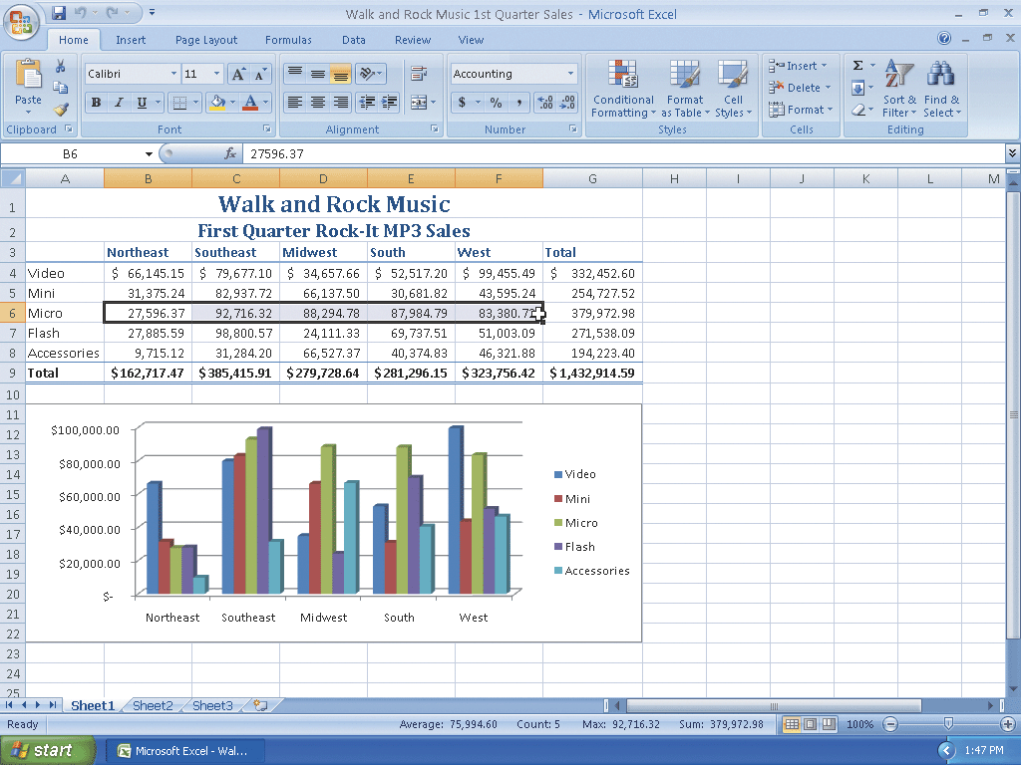
Using the AutoCalculate Area to Determine a Maximum

Slide 59
Searching for Excel Help
Click the Microsoft Office Excel Help button near the upper-right corner of the Excel window to open the Excel Help window
Type format a chart in the Type words to search for text box at the top of the Excel Help window
Press the ENTER key to display the search results
Click the Maximize button on the Excel Help window title bar to maximize the Help window
Click the Format chart elements link to display information regarding formatting chart elements
Click the Close button on the Excel Help window title bar to close the Excel Help window and make Excel active

Slide 60
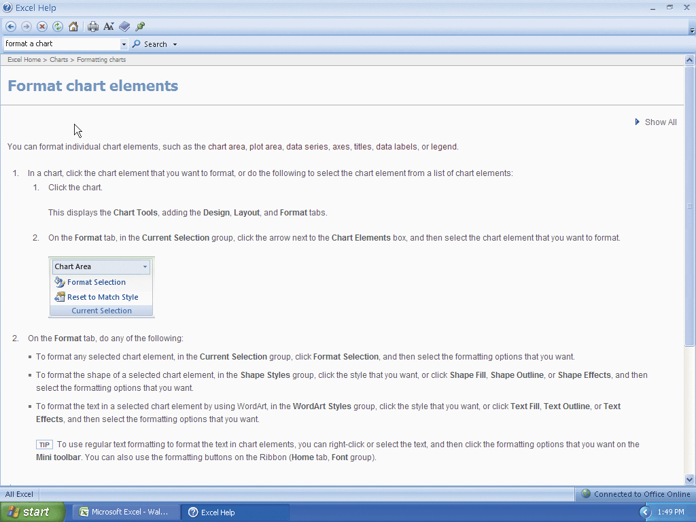
Searching for Excel Help

Slide 61
Quitting Excel
Click the Close button on the right side of the title bar to quit Excel
If necessary, click the No button in the Microsoft Office Excel dialog box so that any changes you have made are not saved

Slide 62
Summary
Start and quit Excel
Describe the Excel worksheet
Enter text and numbers
Use the Sum button to sum a range of cells
Copy the contents of a cell to a range of cells using the fill handle

Slide 63
Summary
Save a workbook
Format cells in a worksheet
Create a 3-D Clustered Column chart
Change document properties
Save a workbook a second time using the same file name

Slide 64
Summary
Print a worksheet
Open a workbook
Use the AutoCalculate area to determine statistics
Correct errors on a worksheet
Use Excel Help to answer questions

Slide 65
Excel Chapter 1 Complete

