Slide 1
Access Chapter 2
Querying a Database

Slide 2
Objectives
Create queries using the Simple Query Wizard
Print query results
Create queries using Design view
Include fields in the design grid
Use text and numeric data in criteria

Slide 3
Objectives
Create and use parameter queries
Save a query and use the saved query
Use compound criteria in queries
Sort data in queries
Join tables in queries

Slide 4
Objectives
Create a report from a query
Perform calculations in queries
Calculate statistics in queries
Create crosstab queries
Customize the Navigation pane

Slide 5
Plan Ahead
Identify the fields
Identify restrictions
Determine whether special order is required
Determine whether more than one table is required
Determine whether calculations are required
If data is to be summarized, determine whether a crosstab query would be appropriate

Slide 6
Starting Access
Click the Start button on the Windows taskbar to display the Start menu
Point to All Programs on the Start menu to display the All Programs submenu and then point to Microsoft Office on the All Programs submenu to display the Microsoft Office Submenu
Click Microsoft Office Access 2007 on the Microsoft Office submenu to start Access and display the Getting Started with Microsoft Office Access window
If the Access window is not maximized, click the Maximize button on its title bar to maximize the window

Slide 7
Opening a Database
With your USB flash drive connected to one of the computer’s USB ports, click the More button to display the Open dialog box
If necessary, click the Look in box arrow and then click UDISK 2.0 (E:) to select the USB flash drive in the Look in list as the new open location. (Your drive letter might be different.)
Click JSP Recruiters to select the file name
Click the Open button to open the database
If a Security Warning appears, click the Options button to display the Microsoft Office Security Options dialog box.
With the option button to enable this content selected, click the OK button to enable the content

Slide 8
Using the Simple Query Wizard to Create a Query
If the Navigation pane is hidden, click the Shutter Bar Open/Close Button to show the Navigation pane
Be sure the Client table is selected
Click Create on the Ribbon to display the Create tab
Click the Query Wizard button on the Create tab to display the New Query dialog box
Be sure Simple Query Wizard is selected, and then click the OK button to display the Simple Query Wizard dialog box
Click the Add Field button to add the Client Number field

Slide 9
Using the Simple Query Wizard to Create a Query
Click the Add Field button a second time to add the Client Name field
Click the Recruiter Number field, and then click the Add Field button to add the Recruiter Number field
Click the Next button
Be sure the title of the query is Client Query
Click the Finish button to create the query
Click the Close button for the Client Query to remove the query results from the screen

Slide 10
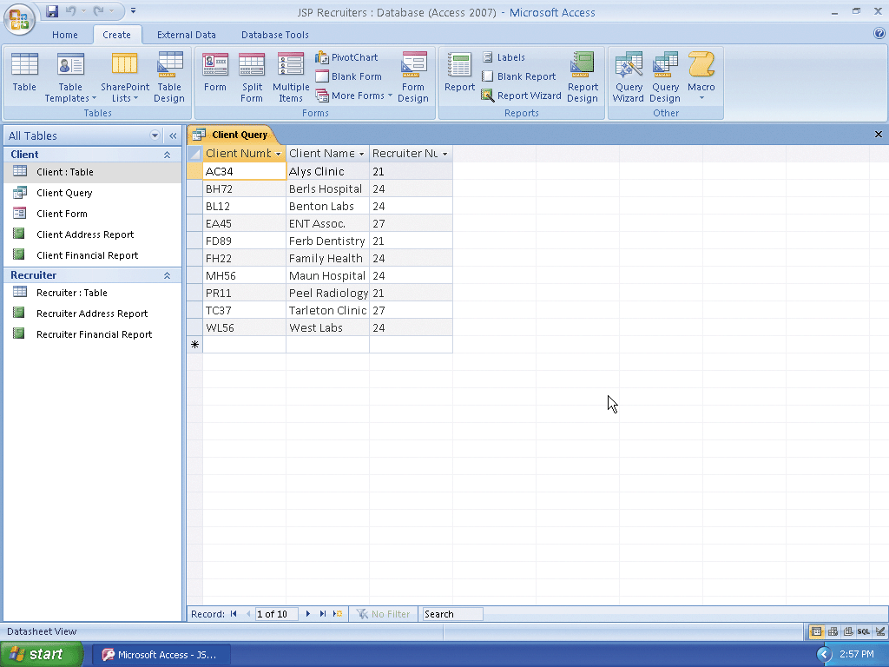
Using the Simple Query Wizard to Create a Query

Slide 11
Using a Criterion in a Query
Right-click Client Query to produce a shortcut menu
Click Design View on the shortcut menu to open the query in Design view
Click the Criteria row in the Recruiter Number column of the grid, and then type 24 as the criterion
Click the View button to display the results in Datasheet view
Close the Client Query window by clicking the Close ‘Client Query’ button
When asked if you want to save your changes, click the No button

Slide 12
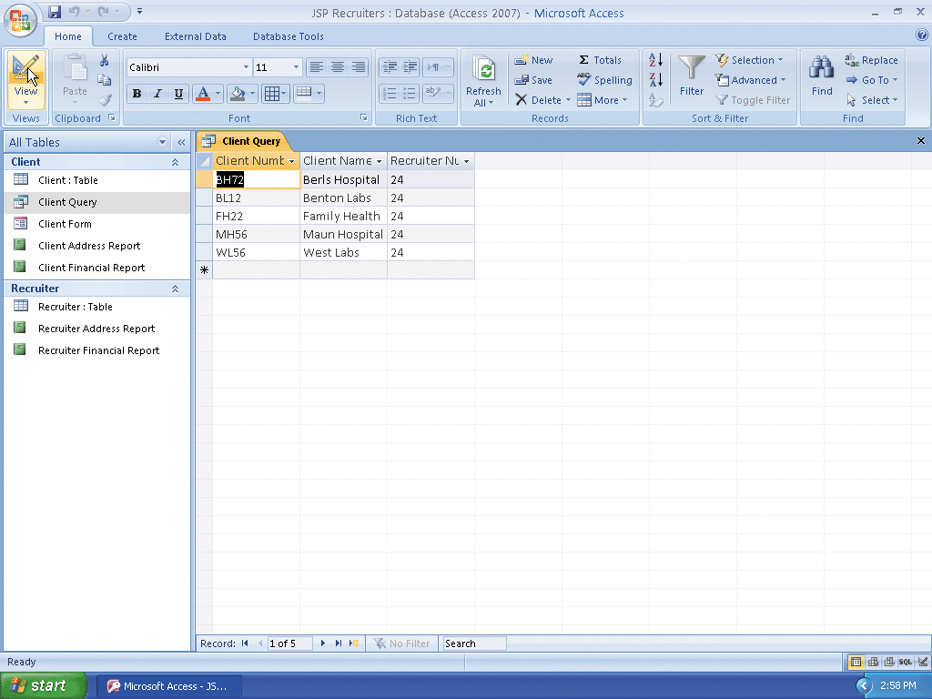
Using a Criterion in a Query

Slide 13
Printing the Results of a Query
With the Client Query selected in the Navigation pane, click the Office Button
Point to Print on the Office button menu
Click Quick Print on the Print submenu

Slide 14
Creating a Query in Design View
Hide the Navigation pane
Click Create on the Ribbon to display the Create tab
Click the Query Design button to create a new query
With the Client table selected, click the Add button in the Show Table dialog box to add the Client table to the query
Click the Close button in the Show Table dialog box to remove the dialog box from the screen
Drag the lower edge of the field box down far enough so all fields in the Client table appear

Slide 15
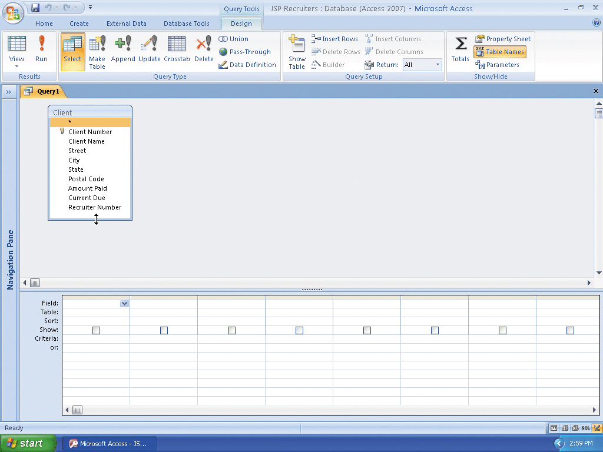
Creating a Query in Design View

Slide 16
Adding Fields to the Design Grid
Double-click the Client Number field in the field list to add the Client Number field to the query
Double-click the Client Name field in the field list to add the Client Name field to the query
Add the Amount Paid field to the query by double-clicking the Amount Paid field in the field list
Add the Current Due field to the query

Slide 17
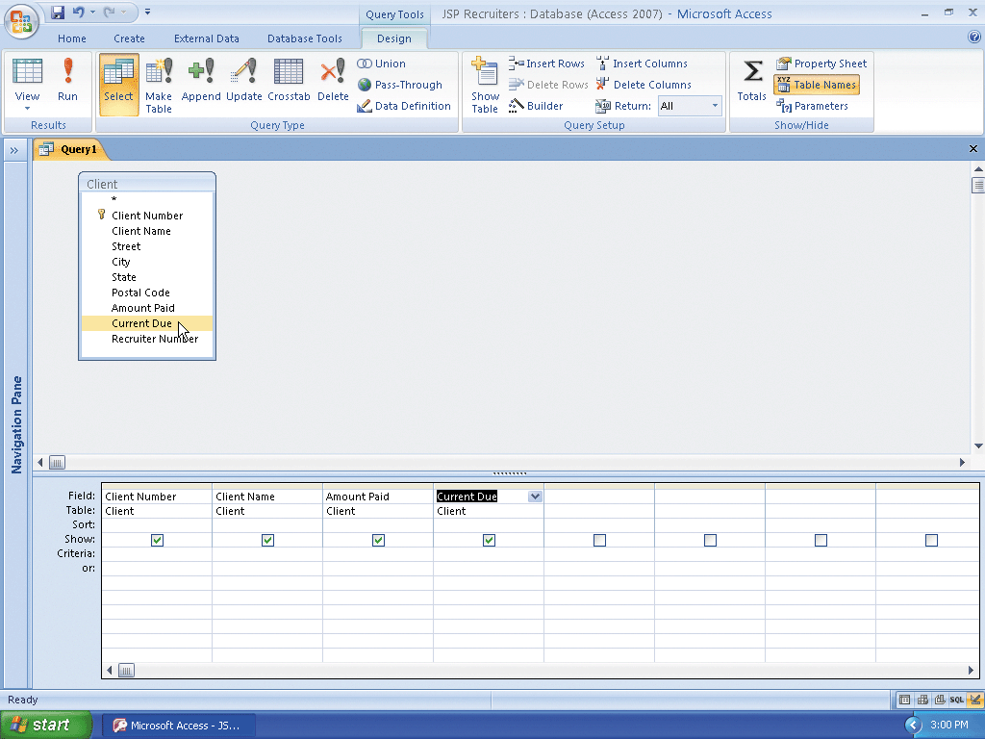
Adding Fields to the Design Grid

Slide 18
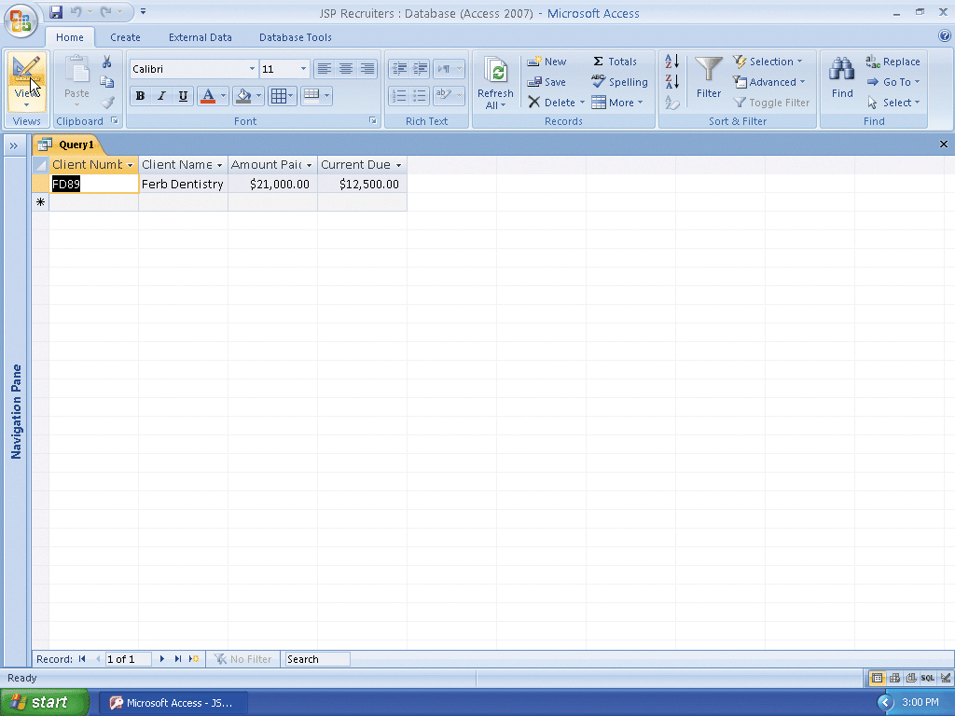
Using Text Data in a Criterion
Click the Criteria row for the Client Number field to produce an insertion point
Type FD89 as the criterion
Click the View button to display the query results

Slide 19
Using a Wildcard
Click the View button to return to Design view
If necessary, click the Criteria row below the Client Number field to produce an insertion point
Use the DELETE or BACKSPACE key as necessary to delete the current entry
Click the Criteria row below the Client Name field to produce an insertion point
Type Be* as the criterion
View the query results by clicking the View button

Slide 20
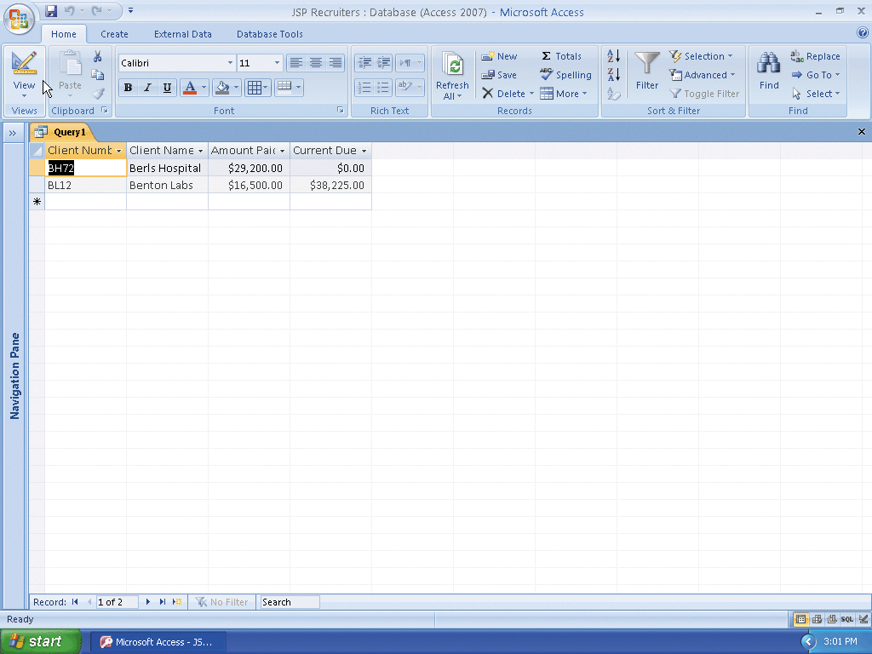
Using a Wildcard

Slide 21
Using Criteria for a Field Not Included in the Results
Click the View button to return to Design view
Erase the criterion in the Client Name field
Include the City field in the query
Type Berridge as the criterion for the City field
Click the Show check box for the City field to remove the check mark
View the query results

Slide 22
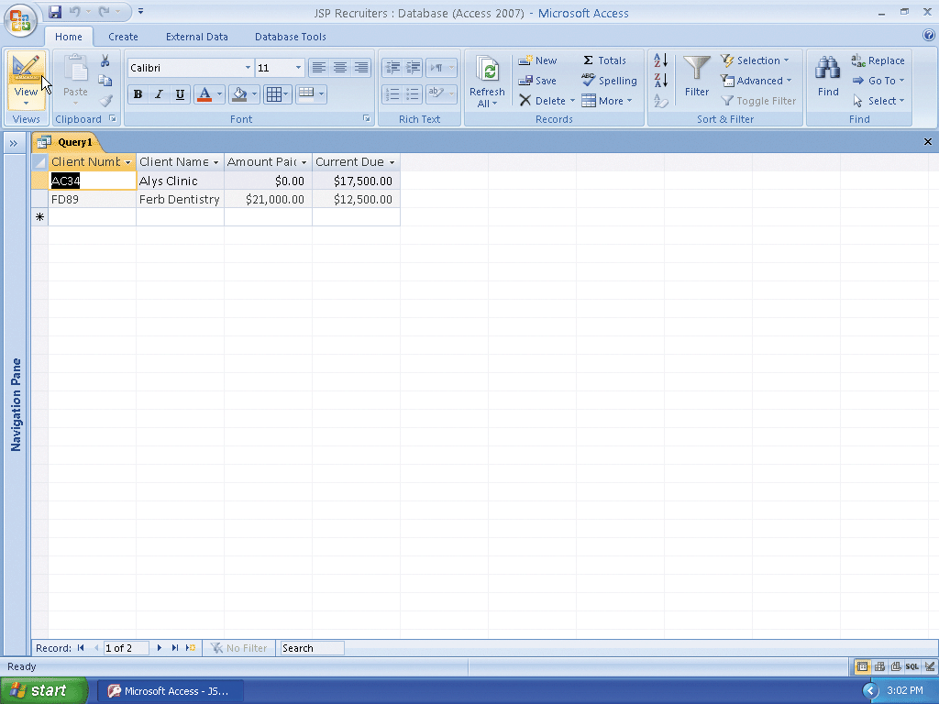
Using Criteria for a Field Not Included in the Results

Slide 23
Creating a Parameter Query
Return to Design view
Erase the current criterion in the City column, and then type [Enter City] as the new criterion
Click the View button to display the Enter Parameter Value dialog box
Type Fort Stewart as the parameter value in the Enter City text box and then click the OK button

Slide 24

Creating a Parameter Query

Slide 25
Saving a Query
Click the Save button on the Quick Access Toolbar to open the Save As dialog box
Type Client-City Query in the Query Name text box
Click the OK button to save the query
Click the Close ‘Client-City Query’ button to close the query and remove it from the screen

Slide 26

Saving a Query

Slide 27
Using a Saved Query
Show the Navigation pane
Right-click the Client-City Query to produce a shortcut menu
Click Open on the shortcut menu to open the query and display the Enter Parameter Value dialog box
Type Fort Stewart in the Enter City text box, and then click the OK button to display the results using Fort Stewart as the city as shown in Figure 2–24 on the previous slide
Click the Close ‘Client-City Query’ button, shown in Figure 2–24, to close the query

Slide 28
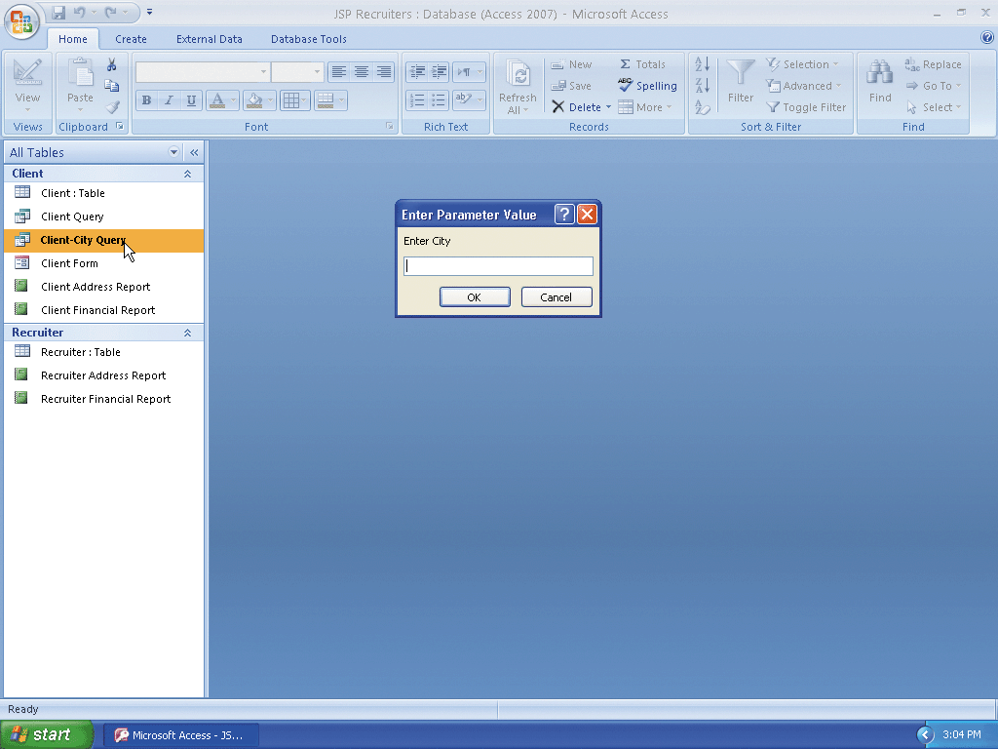
Using a Saved Query

Slide 29
Using a Number in a Criterion
Hide the Navigation pane
Click Create on the Ribbon to display the Create tab
Click the Query Design button to create a new query
With the Client table selected, click the Add button in the Show Table dialog box to add the Client table to the query
Click the Close button in the Show Table dialog box to remove the dialog box from the screen

Slide 30
Using a Number in a Criterion
Drag the lower edge of the field box down far enough so all fields in the Client table are displayed
Include the Client Number, Client Name, Amount Paid, and Current Due fields in the query
Type 0 as the criterion for the Current Due field
View the query results

Slide 31
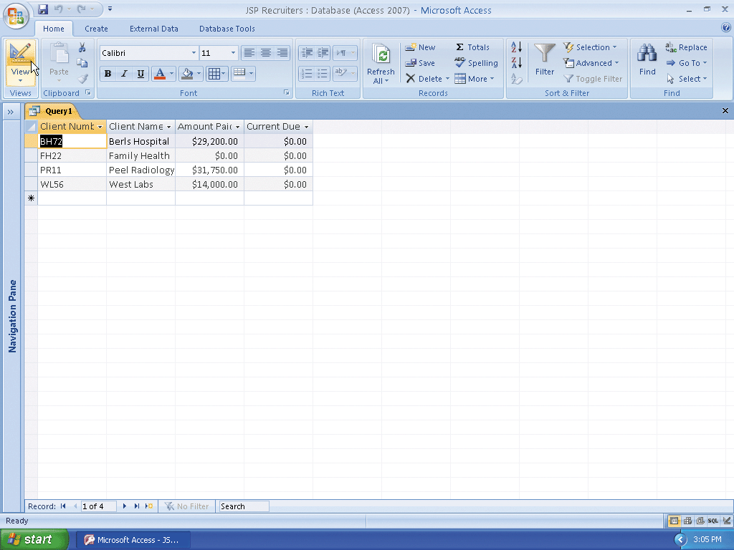
Using a Number in a Criterion

Slide 32
Using a Comparison Operator in a Criterion
Return to Design view
Erase the 0 in the Current Due column
Type >20000 as the criterion for the Amount Paid field
View the query results

Slide 33

Using a Comparison Operator in a Criterion

Slide 34
Using a Compound Criterion
Involving AND
Return to Design view
Include the Recruiter Number field in the query
Type 21 as the criterion for the Recruiter Number field
View the query results

Slide 35
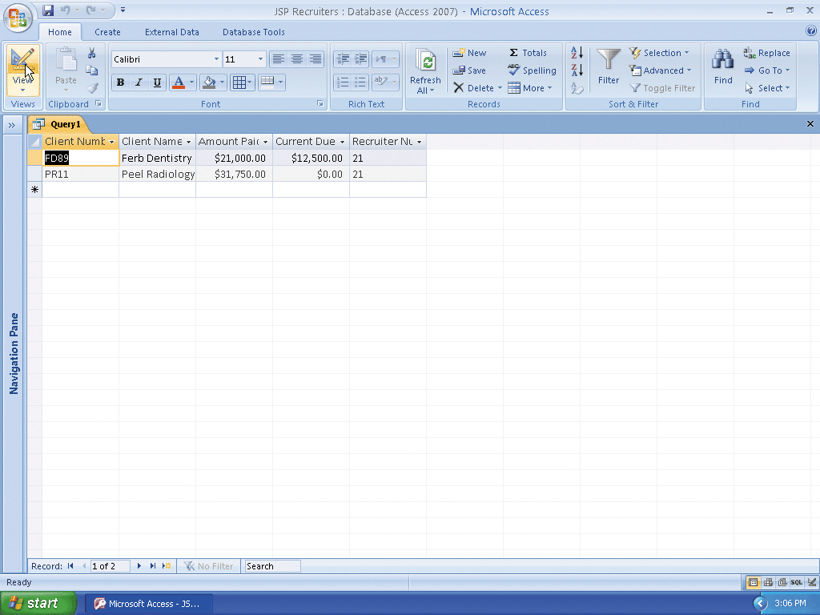
Using a Compound Criterion
Involving AND

Slide 36
Using a Compound Criterion
Involving OR
Return to Design view
If necessary, click the Criteria entry for the Recruiter Number field and then use the BACKSPACE key or the DELETE key to erase the entry (“21”)
Click the or: row (the row below the Criteria row) for the Recruiter Number field and then type 21 as the entry
View the query results

Slide 37
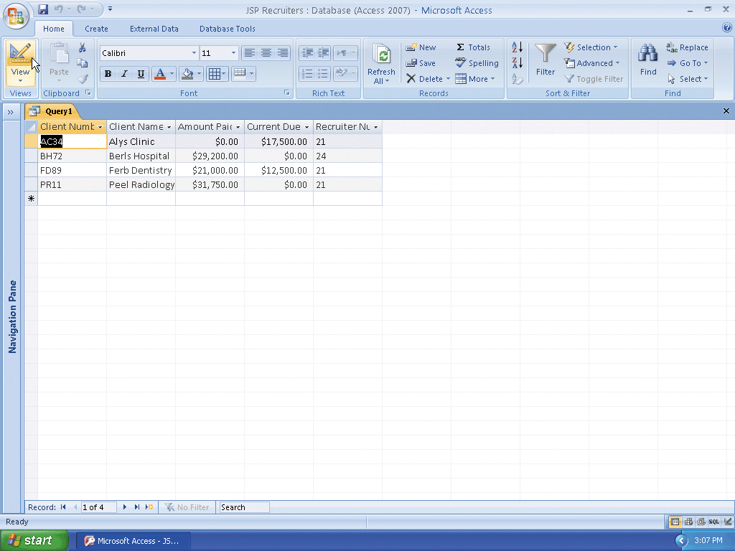
Using a Compound Criterion
Involving OR

Slide 38
Clearing the Design Grid
Return to Design view
Click just above the Client Number column heading in the grid to select the column
Hold the SHIFT key down and click just above the Recruiter Number column heading to select all the columns
Press the DELETE key to clear the design grid

Slide 39
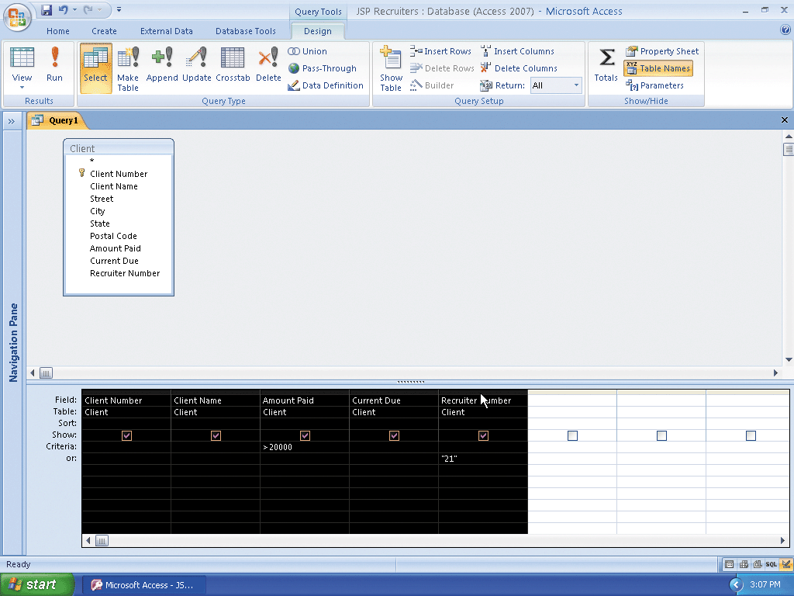
Clearing the Design Grid

Slide 40
Sorting Data in a Query
Include the City field in the design grid
Click the Sort row below the City field, and then click the Sort row arrow to display a menu of possible sort orders
Click Ascending to select Ascending sort order
View the query results

Slide 41
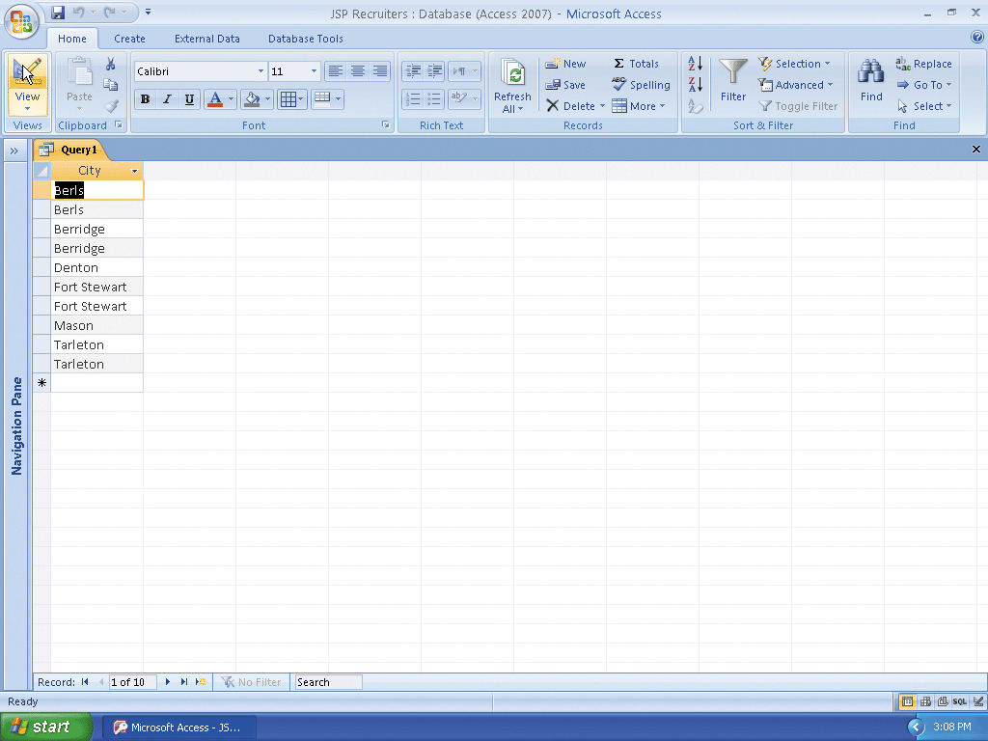
Sorting Data in a Query

Slide 42
Omitting Duplicates
Return to Design view
Click the second field in the design grid (the empty field following City)
If necessary, click Design on the Ribbon to display the Design tab
Click the Property Sheet button on the Design tab to display the property sheet

Slide 43
Omitting Duplicates
Click the Unique Values property box, and then click the arrow that appears to produce a menu of available choices for Unique Values
Click Yes and then close the Query Properties sheet by clicking its Close button
View the query results

Slide 44
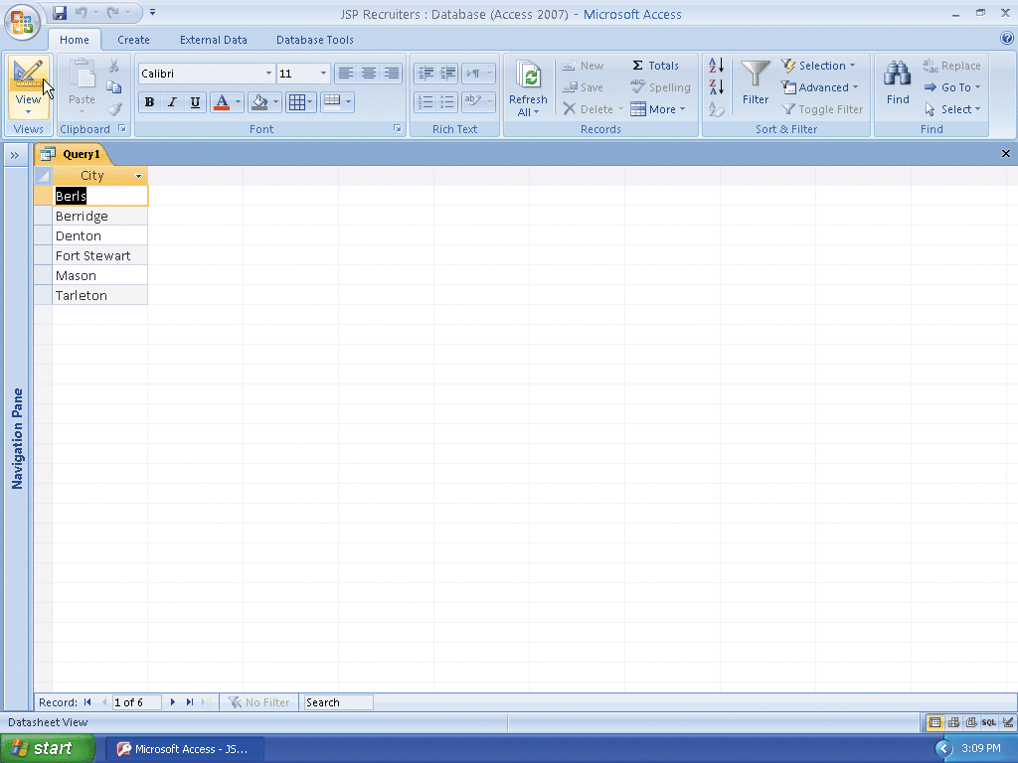
Omitting Duplicates

Slide 45
Sorting on Multiple Keys
Return to Design view
Clear the design grid
Include the Client Number, Client Name, Recruiter Number, and Amount Paid fields in the query in this order
Select Ascending as the sort order for both the Recruiter Number field and the Amount Paid field
View the query results

Slide 46
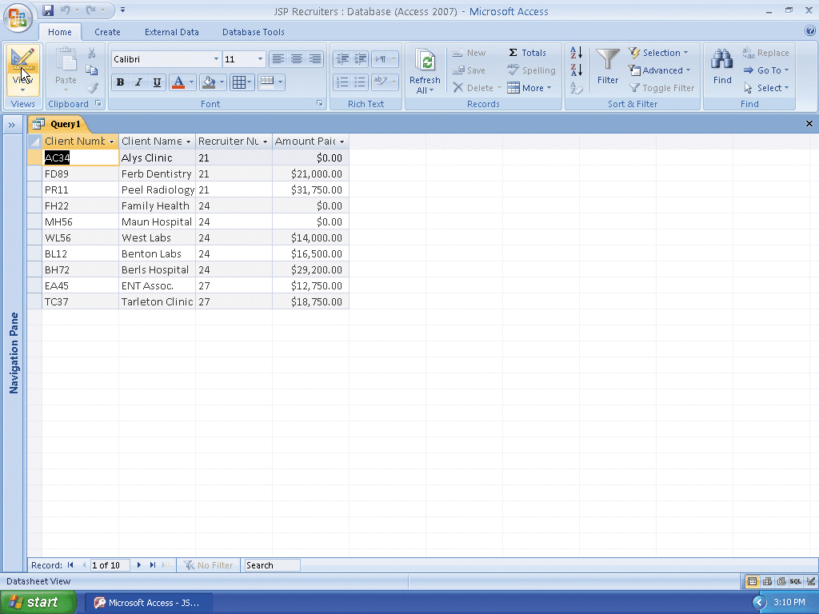
Sorting on Multiple Keys

Slide 47
Creating a Top-Values Query
Return to Design view
If necessary, click Design on the Ribbon to display the Design tab
Click the Return box arrow on the Design tab to display the Return box menu
Click 5 in the Return box menu to specify that the query results should contain the first five rows
View the query results
Close the query by clicking the Close ‘Query1’ button
When asked if you want to save your changes, click the No button

Slide 48
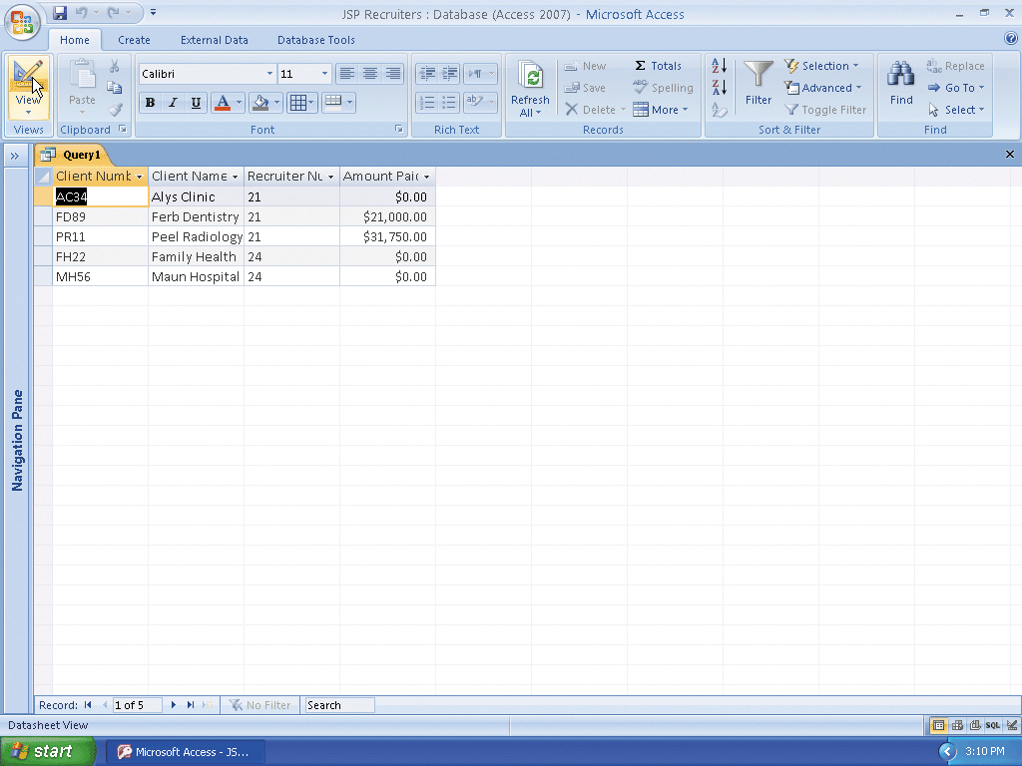
Creating a Top-Values Query

Slide 49
Joining Tables
Click Create on the Ribbon to display the Create tab
Click the Query Design button to create a new query
Click the Recruiter table in the Show Table dialog box to select the table
Click the Add button to add a field list for the Recruiter table to the query
Click the Client table in the Show Table dialog box
Click the Add button to add a field list for the Client table

Slide 50
Joining Tables
Close the Show Table dialog box by clicking the Close button
Expand the size of the field lists so all the fields in the Recruiter and Client tables appear
In the design grid, include the Recruiter Number, Last Name, and First Name fields from the Recruiter table as well as the Client Number and Client Name fields from the Client table
Select Ascending as the sort order for both the Recruiter Number field and the Client Number field
View the query results

Slide 51
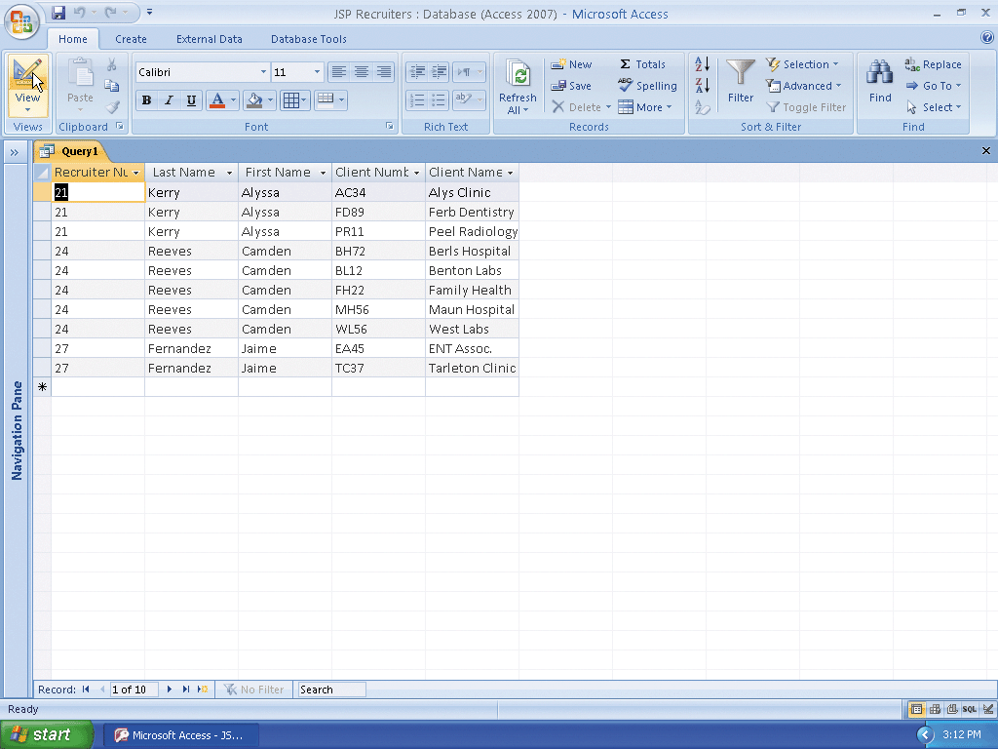
Joining Tables

Slide 52
Saving the Query
Click the Save button on the Quick Access Toolbar to display the Save As dialog box
Type Recruiter-Client Query as the query name
Click the OK button to save the query

Slide 53
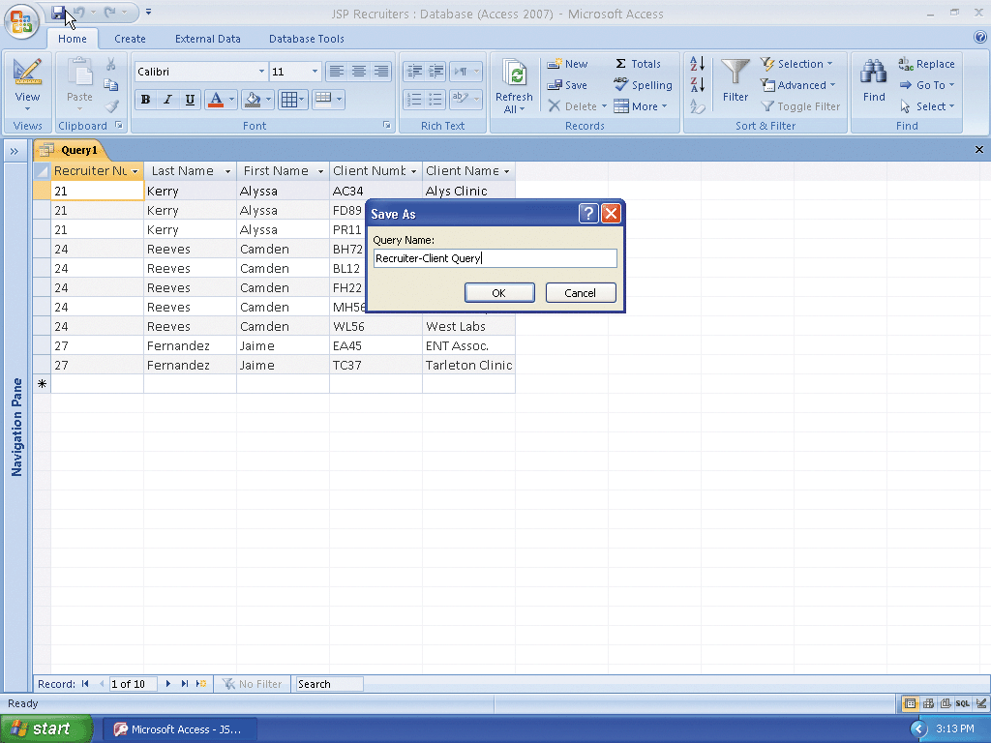
Saving the Query

Slide 54
Changing Join Properties
Return to Design view
Right-click the join line to produce a shortcut menu
Click Join Properties on the shortcut menu to display the Join Properties dialog box
Click option button 2 to include all records from the Recruiter table regardless of whether they match any clients

Slide 55
Changing Join Properties
Click the OK button
View the query results by clicking the View button
Click the Save button on the Quick Access Toolbar
Close the Recruiter-Client Query by clicking the Close ‘Recruiter-Client Query’ button

Slide 56
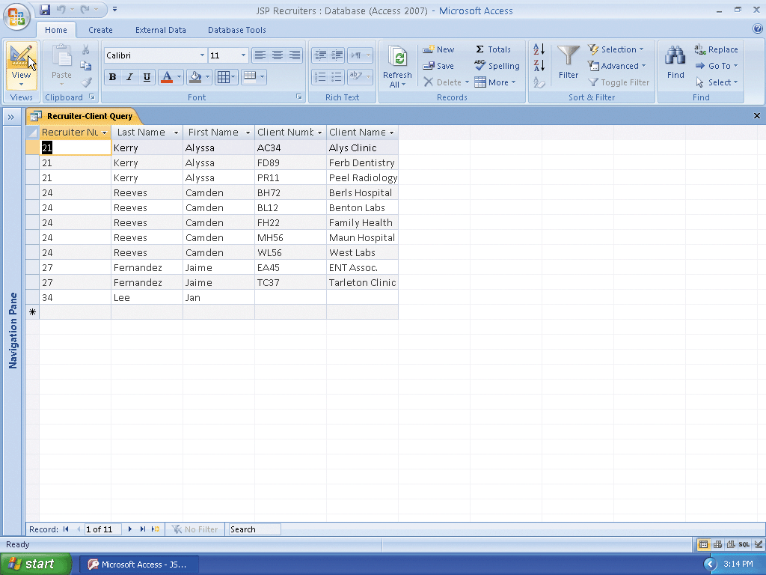
Changing Join Properties

Slide 57
Creating a Report Involving a Join
Show the Navigation pane and be sure the Recruiter-Client Query is selected in the Navigation pane
Click Create on the Ribbon to display the Create tab
Click the Report Wizard button to display the Report Wizard dialog box
Click the Add All Fields button to add all the fields in the Recruiter-Client Query
Click the Next button to display the next Report Wizard screen

Slide 58
Creating a Report Involving a Join
Because you will not specify any grouping, click the Next button in the Report Wizard dialog box to display the next Report Wizard screen
Because you already specified the sort order in the query, click the Next button again to display the next Report Wizard screen
Make sure that Tabular is selected as the Layout and Portrait is selected as the Orientation
Click the Next button to display the next Report Wizard screen
Be sure the Module style is selected

Slide 59
Creating a Report Involving a Join
Click the Next button to display the next Report Wizard screen
Erase the current title, and then type Recruiter-Client Report as the new title
Click the Finish button to produce the report
Click the Close button for the Recruiter-Client Report to remove the report from the screen

Slide 60
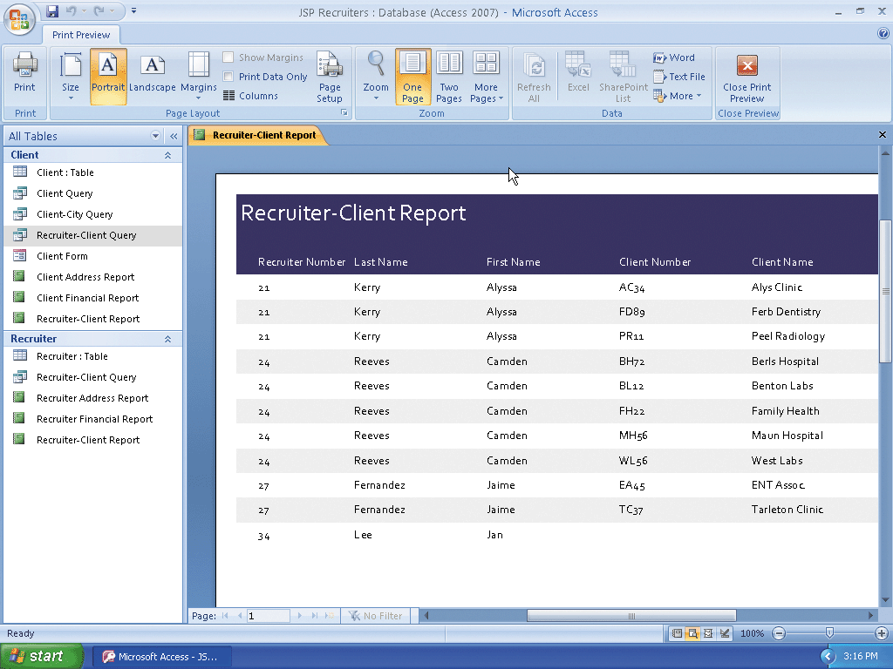
Creating a Report Involving a Join

Slide 61
Printing a Report
With the Recruiter-Client Report selected in the Navigation pane, click the Office Button, point to Print on the Office button menu, and then click Quick Print on the Print submenu to print the report

Slide 62
Restricting the Records in a Join
Open the Recruiter-Client Query in Design view and hide the Navigation pane
Add the Amount Paid field to the query
Type >20000 as the criterion for the Amount Paid field and then click the Show check box for the Amount Paid field to remove the check mark
View the query results
Close the query by clicking the Close ‘Recruiter-Client Query’ button
When asked if you want to save your changes, click the No button

Slide 63
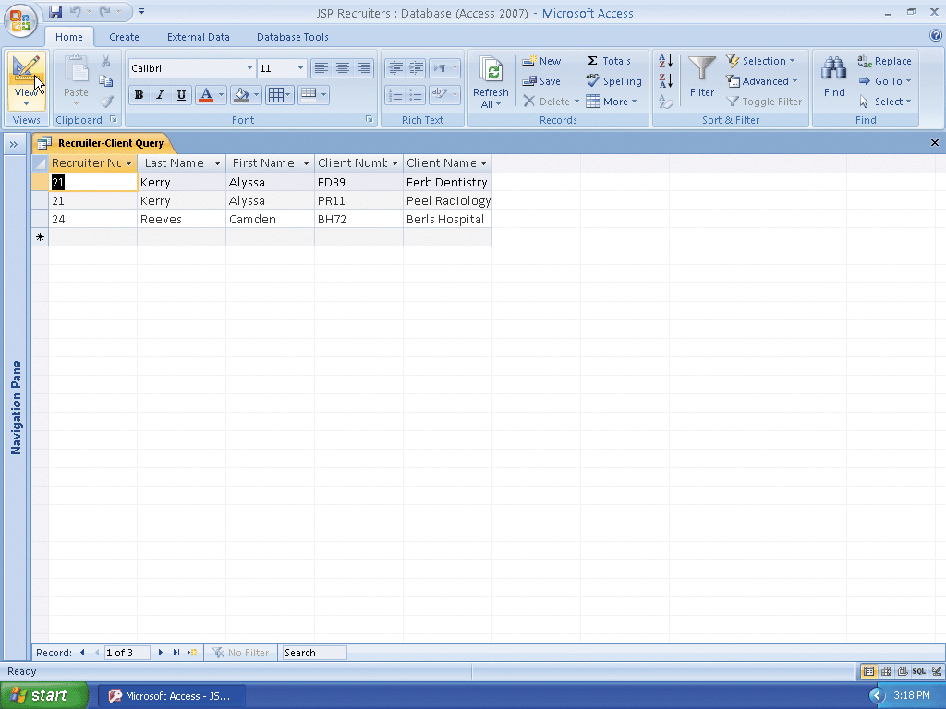
Restricting the Records in a Join

Slide 64
Using a Calculated Field in a Query
Create a query with a field list for the Client table
Add the Client Number, Client Name, Amount Paid, and Current Due fields to the query
Right-click the Field row in the first open column in the design grid to display a shortcut menu
Click Zoom on the shortcut menu to display the Zoom dialog box

Slide 65
Using a Calculated Field in a Query
Type Total Amount:[Amount Paid]+[Current Due] in the Zoom dialog box
Click the OK button to enter the expression
View the query results

Slide 66
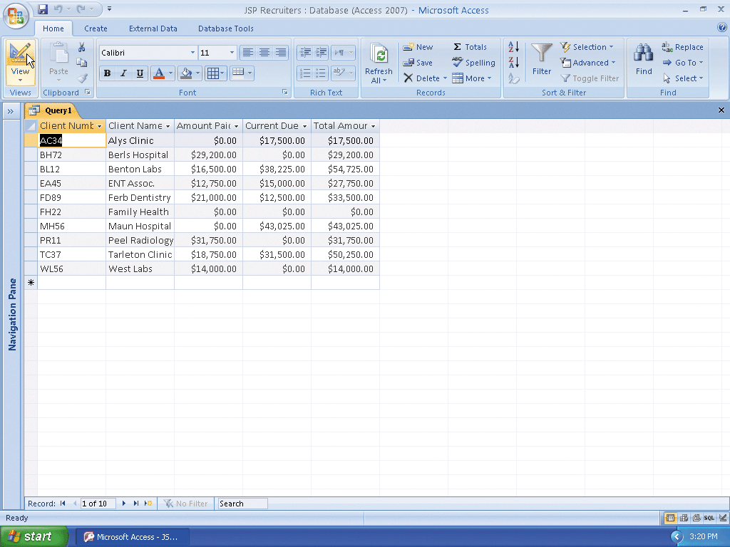
Using a Calculated Field in a Query

Slide 67
Changing a Caption
Return to Design view
Click Design on the Ribbon to display the Design tab
Click the Amount Paid field in the design grid, and then click the Property Sheet button on the Design tab
Click the Caption box, and then type Paid as the caption
Close the property sheet by clicking its Close button
Click the Current Due field in the design grid, and then click the Property Sheet button on the Design tab

Slide 68
Changing a Caption
Click the Caption box, and then type Due as the caption
Close the Property Sheet by clicking its Close button
View the query results
Click the Close ‘Query1’ button to close the query
When asked if you want to save your changes, click the No button

Slide 69

Changing a Caption

Slide 70
Calculating Statistics
Create a new query with a field list for the Client table
If necessary, click Design on the Ribbon to display the Design tab
Add the Amount Paid field to the query
Click the Totals button on the Design tab to include the Total row in the design grid

Slide 71
Calculating Statistics
Click the Total row in the Amount Paid column to display the Total box arrow
Click the Total box arrow to display the Total list
Click Avg to indicate that Access is to calculate an average
View the query

Slide 72
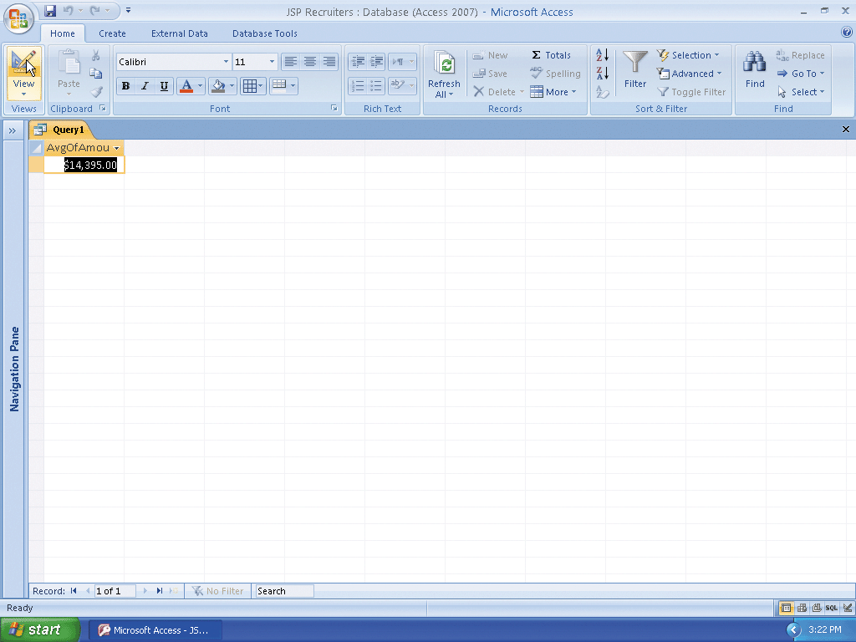
Calculating Statistics

Slide 73
Using Criteria in Calculating Statistics
Return to Design view
Include the Recruiter Number field in the design grid
Click the Total box arrow in the Recruiter Number column to produce a Total list
Click Where
Type 21 as the criterion for the Recruiter Number field
View the query results

Slide 74

Using Criteria in Calculating Statistics

Slide 75
Using Grouping
Return to Design view and clear the design grid
Include the Recruiter Number field in the query
Include the Amount Paid field in the query
Select Avg as the calculation in the Total row for the Amount Paid field
View the query results
Close the query
Do not save your changes

Slide 76
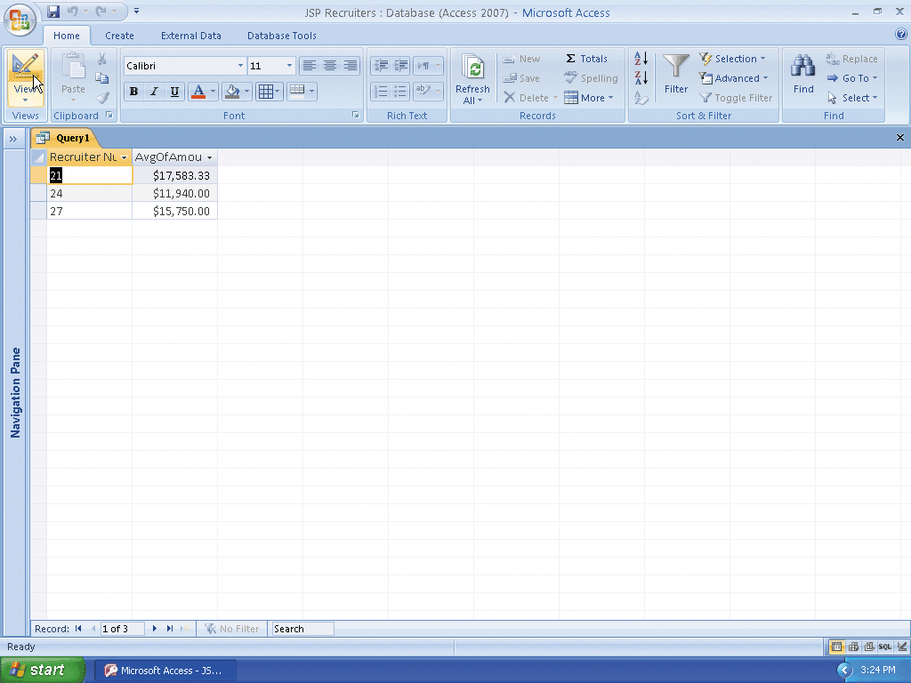
Using Grouping

Slide 77
Creating a Crosstab Query
Click Create on the Ribbon to display the Create tab
Click the Query Wizard button to display the New Query dialog box
Click Crosstab Query Wizard in the New Query dialog box
Click the OK button to display the Crosstab Query Wizard
With the Tables option button selected and the Client table selected, click the Next button to display the next Crosstab Query Wizard screen

Slide 78
Creating a Crosstab Query
Click the City field, and then click the Add Field button to select the City field for row headings
Click the Next button to display the next Crosstab Query Wizard screen
Click the Recruiter Number field to select the Recruiter Number field for column headings
Click the Next button to display the next Crosstab Query Wizard screen
Click the Amount Paid field to select the Amount Paid field for calculations

Slide 79
Creating a Crosstab Query
Click Sum to select Sum as the calculation to be performed
Click the Next button to display the next Crosstab Query Wizard screen
Type Client-Recruiter Crosstab as the name of the query
Click the Finish button to produce the crosstab shown in Figure 2–75 on page AC 122
Close the query

Slide 80
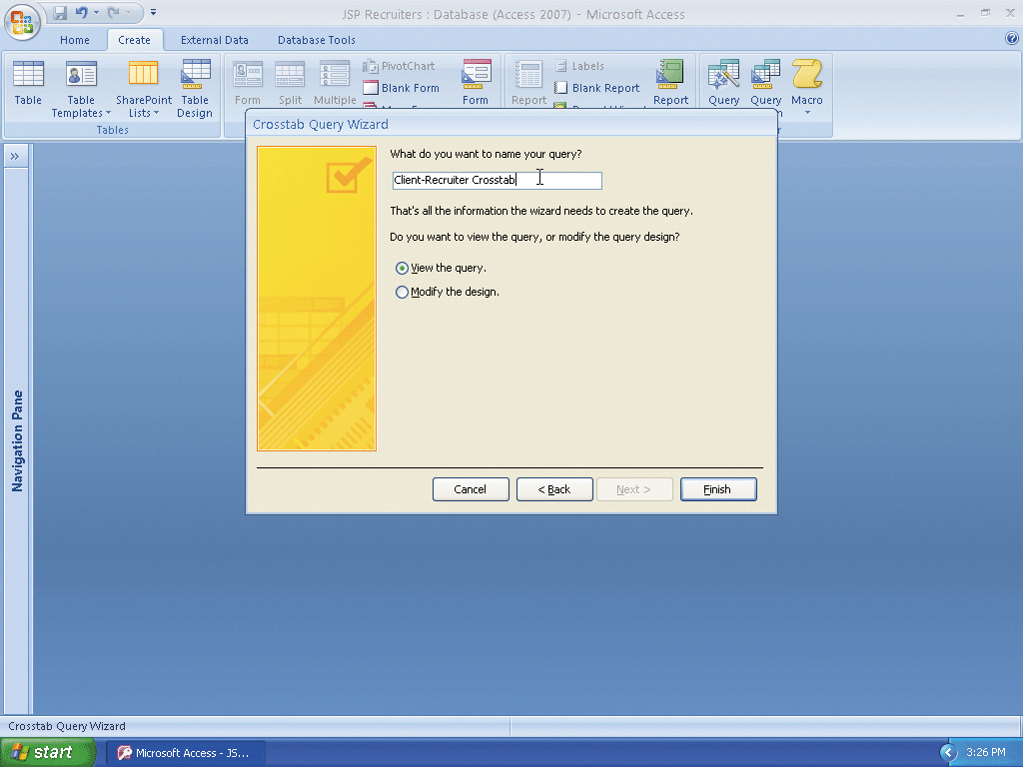
Creating a Crosstab Query

Slide 81
Customizing the Navigation Pane
If necessary, click the Shutter Bar Open/Close Button to show the Navigation pane
Click the Navigation pane arrow to produce the Navigation pane menu
Click Object Type to organize the Navigation pane by the type of object rather than by table
Click the Navigation pane arrow to produce the Navigation pane menu
Click Tables and Related Views to once again organize the Navigation pane by table

Slide 82
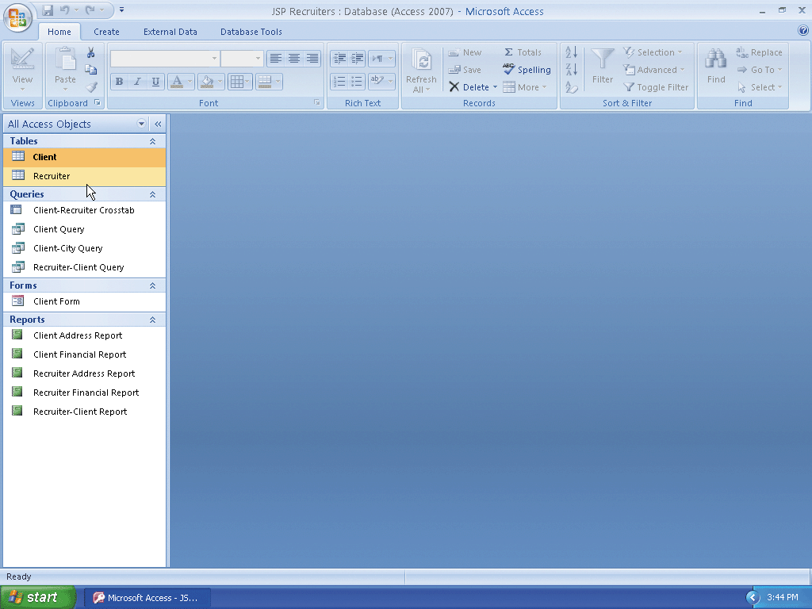
Customizing the Navigation Pane

Slide 83
Quitting Access
Click the Close button on the right side of the Access title bar to quit Access

Slide 84
Summary
Create queries using the Simple Query Wizard
Print query results
Create queries using Design view
Include fields in the design grid
Use text and numeric data in criteria

Slide 85
Summary
Create and use parameter queries
Save a query and use the saved query
Use compound criteria in queries
Sort data in queries
Join tables in queries

Slide 86
Summary
Create a report from a query
Perform calculations in queries
Calculate statistics in queries
Create crosstab queries
Customize the Navigation pane

Slide 87
Access Chapter 2 Complete

